Slide 1
Optimality benchmark for planning and evaluating dose finding designs
Ken Cheung
Columbia Biostatistics
Cheung (2014). Biometrics 70, 389— 397

Slide 2
Agenda
Dose Finding: Overview & Examples
Method: Optimality benchmark
Applications
Design diagnostics
Sample size calculation
Discussion

Slide 3
Dose Finding Trials
Early Phase: Identify a promising dose to move forward
Adaptive (as opposed to parallel randomization)
General design and analysis strategy
Observe a few
Estimate a “good” dose (model-based or algorithm, myopic or global risk)
Treat at the good dose, and observe

Slide 4
Scope of this talk
DF trials with the following features:
Discrete number of test doses (combos)
Multinomial outcome: binary, ordinal, multivariate binary, etc.
A well-defined quantitative objective (estimand)
C.f. 3+3 design

Slide 5
Some generality and notation
A discrete set of test levels {1, …, K}
Multinomial outcome Y:
Y_{i}(k) = Outcome for patient i at dose level k
Take values on L+1 possible values {w₀, w₁, …, w_{L}}
Tail distribution π_{l}(k) = Pr{Y(k) ≥ w_{l} } for l = 1, …, L
Estimand = target dose d(π)
d(.) is a known function of π and takes value on 1, …, K

Slide 6
Example 1
Phase 1 dose finding in cancer trials
Typically test K = 4—7 dose levels, defined by combination of drug dosages and schedule.
Binary outcome Y = 0, 1 (dose-limiting toxicity)
π₁(k) denotes toxicity probability at dose k
Objective: Maximum tolerated dose (MTD)
d(π) = arg min_{k} | π₁(k) – p | for some target p.

Slide 7
Example 1: Phase 1 DF
Methods (up to 2010):
Up-and-down designs (Storer, 1989)
Continual reassessment method (O’Quigley et al, 1990)
Biased coin design (Durham et al, 1997)
EWOC (Babb et al, 1998)
Curve-free method (Gasparini and Eisele, 2000)
A+B and stepwise designs (Lin and Shih, 2001; Cheung 2007)
Stochastic approximation (Cheung, 2010)
Stochastic optimization (Bartroff and Lai, 2010)
…
Method evaluation and sample size justification:
Rely solely on simulation. Exception: stepwise designs

Slide 8
Example 2
Phase 1/2 study of thrombolytic agent for acute stroke
Thall and Cook (2004): K = 5
Trinary outcome (Efficacy-toxicity):
Intracranial hemorrhage (Toxicity; Y=2)
Reperfusion without hemorrhage (Response; Y=1)
Neither (Y=0)
Objective: maximizing desirability
Desirability δ(π_{E},π_{T}) as a function of efficacy response rate π_{E} and toxicity rate π_{T}
d_{TC} (π) = arg max_{k} δ (π_{E}(k), π_{T} (k) )

Slide 9
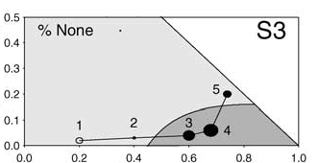
Example 2: Phase 1/2 in Stroke
Thall and Cook (2004): Bayesian, model-based method
Assign patients at dose with maximum desirability based on interim data, subject to acceptability criteria
Consider two dose-response-toxicity models: Proportional odds (PO) and Continuation ratio (CR)

Slide 10
Example 2 Simulation results: Which model to use?
Scenario 3
Model | Dose 1 | Dose 2 | Dose 3 | Dose 4 | Dose 5
Desirability | -0.48 | -0.13 | 0.22 | 0.32 | -0.26
PO✔ | 0 | 0 | 20 | 72 | 7
CR | 0 | 2 | 32 | 49 | 16
Scenario 4
Model | Dose 1 | Dose 2 | Dose 3 | Dose 4 | Dose 5
Desirability | 0.12 | 0.29 | 0.45 | 0.58 | 0.69
PO | 0 | 2 | 10 | 34 | 54
CR✔ | 0 | 0 | 1 | 5 | 94

Slide 11
Dose Finding Trials
Challenge in planning: Complexity
We assume programming is correct w/o theoretical guide
We may not interpret simulation results properly
We don’t have intuition about required N
Proposal: Develop an optimality benchmark that is theoretically tractable

Slide 12
Optimality Benchmark
Idea:
Provide an upper limit of accuracy for any dose finding methods for a given design objective d(.) under a given scenario π.
Cramer-Rao lower bound for unbiased estimation
Not tied to any particular dose finding methods/models

Slide 13
Optimality Benchmark
Definition:
Recall d(π) is the target dose (estimand)
Define d* = d(π*) where π* is a nonparametric estimate of π based on complete outcome profile
Calculate optimality benchmark based on sampling distribution of d*

Slide 14
Complete outcome profile for Phase 1 DF
In an actual trial, we observe a partial outcome profile, e.g., a patient at dose 3 with toxicity
In computer simulation, we can observe a complete profile by generating a uniform tolerance: U < π(k), all k
The nonparametric optimal estimate π*(k) is evaluated by the proportion of toxicity at dose k in a simulated trial
Dose 1 | Dose 2 | Dose 3 | Dose 4 | Dose 5
? | ? | Toxicity | Toxicity | Toxicity
Dose 1 | Dose 2 | Dose 3 | Dose 4 | Dose 5
No toxicity | Toxicity | Toxicity | Toxicity | Toxicity

Slide 15
Complete outcome profile: General (inc. Example 2)
Ordinal outcome Y: Takes values on L+1 possible values {w₀, w₁, …, w_{L}} with tail distribution π(k) at dose k
Y_{i}(k) = Outcome for patient i at dose level k
In simulation, randomly draw a tolerance profile: U_{i1}, U_{i2}, … U_{iL} iid Uniform(0,1)
Generate complete outcome profile Y_{i}(k) for patient i at dose level k as follows:
Y_{i}(k) = w_{l} if U_{i,l+1} > r_{l+1}(k) and U_{ij} ≤ r_{j} for all j=1,…,l
r_{j}(k) = π_{j}(k) / π_{j-1}(k)
Nonparametric optimal π*(k) = average of I{Y_{i}(k) ≥w_{l}}

Slide 16
Complete outcome profile: General (inc. Example 2)
Ordinal outcome Y: Takes values on L+1 possible values {w₀, w₁, …, w_{L}} with tail distribution π(k) at dose k
Y_{i}(k) = Outcome for patient i at dose level k
In simulation, randomly draw a tolerance profile: U_{i1}, U_{i2}, … U_{iL} iid Uniform(0,1)
Generate complete outcome profile Y_{i}(k) for patient i at dose level k as follows:
Y_{i}(k) = w_{l} if U_{i,l+1} > r_{l+1}(k) and U_{ij} ≤ r_{j} for all j=1,…,l
r_{j}(k) = π_{j}(k) / π_{j-1}(k)
Nonparametric optimal π*(k) = average of I{Y_{i}(k) ≥w_{l}}
Looks complicated
Takes 15 minutes to code, a few seconds to run

Slide 17
applications

Slide 18
Example 2: Thall and Cook (2004), revisit
Scenario 3
Model | Dose 1 | Dose 2 | Dose 3 | Dose 4 | Dose 5
Desirability | -0.48 | -0.13 | 0.22 | 0.32 | -0.26
PO✔ | 0 | 0 | 20 | 72 | 7
CR | 0 | 2 | 32 | 49 | 16
d(π*) | 0 | 0 | 13 | 85 | 1
Scenario 4
Model | Dose 1 | Dose 2 | Dose 3 | Dose 4 | Dose 5
Desirability | 0.12 | 0.29 | 0.45 | 0.58 | 0.69
PO | 0 | 2 | 10 | 34 | 54
CR✔ | 0 | 0 | 1 | 5 | 94
d(π*) | 0 | 0 | 0 | 5 | 95
18

Slide 19
Example 2: Thall and Cook (2004), revisit
Application 1: Benchmark accuracy as “effect size”
Benchmark d(π*) performs better in S4 than in S3 suggesting S4 is an “easier” scenario than S3; analogous to large effect size in hypothesis test
Eff-tox using PO model is idiosyncratic in that it does comparatively poorly in an easy scenario (S4).
Continuation ratio model wins in this example (Thall & Cook reached the same conclusion after additional simulations)

Slide 20
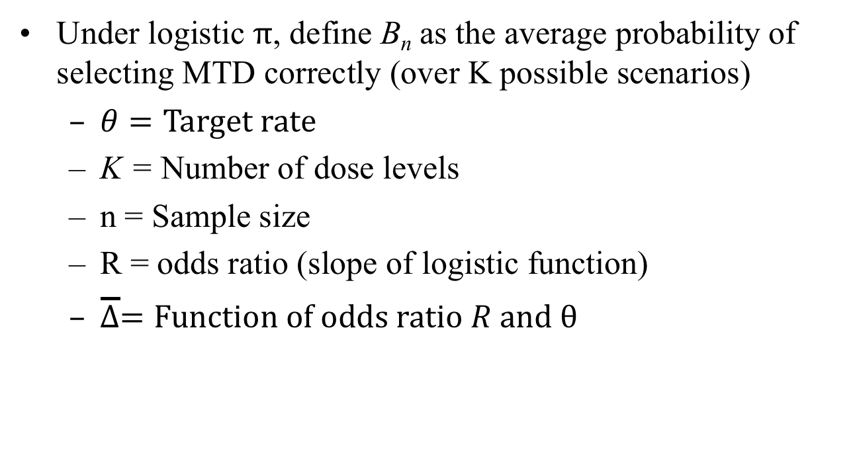
Example 1: Phase 1 DF, revisit
Under logistic $π$, define B_{n} as the average probability of selecting MTD correctly (over K possible scenarios)
$θ=Target rate$
K = Number of dose levels
n = Sample size
R = odds ratio (slope of logistic function)
$\overline{∆}=Function of odds ratio R and θ$
Cheung (2013)

Slide 21
Example 1: Phase 1 DF, revisit
Application 2: Minimum n needed for phase I DF
To select the correct MTD with probability a on average, the benchmark design requires
This expression serves as the smallest sample size needed for any dose finding design

Slide 22
Example 1: Phase 1 DF, with application to CRM
Application 3: Sample size formula for CRM
Cheung (2013) derived the CRM accuracy A_{n} as a function of B_{n}
Fine prints:
Asymptotic approx. not evaluated for n > 60
Formula applies to a specific CRM model

Slide 23
Example 1: Phase 1 DF, with application to CRM
Application 3: Sample size formula for CRM
Fine prints:
Asymptotic approx. not evaluated for n > 60
Formula applies to a specific CRM model
Power dose toxicity function
Median prior MTD
“Skeleton” with sensitivity at 0.25θ
Bayesian with lognormal prior

Slide 24
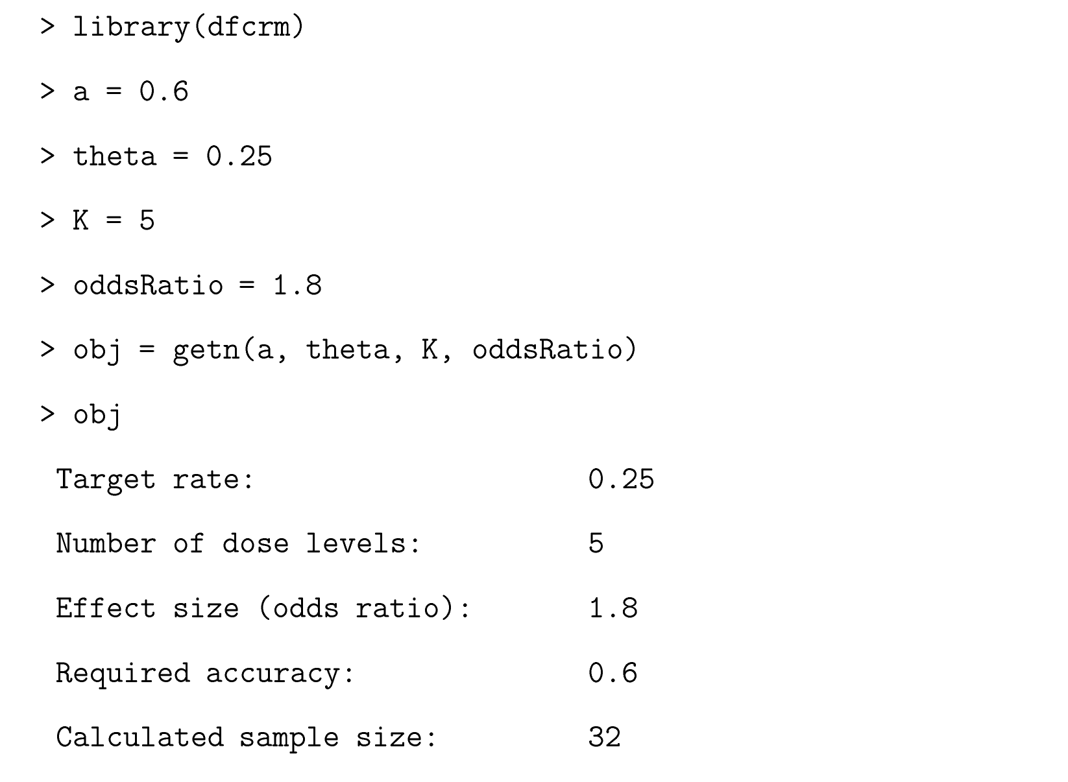
Example 1: Phase 1 DF, with application to CRM
R function to calculate n for CRM

Slide 25
Example 1: Phase 1 DF, with application to CRM
Model | Probability selecting correct MTD when MTD is |  |  |  |  | Accuracy* (simulated)
 | 1 | 2 | 3 | 4 | 5
Assumed by the function ‘getn’ | .77 | .56 | .52 | .52 | .65 | .604
Different model, same prior MTD = 3 | .78 | .56 | .53 | .52 | .66 | .610
Different model, different prior MTD = 2 | .80 | .53 | .52 | .51 | .64 | .600
*Desired accuracy 0.60

Slide 26
Summary & Discussion
We have proposed benchmark design for general dose finding settings; also applicable to platform trials, dose expansion cohorts, etc.
We use benchmark as a design diagnostics tool:
Not to replace simulation, but to help interpret
Useful in complex situations
We use benchmark accuracy as effect size → Sample size
Features of benchmark:
Easy to code (not error prone), quick to compute
Nonparametric: not favoring one model over another

Slide 27
References
Cheung (2013): Sample size formulae for the Bayesian continual reassessment method. Clinical Trials 10:852—861.
Cheung (2014). Simple benchmark for complex dose finding studies. Biometrics 70:389–397.
Chiuzan, Chai, Cheung (2018). Sample size formulae for two-stage continual reassessment method. Under preparation.

