Slide 1
Cloud-Based Biometric
Attendance System
for Educators
🔐
Journal of Physics: Conference Series 2034 (2021)

Slide 2
Presented By
Team Members
1
Ali Mohamed Helal
6
Karim Hany Gamal
2
Mohamed Ahmed Abdelrazek
7
Omar Amir Khalil
3
Mahmoud Ahmed Anwar
8
Youssef Shahat Mohamed
4
Omar Magdy Mahmoud
9
Youssef Hamada Kamal
5
Anas Mohamed Mohamed Ahmed
10
Belal Ibrahim Sayed
Supervisor: Dr. Laila Abo Hashem

Slide 3
Introduction — The Problem This Research Solves
What is this research about?
Every school needs to track student attendance — it affects grades and discipline. But in many developing countries, teachers still pass around a paper sheet for students to sign. This method has serious problems: it is slow, easy to cheat, and the paper can get lost. This research built a modern system that uses a fingerprint scanner to record attendance automatically and saves the data online in real time.
⏳ Wastes Class Time
🕵️ Easy to Cheat
Passing a paper sheet around a large class can take 10–15 minutes. This cuts into valuable teaching time every single lecture.
A student can sign for their absent friend — called 'buddy punching'. It is very common and almost impossible to catch with paper.
📄 Records Get Lost
🚫 No Remote Access
Paper registers can be lost, damaged by water, or destroyed. Once gone, there is no backup — the data is lost forever.
The teacher has no way to check who attended without physically going to school and finding the paper register.

Slide 4
The Solution — A Fingerprint System That Does It All
Instead of paper, this system uses a fingerprint scanner connected to a small Wi-Fi chip (ESP32). When a student touches the scanner, it identifies them in seconds and saves the attendance record directly to Google Drive — automatically, with no teacher involvement needed.
1
2
3
4
5
6
👆
🔍
📟
📡
📊
💻
Student Scans
System Checks
Screen Shows
Data Sent
Saved Online
Teacher Checks
Student places finger
on the FPM10A scanner
ESP32 matches fingerprint
to registered templates
OLED shows 'Welcome'
or 'Unknown User'
Wi-Fi sends data via
IFTTT webhook
Record saved in
Google Sheets
Access from any phone
or laptop, anytime

Slide 5
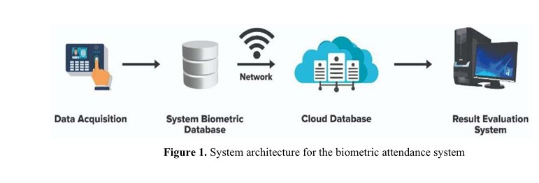
System Architecture — Figure 1: The 4-Stage Flow
Stage 1 — Data Acquisition
Stage 2 — Biometric Database
Stage 3 — Cloud Database
Stage 4 — Result Evaluation
A fingerprint scanner reads the student's finger and sends the data to the ESP32 chip to be processed.
The ESP32 checks if the scanned fingerprint matches any pre-registered student stored in its memory.
If matched, the attendance record is sent over Wi-Fi to Google Drive and saved in a Google Sheet.
The teacher opens Google Sheets from any phone or laptop to view the full attendance report instantly.

Slide 6
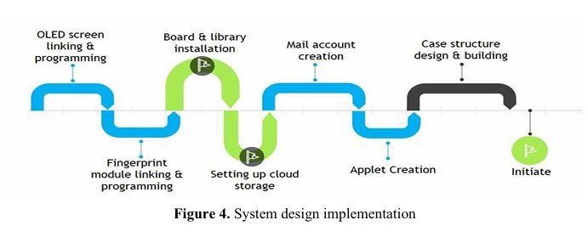
Implementation Steps — Figure 4: How the System Was Built
1. OLED Screen
2. Fingerprint Module
3. Board & Libraries
4. Cloud Storage
Link & program the OLED display so it shows messages to the user.
Connect & program the FPM10A scanner to read and store fingerprints.
Install all required software libraries inside the Arduino IDE.
Set up Google Drive and create the Google Sheet that stores attendance.
5. Mail Account
6. Applet Creation
7. Initiate
Create the email account used by IFTTT to send data to Google Drive.
Build the IFTTT applet that listens for the webhook and triggers the upload.
Power on and test the full system end-to-end to confirm everything works.

Slide 7
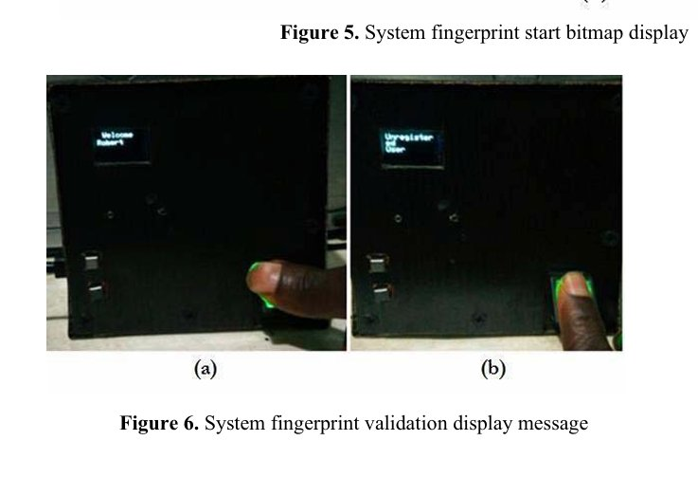
Live Fingerprint Scan — Figure 6: Registered vs Unregistered
(a) Registered Student — Welcome
(b) Unknown Fingerprint — Rejected
The student touches the scanner and the fingerprint matches a stored record. The OLED screen shows 'Welcome Robert' — the student's name. The system then immediately uploads the attendance to Google Drive.
The scanned finger does not match anyone in the system. The screen shows 'Unregistered User' and nothing is recorded. This completely prevents cheating — no student can sign in for an absent friend.

Slide 8
Fingerprint Scan Results — What Happens Next
After the system boots and connects to Wi-Fi, it waits for a student to scan their finger. Here is what the system does depending on whether the fingerprint is recognized or not — and whether the upload to Google Drive succeeds.
✅ Registered Fingerprint — Welcome
❌ Unknown Fingerprint — Rejected
When a student touches the scanner and their fingerprint matches a stored record, the OLED screen shows a welcome message with their name. The system then immediately starts uploading their attendance record to Google Drive via Wi-Fi.
If the fingerprint does not match anyone in the system, the screen displays 'Unregistered User' and nothing is recorded. This completely prevents any cheating — no friend can sign in for an absent student.
☁️ Upload Success — Checkmark on Screen
⚠️ Upload Failed — Red X on Screen
After a successful match and Wi-Fi upload, the OLED shows a fingerprint icon with a green checkmark. This confirms the attendance data has been safely saved in Google Sheets in the cloud.
If the Wi-Fi signal is weak or lost at the moment of upload, the screen shows a fingerprint icon with a red X. The teacher knows to check the connection. This was the only issue found during testing — and it was fixed by switching to a stronger network.

Slide 9
Hardware Components — What Was Used and Why
The system uses four main components that work together. Each one was chosen because it is cheap, easy to find, and reliable. Together they form a complete attendance device that costs very little to build.
👆
📟
⚡
☁️
FPM10A Fingerprint Scanner
OLED Display Screen
ESP32 Microcontroller
Google Drive (Cloud)
Reads and stores fingerprint patterns
Size: 0.96 inch — small but easy to read
Has built-in Wi-Fi and Bluetooth — no extras needed
Free 15 GB storage — more than enough for years
Resolution: 50 dpi — enough to tell people apart
Resolution: 128 × 64 pixels
Made with 40nm TSMC chip technology
Attendance saved in Google Sheets format
Size: 55 × 23 × 21.5 mm — small and compact
Shows status at every stage of the process
Runs all the system code and logic
Teacher can open it from any phone or laptop
Has its own internal memory for templates
Uses very little power compared to LCD screens
Manages all connections between parts
No need to pay for hosting or a server
Cheap and widely available in local markets
Helps users understand what the system is doing
Sends 3.3V power to all other components
Data is always backed up and never lost

Slide 10
Related Work — Other Systems and Their Gaps
Many researchers have tried to build better attendance systems using different technologies. This research studied all of them and found that most had one or more serious problems — especially for use in developing countries with limited budgets and infrastructure.
Face Recognition [2–6]
Works well in labs but needs a powerful camera and computer. Too expensive and slow for everyday classroom use.
Fingerprint Systems [7–11]
Most designs lack cloud storage. Teachers have to be on-site to see the data. This system fixes that by adding Google Drive.
Voice Recognition [12–15]
Easily confused by background noise in a classroom. Not reliable enough for daily attendance recording.
Iris Recognition [16–18]
Very accurate but the sensors cost a lot of money — not affordable for most schools in developing countries.
RFID Cards [19–20]
Cards can be shared or handed to a friend. It still does not truly verify who the person is — cheating is still possible.

Slide 11
How Data Gets to Google Drive — IFTTT & Webhook
The key part of this system is how the attendance record travels from the scanner to Google Drive. It uses a free web tool called IFTTT (If This Then That) that listens for a signal from the ESP32 and automatically sends the data to Google Sheets — no manual steps needed at all.
Fingerprint Matched
The ESP32 confirms the scanned finger belongs to a registered student. This event starts the entire upload process.
1
IFTTT Webhook Triggered
The ESP32 sends a trigger signal to IFTTT — a free web automation service. This signal is called a 'webhook'.
2
HTTP POST Sent
IFTTT sends an HTTP POST request — a standard internet method of sending data — directly to Google Drive.
3
Saved in Google Sheets
A new row is added to the Google Sheet with: Date & Time | Course Code | Student Name | Fingerprint ID | Student ID.
4
Each Google Sheet row stores: Date & Time | Course Code | Student Name | Fingerprint ID | Student ID Number

Slide 12
Advantages & Limitations
✔ What Works Well
✘ Current Limitations
Very cheap to build — no yearly costs at all
Needs internet — upload fails if Wi-Fi is down
No technical skills needed to operate the system
All students must be registered before first use
Makes cheating in attendance completely impossible
Does not work in areas with no internet connection
Teacher can check records from home at any time
Wet or injured fingers may not scan correctly
Free cloud storage — 15 GB is enough for years of data
Records each student in only 2 to 5 seconds
One scanner per room — long queues in big classes

Slide 13
Conclusion — What This System Achieved
In simple words:
This project built a real, working smart attendance system. A student touches the fingerprint scanner and within 2 to 5 seconds, their attendance is saved in Google Drive — fully automatically, with no teacher involvement. It is cheap, easy to use, and designed for schools and universities in countries with limited resources and budgets.
⚡
🎯
💰
📡
Speed
Accuracy
Low Cost
Remote Access
2 to 5 seconds per student — much faster than any paper method, even in large classes.
Fingerprints are unique — no mistakes, no cheating, no one signing for an absent friend.
Cheap hardware + free Google Drive = a system that any school can afford to run long term.
Teacher views attendance from their phone at home — no need to come to school to check.
This system shows that modern technology can solve real everyday problems — even with a very small budget.

Slide 14
Recommendations — Ideas to Make It Even Better
The system works well today, but here are four improvements that future teams can build on top of this project — each one fixes a specific limitation of the current version.
📶 Add an Offline Mode
🏫 Expand to More Classrooms
Right now, if the internet is down, attendance cannot be uploaded. A future version should save the records locally on the device first, and then automatically sync them to Google Drive when the connection comes back.
The current system has one scanner for one room. It should be scaled to cover an entire school — with one scanner per classroom and all attendance data going to the same central Google Sheet.
📱 Build a Mobile App
🔒 Add Stronger Security
A phone app could send real-time notifications to students and parents — for example, automatically sending a message like 'Your child attended today' or 'Your child was absent today'.
For important events like exams, the system could require both a fingerprint AND a PIN number — making it even harder to cheat or for unauthorized people to enter a restricted area.

Slide 15
🎓
Thank You
Supervised by: Dr. Laila Abo Hashem
Journal of Physics: Conference Series 2034 (2021)

