Slide 1
Hire Sync
Ai Recruitment
Mohammad Zbib
Final Year Project

Slide 2
Objective
Objective of the Project
- Build an AI-powered recruitment platform
- Automate job posting and application tracking
- Analyze resumes using AI for skills and experience
- Match candidates to jobs based on relevance
- Reduce manual work and speed up hiring
- Provide a simple, user-friendly interface for recruiters and candidates

Slide 3
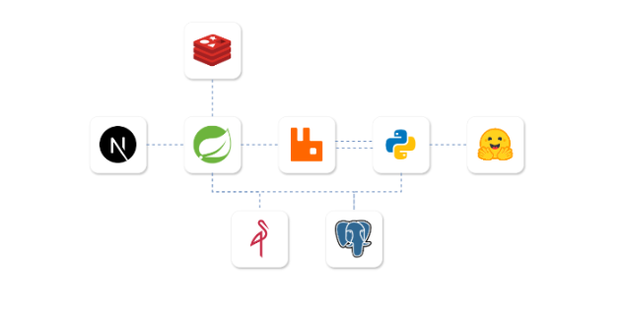
Architecture

Slide 4
Conclusion
- Built a smart, easy-to-use recruitment platform
- Automated key hiring steps with AI
- Improved job-candidate matching
- Made the process faster and more efficient
Future Work
- Add smarter AI matching and predictions
- Support video interviews and real-time chat
- Launch mobile version
- Add analytics and team collaboration
- Improve privacy and global support

