Slide 1
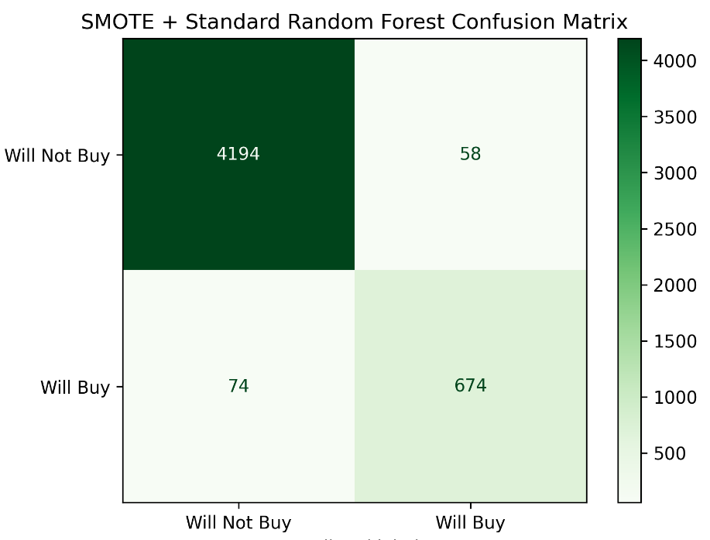
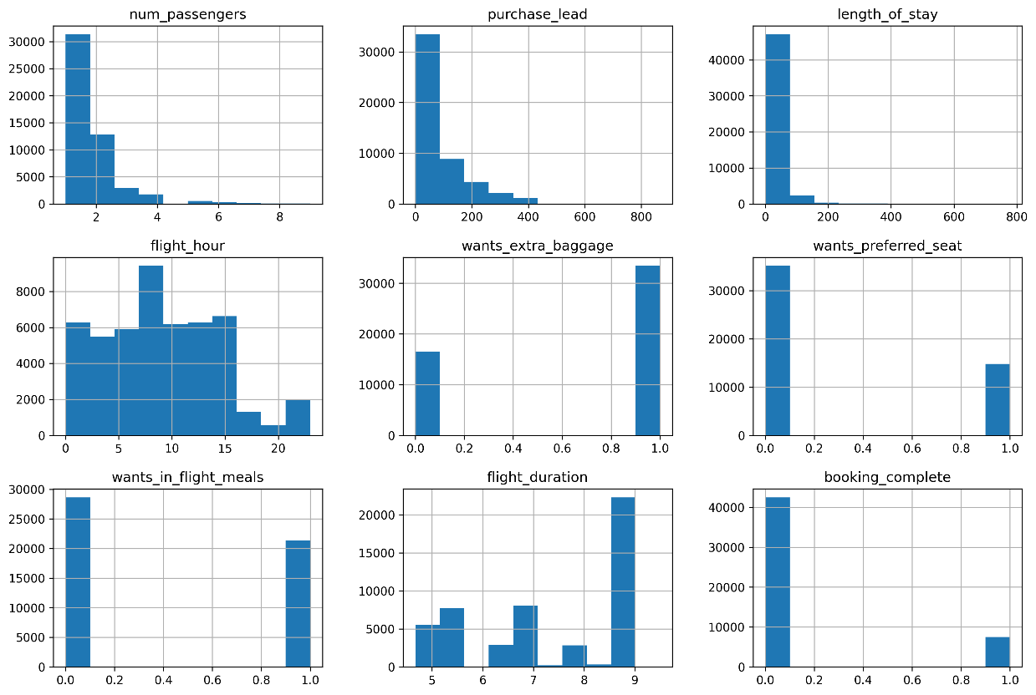
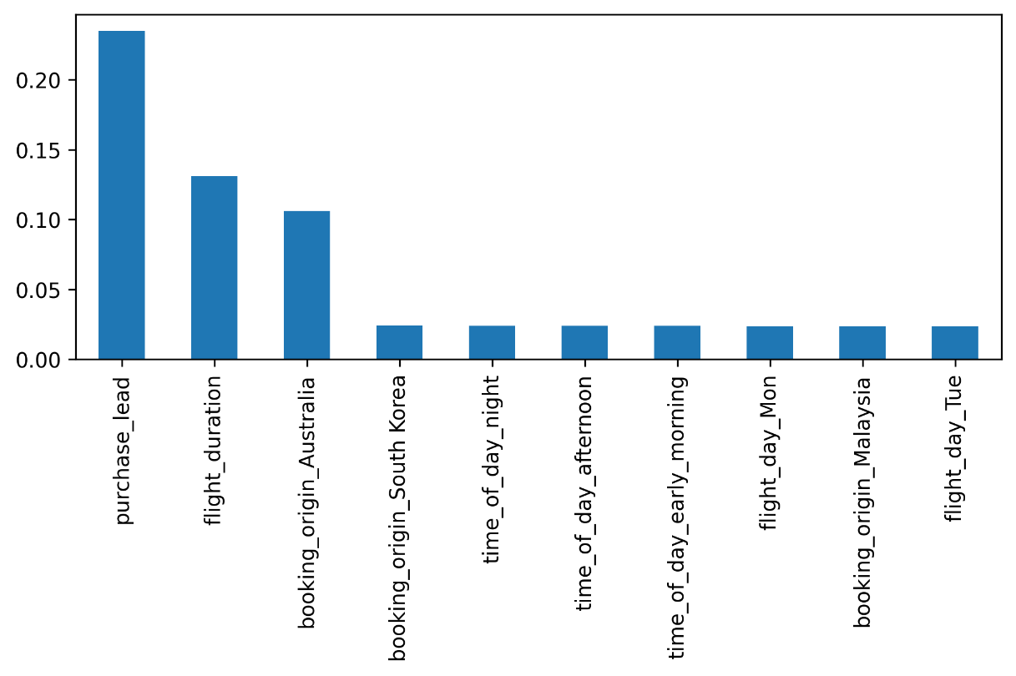
MODEL DETAILS
Average Evalution Metrics After Cross-validation:
Mean f1: 0.886
Mean recall: 0.879
Mean precision: 0.893
Model used: RandomForest from Scikit-Learn
Additional techniques: SMOTE (Synthetic Minority Oversampling Technique) to deal with class imbalance
Data manipulation/feature engineering: OneHotEncoding for features with non-numerical values
Classification Report:
precision recall f1-score support
0 0.98 0.99 0.98 4252
1 0.92 0.90 0.91 748
accuracy 0.97 5000
macro avg 0.95 0.94 0.95 5000
weighted avg 0.97 0.97 0.97 5000
After correcting for class imbalance with SMOTE, the model is quite accurate, but only 3 variables seem to be significant contributors to the model which do not provide too much insight
Distribution of numerical data
Top 10 Variable Contributors
Mohammad Fakhir

