Slide 1
REAL ESTATE MARKET ANALYSIS
Milan Housing
Market Analysis
39
Zones Analyzed
€9,150/m²
Top Price
4.8%
Best Yield
Price Dynamics, Rent Yields & Zone Distribution
Data: OMI — Osservatorio del Mercato Immobiliare
Period: H1 2024 Zones: 39 residential zones License: CC BY 4.0 (open data)
mhmd gholami | Milan, 2024 | github.com/mhmdgholami

Slide 2
Methodology & Data Sources
2 / 7
01
Data Collection — Official Open Data
03
Zone Mapping — Agenzia delle Entrate OMI Portal
Downloaded from Comune di Milano Open Data Portal (CC BY 4.0 license).
Sale prices: DS2832 — OMI Compravendita H1 2024 (486 rows)
Rent prices: DS2833 — OMI Locazione H1 2024 (487 rows)
Source: Agenzia delle Entrate — Osservatorio del Mercato Immobiliare (OMI)
OMI zone codes (B12, C14, D20…) mapped to neighborhood names via the official Agenzia delle Entrate quotation portal.
Fascia: B = Central, C = Semi-central, D = Peripheral, E = Suburban.
02
Data Cleaning & Filtering — Python / Pandas
04
Analysis & Visualization — Python / Matplotlib
Filtered: Tipologia = "Abitazioni civili" & Stato = "NORMALE". Converted Italian decimal separator (comma → dot). Computed midpoint = (min + max) / 2. Joined sale + rent on Zone code. Result: 39 zones with complete data.
Gross annual yield = (rent × 12) / sale price × 100.
Pearson correlation between sale price and yield: r = −0.55.
4 charts at 300 DPI. Tableau 10 color palette.
Data Sources: OMI Sale Data | OMI Rent Data | Zone Names (Agenzia Entrate)

Slide 3
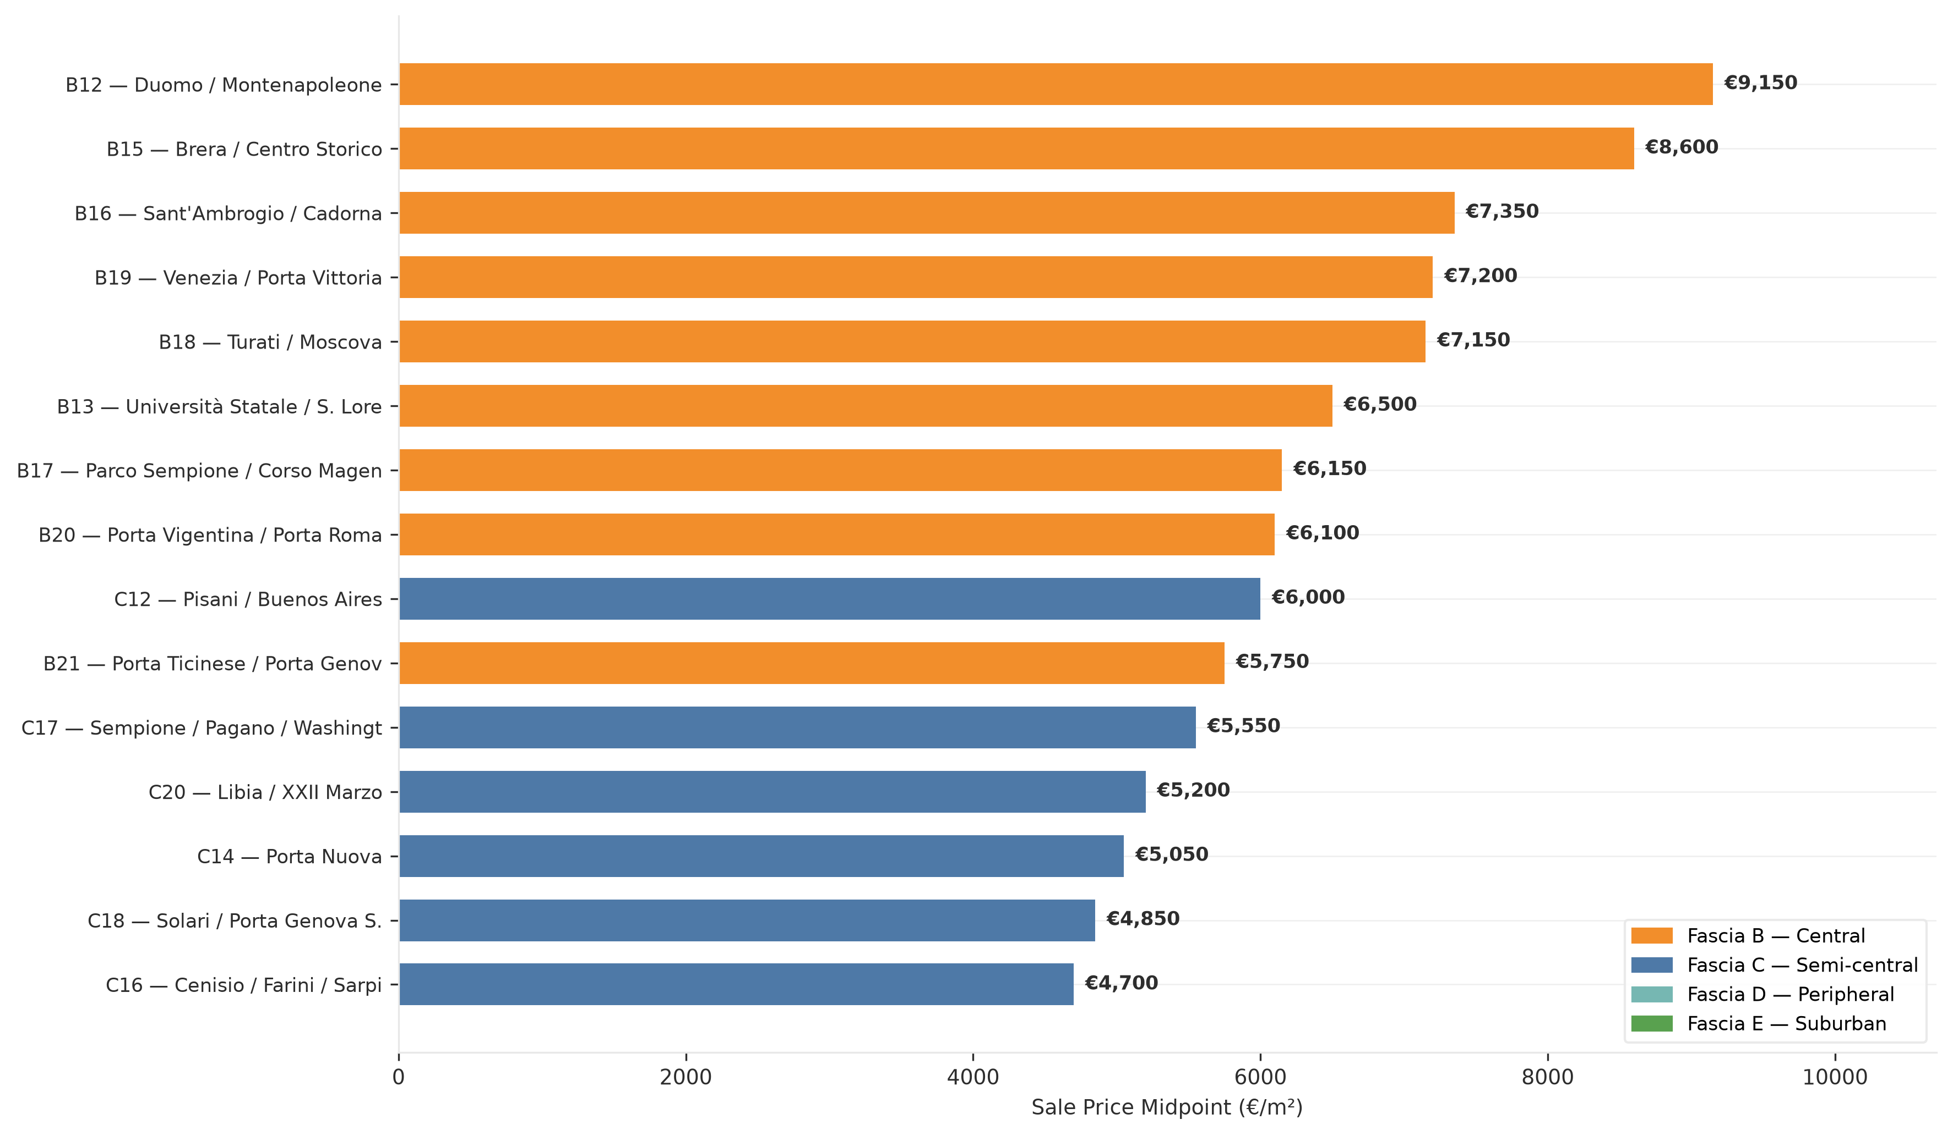
Top 15 Zones by Sale Price — OMI Milano H1 2024
3 / 7
Source: OMI — Comune di Milano Open Data (CC BY 4.0) | H1 2024 | Abitazioni Civili, Stato NORMALE

Slide 4
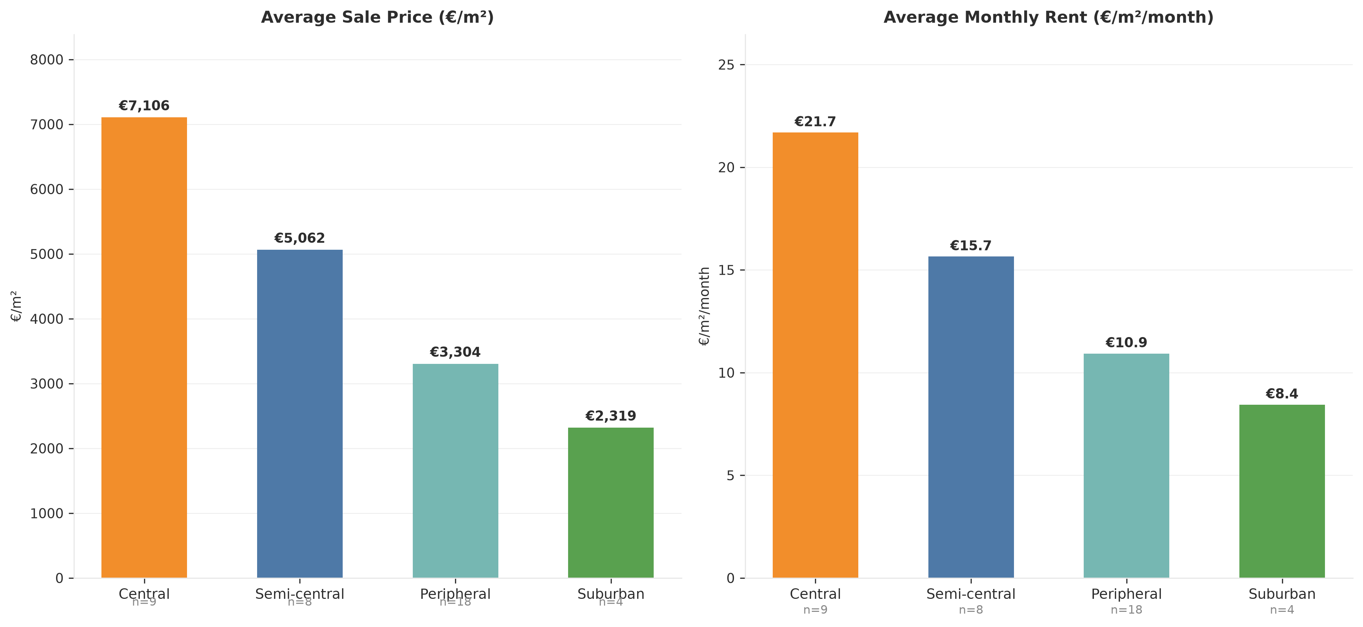
Sale Price vs Monthly Rent by Zone Category
4 / 7
Source: OMI — Comune di Milano Open Data (CC BY 4.0) | H1 2024 | Abitazioni Civili, Stato NORMALE

Slide 5
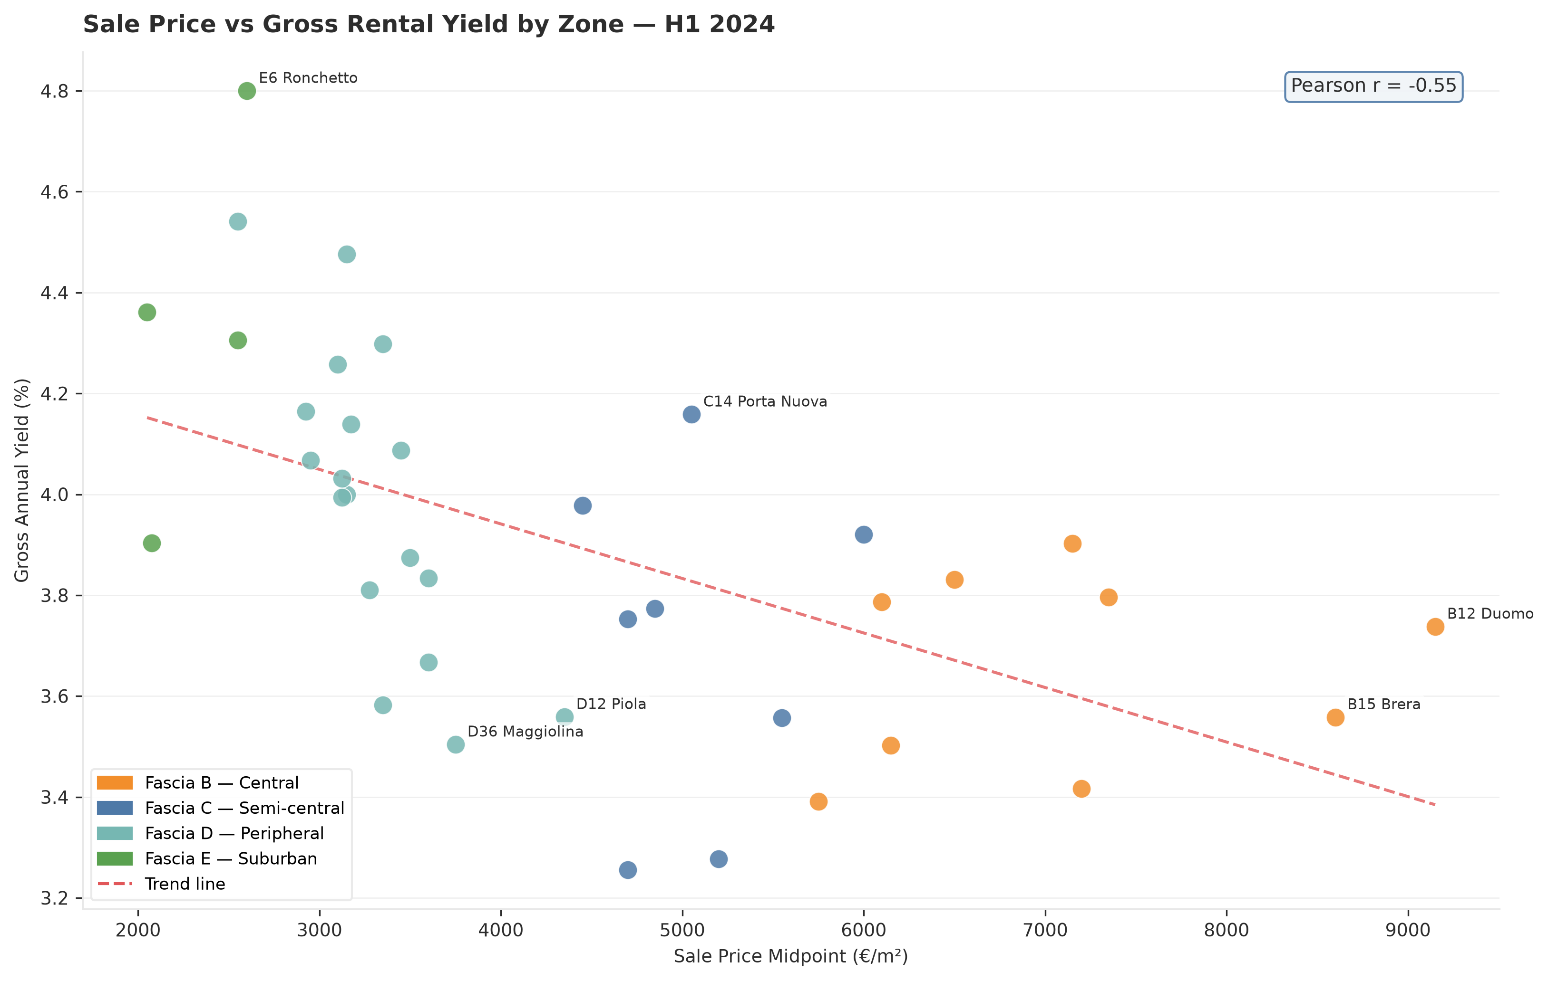
Sale Price vs Gross Rental Yield
5 / 7
Key Insights
-0.55
Pearson r
Moderate negative
correlation (price↑ yield↓)
4.8%
Best Yield Zone
E6 Ronchetto /
Lorenteggio Est
€9,150/m²
Top Sale Price
B12 Duomo /
Montenapoleone
€2,050/m²
Most Affordable
E8 Bruzzano /
Affori
Source: OMI — Comune di Milano Open Data (CC BY 4.0) | H1 2024 | Abitazioni Civili, Stato NORMALE

Slide 6
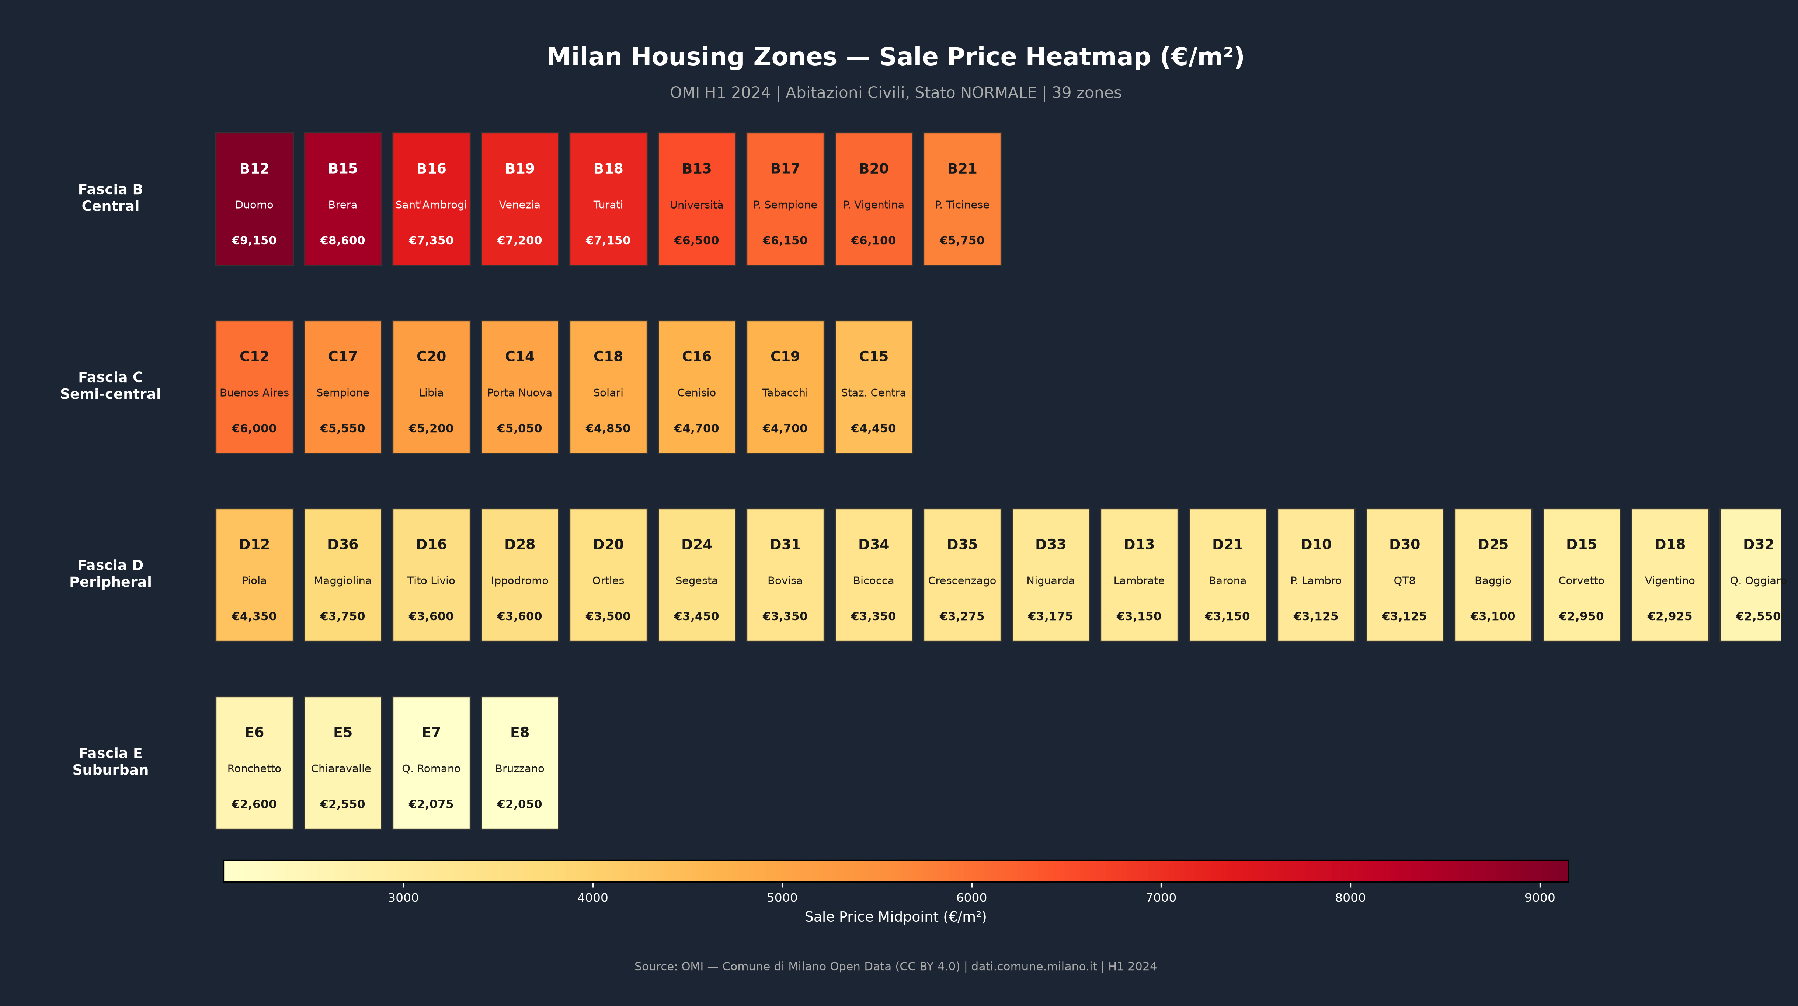
Zone Price Heatmap — All 39 OMI Zones
6 / 7

Slide 7
7 / 7
Key Findings
Milan Housing Market — OMI H1 2024 | 39 Zones Analyzed
01
Steep Center–Periphery Gradient
03
Porta Nuova Regeneration Premium
Central zones (Fascia B) average €7,106/m² — 3× the suburban average of €2,319/m². Duomo / Montenapoleone (B12) peaks at €9,150/m², while Bruzzano (E8) is the most affordable at €2,050/m².
C14 (Porta Nuova) commands a significant premium within Fascia C at €5,050/m² — the highest-ranking semi-central zone after C12 (€6,000/m²), reflecting urban regeneration uplift.
02
Inverse Yield–Price Relationship
04
Rent Market Compression
Pearson r = −0.55 confirms peripheral zones offer higher gross yields (avg 4.3%) vs central zones (avg 3.7%). Best yield: E6 Ronchetto / Lorenteggio Est at 4.8%.
Rent per m²/month ranges €8.4 (suburban) to €21.7 (central). Rent grows slower than sale prices toward the center — explaining higher gross yields in peripheral zones.
mhmd gholami | BSc Business Administration — Ca' Foscari | github.com/mhmdgholami

