Slide 1
AUTOMATION TESTING PROJECT
MOHAMMED HUSSIEN

Slide 2

About me
A 22-year-old hailing from Deir Hanna village.
Graduated in Computer Science from the University of Haifa.
Enjoys hobbies such as cooking, traveling, and coding.
Enthusiastic about expanding knowledge and thriving in the field of automation.

Slide 3
Agenda
Introduction to the Project
Selection and Analysis of the Website
STP (Software Test Plan) File
STD (Software Test Description)
Demonstration
Key Takeaways and Learnings

Slide 4

Introduction
Our objective is to create automated tests for a selected website to ensure the functionality of its features.
The project began with the creation of STP (Software Test Plan) and STD (Software Test Description) files to ensure structured and orderly test implementation.
Tests are designed to verify the proper functioning of key features on the chosen website.
The project focuses on automation testing using Python with Selenium and Selenium Grid.
The entire project was managed through GitHub due to its efficient version control and collaboration features.

Slide 5

Why did I choose the “GeeksforGeeks” website?
I selected the "GeeksforGeeks" website for our project due to its profound impact on my academic and professional journey. As a computer science student, I extensively relied on this platform for study materials and solving practice questions.
Even beyond graduation, I continued to utilize its resources, particularly when preparing for job interviews.
Therefore, based on my personal experience and trust in its effectiveness, I believe "GeeksforGeeks" is an ideal choice for our automation project.

Slide 6
What does GeeksforGeeks offer?
Learning resources: Comprehensive tutorials, articles, and videos covering various programming concepts.
Code execution: Online compilers and interpreters to run and test code snippets in multiple programming languages.
Interview preparation: Resources for practicing coding interview questions and preparing for technical interviews.

Slide 7
Why is "GeeksforGeeks" is an excellent fit for automating testing
Abundant Features: Offering a wide range of features such as coding practice, articles, tutorials, and discussion forums, "GeeksforGeeks" provides diverse testing scenarios and resources for comprehensive test coverage.
Regular Updates: The website continuously updates its content to reflect the latest developments in programming languages, algorithms, and technologies, ensuring relevance and accuracy in testing procedures.
Quality Source Code: The website's well-written and reliable code snippets serve as valuable references for creating robust and accurate test scripts, reducing the time and effort required for test development.

Slide 8
Definitions and examples:
Functional tests verify that the software functions as expected, based on its specifications and requirements.
Example : Verify that the login functionality of GeeksforGeeks allows a registered user to log in successfully using valid credentials
Non-functional tests evaluate aspects like performance, usability, and security, ensuring the software meets user expectations beyond its basic functionality.
Example: (Performance)Evaluate the time taken for the code to execute and produce the output.
Negative tests focus on intentionally breaking the software by providing invalid inputs or unexpected scenarios, validating its resilience and error-handling capabilities.
Example: entering an invalid search query and verifying that the system displays an appropriate error message.

Slide 9
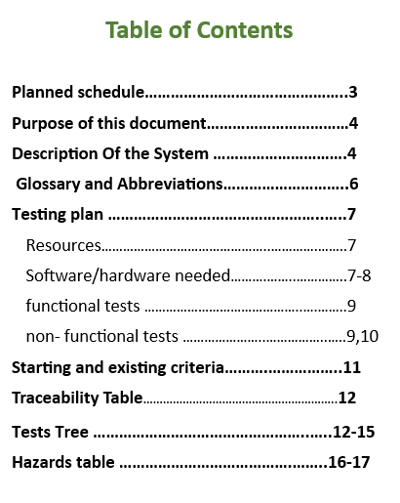
THE STP FILE
The purpose of the document is to define a framework program for testing This framework plan will include all relevant topics for planning and performing the tests, such as the test topics and types of tests, the schedule, and the planned work method for testing the system.

Slide 10
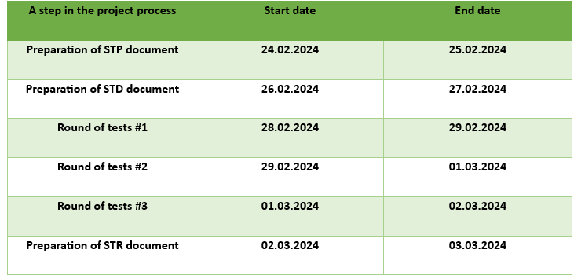
Planned Schedule

Slide 11
Starting and exiting Criteria
Criteria for starting the tests:
100% of the planned sanity tests were carried out and passed successfully.
A traceability matrix is established, linking each test case to specific requirements.
Sufficient and accurate test data for both positive and negative scenarios is available.
Completion/Release Criteria:
100% of planned functional and non-functional tests have been executed, and results have been documented.
100% of test cases passed successfully.
All critical bugs have been fixed at this point.

Slide 12
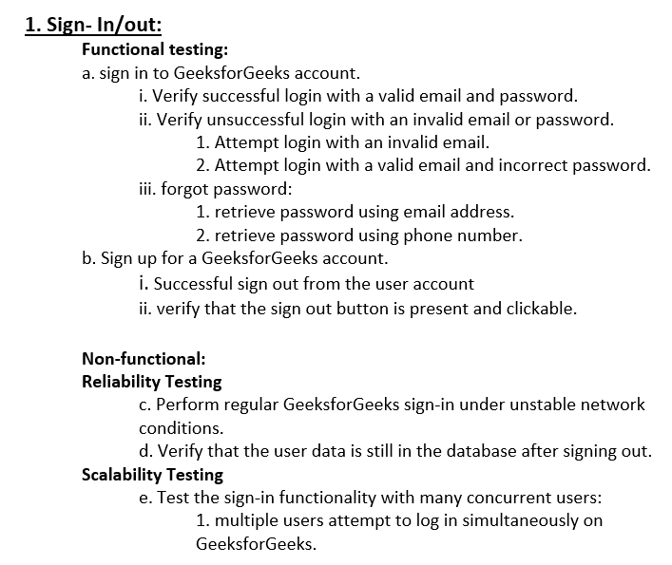
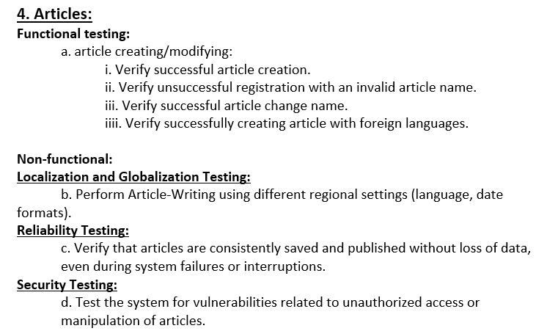
TESTING TREE

Slide 13
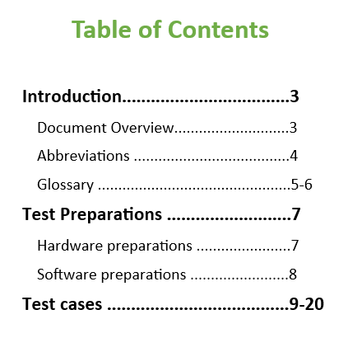
THE STD FILE
This document serves as the software test description for the GeeksforGeeks software development project. It provides a comprehensive overview of the tests outlined in the software test plan. These tests are important to the success of the project as they include both functional and non-functional aspects, ensuring the platform's stability and reliability.

Slide 14
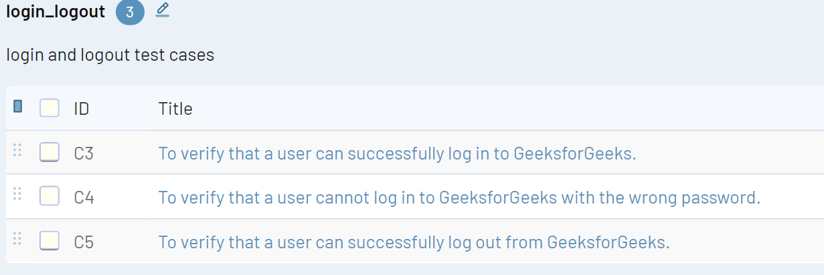
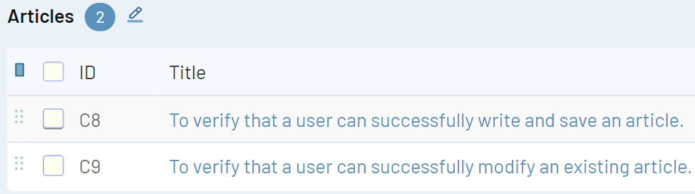
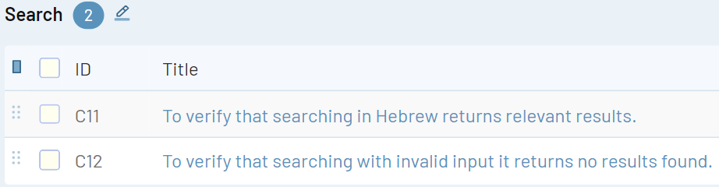
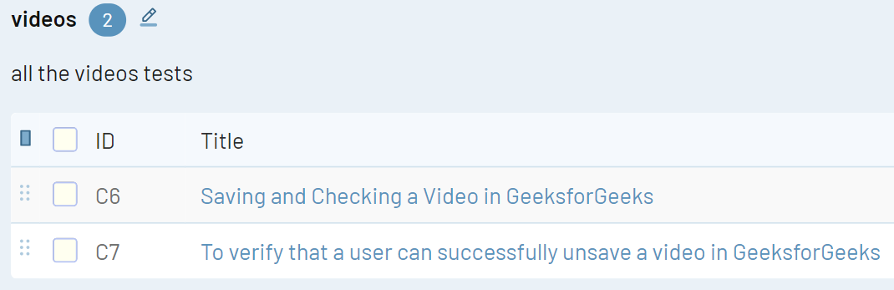
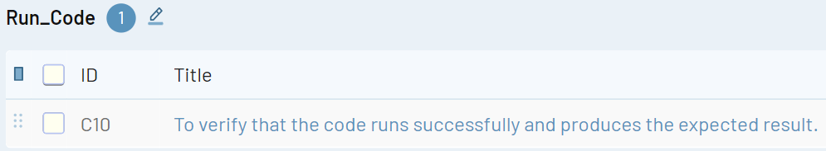
Test cases

Slide 15
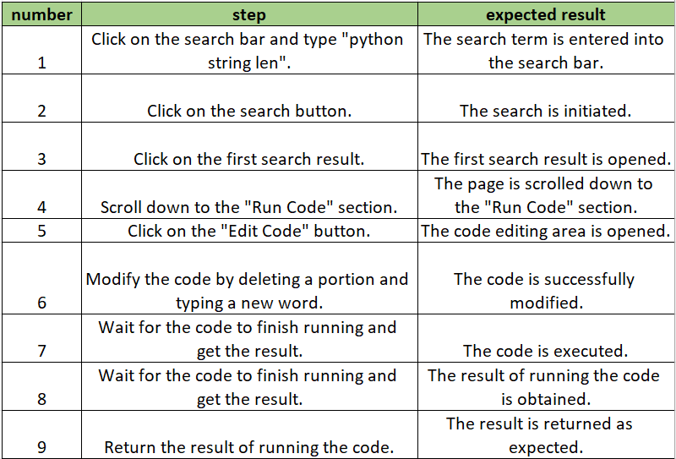
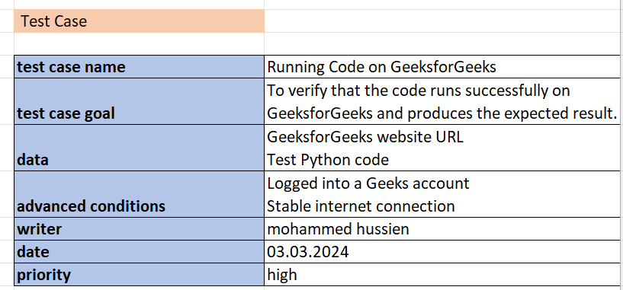
Test case example

Slide 16

Power of communication

Slide 17

Challenges faced
Dynamic Website Content: The website you are testing may have dynamic content that changes frequently. This can make it challenging to locate elements consistently, requiring you to update your locators and selectors regularly.
Handling Pop-ups and Alerts: Pop-up windows, alerts, and browser notifications can disrupt your automation flow.
Sticking to the project timeline without straying or falling behind to ensure deadlines are met efficiently.

Slide 18
Lessons learned
Effective Time Management: Learning to prioritize tasks and allocate time efficiently was crucial for meeting project deadlines.
Good Code Structure: Maintaining a well-structured codebase helped in enhancing code readability, reusability, and maintainability, reducing the likelihood of errors.
Documentation: Maintaining comprehensive documentation for code, test cases, and project progress was vital for knowledge sharing and future reference.

Slide 19

Questions

Slide 20
Thank you
Mohammed Hussein

