Slide 1
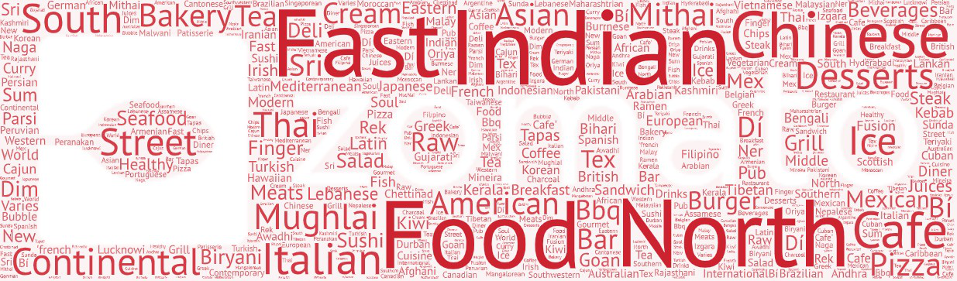
FINAL PROJECT JCDS
Predictions of Average Cost for Two and Recommendation System for Similar Restaurant in Zomato
MUHAMMAD IRFAN

Slide 2



PROJECT GOALS
Predict prices as a benchmark price from the owner and buyer side
Looking for alternative choices for users based on the similarity of food sold and the location of the restaurant
www.zomato.com

Slide 3
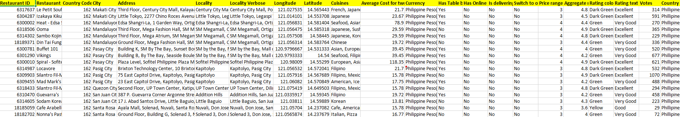
Dataset
Data is taken from Kaggle and obtained from the Zomato API
www.zomato.com

Slide 4
Dataset
Data is taken from Kaggle and obtained from the Zomato API
www.zomato.com

Slide 5
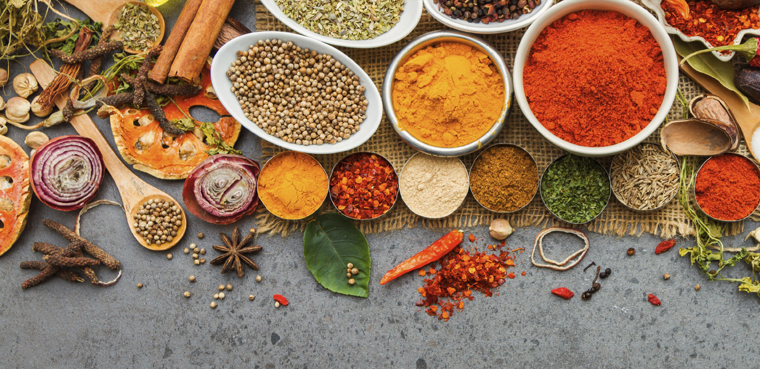
Data Manipulation
Fill NaN values (using modes & mean)
Drop item
Convert currencies
New columns for Location and Total Cuisine Variety
www.zomato.com

Slide 6
Data Manipulation
Fill NaN values (using modes & mean)
Drop item
Convert currencies
New columns for Location and Total Cuisine Variety
www.zomato.com

Slide 7
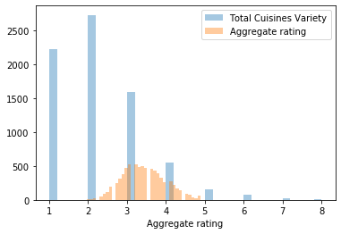
Statistic Test
From anderson test, i assume that data not normal dist.
{'Anderson': {15.0: 0.576,
10.0: 0.656,
5.0: 0.787,
2.5: 0.918,
1.0: 1.092,
'stat': 544.8807074813303}}
www.zomato.com

Slide 8
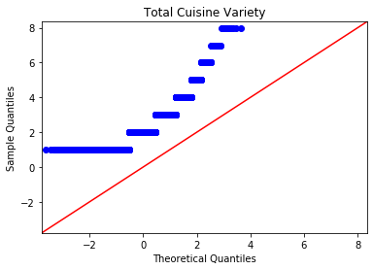
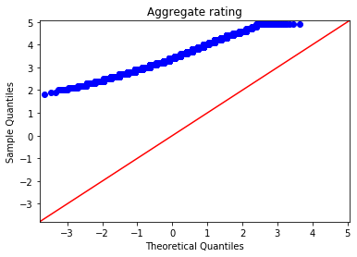
Statistic Test
 | Source | ddof1 | H | p-unc
Kruskal | Total Cuisines Variety | 7 | 158.287 | 7.355946e-31
www.zomato.com

Slide 9
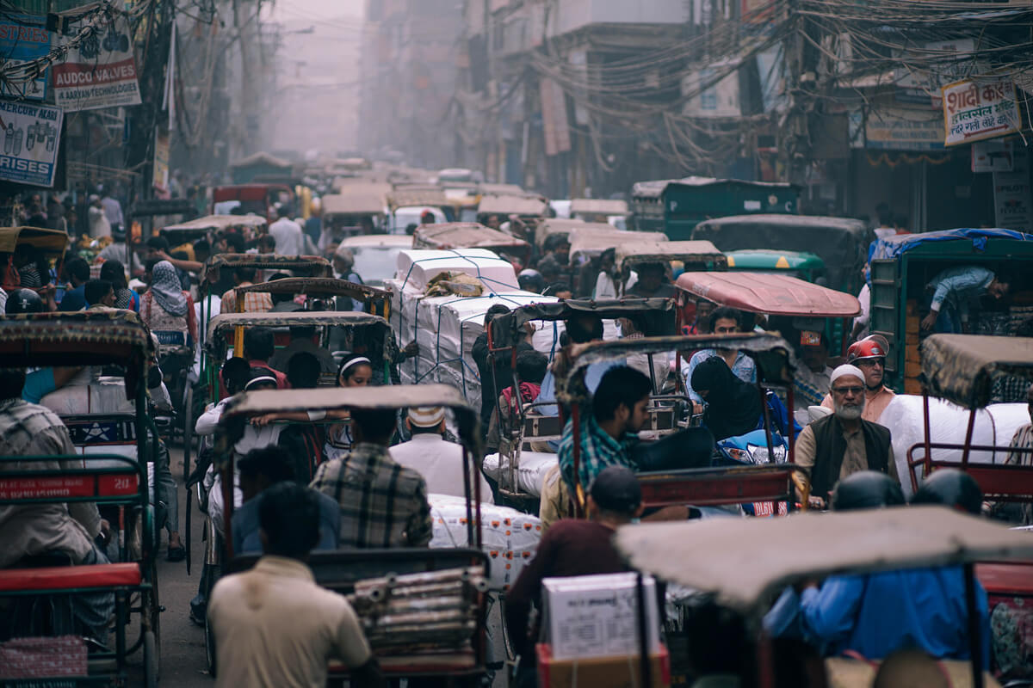
Recommendation System (Content Based)
Using Count Vectorizer
Cosine SImilarity by Location and Cuisine
Predict the distance of the Restaurants
www.zomato.com

Slide 10
Machine Learning Model
 | MAE | RMSE | R2 Score
Linear Regression | 1.202 | 1.496 | 0.814
Lasso | 2.668 | 3.456 | 0.000
DecisionTreeRegressor | 1.200 | 1.496 | 0.810
RandomForestRegressor | 1.476 | 1.972 | 0.672
GradientBoostingRegressor | 1.238 | 1.574 | 0.790
Ridge | 1.162 | 1.468 | 0.820
www.zomato.com

Slide 11
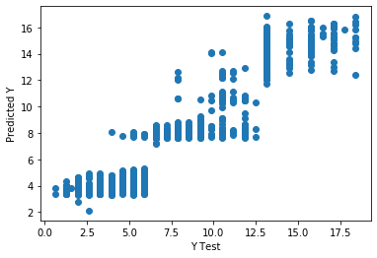
Machine Learning Model
(GRADIENT BOOSTING REGRESSOR)
MAE: 1.0667213072812751
MSE: 1.6886021483918485
RMSE: 1.2994622535463847
R2 Score: 0.8575102319615816
www.zomato.com

Slide 12
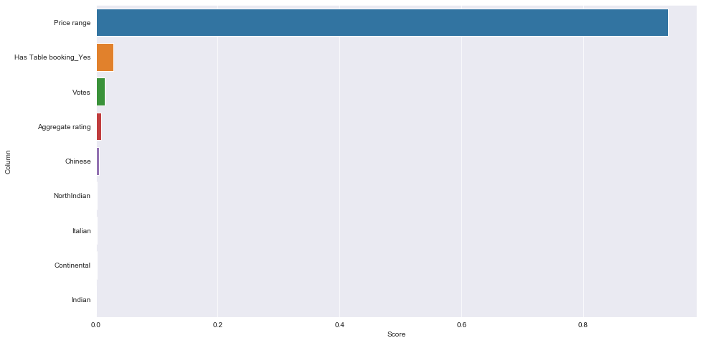
FEATURE IMPORTANCES
www.zomato.com

Slide 13
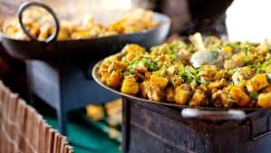
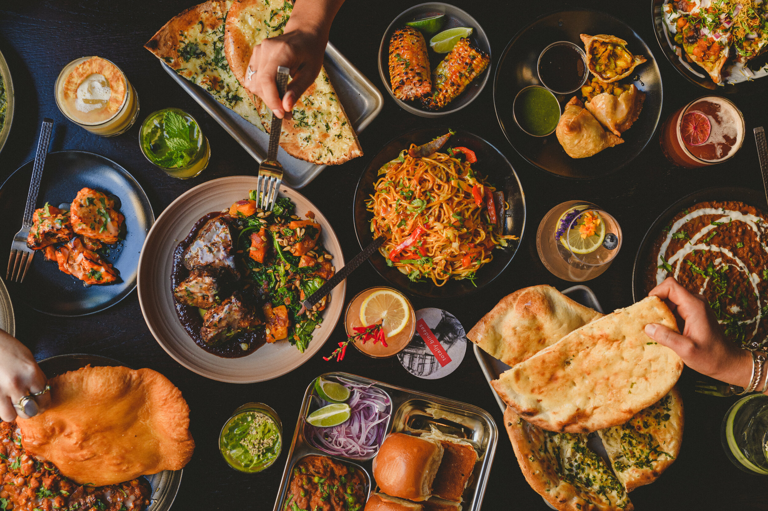
Thank You
www.zomato.com

