Slide 1
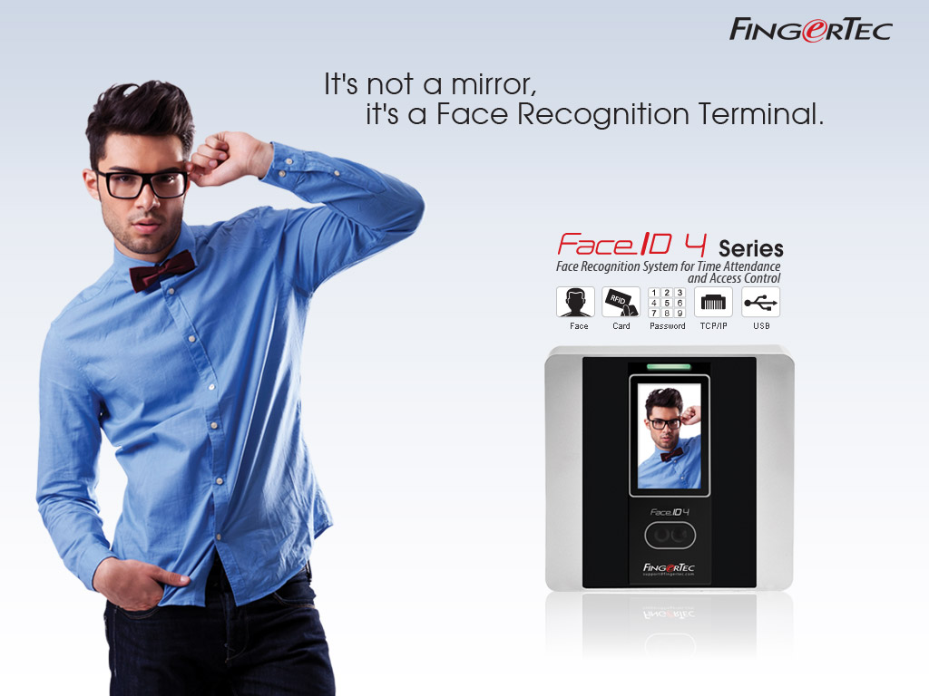
Copyright © 2013 FingerTec Worldwide Sdn.Bhd. All rights reserved.

Slide 2
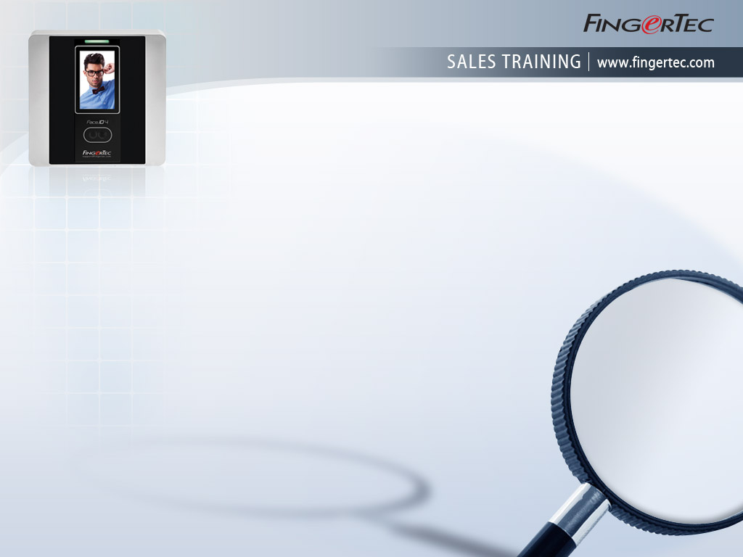
The Benefits of a Biometric System
Convenient and easy to use
Promotes punctuality effortlessly
Eliminates tardiness and buddy punching
Accurate data records and automated
data analysis
Economical and suitable for SMEs and big corporations
Centralized data system to reduce administrative costs and frustrations

Slide 3
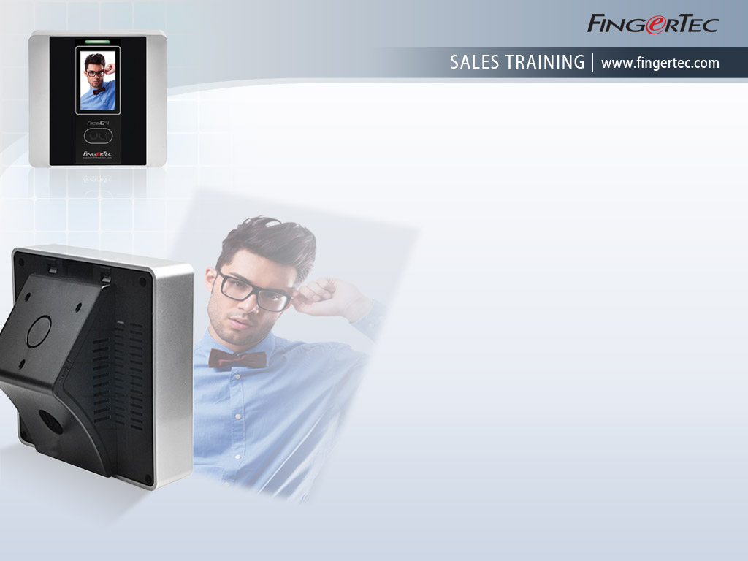
Biometrics Gets Advanced with
Face Recognition Technology
Next to fingerprint and iris, face recognition technology has been gaining popularity amongst users because it is:
Quick & Hassle-free – Registration and Verification done in mere seconds!
Hygienic – Contactless verification.
No touching, just scanning!
Convenient – Tokenless system. No more worries about keys!
Anti-Fraud capable – No fake face can take your place!

Slide 4
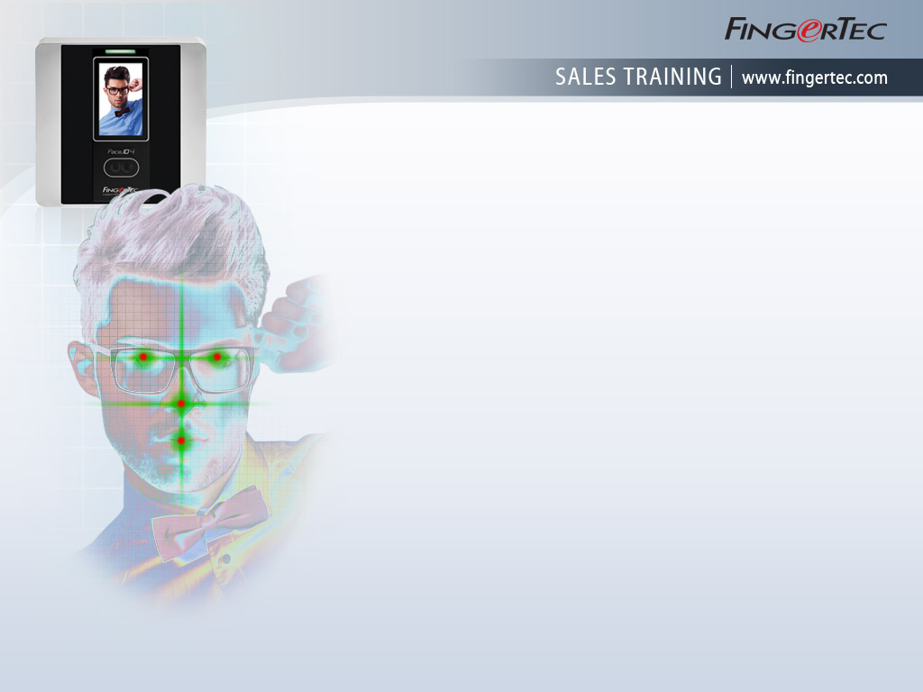
Introducing Face ID 4
An advanced recognition system using a technology that traces the focal points of your face and verifies them to be uniquely yours.
With one look at the camera, you are good to go without any worries.
The genuine data is captured instantly and can be used for time attendance and door access control purposes.
Face ID 4 offers 3 verification options:
Face, card and password.
Ideal for modern offices of any size.

Slide 5

Great Features
at an Affordable Price!
3.0” full color touch screen
Contains up to 400 face templates, 10K cards
200K transaction logs at any time
Speed and Accuracy : Less than two seconds of verification, 99.99% accuracy
Dual camera and infrared face scanning
Ergonomic and stylish design
Data transfer is easy via the commonly used methods, TCP/IP & USB
Management through FingerTec’s powerful software

Slide 6
More Great Features
at an Affordable Price!
Multiple Verification methods to opt for:
face, card and password
Dual usage: Time Attendance & Door Access
Work Codes to determine the whereabouts of away employees are available for employee convenience
Short messaging system for effective management of employee communications/announcements

Slide 7
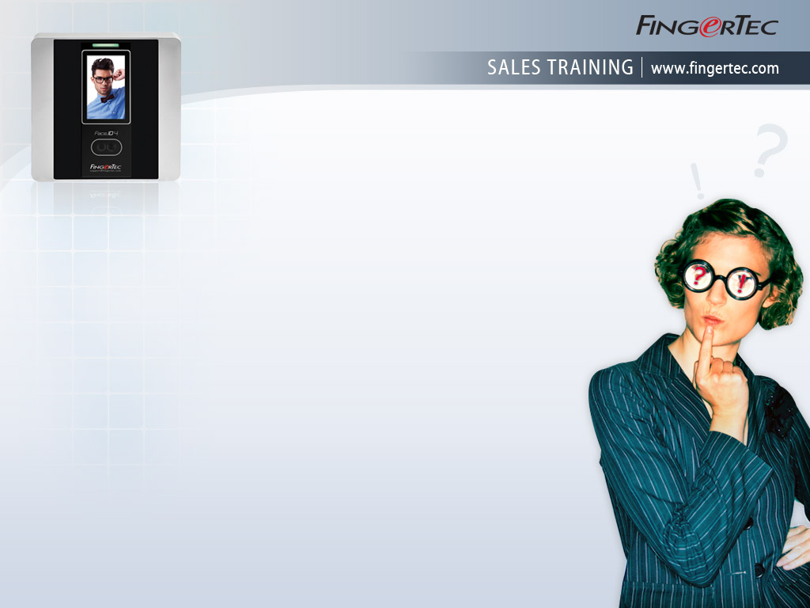
Face ID 4 Brings Advanced Technology Closer to You,
What are Your Concerns?
Since face recognition technology is relatively new, would it be expensive and difficult to install?
The Face ID series offer advanced technology, automated & accurate data, and convenience for its users while also boosting their productivity. Furthermore, with the 2 years warranty and FingerTec’s instant support, the price is very competitive compared to other more inferior systems in the market.
Will it be difficult to enrol users?
Not at all! Enrollment takes less than a minute per user and user data can be imported from other format i.e. xls., txt., etc to make things easy
Do we really need such advanced technology for our SMEs?
When the price is right and the technology promotes discipline and boosts productivity, it’s a great investment for now and the future. Regardless of your company’s size, the benefits speak for themselves!

Slide 8
Face ID 4 Brings Advanced Technology Closer to You,
What are Your Concerns?
How reliable is the technology and would it stay for long?
The acceptance and rejection rate of Face ID 4 is negligible, the technology is highly stable and when it can be combined with other biometric technologies (i.e.: fingerprint) and other systems (i.e.: card), it can potentially be applicable to any industry in the long term. It’s definitely here to stay.
If another biometric technology comes along, would this become a stale technology?
It has been proven that face and fingerprint technology are the two technologies that are highly accepted by consumers due to their user-friendliness, convenience & non-intrusive nature.

Slide 9
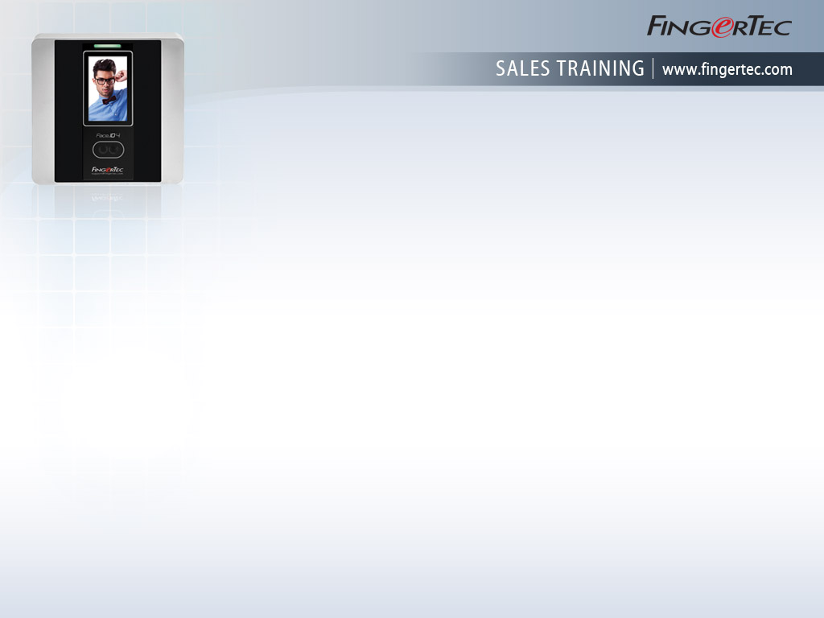
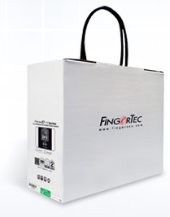


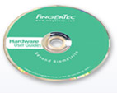

Get All of These
When You Purchase Face ID 4
Extensive
All-In-One CD
Extensive
Online Resources
Strong
After-Sales Support
Top Quality Hardware
Powerful Software

Slide 10
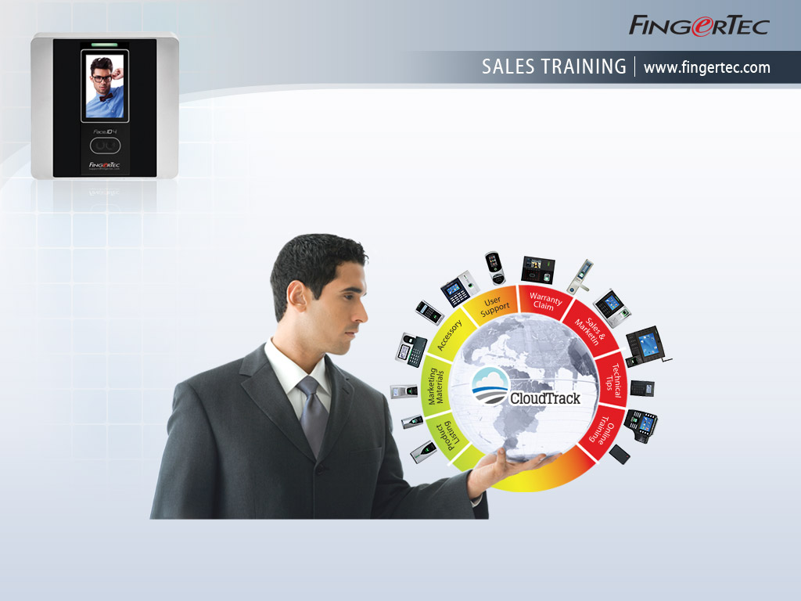
We give you more and then SOME !
http://www.fingertec.com/microsites/

Slide 11
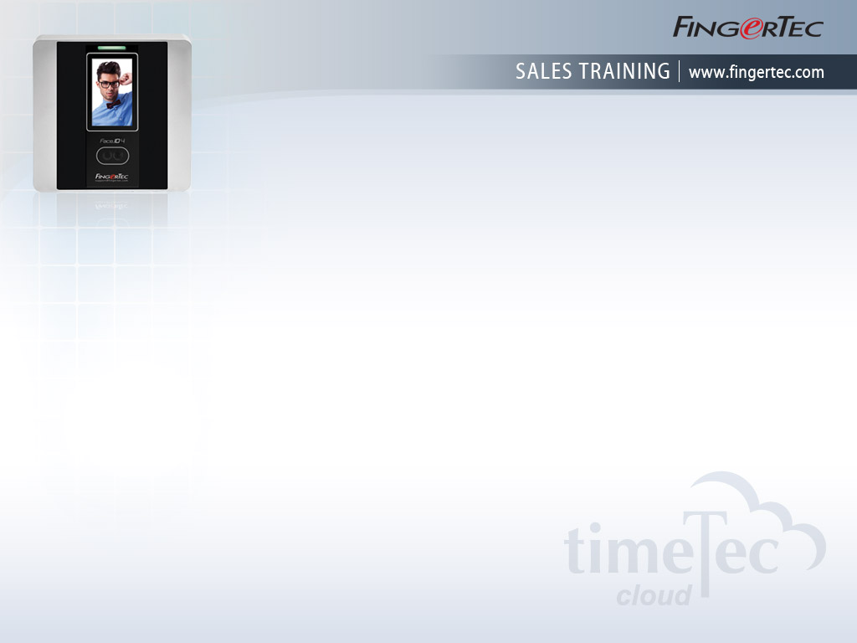
Staff Attendance and Scheduling Made Easy via TimeTec Cloud
Connect to FingerTec time clocking devices easily
Supports variety of work schedules, shifts and rosters to accommodate all working environments
Job costing features are available for flexi-schedule workers
Management of leaves, holidays and tardiness are made available
Various printable and presentable attendance reports, exportable in a variety of formats
Employees can do clocking activities 3 ways, biometrics reader, mobile check in and web check in
Easy integration with 3rd party applications
Data is always secured and available online
Access rights can be assigned for added security.
Get TimeTec Cloud at www.timeteccloud.com

Slide 12
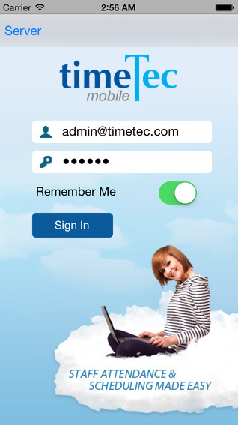
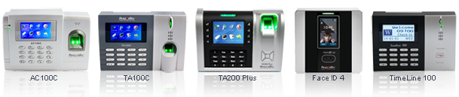
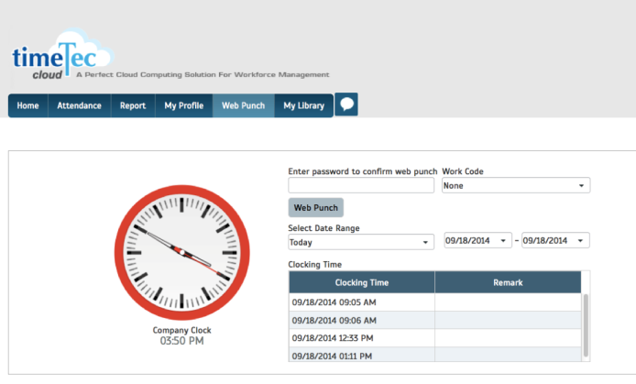
TimeTec Cloud
Clocking Conveniently in 3 ways!
3. TimeTec Mobile
1. Biometrics Time Clock
2. Web Check in

Slide 13
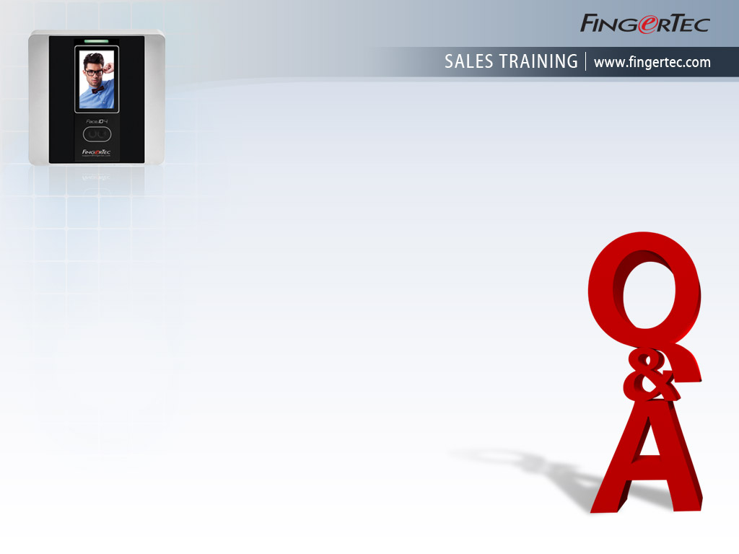
You Ask,
We Answer!
Can the terminal recognize me if I wear headgear/eyewear during verification?
As the machine reads focal face points, obstructions to the points might cause slight difficulty during verification. Advisable to remove the unnecessary accessories.
Can the camera pick up images in dim/low lighting?
As the machine reads focal face points, obstructions to the points might cause slight difficulty during verification. Advisable to remove the unnecessary accessories.
If I use Face ID 4, can I also use other terminals be installed at other doors and linked to a central system?
Yes you can. FingerTec system is designed to accept all FingerTec terminals and link them up in a centralized system via FingerTec Ingress software or TimeTec Cloud.
Can the data be linked to a third party software?
Yes, FingerTec provides a way to do it via FingerTec Biobridge which comes complimentary when you have FingerTec products.

Slide 14
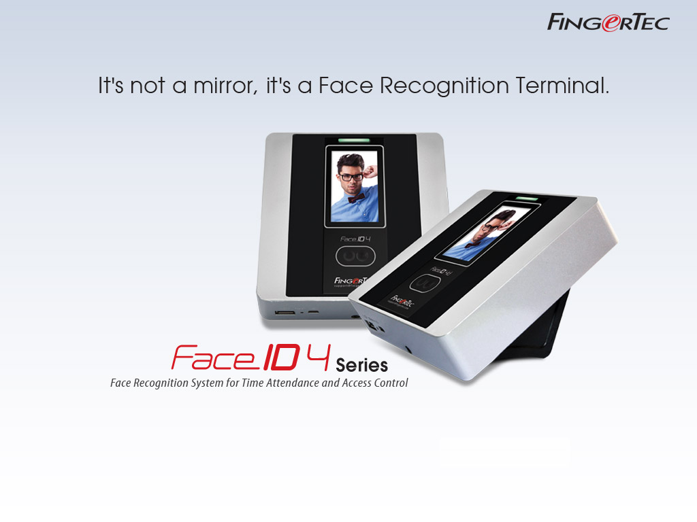
Copyright © 2014 Timetec Computing Sdn Bhd. All rights reserved.

