Slide 1
Team: StudyHub
FINAL DEFENSE
Smart Study Planner
Mahmod Khshan
lead developer
Islam Baloom
A personal academic planner
with course-level collaboration hubs.
Scrum Master
Abd Al Majid Ajmil
Product Owner
Amir Arabi
Full-Stack Developer
Mustafa Sbetan
QA & DevOps Lead
Software Project Management · Spring 2026

Slide 2
02 — The Problem
1.
Fragmented Deadlines
3 in 5
Calendar apps hold deadlines, but know nothing about courses.
2.
No Separation Between Courses
students use WhatsApp
or Telegram for course
discussion & file sharing
— yet find it inadequate.
Group chats mix all courses together; history gets buried.
3.
No Structured File Sharing
Cloud links shared in chats break, expire, or get lost.
4.
Zero Integration
No tool connects the planner, the chat, and the files in one place.
StudyHub · Smart Study Planner · Spring 2026

Slide 3
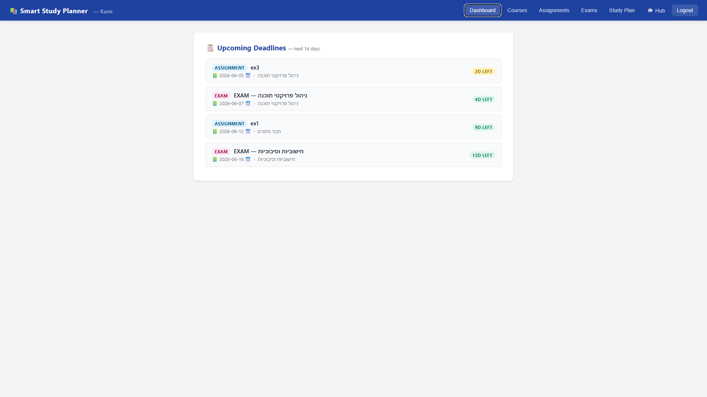
03 — Our Solution
01
Personal Dashboard
Assignments & exams sorted by deadline, across all courses in one view.
02
Course Groups
Create a course with course_id + join_code. Teammates join instantly.
03
Community Hub
Chat · Materials (PDF upload) · Q&A · Activity Feed — per course.
bejewelled-valkyrie-fee7bb.netlify.app
StudyHub · Smart Study Planner · Spring 2026

Slide 4
04 — Architecture
FRONTEND
Netlify · index.html · Vanilla JavaScript
▼
HTTPS · Fetch API
BACKEND
Render · Python Flask REST API (35 routes) · is_course_member() guard
▼
PyMongo
DATABASE
MongoDB Atlas (10 collections) + GridFS (binary file storage)
All Course Hub routes call is_course_member(course_id, username) before returning or modifying any hub data.
StudyHub · Smart Study Planner · Spring 2026

Slide 5
Live Demo
1
Login or register with a username and password
2
Select institution and degree to discover course groups
3
Join an existing course by join_code or create a new course group
4
Add an assignment or exam — see it appear on the dashboard
5
Open the Course Hub — post a message, upload a file, ask a Q&A question
https://bejewelled-valkyrie-fee7bb.netlify.app/
StudyHub · Smart Study Planner · Spring 2026

Slide 6
06 — Sprint Journey & Velocity
Sprint 1 — 20 SP
Below plan (target 25). Setup overhead: Atlas IP config, first Render deploy.
Sprint 2 — 35 SP
Above plan (target 32). Team rhythm established; MVP features well-understood.
Sprint 3 — 40 SP
On trend. Integration overhead limited further acceleration compared with Sprint 2.
Avg velocity: 31.7 SP/sprint · Sprint 3 delivery stayed close to the expected range based on Sprint 2 velocity.
StudyHub · Smart Study Planner · Spring 2026

Slide 7
07 — Final EVM Scorecard
0.95
0.81
95%
−24h
SPI
(Schedule Performance)
CPI
(Cost Performance)
Scope Delivered
(of 100 planned SP)
VAC
(Cost Variance at Completion)
We stayed close to schedule and delivered most planned scope — but underestimated integration cost (CPI 0.81).
StudyHub · Smart Study Planner · Spring 2026

Slide 8
08 — Risks That Materialized
R-03
Course Privacy — Missing Membership Check
Trigger: Hub GET routes initially returned data for any course_id without verifying the requester was a member.
Action: Added is_course_member() guard to every hub route. All hub data is now membership-gated.
Verdict: Ineffective contingency — risk was not identified in advance. Fix cost ~8 hrs to trace.
R-04
GridFS Learning Curve
Trigger: File upload, download, and cascade delete took 16 hrs vs. 4 hrs estimated.
Action: Absorbed via overtime. No contingency had been planned for a new storage library.
Verdict: Ineffective — treated as simple CRUD. Should have been a dedicated spike.
StudyHub · Smart Study Planner · Spring 2026

Slide 9
09 — Lessons Learned
01
Estimation
New infrastructure needs a spike first.
GridFS was treated as a simple library call and estimated at 4 hrs. It took 16. Any new storage or auth model must be spiked before sprint planning — estimate at 3× the spike findings.
02
Process
Authorization must be part of Definition of Done.
Authentication (who are you?) and authorization (are you allowed?) are separate layers. Every hub route needs an explicit membership check in its DoD checklist — not discovered during integration testing.
03
Demo Readiness
Test from a cold deployment, not a warm one.
Render's free tier spins down after 15 minutes. The cold-start 502 appeared during rehearsal, not during development. Run a full Golden Path from cold at least 24 hrs before the defense.
StudyHub · Smart Study Planner · Spring 2026

Slide 10
What's Next
>>
Mobile-Responsive Layout (US-22)
Deferred
The highest-value next sprint. Most academic task management happens on a phone — the current desktop layout requires horizontal scrolling.
>>
Hub Moderation Workflow
Known Gap
Flag mechanism exists in hub_reports. Owner-facing review UI and hide/remove actions are not yet built.
>>
Server-Side Session Management
Known Gap
Current session uses browser storage. A production deployment requires server-side token validation or JWT-based authentication.
Thank you. Questions?
StudyHub · Smart Study Planner · Spring 2026 · Software Project Management
StudyHub · Smart Study Planner · Spring 2026

