Slide 1

PATENT REVIEW
Hierarchical Bandit-Guided
Scientific Discovery
Language models generate programs that construct scientific solutions.
Evaluated outcomes guide search and improve the generating model.
Technical solution and observed experimental evidence
Huawei Confidential
Secret Level:
Page 1
Notes:
Hierarchical Bandit-Guided Scientific Discovery
The method couples language-model generation, outcome-guided sampling, historical risk-sensitive reinforcement learning, and dependency-aware execution.
Sources: supplied IMG_7154 Large.pdf. Huawei logo: https://www.huawei.com/-/media/hcomponent-header/1.0.1.20260908162100/component/img/huawei_logo.png

Slide 2

Contents
•
Idea Compliance Check
•
Background
◦
LLM-Based Scientific Discovery
◦
Prior Art: Candidate Sampling and Search
◦
Technical Problems in Existing Approaches
•
Technical Solution
◦
Hierarchical Discovery Pipeline
◦
Allocation and Policy Training
◦
Dependency-Aware Execution
•
Distinguishing Features of the Idea
•
Experiments and Design Rationale
•
Advantageous Effects of the Idea
•
Value Statement for Obtaining a Patent
Huawei Confidential
Secret Level:
Page 2
Notes:
Contents
The technical solution contains the generation hierarchy, adaptive sampling, the policy-training reference, and the execution dependencies. The evidence separates the behavioral ablation from end-to-end scientific results.

Slide 3

Idea Compliance Self-Check
No.
Self-check item
Declaration
1
Does the idea involve another party’s non-public information from technical collaborations, procurement, supplier or
No
customer communications, or another organization?
2
No non-public software algorithms, designs, layouts, or confidential technical solutions of a third party are used without
Confirmed
authorization.
3
No third-party non-public information forms the basis of an improvement to the technology described in that information.
Confirmed
4
No non-public third-party information obtained by disassembly or reverse engineering is used in the patent application.
Confirmed
5
The idea does not involve non-public information of a former employer or work products belonging to that employer.
Confirmed
Inventor declarations. Use the applicable official submission checklist.
Huawei Confidential
Secret Level:
Page 3
Notes:
Idea Compliance Self-Check
Source: supplied presentation, Page 3. These are the supplied inventor declarations, not independent legal or compliance findings. Use the applicable official internal checklist when submitting.

Slide 4

Background: LLM-Based Scientific Discovery
A large language model (LLM) writes a program that constructs a candidate solution. A task-specific evaluator
checks the construction and assigns its score.
Task + parent
LLM program
Construction
Evaluated score
Problem-specific context
Executable source
Program output
Task-specific evaluator
Search with a fixed model
Search with reinforcement learning
The search reuses promising solutions as context for new
Evaluation also supplies a learning signal. The LLM
programs. The model’s weights stay unchanged.
updates its weights to favor programs with stronger
outcomes.
Parent: a scored starting solution. Rollout: one generated program. Archive: retained solutions and their ancestry.
Success means finding a better valid construction, even if many attempts fail.
Huawei Confidential
Secret Level:
Page 4
Notes:
Background: LLM-Based Scientific Discovery
A rollout is one generated candidate program and its evaluation. The environment, not the LLM itself, executes the program. The raw problem score can be minimized or maximized. Training rewards use a larger-is-better convention.

Slide 5
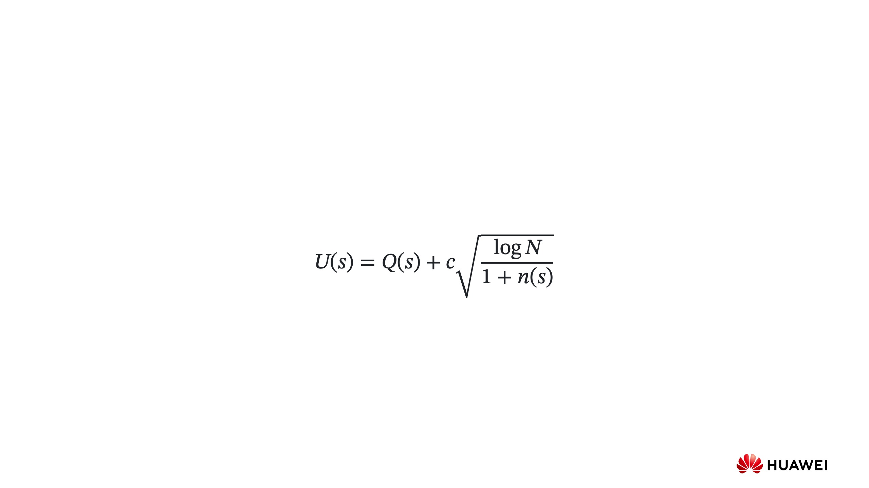
Prior Art: Candidate Sampling and Search
1.
Uniform sampling: generate the same number of programs from each selected parent, regardless of early results.
2.
Evolutionary and island-based search: populations retain and mutate strong evaluated candidates. Separate
populations help maintain diversity.
3.
Tree-based search: select a starting solution by balancing observed quality with exploration. UCT illustrates this
tradeoff:
s: archived state Q(s): observed quality n(s): expansions of s
N: total expansions c: exploration strength U(s): parent-selection score
Parent selection chooses a starting solution. The LLM then generates candidate programs from that context.
Illustrative UCT form. The PUCT parent selector also weights exploration using a prior P(s) over archived states.
Huawei Confidential
Secret Level:
Page 5
Notes:
Prior Art: Candidate Sampling and Search
Source: supplied presentation, Page 5. This expression illustrates UCT. PUCT additionally weights exploration using a prior over archived states. Parent selection supplies context to the language model that generates candidate programs. Closest-reference novelty analysis remains separate.

Slide 6

Technical Problems in Existing Approaches
01
One generation combines algorithm selection and implementation
The LLM chooses an approach while writing the program. Additional samples can repeat the same approach without
explicitly testing alternatives.
02
Reinforcement learning can favor copies of an existing solution
Reproducing an existing construction can still earn a high reward. Reinforcing these outputs can make the LLM generate
more copies and fewer distinct constructions.
03
A fixed sampling split cannot adapt to early evaluation results
Equal sampling continues after early results indicate that some directions are more promising. The remaining budget cannot
shift toward those directions.
04
Group-relative training can discard useful reward information
When all programs in a group receive the same reward, their group-relative advantages are zero. This removes the reward-
based update even if that reward improves on earlier results.
Huawei Confidential
Secret Level:
Page 6
Notes:
Technical Problems in Existing Approaches
The first point concerns direct program generation without explicit algorithm-level sampling choices. It does not claim that a single LLM cannot produce different algorithms. The second is a conditional reinforcement mechanism: copying a strong construction can remain rewarding, and reinforcing such outputs can reduce construction-level exploration. It does not establish that RL always causes collapse. The third concerns fixed, equal allocation rather than adaptive search methods in general; early evidence can be uncertain. The fourth concerns group-relative advantages formed by centering rewards on the current group's mean. Exactly equal rewards produce zero reward advantages, although a separate KL regularizer may still contribute gradients. A historical reference can assign a shared nonzero advantage to that group but cannot rank identical rewards within it. These are specific limitations motivating the proposed method, not universal claims about every prior system.

Slide 7

Technical Solution: Hierarchical Discovery Pipeline
Parent p
One of P parents
Archive
Scores + ancestry
Strategist: frozen planning LLM. Coder: shared LLM trained on all evaluated programs.
Huawei Confidential
Secret Level:
Page 7
Notes:
Technical Solution: Hierarchical Discovery Pipeline
Source: supplied presentation, Page 7. The proposed hierarchy separates two roles: the strategist is a frozen planning LLM, and the coder is a trainable program-generating LLM. Archive states include programs, constructions, scores, and lineage. The parent selector picks P states. A frozen strategist generates S sequential, distinct plans for each parent. Each coder prompt receives only its own parent and one extracted plan, not the other strategies or hidden strategist reasoning. Equal pilots precede bandit allocation of each parent's fixed remaining budget. Top-r per strategy then top-K per parent feed the archive. Pilot and phase-2 programs train the coder. The coder may correct scientific or interface errors in a strategy. Animation illustrates dependencies, not measured timings.

Slide 8
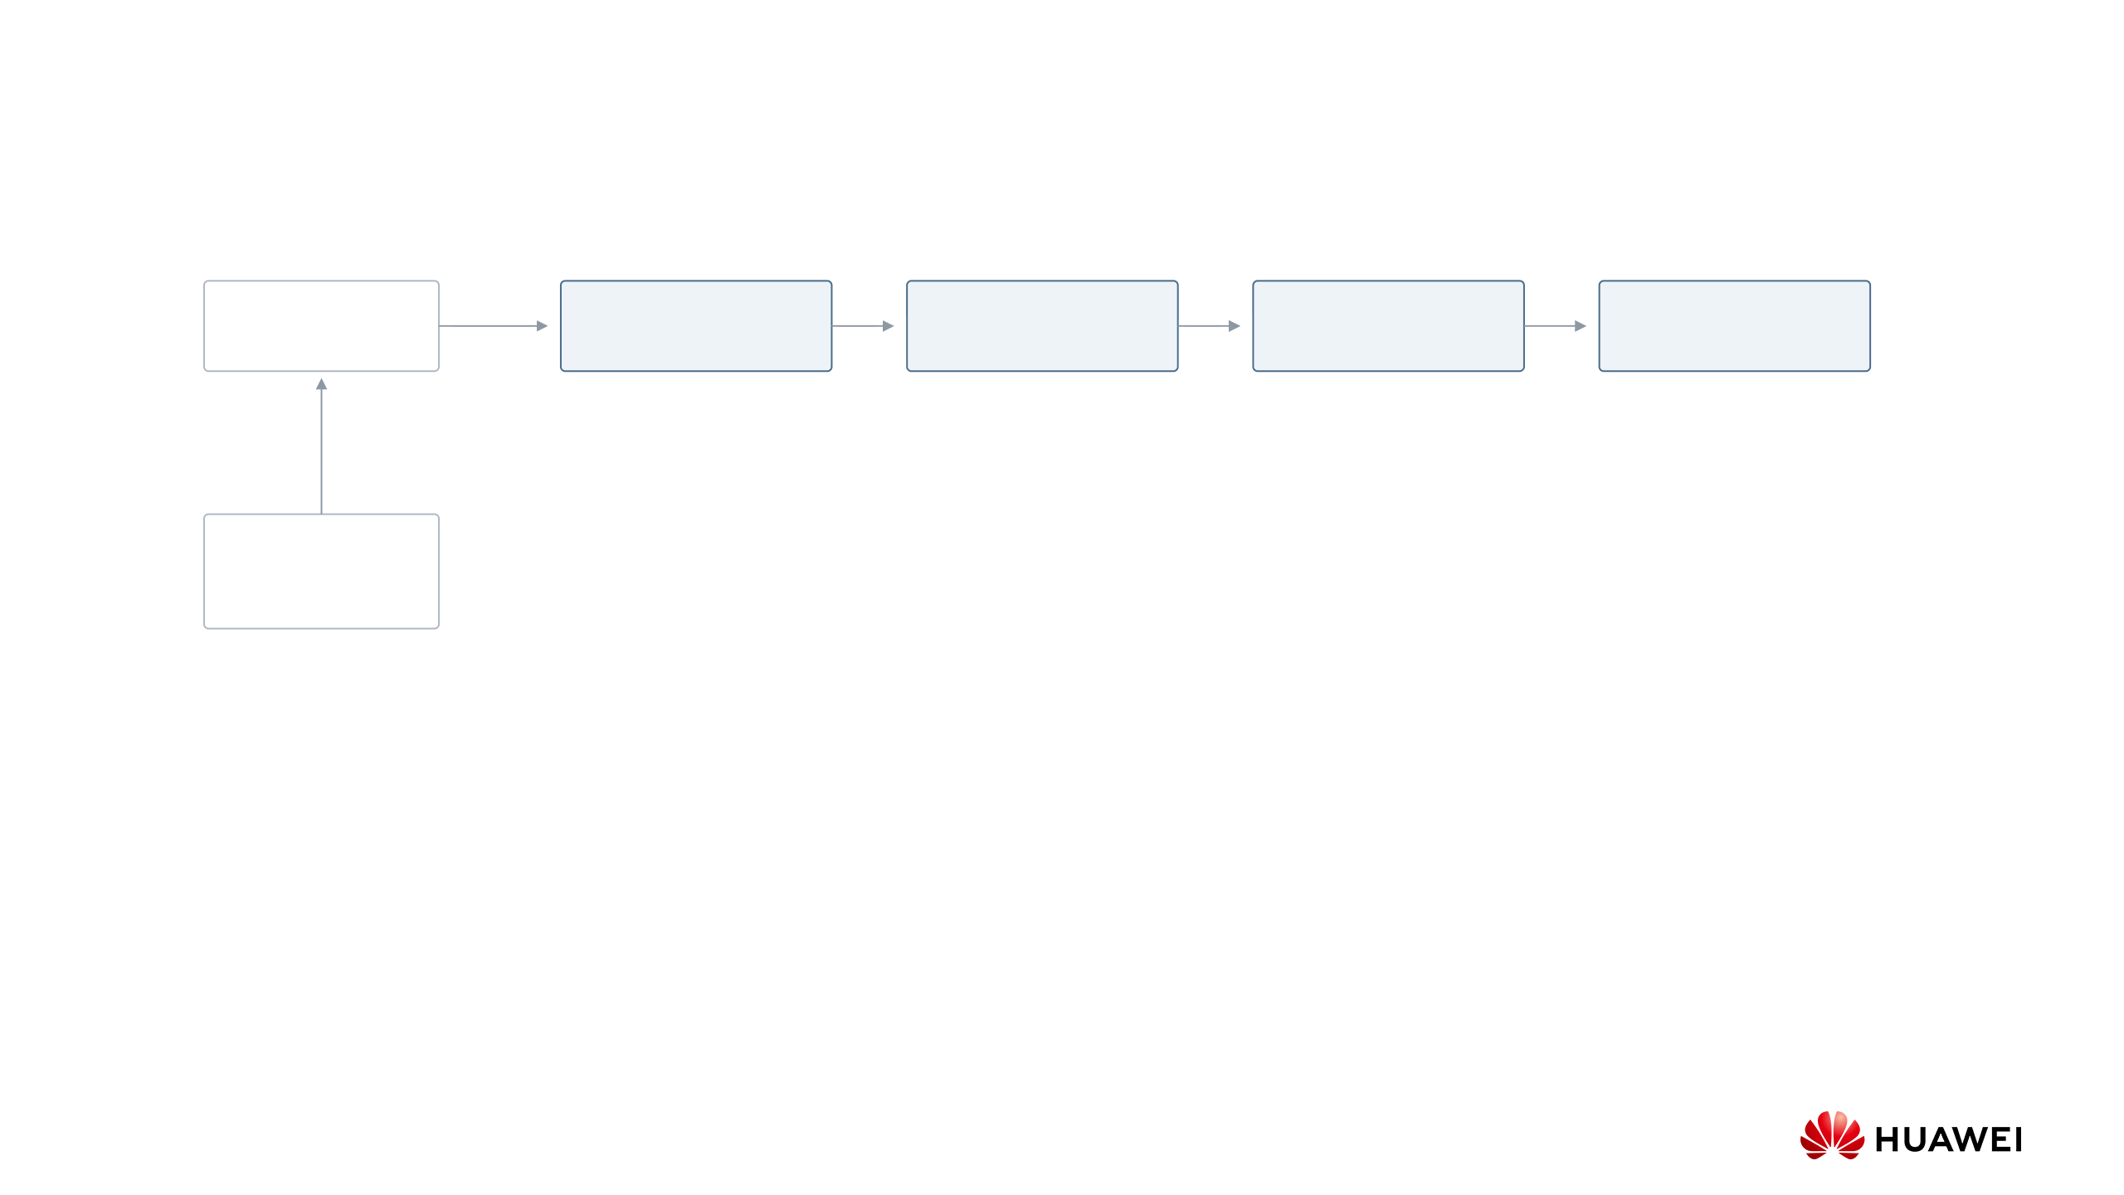
Technical Solution: Hierarchical Discovery Pipeline
Each new plan sees earlier plans to encourage a different approach
Parent p
Strategy 1
Strategy 2
Strategy 3
Strategy 4
One of P parents
Plan for parent p
Plan for parent p
Plan for parent p
Plan for parent p
Archive
Scores + ancestry
Strategist: frozen planning LLM. Coder: shared LLM trained on all evaluated programs.
Huawei Confidential
Secret Level:
Page 7
Notes:
Technical Solution: Hierarchical Discovery Pipeline
Source: supplied presentation, Page 7. The proposed hierarchy separates two roles: the strategist is a frozen planning LLM, and the coder is a trainable program-generating LLM. Archive states include programs, constructions, scores, and lineage. The parent selector picks P states. A frozen strategist generates S sequential, distinct plans for each parent. Each coder prompt receives only its own parent and one extracted plan, not the other strategies or hidden strategist reasoning. Equal pilots precede bandit allocation of each parent's fixed remaining budget. Top-r per strategy then top-K per parent feed the archive. Pilot and phase-2 programs train the coder. The coder may correct scientific or interface errors in a strategy. Animation illustrates dependencies, not measured timings.

Slide 9
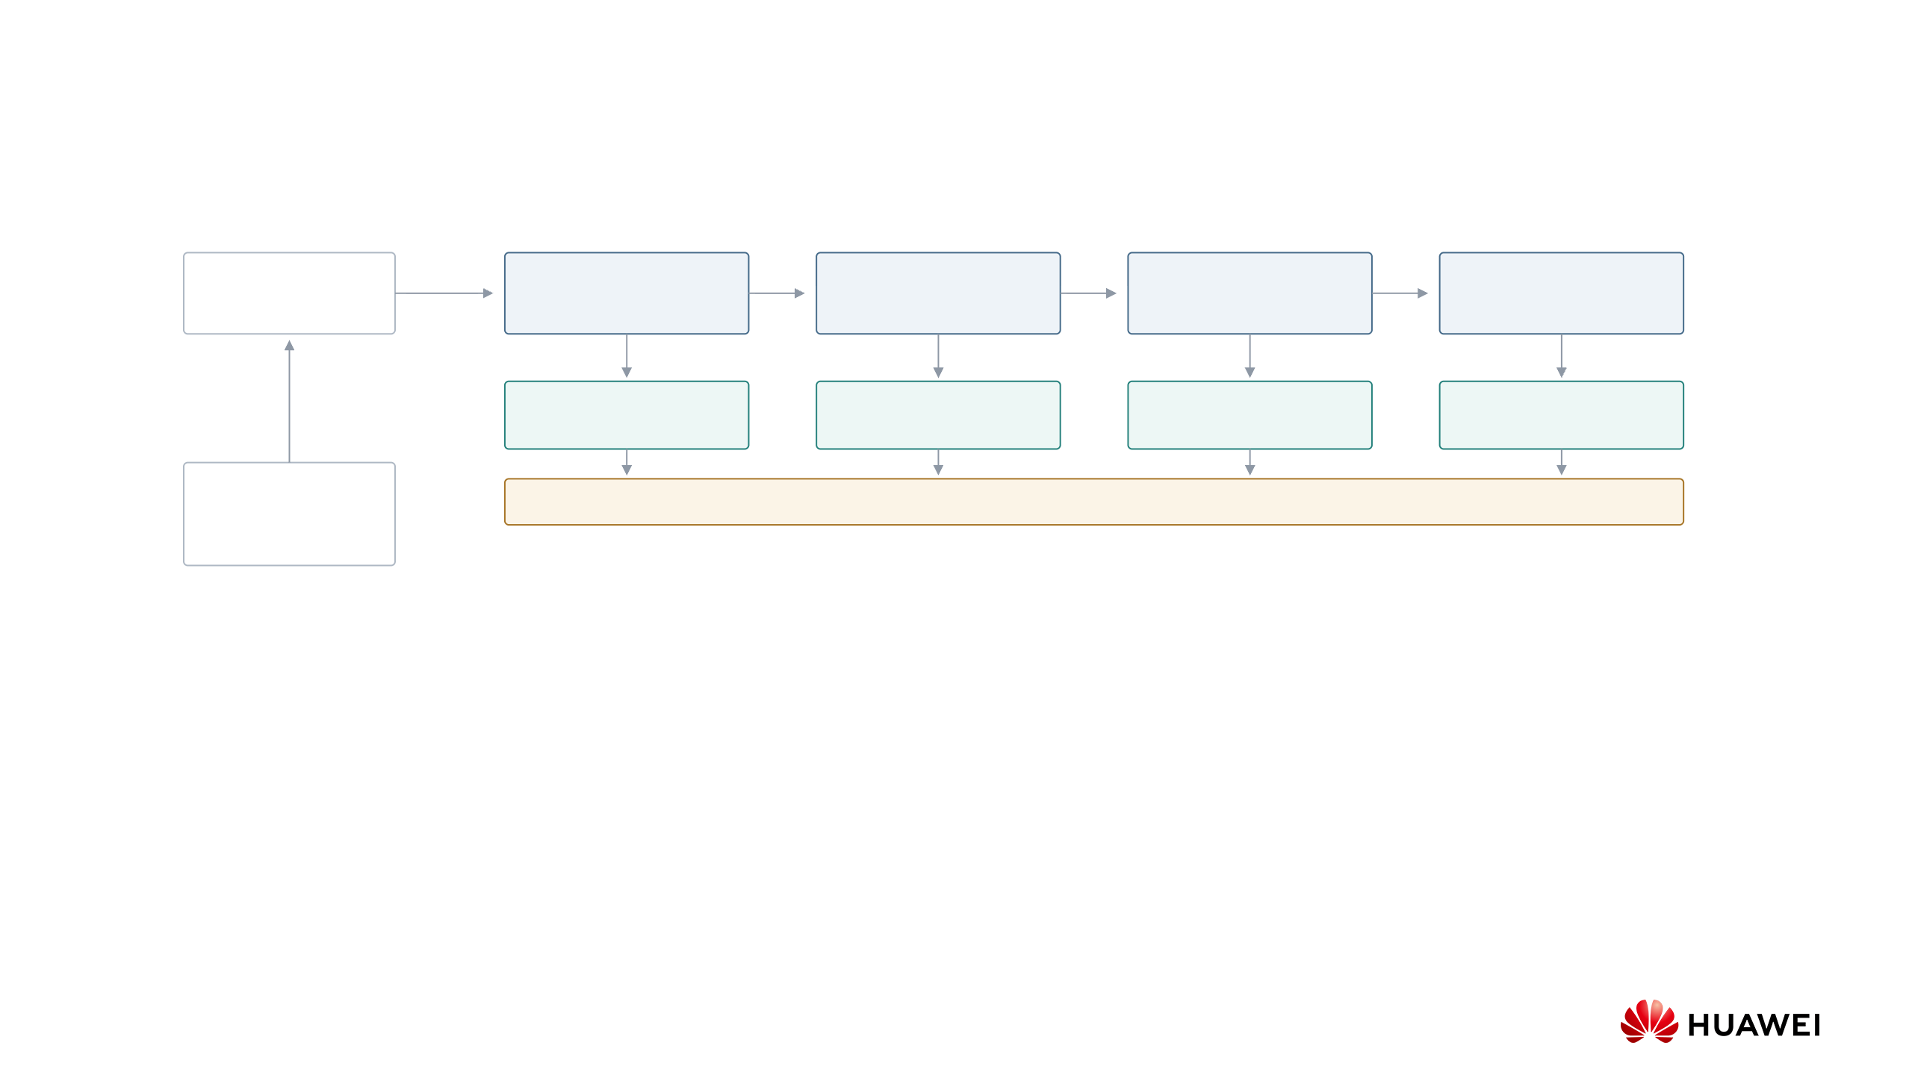
Technical Solution: Hierarchical Discovery Pipeline
Each new plan sees earlier plans to encourage a different approach
Parent p
Strategy 1
Strategy 2
Strategy 3
Strategy 4
One of P parents
Plan for parent p
Plan for parent p
Plan for parent p
Plan for parent p
H pilot programs
H pilot programs
H pilot programs
H pilot programs
Archive
CPU evaluation streams results as programs arrive
Scores + ancestry
Strategist: frozen planning LLM. Coder: shared LLM trained on all evaluated programs.
Huawei Confidential
Secret Level:
Page 7
Notes:
Technical Solution: Hierarchical Discovery Pipeline
Source: supplied presentation, Page 7. The proposed hierarchy separates two roles: the strategist is a frozen planning LLM, and the coder is a trainable program-generating LLM. Archive states include programs, constructions, scores, and lineage. The parent selector picks P states. A frozen strategist generates S sequential, distinct plans for each parent. Each coder prompt receives only its own parent and one extracted plan, not the other strategies or hidden strategist reasoning. Equal pilots precede bandit allocation of each parent's fixed remaining budget. Top-r per strategy then top-K per parent feed the archive. Pilot and phase-2 programs train the coder. The coder may correct scientific or interface errors in a strategy. Animation illustrates dependencies, not measured timings.

Slide 10
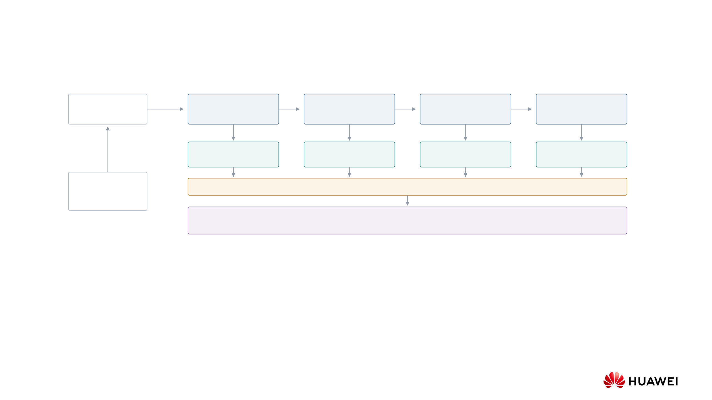
Technical Solution: Hierarchical Discovery Pipeline
Each new plan sees earlier plans to encourage a different approach
Parent p
Strategy 1
Strategy 2
Strategy 3
Strategy 4
One of P parents
Plan for parent p
Plan for parent p
Plan for parent p
Plan for parent p
H pilot programs
H pilot programs
H pilot programs
H pilot programs
Archive
CPU evaluation streams results as programs arrive
Scores + ancestry
Parent-relative hurdle bandit
Use pilot outcomes to allocate B follow-up programs
Strategist: frozen planning LLM. Coder: shared LLM trained on all evaluated programs.
Huawei Confidential
Secret Level:
Page 7
Notes:
Technical Solution: Hierarchical Discovery Pipeline
Source: supplied presentation, Page 7. The proposed hierarchy separates two roles: the strategist is a frozen planning LLM, and the coder is a trainable program-generating LLM. Archive states include programs, constructions, scores, and lineage. The parent selector picks P states. A frozen strategist generates S sequential, distinct plans for each parent. Each coder prompt receives only its own parent and one extracted plan, not the other strategies or hidden strategist reasoning. Equal pilots precede bandit allocation of each parent's fixed remaining budget. Top-r per strategy then top-K per parent feed the archive. Pilot and phase-2 programs train the coder. The coder may correct scientific or interface errors in a strategy. Animation illustrates dependencies, not measured timings.

Slide 11
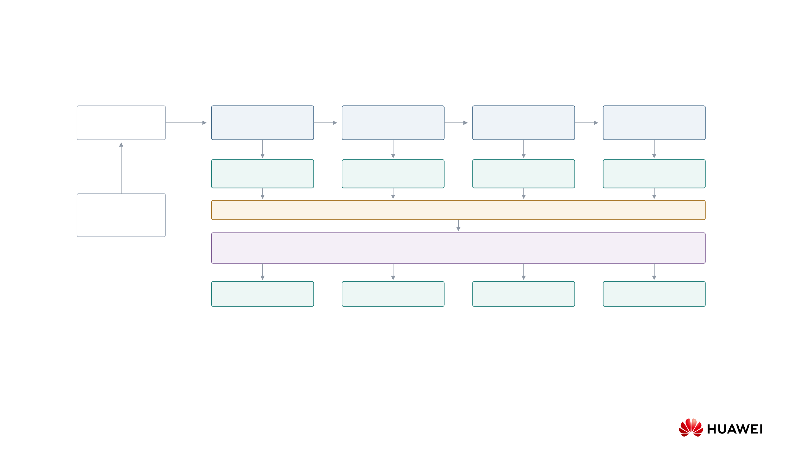
Technical Solution: Hierarchical Discovery Pipeline
Each new plan sees earlier plans to encourage a different approach
Parent p
Strategy 1
Strategy 2
Strategy 3
Strategy 4
One of P parents
Plan for parent p
Plan for parent p
Plan for parent p
Plan for parent p
H pilot programs
H pilot programs
H pilot programs
H pilot programs
Archive
CPU evaluation streams results as programs arrive
Scores + ancestry
Parent-relative hurdle bandit
Use pilot outcomes to allocate B follow-up programs
a₁ new programs
a₂ new programs
a₃ new programs
a₄ new programs
Strategist: frozen planning LLM. Coder: shared LLM trained on all evaluated programs.
Huawei Confidential
Secret Level:
Page 7
Notes:
Technical Solution: Hierarchical Discovery Pipeline
Source: supplied presentation, Page 7. The proposed hierarchy separates two roles: the strategist is a frozen planning LLM, and the coder is a trainable program-generating LLM. Archive states include programs, constructions, scores, and lineage. The parent selector picks P states. A frozen strategist generates S sequential, distinct plans for each parent. Each coder prompt receives only its own parent and one extracted plan, not the other strategies or hidden strategist reasoning. Equal pilots precede bandit allocation of each parent's fixed remaining budget. Top-r per strategy then top-K per parent feed the archive. Pilot and phase-2 programs train the coder. The coder may correct scientific or interface errors in a strategy. Animation illustrates dependencies, not measured timings.

Slide 12
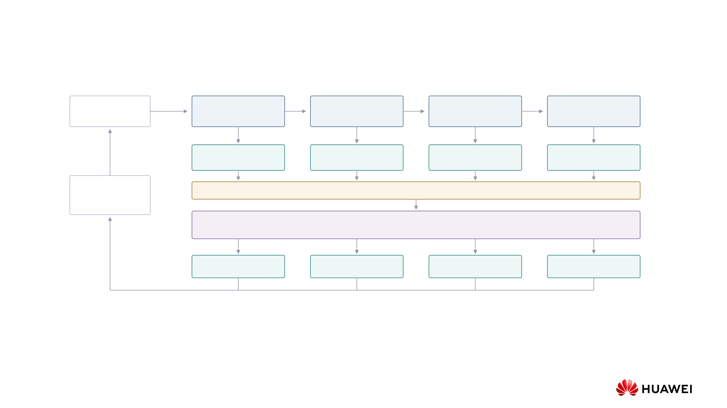
Technical Solution: Hierarchical Discovery Pipeline
Each new plan sees earlier plans to encourage a different approach
Parent p
Strategy 1
Strategy 2
Strategy 3
Strategy 4
One of P parents
Plan for parent p
Plan for parent p
Plan for parent p
Plan for parent p
H pilot programs
H pilot programs
H pilot programs
H pilot programs
Archive
CPU evaluation streams results as programs arrive
Scores + ancestry
Update
Parent-relative hurdle bandit
Use pilot outcomes to allocate B follow-up programs
a₁ new programs
a₂ new programs
a₃ new programs
a₄ new programs
Evaluate follow-ups and retain top candidates per strategy, then per parent
Strategist: frozen planning LLM. Coder: shared LLM trained on all evaluated programs.
Huawei Confidential
Secret Level:
Page 7
Notes:
Technical Solution: Hierarchical Discovery Pipeline
Source: supplied presentation, Page 7. The proposed hierarchy separates two roles: the strategist is a frozen planning LLM, and the coder is a trainable program-generating LLM. Archive states include programs, constructions, scores, and lineage. The parent selector picks P states. A frozen strategist generates S sequential, distinct plans for each parent. Each coder prompt receives only its own parent and one extracted plan, not the other strategies or hidden strategist reasoning. Equal pilots precede bandit allocation of each parent's fixed remaining budget. Top-r per strategy then top-K per parent feed the archive. Pilot and phase-2 programs train the coder. The coder may correct scientific or interface errors in a strategy. Animation illustrates dependencies, not measured timings.

Slide 13
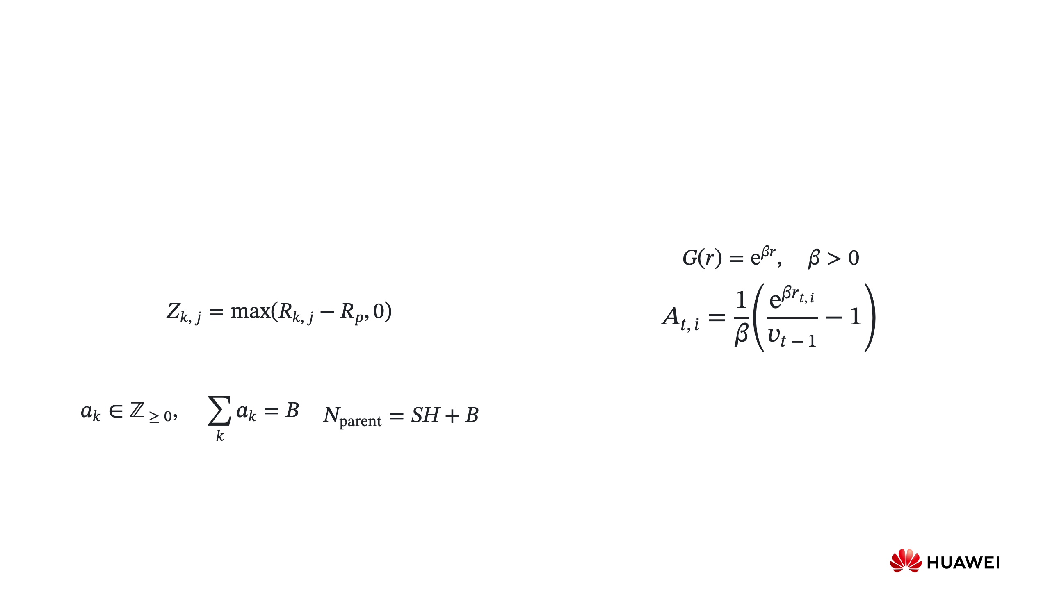
Technical Solution: Allocation and Policy Training
Parent-relative bandit allocation
Historical-baseline training (SPO²)
•
Generate H pilot programs for each of S strategies.
•
Higher rewards receive exponentially larger weights.
•
Estimate each plan’s chance of improving on its parent and
•
Compute every advantage against the same moving
the size of successful gains.
average of earlier transformed rewards.
•
Allocate B follow-ups by their expected effect on the best
sampled reward, accounting for uncertainty.
R
k,j
: reward of pilot j for strategy k. R
: parent reward.
p
Z
: improvement over the parent, set to zero for invalid outputs.
k,j
v
: moving average of earlier G(r). β: strength of reward shaping.
t−1
r
: reward. A
: training weight for rollout i at step t.
t,i
t,i
Positive A reinforces a program. Negative A discourages it. A tied group
can still receive a nonzero weight relative to earlier rewards. Hold β and
a
: follow-ups for strategy k.
k
the baseline fixed within the step, then update the baseline.
N
parent
: total planned programs for that parent.
R and r denote larger-is-better training rewards. Scientific plots show the raw task score, minimized for the Erdős problem.
Huawei Confidential
Secret Level:
Page 8
Notes:
Technical Solution: Allocation and Policy Training
Source: supplied presentation, Page 8. H is pilot count per strategy, S strategy count, B the parent's fixed follow-up budget, and a_k integer follow-up allocations. The hurdle model uses strict parent-relative improvement and conditional positive gain. Invalid candidates are zero gain. Expected-best allocation targets the upper tail, not the mean. Fixed-beta SPO² uses transformed rewards and a shared historical moving reference with policy-adaptive retention. A common baseline can assign nonzero advantages to a tied group relative to history but cannot rank identical rewards within that group. Policy parameters remain fixed until accumulated gradients and required evaluation results are ready.

Slide 14

Observed Allocation: Equal Pilots, Targeted Follow-ups
One parent has a budget of 64 programs. Generate 11 pilots for each of four strategies, then use their results to
allocate the remaining 20 programs.
Strategy
Equal pilot budgets
Expected-best allocation
Allocated follow-ups
Strategy 1
11
Strategy 2
11
Strategy 3
11
Strategy 4
11
44 initial programs
Erdős minimum-overlap task. C₅ is the evaluated bound, lower is better.
Huawei Confidential
Secret Level:
Page 9
Notes:
Observed Allocation: Equal Pilots, Targeted Follow-ups
Source: runs/erdos_Qwen3.8-27B_1013-0544/step00/step00.summary.json, strategy_pilot_allocation, parent_group=7. Strategies are numbered 1–4 on the slide and indexed 0–3 in the source. Pilot counts are [11,11,11,11], follow-up counts [0,0,17,3], total programs 64. Best pilot C5 is 0.38115914452013333. The best subsequent saved outcome is 0.3809799144362922. The recorded hurdle probabilities and positive-gain summaries remain embedded in evidence.json. The allocator uses the full posterior expected-best gain, rather than just improvement probability or mean gain. This is an actual budget decision and observed outcome, not a counterfactual comparison against uniform allocation. No probabilities are recomputed from final outcomes.

Slide 15

Observed Allocation: Equal Pilots, Targeted Follow-ups
One parent has a budget of 64 programs. Generate 11 pilots for each of four strategies, then use their results to
allocate the remaining 20 programs.
Strategy
Equal pilot budgets
Expected-best allocation
Allocated follow-ups
Strategy 1
11
Strategy 2
11
Strategy 3
11
Strategy 4
11
44 initial programs
Erdős minimum-overlap task. C₅ is the evaluated bound, lower is better.
Huawei Confidential
Secret Level:
Page 9
Notes:
Observed Allocation: Equal Pilots, Targeted Follow-ups
Source: runs/erdos_Qwen3.8-27B_1013-0544/step00/step00.summary.json, strategy_pilot_allocation, parent_group=7. Strategies are numbered 1–4 on the slide and indexed 0–3 in the source. Pilot counts are [11,11,11,11], follow-up counts [0,0,17,3], total programs 64. Best pilot C5 is 0.38115914452013333. The best subsequent saved outcome is 0.3809799144362922. The recorded hurdle probabilities and positive-gain summaries remain embedded in evidence.json. The allocator uses the full posterior expected-best gain, rather than just improvement probability or mean gain. This is an actual budget decision and observed outcome, not a counterfactual comparison against uniform allocation. No probabilities are recomputed from final outcomes.

Slide 16

Observed Allocation: Equal Pilots, Targeted Follow-ups
One parent has a budget of 64 programs. Generate 11 pilots for each of four strategies, then use their results to
allocate the remaining 20 programs.
Strategy
Equal pilot budgets
Expected-best allocation
Allocated follow-ups
Strategy 1
11
0
Strategy 2
11
0
Strategy 3
11
17
Strategy 4
11
3
44 initial programs
20 additional programs
Erdős minimum-overlap task. C₅ is the evaluated bound, lower is better.
Huawei Confidential
Secret Level:
Page 9
Notes:
Observed Allocation: Equal Pilots, Targeted Follow-ups
Source: runs/erdos_Qwen3.8-27B_1013-0544/step00/step00.summary.json, strategy_pilot_allocation, parent_group=7. Strategies are numbered 1–4 on the slide and indexed 0–3 in the source. Pilot counts are [11,11,11,11], follow-up counts [0,0,17,3], total programs 64. Best pilot C5 is 0.38115914452013333. The best subsequent saved outcome is 0.3809799144362922. The recorded hurdle probabilities and positive-gain summaries remain embedded in evidence.json. The allocator uses the full posterior expected-best gain, rather than just improvement probability or mean gain. This is an actual budget decision and observed outcome, not a counterfactual comparison against uniform allocation. No probabilities are recomputed from final outcomes.

Slide 17
Observed Allocation: Equal Pilots, Targeted Follow-ups
One parent has a budget of 64 programs. Generate 11 pilots for each of four strategies, then use their results to
allocate the remaining 20 programs.
Strategy
Equal pilot budgets
Expected-best allocation
Allocated follow-ups
Strategy 1
11
0
Strategy 2
11
0
Strategy 3
11
17
Strategy 4
11
3
44 initial programs
20 additional programs
Best C₅: pilots
0.381159145
→
0.380979914
After follow-ups
Erdős minimum-overlap task. C₅ is the evaluated bound, lower is better.
Huawei Confidential
Secret Level:
Page 9
Notes:
Observed Allocation: Equal Pilots, Targeted Follow-ups
Source: runs/erdos_Qwen3.8-27B_1013-0544/step00/step00.summary.json, strategy_pilot_allocation, parent_group=7. Strategies are numbered 1–4 on the slide and indexed 0–3 in the source. Pilot counts are [11,11,11,11], follow-up counts [0,0,17,3], total programs 64. Best pilot C5 is 0.38115914452013333. The best subsequent saved outcome is 0.3809799144362922. The recorded hurdle probabilities and positive-gain summaries remain embedded in evidence.json. The allocator uses the full posterior expected-best gain, rather than just improvement probability or mean gain. This is an actual budget decision and observed outcome, not a counterfactual comparison against uniform allocation. No probabilities are recomputed from final outcomes.

Slide 18

Technical Solution: Dependency-Aware Execution
(a) Sequential execution
Each stage waits for the previous stage
Strategist
Plans
Coder
Pilot programs
Follow-up programs
CPU evaluation
Evaluate pilots
Evaluate outputs
Allocation
Allocate
Trainer
Scoring / backward
Update
(b) Dependency-aware execution
Follow-ups start once a parent’s pilot results are complete
Strategist
Coder
CPU evaluation
Allocation
Trainer
Evaluate programs as they arrive. Once generation ends, train on evaluated programs while CPU evaluation continues. Keep
parameters fixed until the step’s final optimizer update.
Huawei Confidential
Secret Level:
Page 10
Notes:
Technical Solution: Dependency-Aware Execution
Sources: supplied presentation, Page 9, and pipeline_implementation.tex. Completed programs enter CPU evaluation as generation continues. Phase 2 may start when an individual parent's pilot evaluations are ready. In the shared-GPU layout, training begins after generation and required policy scoring, while remaining CPU evaluations continue. Reward-ready backward work can proceed without waiting for unrelated pending evaluations. Parameters are not updated during rollout generation or partial gradient accumulation. One optimizer update follows all required gradients. The historical normalization is frozen for the step. The bar lengths are schematic and do not establish measured speedup or continuous 100% GPU utilization.

Slide 19

Technical Solution: Dependency-Aware Execution
(a) Sequential execution
Each stage waits for the previous stage
Strategist
Plans
Coder
Pilot programs
Follow-up programs
CPU evaluation
Evaluate pilots
Evaluate outputs
Allocation
Allocate
Trainer
Scoring / backward
Update
(b) Dependency-aware execution
Follow-ups start once a parent’s pilot results are complete
Strategist
Plans
Coder
Pilot programs
CPU evaluation
Evaluate pilots
Allocation
Trainer
Evaluate programs as they arrive. Once generation ends, train on evaluated programs while CPU evaluation continues. Keep
parameters fixed until the step’s final optimizer update.
Huawei Confidential
Secret Level:
Page 10
Notes:
Technical Solution: Dependency-Aware Execution
Sources: supplied presentation, Page 9, and pipeline_implementation.tex. Completed programs enter CPU evaluation as generation continues. Phase 2 may start when an individual parent's pilot evaluations are ready. In the shared-GPU layout, training begins after generation and required policy scoring, while remaining CPU evaluations continue. Reward-ready backward work can proceed without waiting for unrelated pending evaluations. Parameters are not updated during rollout generation or partial gradient accumulation. One optimizer update follows all required gradients. The historical normalization is frozen for the step. The bar lengths are schematic and do not establish measured speedup or continuous 100% GPU utilization.

Slide 20
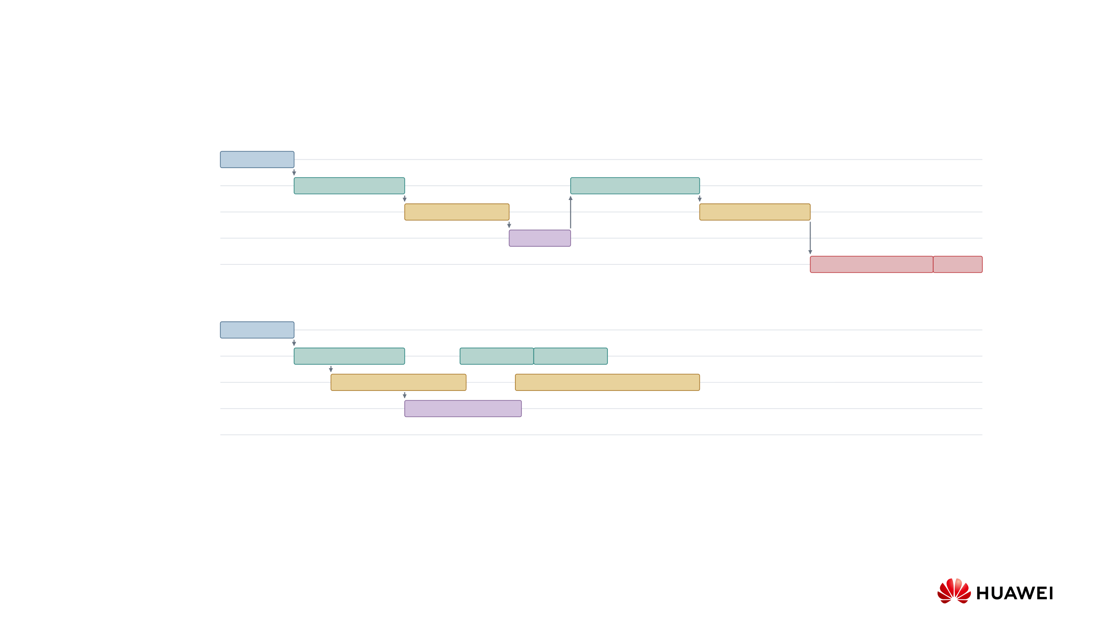
Technical Solution: Dependency-Aware Execution
(a) Sequential execution
Each stage waits for the previous stage
Strategist
Plans
Coder
Pilot programs
Follow-up programs
CPU evaluation
Evaluate pilots
Evaluate outputs
Allocation
Allocate
Trainer
Scoring / backward
Update
(b) Dependency-aware execution
Follow-ups start once a parent’s pilot results are complete
Strategist
Plans
Follow-ups start per ready parent
Coder
Pilot programs
Parent a
Parent b
CPU evaluation
Evaluate pilots
Evaluate follow-ups
Allocation
Allocate per parent
Trainer
Evaluate programs as they arrive. Once generation ends, train on evaluated programs while CPU evaluation continues. Keep
parameters fixed until the step’s final optimizer update.
Huawei Confidential
Secret Level:
Page 10
Notes:
Technical Solution: Dependency-Aware Execution
Sources: supplied presentation, Page 9, and pipeline_implementation.tex. Completed programs enter CPU evaluation as generation continues. Phase 2 may start when an individual parent's pilot evaluations are ready. In the shared-GPU layout, training begins after generation and required policy scoring, while remaining CPU evaluations continue. Reward-ready backward work can proceed without waiting for unrelated pending evaluations. Parameters are not updated during rollout generation or partial gradient accumulation. One optimizer update follows all required gradients. The historical normalization is frozen for the step. The bar lengths are schematic and do not establish measured speedup or continuous 100% GPU utilization.

Slide 21
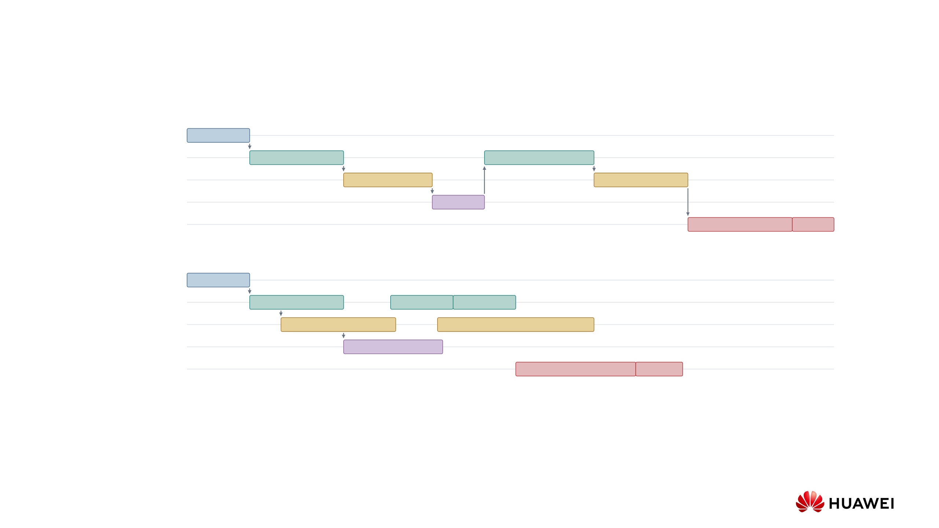
Technical Solution: Dependency-Aware Execution
(a) Sequential execution
Each stage waits for the previous stage
Strategist
Plans
Coder
Pilot programs
Follow-up programs
CPU evaluation
Evaluate pilots
Evaluate outputs
Allocation
Allocate
Trainer
Scoring / backward
Update
(b) Dependency-aware execution
Follow-ups start once a parent’s pilot results are complete
Strategist
Plans
Follow-ups start per ready parent
Coder
Pilot programs
Parent a
Parent b
CPU evaluation
Evaluate pilots
Evaluate follow-ups
Allocation
Allocate per parent
Training overlaps remaining evaluations
Trainer
Scoring / backward
Update
Step complete
Evaluate programs as they arrive. Once generation ends, train on evaluated programs while CPU evaluation continues. Keep
parameters fixed until the step’s final optimizer update.
Huawei Confidential
Secret Level:
Page 10
Notes:
Technical Solution: Dependency-Aware Execution
Sources: supplied presentation, Page 9, and pipeline_implementation.tex. Completed programs enter CPU evaluation as generation continues. Phase 2 may start when an individual parent's pilot evaluations are ready. In the shared-GPU layout, training begins after generation and required policy scoring, while remaining CPU evaluations continue. Reward-ready backward work can proceed without waiting for unrelated pending evaluations. Parameters are not updated during rollout generation or partial gradient accumulation. One optimizer update follows all required gradients. The historical normalization is frozen for the step. The bar lengths are schematic and do not establish measured speedup or continuous 100% GPU utilization.

Slide 22
Distinguishing Features of the Idea
•
Separate planning from learning: the strategist proposes plans with fixed weights. Only the shared coder learns
from evaluated programs.
•
Compare each plan with its parent: estimate both improvement probability and gain size, so rare large gains
enter the allocation decision.
•
Allocate after observing the pilots: use their results to choose follow-up counts while keeping the total program
budget fixed.
•
Use one historical baseline across groups: compare outputs with earlier rewards. Larger policy changes reduce
the weight of older rewards.
•
Account for related archive states: update ancestor expansion counts and avoid selecting a solution with its own
descendant in the same batch.
•
Overlap work without changing the policy: train on evaluated outputs while other evaluations continue, then
apply one final update.
Huawei Confidential
Secret Level:
Page 11
Notes:
Distinguishing Features of the Idea
Source: supplied presentation, Page 10. Lineage is the recorded parent–child ancestry. PUCT combines best-child reward, archive priors, and expansion counts for parent selection. The hierarchy, allocator, training reference, archive controls, and execution dependencies form the technical disclosure. Internal records can show which mechanisms a system implements. Legal novelty and claim scope require a separate closest-reference assessment.

Slide 23
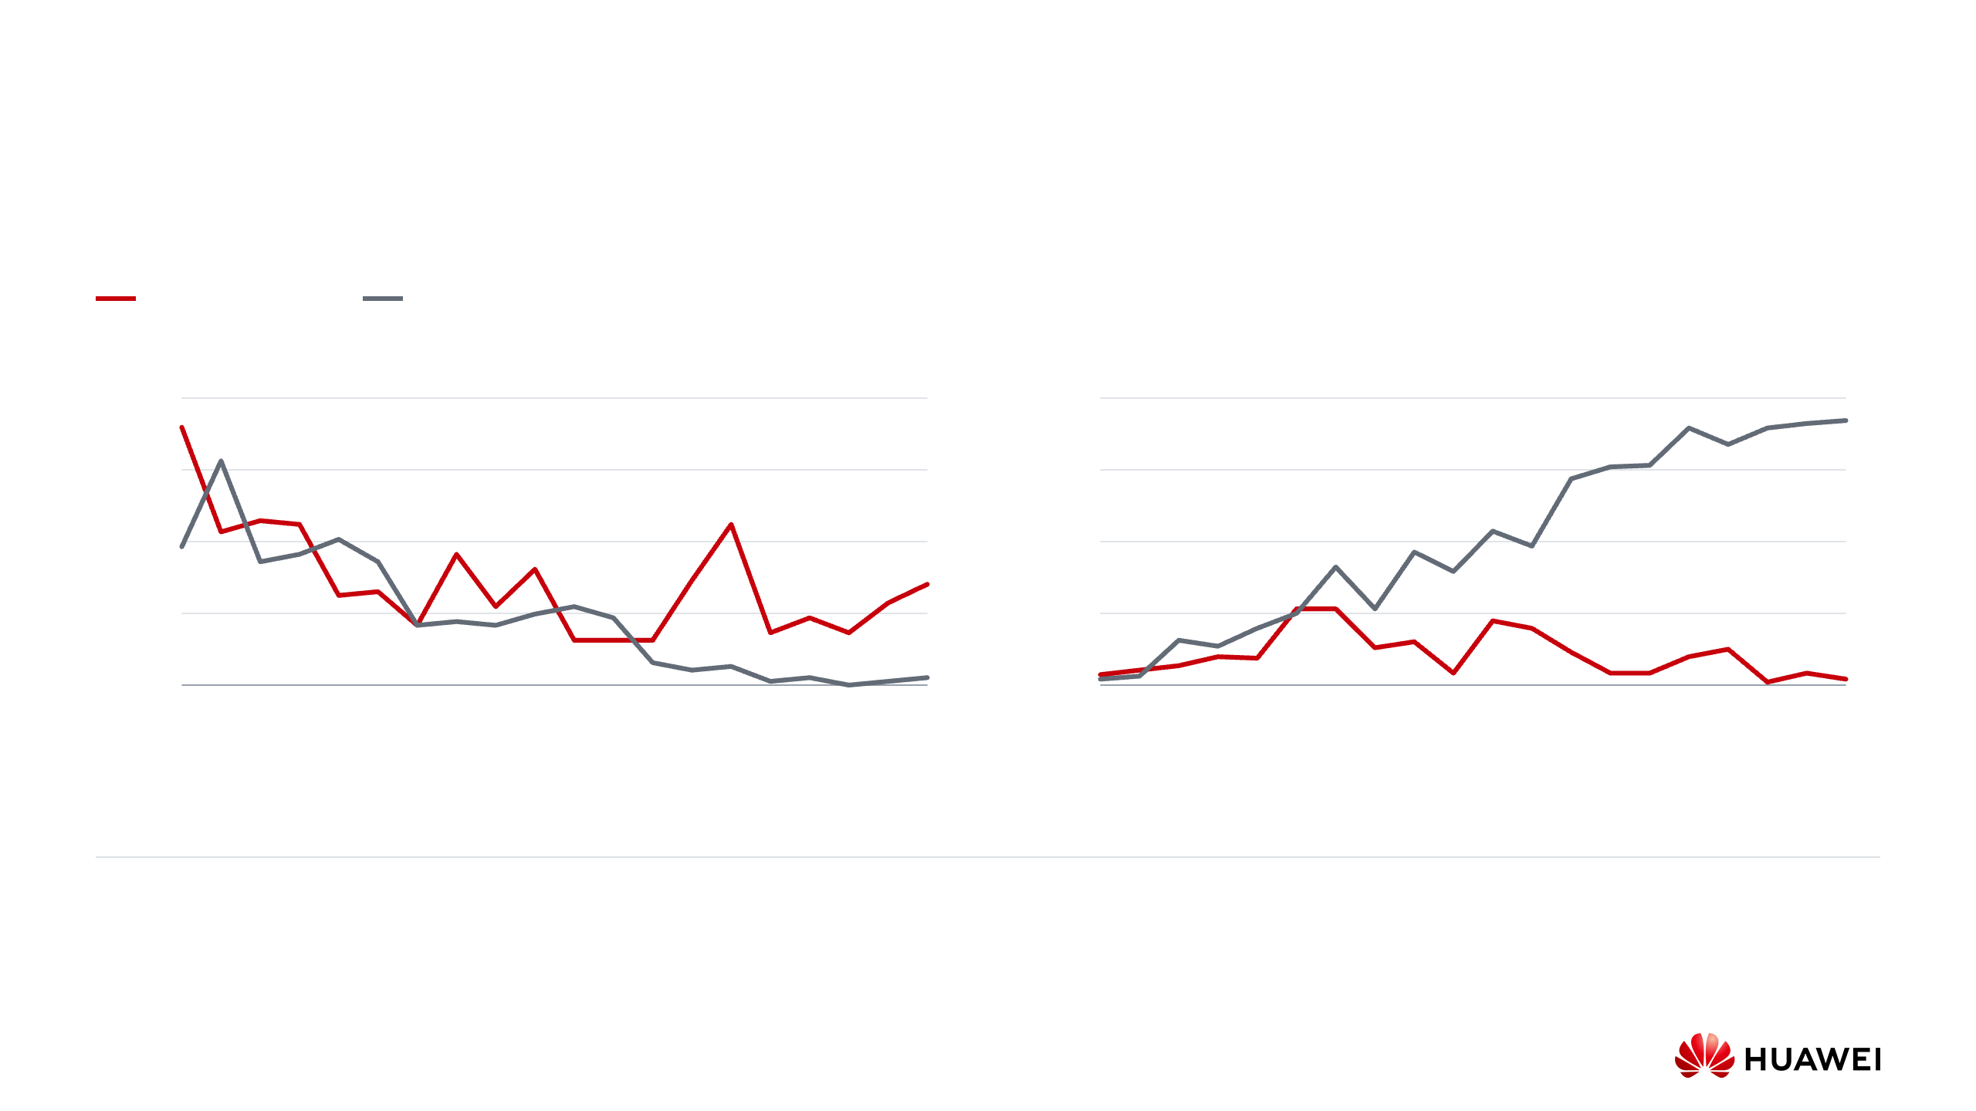
Advantageous Effects: Construction-Level Exploration
Erdős task: train a Qwen3-8B coder on task + parent context, with or without an added frozen-strategist plan.
With strategist
Without strategist
192 coder attempts per step in both runs
Distinct non-parent outputs (%)
Parent-copy rate (%)
40
100
92.2%
30
75
20
14.1%
50
10
25
1.0%
2.1%
0
0
0
4
8
12
16
19
0
4
8
12
16
19
Training step
Training step
Left: unique valid constructions different from every selected parent,
Right: valid constructions equivalent to any selected parent, including
counted once per step.
repeated copies.
Strategy conditioning sustains distinct outputs late in training. Direct generation mostly copies parents.
Huawei Confidential
Secret Level:
Page 12
Notes:
Advantageous Effects: Construction-Level Exploration
Sources: output/pdf/strategy_exploration_comparison.json and the supplied behavioral-ablation figure. Shared horizon is steps 0–19, with 192 coder attempts per step in each run. With strategist: erdos_Qwen3-8B_1007-2324. Without strategist: erdos_Qwen3-8B_1008-0537. Distinct valid non-parent constructions are deduplicated within each step and compared against every selected parent. Parent copies count repeated valid outputs. Equivalence compares normalized piecewise-constant functions on the exact union grid, modulo reflection/complement, tolerance 1e-8. All attempts, including invalid outputs and retries, form the denominator. At step 19, parent-copy percentages are 2.0833 and 92.1875, distinct percentages 14.0625 and 1.0417. One saved run per condition; no equal-compute causal claim or token-entropy conclusion.

Slide 24

Experiments: Coder Learning and Reward Design
These runs compare binary success and score-based rewards, and group-relative and historical-baseline training.
Coder learning with a frozen strategist
Direct Qwen3-8B coder
R1-Distill-Qwen-32B strategist
No strategist
Qwen3-Coder-30B-A3B-Instruct coder, no bandit
Compare group-relative and historical-baseline learning
Coder update
Programs
Reward > 0
Best C₅ ↓
Coder update
Programs
Reward > 0
Best C₅ ↓
RL off
4.2k
70.38%
0.381009
Entropic-GRPO
12.2k
85.23%
0.380988
Binary-PPO
2.3k
68.61%
0.381086
SPO²
4.6k
78.39%
0.380980
SPO²
4.8k
63.74%
0.380971
Why a historical baseline
Why score-based rewards
When all rewards within a group are equal, group-relative
advantages are zero. A historical baseline can still assign a
Two valid programs can return different C₅ bounds. Binary
nonzero advantage relative to past rewards.
success gives them the same reward. A score-based reward
retains this difference.
Huawei Confidential
Secret Level:
Page 13
Notes:
Experiments: Coder Learning and Reward Design
Source: /Users/mohammad/Downloads/Copy of report.pdf, pages 6 and 12. The report's later table names the historical risk-sensitive SPO variant SPO²; this deck uses that requested naming consistently. Frozen R1-Distill-Qwen-32B with Qwen3-Coder-30B-A3B-Instruct: RL off, 4.2k programs, reward-positive 70.38%, best C5 0.381009; binary-PPO, 2.3k, 68.61%, 0.381086; SPO², 4.8k, 63.74%, 0.380971. Direct Qwen3-8B: entropic-GRPO, 12.2k, 85.23%, 0.380988; SPO², 4.6k, 78.39%, 0.380980. These are rounded report snapshots, not recomputed final totals. Configurations in runs/erdos-old confirm frozen planner, no_train, binary_coder_training and advantage_mode distinctions. Budgets, search histories and other settings are not fully controlled. The tied-group rationale is a property of the normalization, not a measured isolated cause of the reported score gap. No claim that training the strategist would perform worse is made.

Slide 25

Experiments: Planning and Coding Models
A higher reward-positive rate did not necessarily correspond to a lower C₅ bound.
Same Qwen3-8B coder and entropic-GRPO, different frozen strategists
Frozen strategist
Programs
Reward > 0
Best C₅ ↓
Qwen3-8B
6.6k
64.02%
0.381022
R1-Distill-Qwen-32B
3.1k
43.45%
0.380919
The R1 planner run reached a lower C₅ bound despite a lower positive-reward rate.
Same R1-Distill-Qwen-32B strategist, different coder configurations
Coder and update
Programs
Reward > 0
Best C₅ ↓
Qwen3-Coder-30B (SPO²)
4.8k
63.74%
0.380971
Qwen3-8B (Entropic-GRPO)
3.1k
43.45%
0.380919
The Qwen3-8B run reached a lower bound than the Qwen3-Coder-30B run, but its RL objective also differed.
Huawei Confidential
Secret Level:
Page 14
Notes:
Experiments: Planning and Coding Models
Source: /Users/mohammad/Downloads/Copy of report.pdf, pages 7, 8 and 12. Planner comparison with Qwen3-8B coder and entropic-GRPO, without bandit: Qwen3-8B strategist, 6.6k programs, reward-positive 64.02%, C5 0.381022; R1-Distill-Qwen-32B strategist, 3.1k, 43.45%, 0.380919. Coder comparison with the same R1-Distill-Qwen-32B planner: Qwen3-Coder-30B-A3B-Instruct and SPO², 4.8k, 63.74%, 0.380971; Qwen3-8B and entropic-GRPO, 3.1k, 43.45%, 0.380919. Reports use Qwen3-Coder-30B-Instruct as a shortened model name. Run configurations identify the full A3B-Instruct name. These observations motivate evaluating the planner and coder separately, but do not establish a general scaling law, a matched-compute planner effect, or superiority of one coder size. Reward-positive rate is the report's recorded metric, not a measure of novelty or entropy.

Slide 26
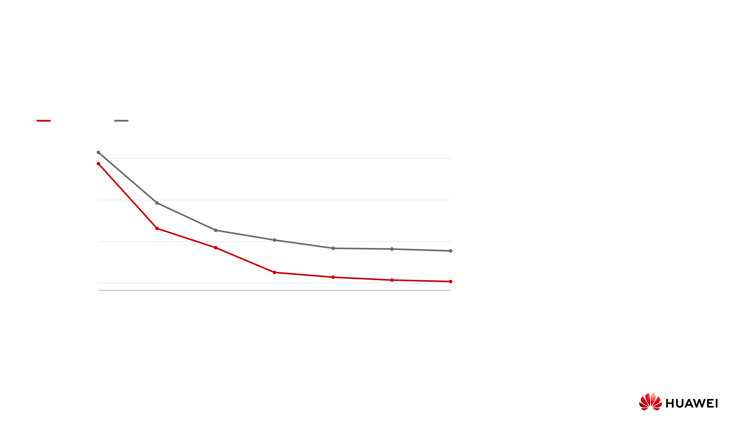
Experiments: Two Runs of the Full Pipeline
Same Qwen3.8-27B coder and frozen R1-0528-Qwen3-8B strategist. Both runs use pilots and bandit follow-ups.
SPO² run
Earlier entropic-GRPO run
Best-so-far C₅ (lower is better)
Observed bounds at step 6
0.38098
Earlier entropic-GRPO
0.380890913
0.38094
544 programs per step, 24 follow-ups per parent
SPO²
0.38090
0.380861410
512 programs per step, 20 follow-ups per parent
0.38086
0
1
2
3
4
5
6
The runs also differ in context limits, reasoning
Completed step
settings, and rollout budgets. This comparison
therefore cannot isolate the effect of the RL objective
or allocator.
Huawei Confidential
Secret Level:
Page 15
Notes:
Experiments: Two Runs of the Full Pipeline
Sources: runs/erdos_Qwen3.8-27B_GRPO-Strategy1/config.json and step00 through step06 summary files; runs/erdos_Qwen3.8-27B_1013-0544/config.json and step00 through step06 summary files. The earlier directory corresponds to original run erdos_Qwen3.8-27B_1006-0453. Both configurations use 8 parents, 4 strategies per parent, and 11 pilots per strategy. Earlier: group_size=68, 544 planned programs/step and 24 follow-ups/parent, entropic objective; step-6 best 0.3808909130751305. 0544: group_size=64, 512 planned programs/step and 20 follow-ups/parent, fixed-beta SPO²; step-6 best 0.38086141036211585. Charted values are best_seen_raw_score from seven completed summaries each, not approximations transcribed from screenshots. Coder context limits, effort handling, prompts, software and evolving parent histories also differ, so do not attribute the gap solely to SPO² or the allocator. The separate behavioral strategist ablation and the observed allocation/ancestry have different evidentiary scopes.

Slide 27
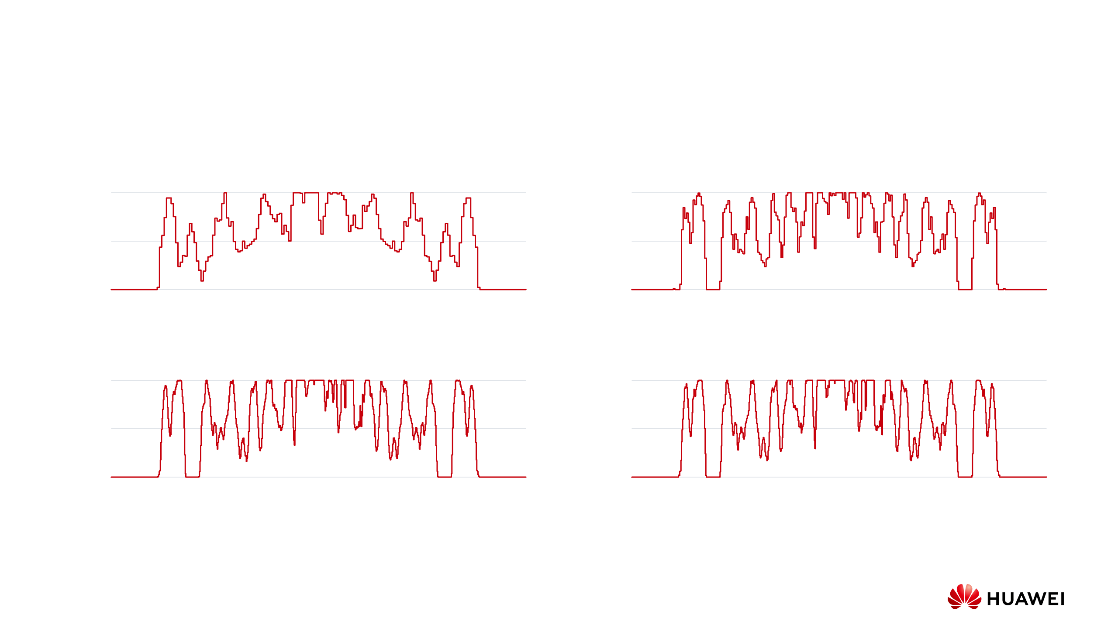
Advantageous Effects: Saved Construction Evolution
Each plot shows the step’s best h(x), with n equal-width pieces. Lower C₅ means less peak overlap with shifted 1 − h(x).
Step 0
n = 180 C₅ = 0.380975069
Step 3
n = 250 C₅ = 0.380870161
1
1
h(x)
0.5
h(x)
0.5
0
0
0
1
2
0
1
2
x
x
Step 7
n = 700 C₅ = 0.380861062
Step 10
n = 700 C₅ = 0.380860634
1
1
h(x)
0.5
h(x)
0.5
0
0
0
1
2
0
1
2
x
x
Huawei Confidential
Secret Level:
Page 16
Notes:
Advantageous Effects: Saved Construction Evolution
Sources: valid rollout metadata with minimum raw_score in steps 0, 3, 7, and 10 of erdos_Qwen3.8-27B_1013-0544. Exact file IDs, resolutions, raw scores, and raw arrays are embedded in evidence.json and this deck. h(x) lies in [0,1] on [0,2] and integrates to 1. The display matches plot_erdos.py's canonical_orientation: among h, 1-h, reflected h, and reflected 1-h, choose the form with the least mean mass at the ends. These symmetries preserve the C5 objective and integral. The raw saved arrays are unchanged. These snapshots show saved outputs, not independent replications or proof that a particular component caused each improvement. Model effort and other run settings changed during later resumes, so the curve is an end-to-end trajectory rather than an isolated effort ablation.

Slide 28
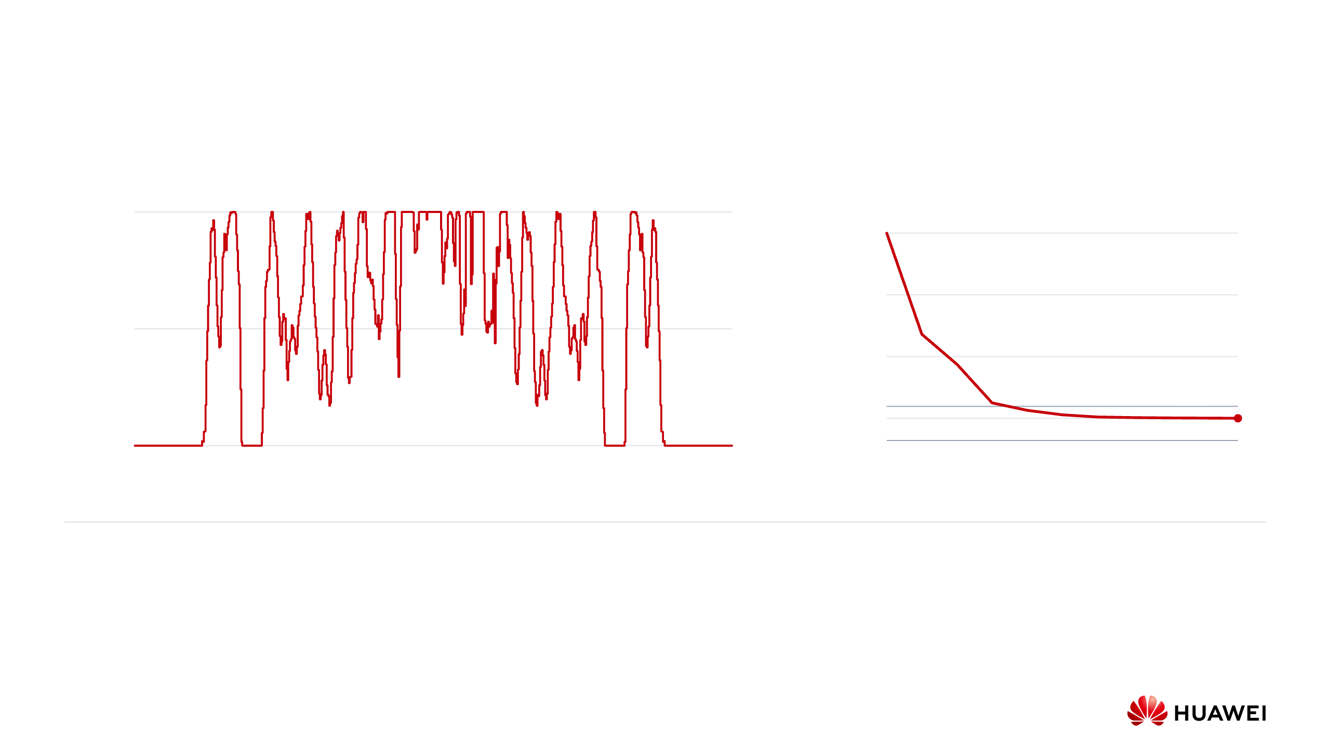
Advantageous Effects: Evaluated Scientific Result
Best saved construction
Best-so-far C₅ bound
1
0.38098
0.38094
h(x)
0.5
0.38090
SimpleTES reference: 0.380868
0.38086
0
0
1
2
0
2
4
6
8
10
x
Completed step
700 equal-width pieces, Qwen3.8-27B coder
C₅ ≤ 0.380860634340
The full pipeline found a construction below the
historical reference of 0.380868. Re-evaluating its
saved array reproduces the bound shown here.
Huawei Confidential
Secret Level:
Page 17
Notes:
Advantageous Effects: Evaluated Scientific Result
Source: runs/erdos_Qwen3.8-27B_1013-0544/step10/step10.best.json. Stored raw_score 0.3808606343399664, 700 entries. The objective is max linear correlation of h and 1-h, multiplied by 2/n, with bounds 0–1 and unit integral. Curve: completed step summaries 0–10. The reference 0.380868 is the historical SimpleTES comparison supplied with the presentation, not a statement about the current world record. The figures refer consistently to the exact saved 0544 result. No independent mathematical certification or new record survey is claimed.

Slide 29

Value Statement for Obtaining a Patent
Aspect
Proposed patent value
Technical
A frozen LLM proposes plans. Pilot outcomes allocate further programs, while evaluated programs
contribution
train a shared LLM and update the search archive.
Potential use
Tasks where a generated program returns a candidate and an evaluator checks its constraints and
score.
Detection
Prompt records show the two model roles. Allocation and training logs show how pilot outcomes set
budgets, how the historical baseline changes, and when updates occur.
Alternative designs
Uniform allocation and group-relative learning are alternatives. Isolating their effects requires
matched-setting experiments.
Standards
No direct mandatory standards relevance identified in the supplied materials.
relevance
Huawei Confidential
Secret Level:
Page 18
Notes:
Value Statement for Obtaining a Patent
Source: supplied presentation, Page 12. External-output-only detection may be difficult. Commercial and legal conclusions require their own assessment. The proposed value statement does not claim legal validity, unavoidable infringement, measured commercial savings, or a formal prior-art search. Supporting evidence is internal technical operation and saved experimental outputs. Official submission and legal assessment are separate.

Slide 30
Thank you
Hierarchical scientific discovery
Technical solution and experimental evidence
Huawei Confidential
Secret Level:
Page 19
Notes:
Thank you
The technical proposal separates scientific planning from coder learning, directs additional rollouts using observed pilot outcomes, and retains a common historical training reference. Behavioral evidence concerns continued exploration. The saved scientific construction demonstrates one end-to-end evaluated result.

