Slide 1
Cancer detection using HRCT images in ILD patients
By:
Mohamad-hosein Moslemi
Under the supervision of:
Dr. Arash Amini
27 Nov. 2021

Slide 2
Outline
- Introduction
- ILD :Interstitial lung disease
- HRCT :High-resolution computed tomography
- Lung Atlas
- Lung segmentation
- Lung regions
- Graph approach
- Graph configuration
- Method
- Our plan
- References

Slide 3
Introduction Lung Atlas Graph approach Our plan References
ILD
HRCT
ILD :Interstitial lung disease
Group of more than 150 disorders.
Texture changes of the lung leading to breathing dysfunction.
Only 7 frequent ILDs : Pulmonary fibrosis(PF) , Tuberculosis (TB) , …

Slide 4
Introduction Lung Atlas Graph approach Our plan References
ILD
HRCT
ILD :Interstitial lung disease (cont.)
How to identify ILD types?
- A critical task for determining the treatment
- Distribution of specific patterns in the lung → Graph

Slide 5
Introduction Lung Atlas Graph approach Our plan References
ILD
HRCT
HRCT : High-resolution CT scan
Why not conventional CT scans?
First solution → MDCT : multidetector-CT but high amount of radiation.
HRCT : MDCT with skipped areas
Hounsfield Units (HU) :
Lung : -700 to -600 Water : 0
Bone : +300 to +1900 Air : -1000

Slide 6
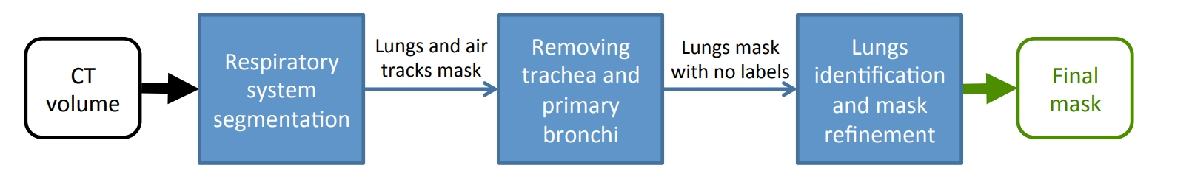
Introduction Lung Atlas Graph approach Our plan References
Lung segmentation
Lung regions
Mask for lung segmentation
We use an unsupervised method without training
Can be applied to new images with no modifications

Slide 7
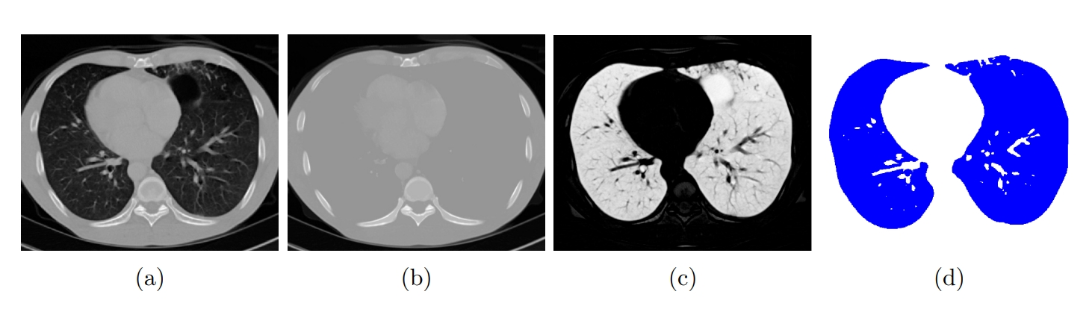
Introduction Lung Atlas Graph approach Our plan References
Lung segmentation
Lung regions
Mask for lung segmentation (cont.)
Step1: respiratory system segmentation
Filling the holes → dense body image :(b)
Absolute difference : |original - dense body|(c)
K-means with K=2 : (d)

Slide 8
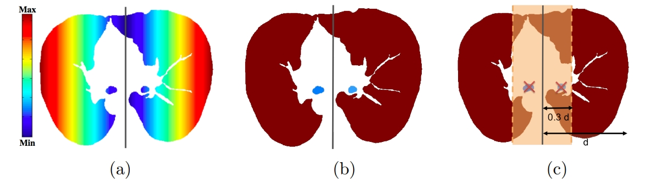
Introduction Lung Atlas Graph approach Our plan References
Lung segmentation
Lung regions
Mask for lung segmentation (cont.)
Step2: removing airways
- Euclidean distance from reference plane (a)
- Assign max distance to each component (b)
- Remove below threshold (c)

Slide 9
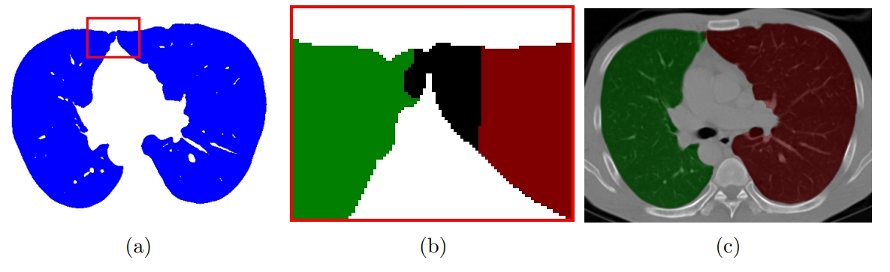
Introduction Lung Atlas Graph approach Our plan References
Lung segmentation
Lung regions
Mask for lung segmentation (cont.)
Step3: Right and left lung segmentation

Slide 10
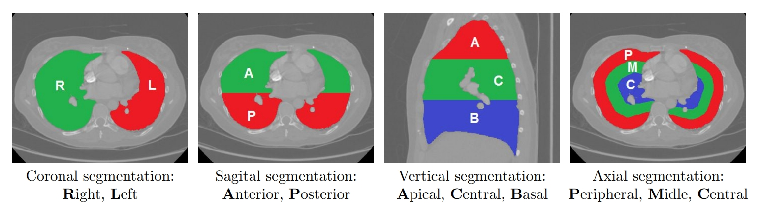
Introduction Lung Atlas Graph approach Our plan References
Lung segmentation
Lung regions
Lung regions
1. Coronal: Right - left
2. Sagital: anterior - posterior
3. Vertical: apical – central - basal
4. Axial: (peripheral - middle)- central
36 / 24 regions

Slide 11
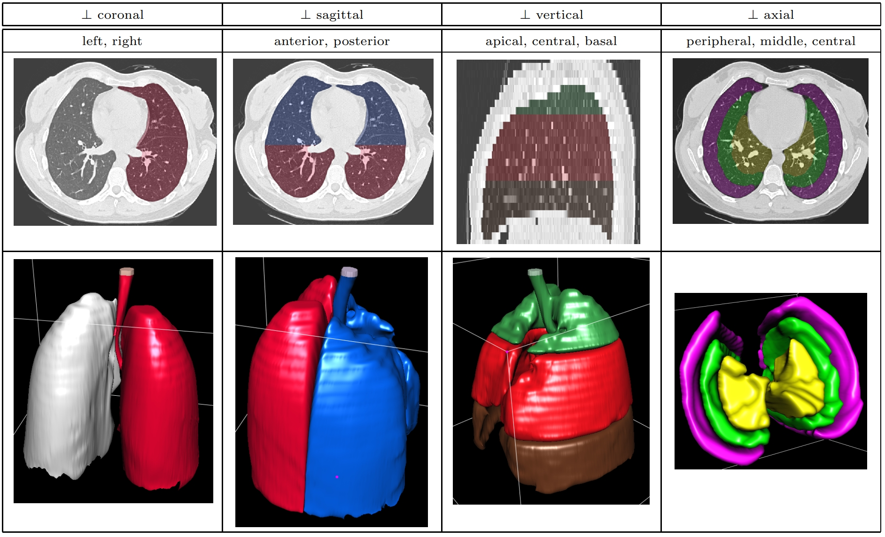

Slide 12
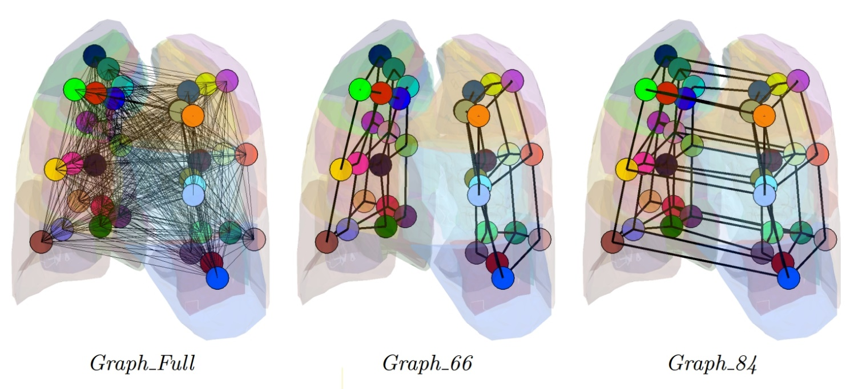
Introduction Lung Atlas Graph approach Our plan References
Graph configuration
Method 1
Method 2
Graph-Full: 630 edges , fully connected
Graph-66: 66 edges only between adjacency region
Graph-84: Graph-66 and edges between opposite

Slide 13
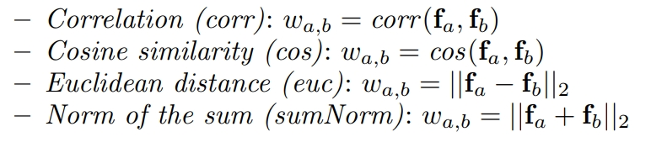

Introduction Lung Atlas Graph approach Our plan References
Graph configuration
Method
- Fully connected graph
- For each Voxel in a region:
- FHOG: f_{H} є $ℝ^{28}$
- 3D Riesz-wavelet filter banks :energy of each filter f_{R} є $ℝ^{10}$
For each region: mean and STD for f_{H} or f_{R} → 40-dimentianl vector for each region: f_{a}
For each edge of graph:

Slide 14
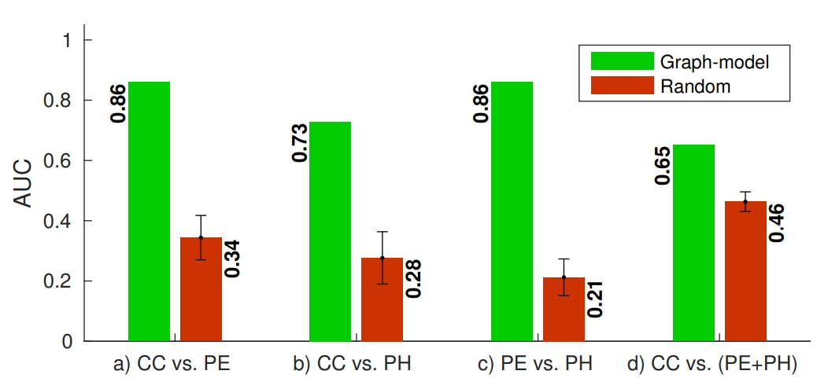
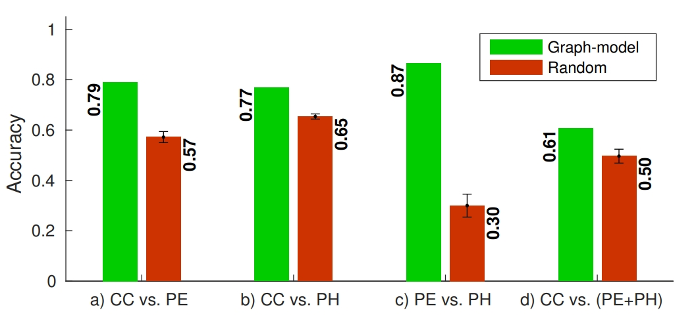
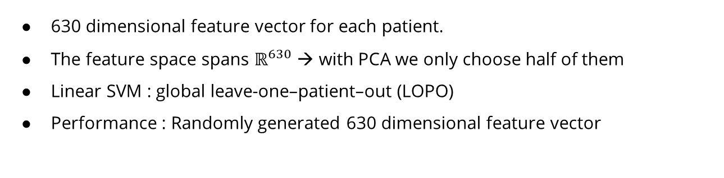
Introduction Lung Atlas Graph approach Our plan References
Graph configuration
Previous method
630 dimensional feature vector for each patient.
The feature space spans $ℝ^{630}$ → with PCA we only choose half of them
Linear SVM : global leave-one–patient–out (LOPO)
Performance : Randomly generated 630 dimensional feature vector

Slide 15
Introduction Lung Atlas Graph approach Our plan References
Get Access to the database
We may ignore the Lung regions
Learn Graph from HU of HRCT Voxels
→ GSPBOX developed by LTS2 lab in EPFL

Slide 16
1.Depeursinge, A., Zrimec, T., Busayarat, S., M¨uller, H.: 3D lung image retrieval using localized features. In: Medical Imaging 2011: Computer-Aided Diagnosis, vol. 7963, p. 79632E. SPIE, February 2011
2.Dicente Cid, Y., Depeursinge, A., Foncubierta-Rodríguez, Platon, A., Poletti, P.A., Muller, H.: Pulmonary embolism detection using localized vessel-based features in dual energy CT. In: SPIE Medical Imaging. International Society for Optics and Photonics (2015)
3.Dicente Cid, Y., Jimenez-del-Toro, O., Depeursinge, A., and M¨uller, H., “Efficient and fully automatic segmentation of the lungs in CT volumes,” in [Proceedings of the VISCERAL Challenge at ISBI], Orcun Goksel, Jimenez-del-Toro, O., Foncubierta-Rodríguez, A., and M¨uller, H., eds., CEUR Workshop Proceedings, 31–35 (Apr 2015).
4. Dicente Cid, Y., Muller, H., Platon, A., Janssens, J.-P., Frederic, L., Poletti, P.-A., and Depeursinge, A., “A lung graph-model for pulmonary hypertension and pulmonary embolism detection on DECT images,” in [MICCAI Workshop on Medical Computer Vision: Algorithms for Big Data], MICCAI-MCV, 58–68 (Oct. 2016).
5. Dicente Cid, Y., Batmanghelich, K., M¨uller, H.: Textured graph-model of the lungs for tuberculosis type classification and drug resistance prediction: participation in ImageCLEF 2017. In: CLEF2017 Working Notes. CEUR Workshop Proceedings, CEUR-WS.org, Dublin, Ireland, 11–14 September 2017 (2017)
6. Dicente Cid Y., Jimenez-del-Toro O., Poletti PA., Müller H. (2019) A Graph Model of the Lungs with Morphology-Based Structure for Tuberculosis Type Classification. In: Chung A., Gee J., Yushkevich P., Bao S. (eds) Information Processing in Medical Imaging. IPMI 2019. Lecture Notes in Computer Science, vol 11492. Springer, Cham. https://doi.org/10.1007/978-3-030-20351-1_28
7. Perraudin Nathanaël, Johan Paratte, David Shuman, Lionel Martin, Vassilis Kalofolias, Pierre Vandergheynst and David K. Hammond}, GSPBOX: A toolbox for signal processing on graphs. Arxiv e-print, 08-2014

