Slide 1
GTÜ BİL MUH BİL 495 ve 496 Roman Domination Number
BIL 495
Son Sunum
Mehmet Acar
Proje Danışmanı: Prof Dr. Didem Gözüpek
Ocak 2023

Slide 2
Roman Domination Number
Emperor Constantine had to decide where to station his four field army units to protect eight regions.
Place the army units so that every region was either secured by its own army (one or two units) or was securable by a neighbor with two army units, one of which can be sent to the undefended region directly if a conflict breaks out.

Slide 3
Properties of Roman Domination Number
A Roman dominating function of G is a function f : V -> {0,1,2} such that every vertex u with f(u) = 0 is adjacent to a vertex v with f(v) = 2.
The weight of a Roman dominating function f is sum of values assigned to all vertices.
The minimum weight of a Roman dominating function of a graph G is the Roman domination number of G, written Ɣr(G).

Slide 4
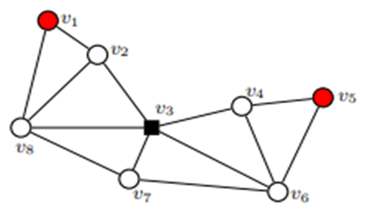
Input and Output of Roman Domination Number
The optimal number of legions necessary to defend the given graph is 4, provinces represented by vertices v1 and v5 are with one stationed legion, province represented by vertex v3 is with two stationed legions and all other provinces are without stationed legions. With the given schedule, vertices v1, v3 and v5 are defended because they have at least one legion stationed within it, while v2, v4, v6, v7 and v8 are defended since they are in the neighborhood of the vertex v3, which is with two stationed legions. The optimal solution to the proposed problem is illustrated in Figure which are above, where vertices are marked by black squares if they are representing provinces with two stationed legions, marked by red circles if they are representing provinces with one stationed legion, and marked by white circles if they are representing provinces without stationed legions.

Slide 5
Project Requirements - 1
Research heuristic algorithms
Literature review about problem
Decide an heuristic algorithm which has polynomial time
Implement an algorithm on the problem
Comparing implemented algorithm with other selected algorithm
Visualizing both algorithms on the problem

Slide 6
Project Requirements - 2
Software Requirements
I decide to visualize undirected graphs in Python with the help of networkx and matplotlib library.
Hardware Requirements
No hardware requirements are needed

Slide 7
Success Criterias
Implement an heuristic algorithm on the problem
Implemented algorithm’s time complexity should be polynomial time
Comparing selected heuristic algorithm with other selected method
Visualizing both algorithms on the problem

Slide 8
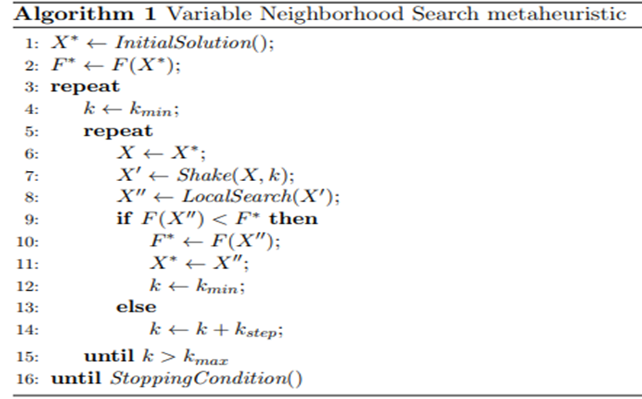
Searched Paper

Slide 9
Heuristic algorithm considered for solution
I thought that I can use Variable Neighborhood Search algorithm in order to solve Roman Domination Number problem.

Slide 10
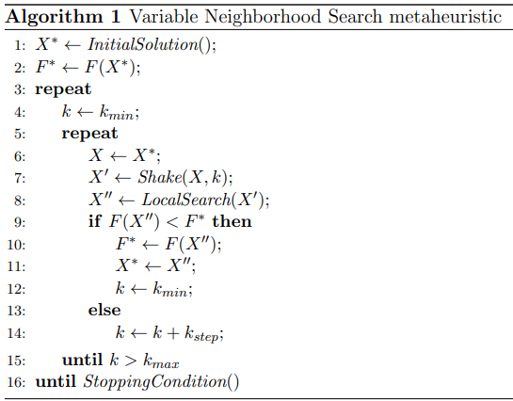
Pseudocode Step By Step
The VNS algorithm is presented as Algorithm1. Functions InitialSolution(), Shake(), LocalSearch() and StoppingCondition() are described in next pages.

Slide 11
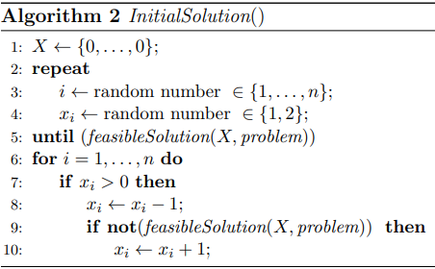
Initial Solution Function
Function InitialSolution() (pseudo code is presented as Algorithm 2) is defined
so that it produces an initial feasible
solution X∗ by applying random changes
to elements of the zero vector X.

Slide 12
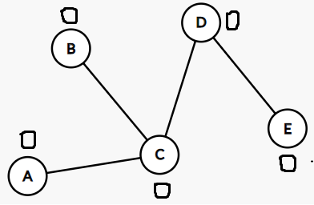
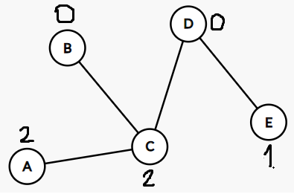
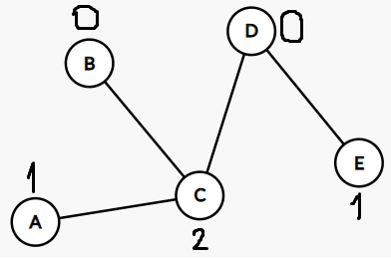
Initial Solution Example
Assigns randomly generated number from the set{1,2} to randomly chosen element of vector X until X becomes a feasible solution
Among the elements of the vector X with positive value, searches for an element whose value could be decreased by one such that the resulting vector remains a feasible solution

Slide 13
Now, if it is possible to find a feasible solution with the same or smaller objective function value than current incumbent , the resulting solution will be better than the current incumbent. Hence, we define the following two functions, Shake() and LocalSearch(). These two functions are defined to search for a better feasible solution than the one with which they start the searching process.

Slide 14
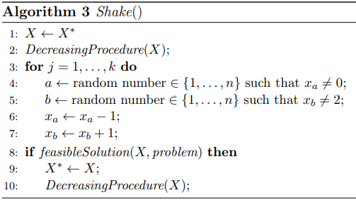
Shake Function
This function creates another solution X0 ∈ Nk(X).
It applies this operation with movement of a certain
number of legions)

Slide 15
Shake Function Example
In order to show the shake function process easily, let’s assume that k value is equal to 1.

Slide 16

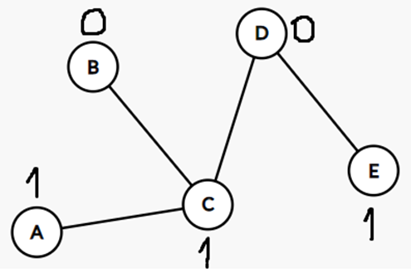
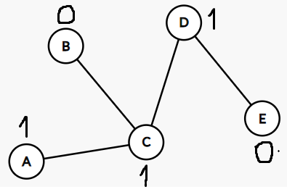
Shake Function Example
Decreasing Procedure
First chosen element is D and
second chosen element is E. Element D is increased by 1. Element E is decreased by 1.

Slide 17
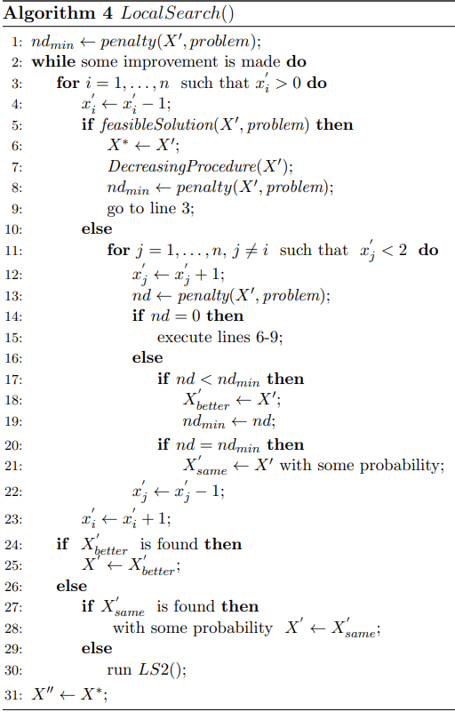
Local Search Function
In the searched neighborhood, if better solution is found, local search method continue its search in the same neighborhood. But if better solution is not found, local search method its search in different neighborhood.

Slide 18
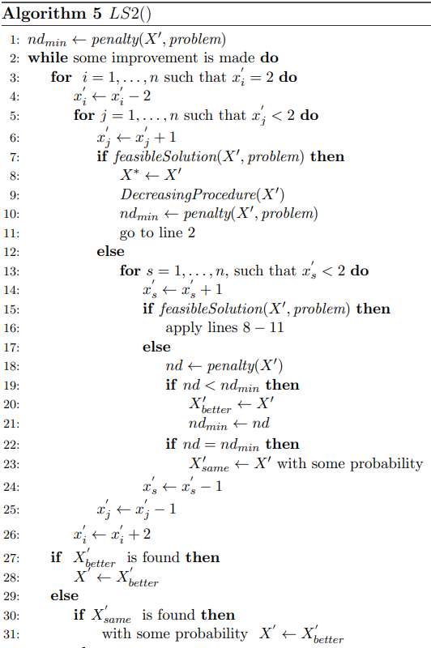

Local Search Function

Slide 19
Stopping Condition Function
Input parameters for the VNS heuristic are the problem, the minimal (kmin) and the maximal (kmax) numbers of neighborhoods that should be searched, the increment of the parameter k (kstep) and the maximum CPU time allowed (tmax). In our implementation StoppingCondition() finishes the VNS algorithm if either kmax or maximal CPU time allowed is reached.

Slide 20
VNS Algorithm On Input Graph
In this part, in the code, I create undirected input graph with 5 vertexes and I assign number 0’s to each vertexes. Then, I create several edges on the graph. Then, local search metaheuristic is applying to the graph.

Slide 21
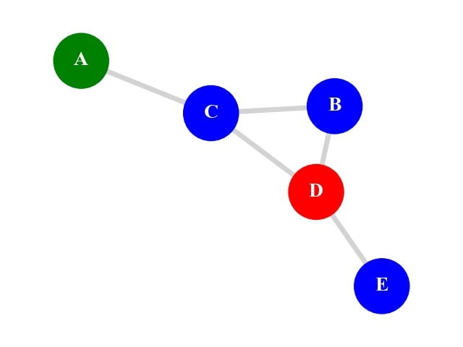
Example Output of VNS
Finally, in output graph, I colored vertexes which have number 0 with blue, which have number 1 with green and which have number 2 with blue and example output is like on the right figure.
As you see from this figure, vertexes which has 0 as a number is adjacent to vertex which has 2 as a number. And this graph obeys the rules of Roman Domination Graph. Roman Domination number of this graph is equal to the sum of numbers which are vertexes have. So, Roman domination number of this graph is equal to the 3. In this figure, we get an optimal solution but VNS does not guarentee the optimal solution every time.

Slide 22
Brute Force Algorithm
In order to compare VNS with other algorithm, Brute Force method is used. A brute force algorithm solves a problem through exhaustion: it goes through all possible choices until a solution is found. In the code, all combinations of numbers that vertexes in the graph can have is examined. From these combinations which have feasible solutions in terms of Roman Domination graph, the solution which has minimum weight(Roman Domination Number) is found.

Slide 23
Brute Force Algorithm on Input Graph
In this part, in the code, I create undirected input graph with 5 vertexes. Then, I create several edges are on the graph. Then, brute force algorithm is applying to the graph.

Slide 24
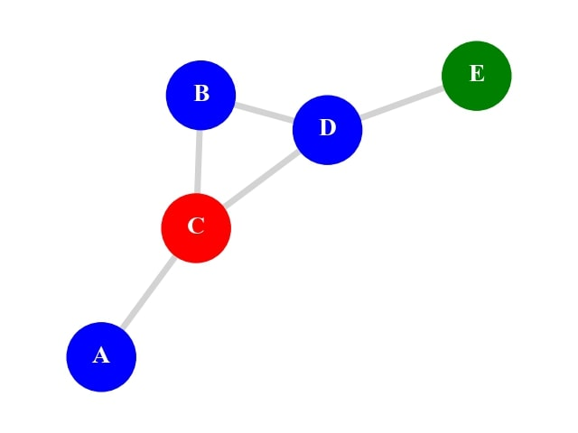
Example Output of Brute Force
Finally, in output graph, vertexes which have number 0 are colored with blue, vertexes which have number 1 are colored with green and vertexes which have number 2 are colored with blue and example output is like on the right figure .
As you see from this figure, vertexes which has 0 as a number is adjacent to vertex which has 2 as a number. And this graph obeys the rules of Roman Domination Graph.
Roman Domination number of this graph is equal to the sum of numbers which are vertexes have. So, Roman domination number of this graph is equal to the 3. This is optimal
solution. Because Brute Force guarentees optimal solution every time.

Slide 25
Comparison of VNS and Brute Force
In order to compare VNS and Brute Force algorithm , I create different input graphs. In these graphs, I kept one parameter fixed and kept other parameter changeable. These parameters are vertex and edge number.
Then, I observed the changement of roman domination number when vertex or edge number is increased on input graphs and printed the comparison of VNS and Brute Force as a figure.

Slide 26
Different Edge Numbered Graphs
In this part, in the code, I create 10 different input graphs which have same vertex number but different edge number. All graph has 6 vertexes. The input graph which has lowest number of edges has 5 edges and input graph which has highest number of edges has 15 edges.

Slide 27
Steps of Getting RDN of Graphs
Then, VNS and Brute Force algorithms are applied to each graph 30 times. Then, average of roman domination number of 30 observation is taken and this value is equal to the Roman Domination Number of each graph and comparison of VNS and and Brute Force Algorithm in terms of Roman Domination Number is printed on the next page figure.

Slide 28
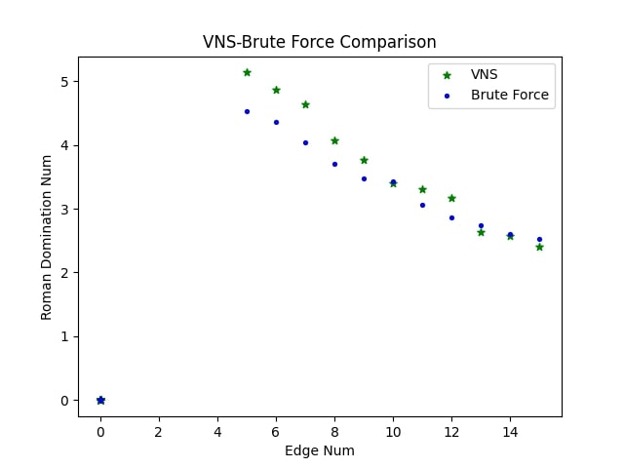
Output Example
According to the right figure, if number of edge is increasing on input graphs, roman domination number will be decreasing. Generally, this situation is occurred. But, rarely roman domination number can be increase while number of edge is increasing on input graphs. In Variable Neighborhood Search (VNS) method, this event is caused by VNS does not guarentee the optimal solution or position of the added edge. On the other hand, in Brute Force method, this event is caused by only position of the added edge.

Slide 29
Different Vertex Numbered Graphs
In this part, in the code, I create 10 different input graphs which have same edge number but different vertex number. All graph has 5 edges. The input graph which has lowest number of vertexes has 5 vertex and input graph which has highest number of vertexes has 15 vertexes.

Slide 30
Steps of Getting RDN of Graphs
Then, VNS and Brute Force algorithms are applied to each graph 30 times. Then, average of roman domination number of 30 observation is taken and this value is equal to the Roman Domination Number of each graph and comparison of VNS and and Brute Force Algorithm in terms of Roman Domination Number is printed on the next page figure.

Slide 31
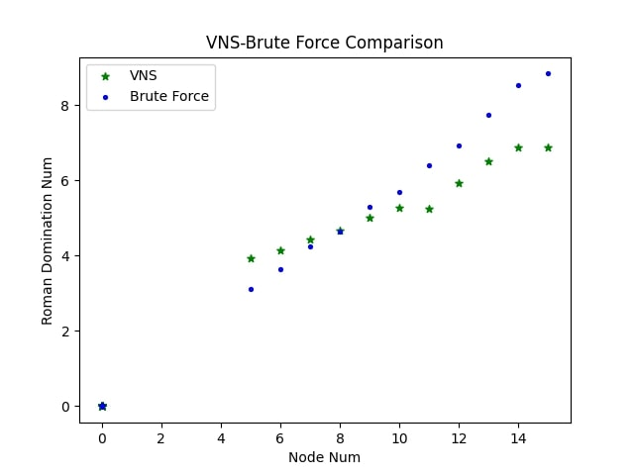
Output Example
According to the right figure, if number of vertex is increasing on input graphs, roman domination number will be increasing. In Brute Force method, this situation is occurred every time. But in Variable Neighborhood Search (VNS) method, rarely roman domination number can be decrease while number of vertex is increasing on input graphs. In Variable Neighborhood Search (VNS) method, this event is caused by VNS does not guarentee the optimal solution.

Slide 32
Time Complexities
Time complexity of Variable Neighborhood Search (VNS) method which is applying for finding Roman Domination Number of graph, is equal to: O(n⁴) In time complexity, n is a input graph’s vertex number. And 4 is coming from nested loops.
Time complexity of Brute method which is applying for finding Roman Domination Number of graph, is equal to O(3^{n} ). Each vertex in input graph can take the number 0 or 1 or 2. So, each vertex can take one of 3 numbers.So, in time complexity, 3 is coming from here. And in time complexity, n is a input graph’s vertex number.

Slide 33
Result
As a result, in this project, I implemented Variable Neighborhood Search algorithm as a polynomial time heuristic algorithm on Roman Domination Number problem.
In order to compare heuristic algorithm with other algorithm, I used Brute Force algorithm.
I visualize the implemented algorithms.
So, I completed all the success criterias.

Slide 34
References
E.J. Cockayne, P.A. Dreyer, Jr., S.M. Hedetniemi, S.T. Hedetniemi, Roman Domination in Graphs, Discrete Mathematics 278(2004) 11-12.
Ivanović, M., & Urošević, D. (2019). Variable Neighborhood Search Approach for Solving Roman and Weak Roman Domination Problems on Graphs.
Sergio Bermudo, Henning Fernau, Jose M. Sigarreta:
The differential and the Roman domination number of a
graph. Appl. Anal. Discrete Math. 8(1), 155-171(2014)

