Slide 1
GTÜ BİL MUH BİL 495 ve 496 İLK SUNUM FORMATI
BIL 495
İlk Sunum
Mehmet Acar
Proje Danışmanı: Prof Dr. Didem Gözüpek
Ekim 2022

Slide 2
Roman Domination Number
Emperor Constantine had to decide where to station his four field army units to protect eight regions.
Place the army units so that every region was either secured by its own army (one or two units) or was securable by a neighbor with two army units, one of which can be sent to the undefended region directly if a conflict breaks out.

Slide 3
Properties of Roman Domination Number
A Roman dominating function of G is a function f : V -> {0,1,2} such that every vertex u with f(u) = 0 is adjacent to a vertex v with f(v) = 2.
The weight of a Roman dominating function f is sum of values assigned to all vertices.
The minimum weight of a Roman dominating function of a graph G is the Roman domination number of G, written Ɣr(G).

Slide 4
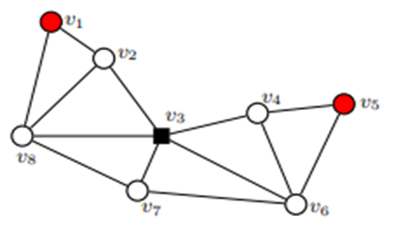
Input and Output of Roman Domination Number
The optimal number of legions necessary to defend the given graph is 4, provinces represented by vertices v1 and v5 are with one stationed legion, province represented by vertex v3 is with two stationed legions and all other provinces are without stationed legions. With the given schedule, vertices v1, v3 and v5 are defended because they have at least one legion stationed within it, while v2, v4, v6, v7 and v8 are defended since they are in the neighborhood of the vertex v3, which is with two stationed legions. The optimal solution to the proposed problem is illustrated in Figure which are above, where vertices are marked by black squares if they are representing provinces with two stationed legions, marked by red circles if they are representing provinces with one stationed legion, and marked by white circles if they are representing provinces without stationed legions.

Slide 5
Visualize Graph
I decide to visualize undirected graphs in Python with the help of networkx and matplotlib library.

Slide 6
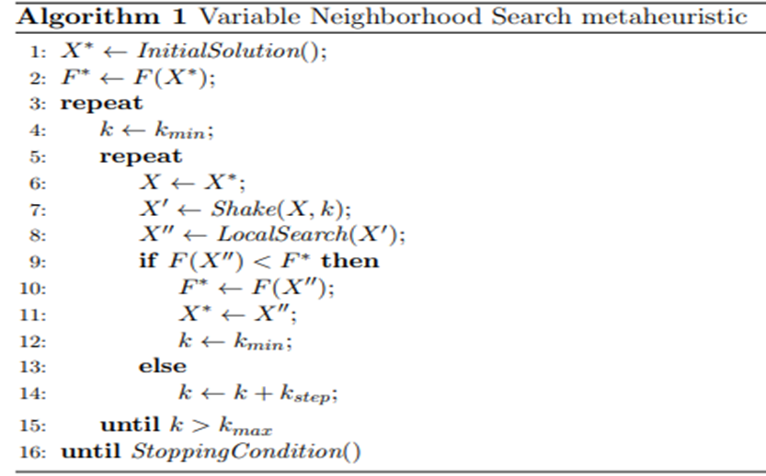
Searched Paper

Slide 7
Heuristic algorithm considered for solution
I thought that I can use Variable Neighborhood Search algorithm in order to solve Roman Domination Number problem.

Slide 8
References
E.J. Cockayne, P.A. Dreyer, Jr., S.M. Hedetniemi, S.T. Hedetniemi, Roman Domination in Graphs, Discrete Mathematics 278(2004) 11-12.
Ivanović, M., & Urošević, D. (2019). Variable Neighborhood Search Approach for Solving Roman and Weak Roman Domination Problems on Graphs.
Sergio Bermudo, Henning Fernau, Jose M. Sigarreta:
The differential and the Roman domination number of a
graph. Appl. Anal. Discrete Math. 8(1), 155-171(2014)

