Slide 1
GTÜ BİL MUH BİL 495 ve 496 Roman Domination Number
BIL 495
İkinci Sunum
Mehmet Acar
Proje Danışmanı: Prof Dr. Didem Gözüpek
Ekim 2022

Slide 2
Roman Domination Number
Emperor Constantine had to decide where to station his four field army units to protect eight regions.
Place the army units so that every region was either secured by its own army (one or two units) or was securable by a neighbor with two army units, one of which can be sent to the undefended region directly if a conflict breaks out.

Slide 3
Properties of Roman Domination Number
A Roman dominating function of G is a function f : V -> {0,1,2} such that every vertex u with f(u) = 0 is adjacent to a vertex v with f(v) = 2.
The weight of a Roman dominating function f is sum of values assigned to all vertices.
The minimum weight of a Roman dominating function of a graph G is the Roman domination number of G, written Ɣr(G).

Slide 4
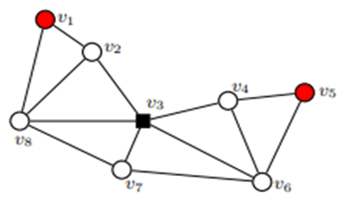
Input and Output of Roman Domination Number
The optimal number of legions necessary to defend the given graph is 4, provinces represented by vertices v1 and v5 are with one stationed legion, province represented by vertex v3 is with two stationed legions and all other provinces are without stationed legions. With the given schedule, vertices v1, v3 and v5 are defended because they have at least one legion stationed within it, while v2, v4, v6, v7 and v8 are defended since they are in the neighborhood of the vertex v3, which is with two stationed legions. The optimal solution to the proposed problem is illustrated in Figure which are above, where vertices are marked by black squares if they are representing provinces with two stationed legions, marked by red circles if they are representing provinces with one stationed legion, and marked by white circles if they are representing provinces without stationed legions.

Slide 5
Project Requirements - 1
Research heuristic algorithms
Literature review about problem
Decide an algorithm which has polynomial time
Implement an algorithm on problem
Comparing implemented algorithm with other heuristic algorithm
Preparing GUI for demonstrating execution of implemented algorithm

Slide 6
Project Requirements - 2
Software Requirements
I decide to visualize undirected graphs in Python with the help of networkx and matplotlib library.
Hardware Requirements
No hardware requirements are needed

Slide 7
Success Criterias
Visualizing the implemented algorithm on graph
Implemented algorithm’s time complexity should be polynomial time
Preparing GUI for demonstrating execution of algorithm

Slide 8
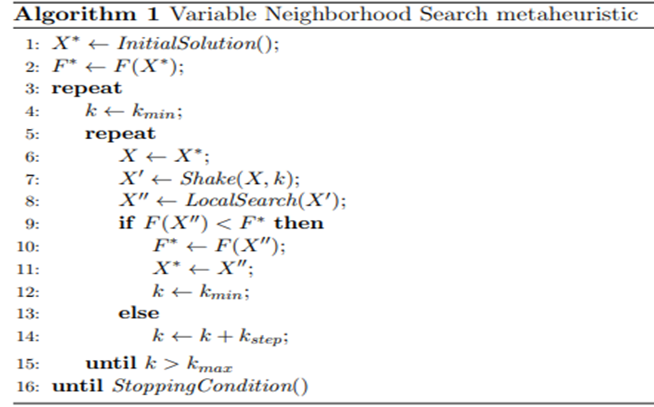
Searched Paper

Slide 9
Heuristic algorithm considered for solution
I thought that I can use Variable Neighborhood Search algorithm in order to solve Roman Domination Number problem.

Slide 10
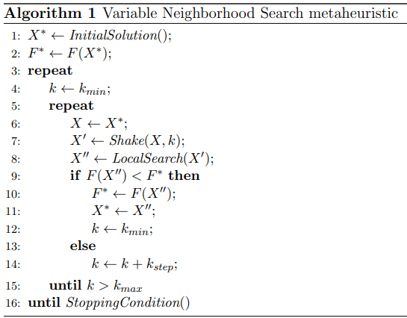
Pseudocode Step By Step
The VNS algorithm is presented as Algorithm1. Functions InitialSolution(), Shake(), LocalSearch() and StoppingCondition() are described in next pages.

Slide 11
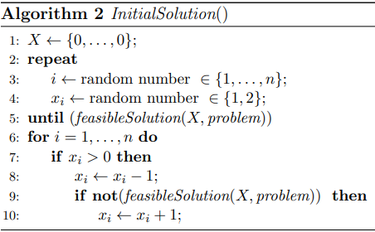
Initial Solution Function
Function InitialSolution() (pseudo code is presented as Algorithm 2) is defined so that it produces an initial feasible solution X∗ by applying random changes to elements of the zero vector X. That is, InitialSolution() assigns randomly generated number from the set {1, 2} to a randomly chosen element of the vector X until X becomes a feasible solution. Then, given that the function InitialSolution() finds a feasible solution, and our goal is to find a feasible solution such that the objective function value is minimal, the found solution will be, for now, saved as the best one (X∗ ← X, F ∗ ← F(X∗ )).

Slide 12
Initial Solution Function
Further, in order to lower the value F ∗ , i.e., to improve the incumbent, among the elements of the vector X with positive value, InitialSolution() searches for an element whose value could be decreased by one such that the resulting vector remains a feasible solution. If such an element is found, InitialSolution() will decrease its value by one, and then continue to search for an element of the incumbent with the same property. Whenever the procedure of decreasing a value of one element produces a feasible vector, the resulting vector will be stored as the best one and objective function value F(X) will be stored as F ∗ . This procedure repeats until there are no elements whose decreased value will result with feasible X.

Slide 13
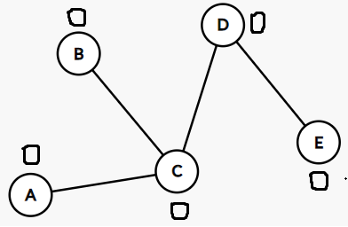
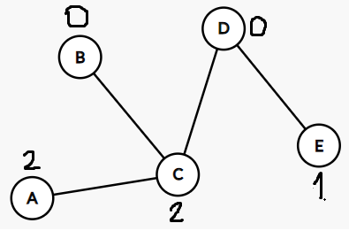
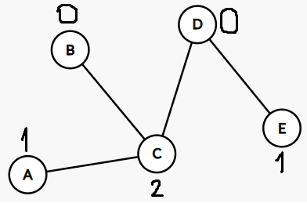
Initial Solution Example
Assigns randomly generated number from the set{1,2} to randomly chosen element of vector X until X becomes a feasible solution
Among the elements of the vector X with positive value, searches for an element whose value could be decreased by one such that the resulting vector remains a feasible solution

Slide 14
Now, if it is possible to find a feasible solution with the same or smaller objective function value than F ∗ , the resulting solution will be better than the current incumbent. Hence, we define the following two functions, Shake() and LocalSearch(). These two functions are defined to search for a better feasible solution than the one with which they start the searching process.

Slide 15
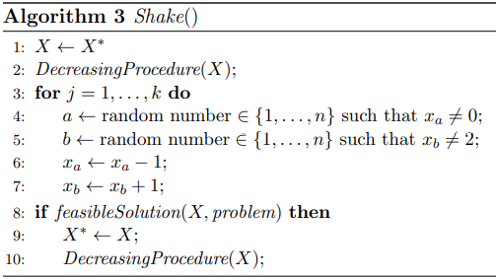
Shake Function
Therefore, Shake(X∗ , k) function (presented as Algorithm 3) starts with a feasible solution X∗ , stores it as X (X ← X∗ ) and then randomly chooses an element of the solution X with positive value and decreases its value by one. If the resulting vector is again a feasible solution, it stores it as the new best solution and repeats the process until an infeasible solution is found. We call this process DecreasingProcedure(). Then, among the elements of the current solution X with value lower than 2, shake function randomly choses one element, and among the elements with positive value of the incumbent X, it randomly chooses another element and increases a value of the first chosen element by one and decreases the value of the second chosen element also by one (i.e., it moves one legion) and repeats this process k times. If the resulting vector X0 is a feasible one, given that F(X0 ) < F∗ the new best feasible is found. Therefore, X0 will be stored as the new best feasible (X∗ ← X0 ). Also, if X0 is feasible, we will apply DecreasingProcedure() to the vector X0 and resulting vector denote as X0 .

Slide 16
Shake Function Example
In order to show the shake function process easily, let’s assume that k value is equal to 1.

Slide 17

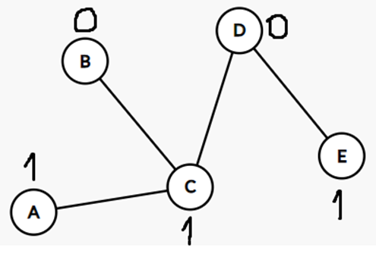
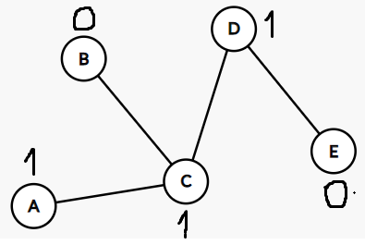
Shake Function Example
Decreasing Procedure
First chosen element is D and
second chosen element is E. Element D is increased by 1. Element E is decreased by 1.

Slide 18
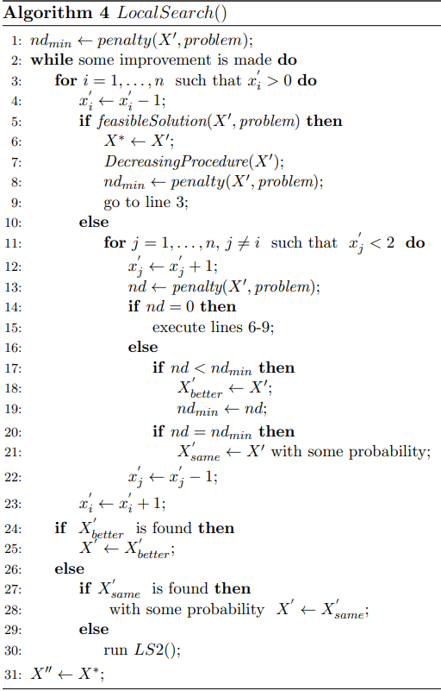
Local Search Function
Now, the LocalSearch(X0 ) function (presented as Algorithms 4 and 5) starts with an infeasible incumbent X0 , calculates its penalty(X0 , problem) value and stores it as ndmin. Then it searches a neighborhood N1(X0 ) of the incumbent X0 in order to find a feasible solution. If a solution with lower penalty value is found it will be stored as incumbent and search for a better solution continues. If a solution with penalty value equal to zero is found, it means that a feasible solution is found. If there is no solution with penalty value lower or equal to ndmin within the neighborhood N1(X0 ) of the incumbent, local search procedure will continue its search in the neighborhood N2(X0 ) of the incumbent. In both cases, whenever a feasible solution is found, it will be stored as the new best feasible solution. Also, local search procedure will continue to search for a feasible solution within the neighborhoods of the incumbent (i.e., a decreasing procedure will be applied to the feasible incumbent) until there is no better feasible solution.

Slide 19
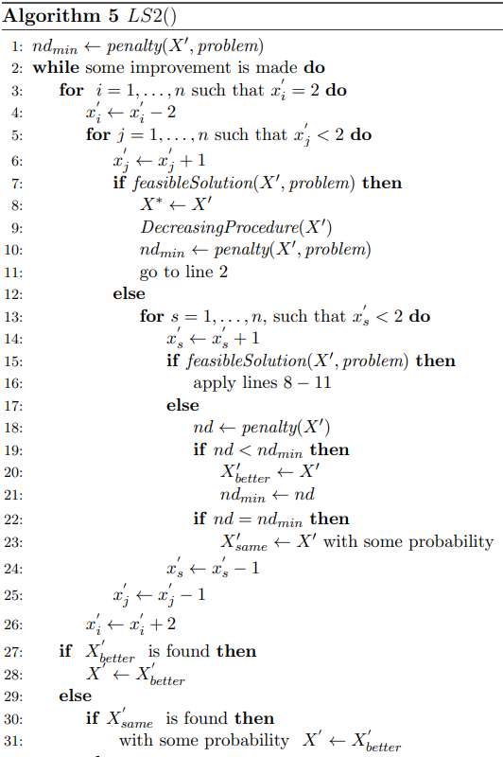

Local Search Function

Slide 20
Stopping Condition Function
Input parameters for the VNS heuristic are the problem, the minimal (kmin) and the maximal (kmax) numbers of neighborhoods that should be searched, the increment of the parameter k (kstep) and the maximum CPU time allowed (tmax). In our implementation StoppingCondition() finishes the VNS algorithm if either kmax or maximal CPU time allowed is reached.

Slide 21
Next Steps In The Project
Until final presentation, I am going to start the code part of project and try to visualize the algorithm.
Then, I am going to compare implemented algorithm with other heuristic algorithm.

Slide 22
References
E.J. Cockayne, P.A. Dreyer, Jr., S.M. Hedetniemi, S.T. Hedetniemi, Roman Domination in Graphs, Discrete Mathematics 278(2004) 11-12.
Ivanović, M., & Urošević, D. (2019). Variable Neighborhood Search Approach for Solving Roman and Weak Roman Domination Problems on Graphs.
Sergio Bermudo, Henning Fernau, Jose M. Sigarreta:
The differential and the Roman domination number of a
graph. Appl. Anal. Discrete Math. 8(1), 155-171(2014)

