Slide 1
CMPE 281 - BOOKSMART
TEAM Starburst
Chaithra Lakshmi Sathyanarayana
Luis Otero
Mithun Harikumar Nair
Sowmya Gowrishankar
Radhika Srinivasan

Slide 2
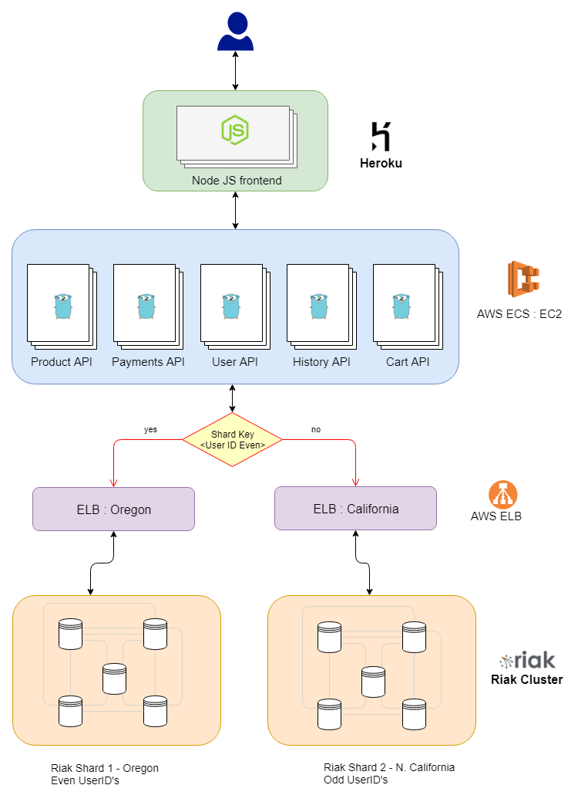
ARCHITECTURE

Slide 3
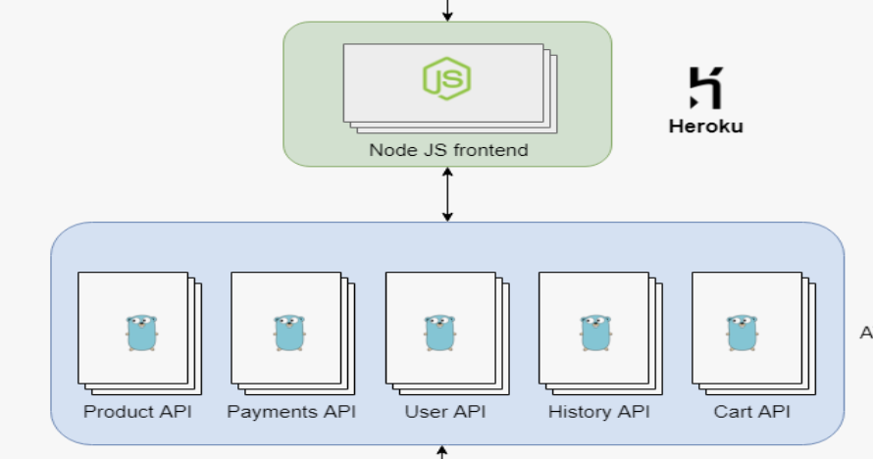
AKF SCALING
X-axis: Horizontal Duplication
X-axis scaling refers to running multiple copies of an application behind a load balancer.
Front end in Node js deployed in Heroku, thereby handling X scaling. Heroku apps running on Professional-tier dynos can be scaled to run on multiple dynos simultaneously.
Multiple GO APIs running behind load balancer to distribute data load.

Slide 4
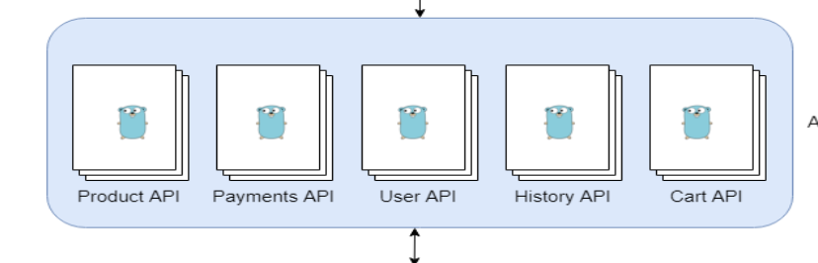
AKF SCALING
Y-axis: Functional Split
Service split means scaling a system by splitting out each individual functions.
Multiple microservices deployed on aws. Independent services for handling user data, payment data etc.

Slide 5
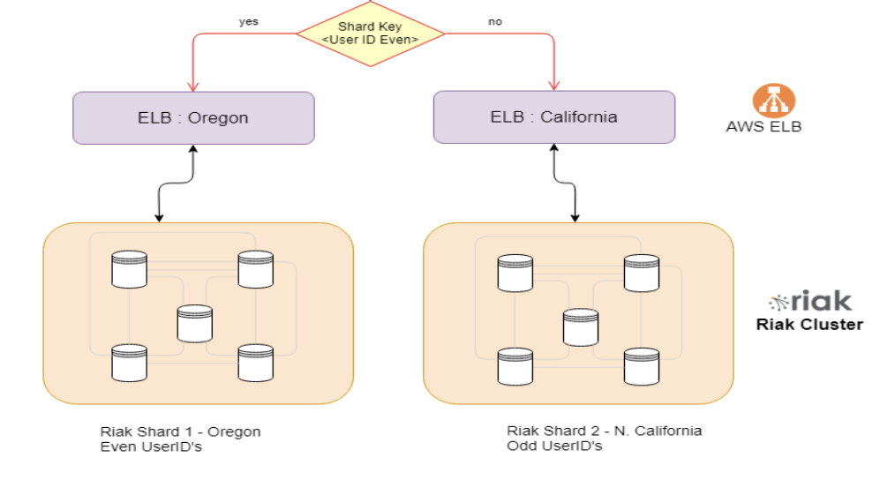
AKF SCALING
Z axis: Look-up Oriented Split (Sharding)
A database shard is a horizontal partition of data in a database. Each shard is held on a separate database server instance, to spread load.
Some data within a database remains present in all shards but some appears only in a single shard. Each shard (or server) acts as the single source for this subset of data
In our application, we have created two shards (RIAK clusters) based on the user ID being odd or even.

Slide 6
RIAK PARTITION TOLERANCE
Riak takes an AP approach to partition tolerance
There is no “master-slave” concept. Each node in a cluster is fully capable of serving any client request it receives.
This uniformity provides the basis for Riak’s fault-tolerance and scalability.

Slide 7
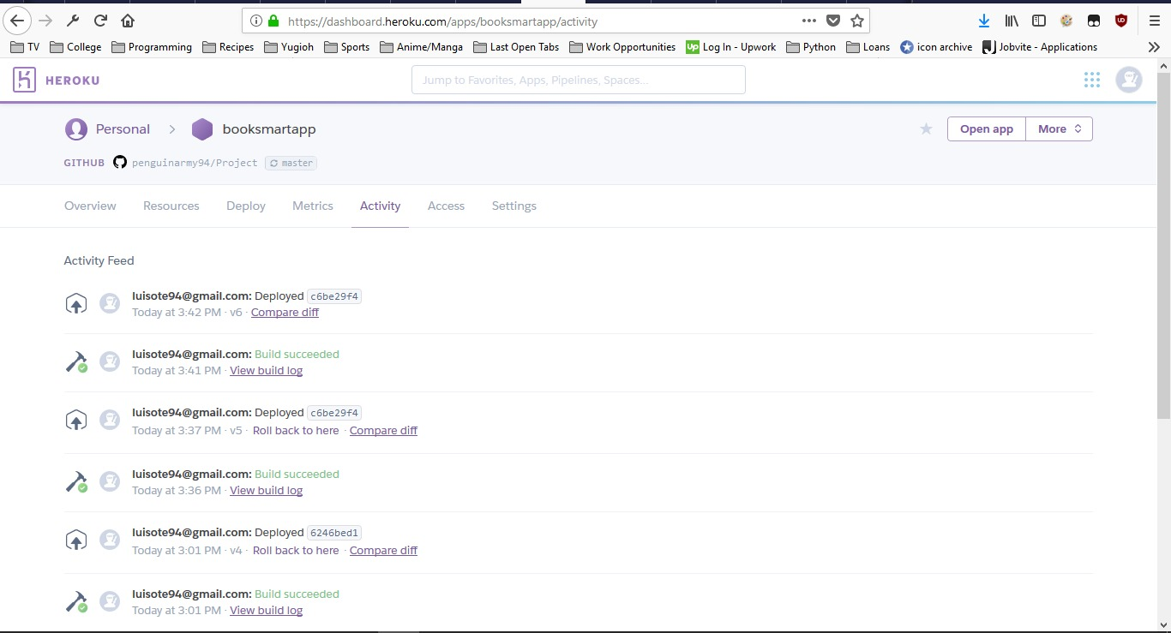
APP DEPLOYED ON HEROKU

Slide 8
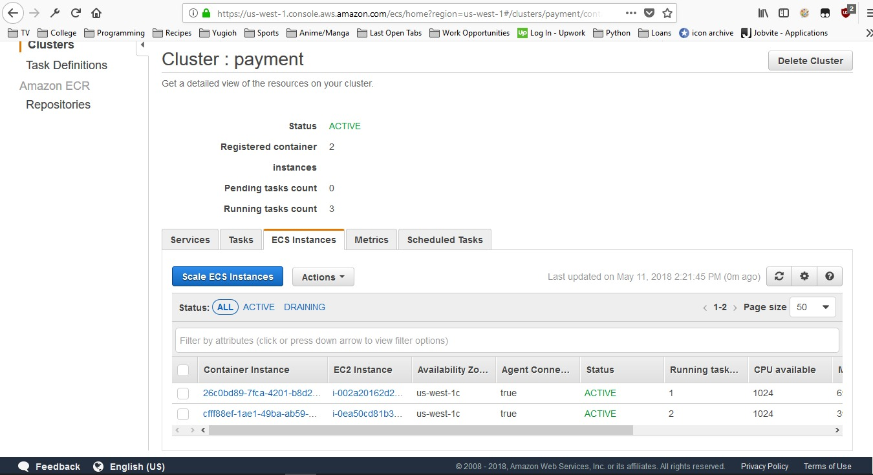
API’s DEPLOYED USING ECS ON AWS

Slide 9
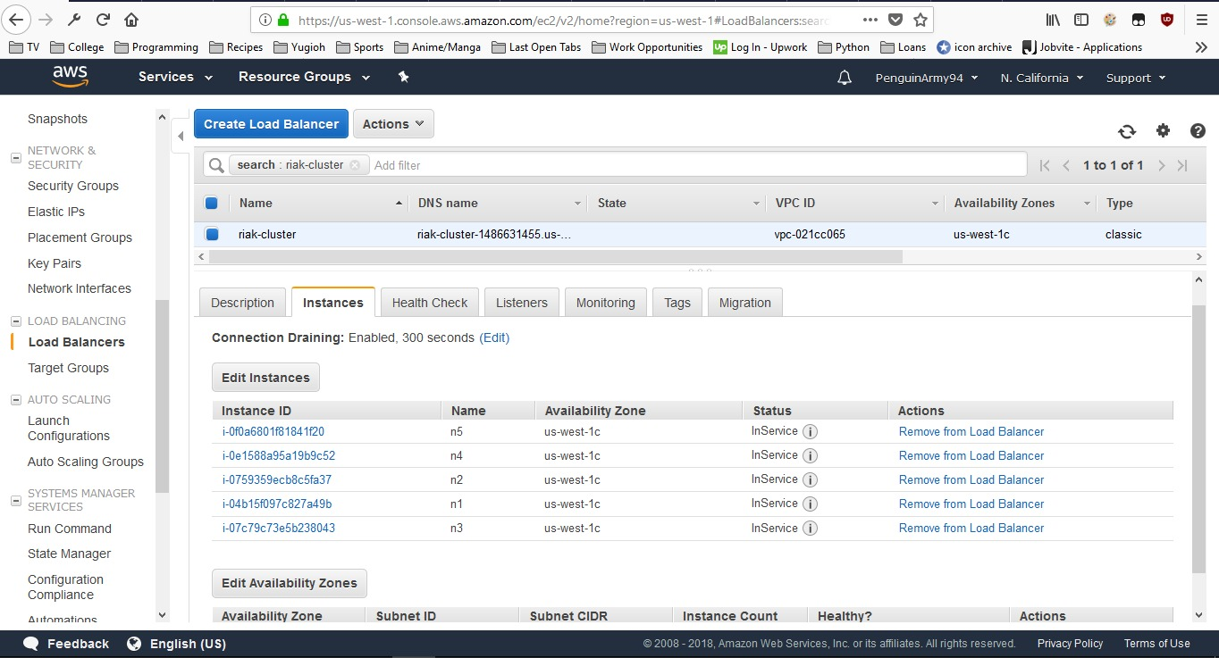
RIAK CLUSTERS ON ELB

