Slide 1
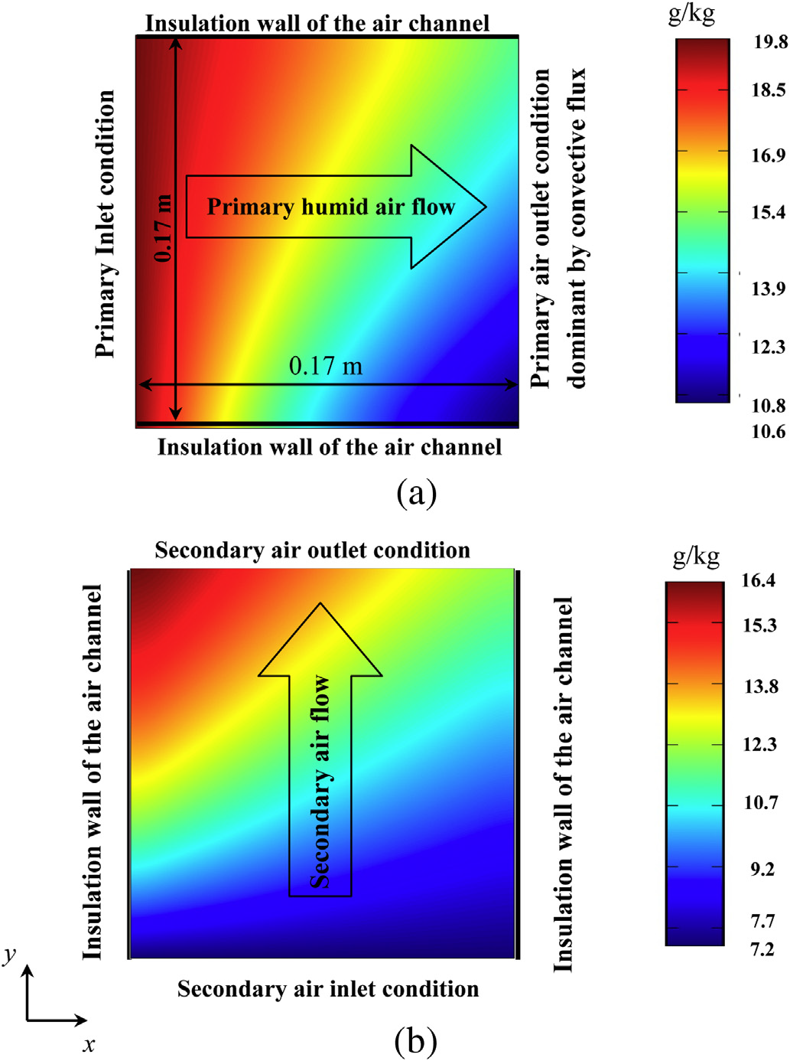
Temperaturverteilung an den Ausgängen eines Crossflow Enthalpieübertragers
Quelle: Analysis of a membrane based air-dehumidification unit for air conditioning in tropical climates, Khin ZAW, M. Reza Safizadeh, Joachim Luther, Kim Choon Ng, Applied Thermal Enginieering

Slide 2
Literatur:
Analysis of a membrane based air-dehumidification unit for air conditioning in tropical climates
Cross-flow membrane-based enthalpy exchanger balanced and unbalanced flow
Heat and moisture transfer in application scale parallel-plates enthalpy exchangers with novel membrane materials

Slide 3
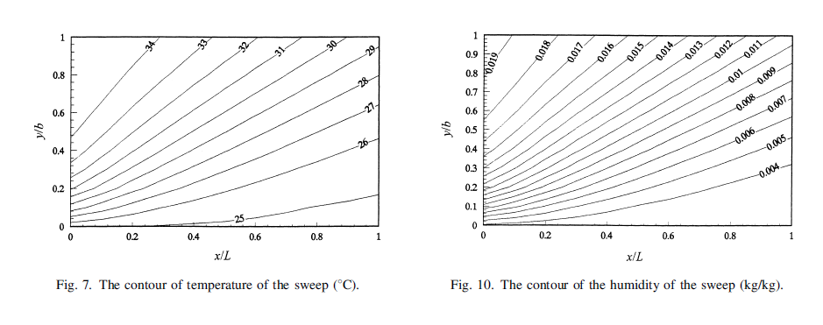
x
o
l
m
r
u
y
sweep
feed

Slide 4
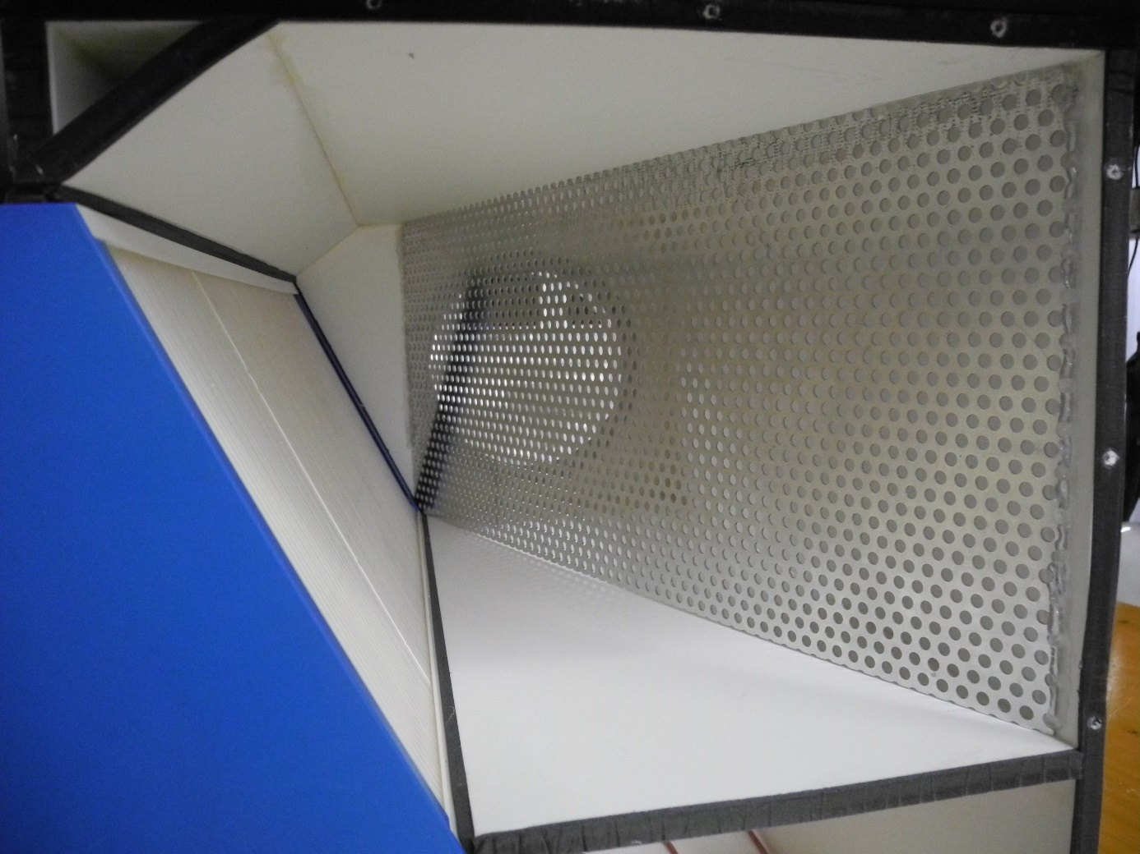
Anströmfläche
Lochblech

