Slide 1
Final Exam Review
BIOS 600 Summer Session II

Slide 2
Announcements
Reminder that HW 15 is due tonight by midnight
Please reach out to me over email with any questions you run into over the next few days! I will do my best to reply in a timely manner.
Tomorrow (7/24) I will plan to be in the classroom during our usual class time for open office hours

Slide 3
Exam Info
Reminder that the exam is closed-note – all you need to bring is a pencil (or pen)!
There are three categories of question – code-based, applications, and theory
Questions will be a mix of multiple-choice, true/false, and open response
Questions follow formats like the review questions on Canvas

Slide 4
Jeopardy game

Slide 5
Set-up/Rules
Split into three groups
Each group will work as a team to earn points, which are determined by the “worth” of the questions.
There are six categories, and each category has 5 questions with value ranging from $200 to $1000, with difficulty roughly aligned with the worth of the question.
If your group gets an answer correct, the worth of that question is added to your score; if you do not get the answer correct, it is subtracted from your score and the other teams will have the chance to answer it

Slide 6
Set-up/Rules
I’ll pick a group at random to start; they will pick a question off of the board (for example, “BIOS 600 fun facts for $400”)
Once the question is revealed, whichever group has someone raise their hand the fastest will then have 10 seconds to answer the question
Can answer in the form of a question or not, up to you
After we clear the first round, there will be a final jeopardy question, at which point your team can wager as many of your points as you want – if you get the question correct, that wager is added to your final score; if not, it is subtracted.

Slide 7
Two Final Rules
No referencing notes/the internet/textbooks! This is an opportunity for you to see what you know ahead of tomorrow’s exam.
I will read out loud the prompt. Groups may not raise their hands until the prompt has been read in full.

Slide 8
Correlation Station | Out on a (g)lm() | Assumptions | Beating the Odds | Interpretation, not Interpolation | Miscellany
$200 | $200 | $200 | $200 | $200 | $200
$400 | $400 | $400 | $400 | $400 | $400
$600 | $600 | $600 | $600 | $600 | $600
$800 | $800 | $800 | $800 | $800 | $800
$1000 | $1000 | $1000 | $1000 | $1000 | $1000

Slide 9
Correlation Station-$200
This type of correlation is the default for the R functions cor() and pcor.test().

Slide 10
What is Pearson’s correlation?

Slide 11
Correlation Station-$400
If two variables have ρ = 0.95, we could describe their association with this two-word phrase.

Slide 12
What is strongly positive?

Slide 13
Correlation Station-$600
This type of correlation is calculated using ranks.

Slide 14
What is Spearman’s correlation?

Slide 15
Correlation Station-$800
This function is used to make correlation heatmap plots.

Slide 16
What is ggcorrplot()?

Slide 17
Correlation Station-$1000
This quantity can be used to quantify the association between two variables, while accounting for possible confounder(s).

Slide 18
What is partial correlation?

Slide 19
Out on a (g)lm() - $200
This symbol separates your outcome variable from your predictor variable(s) in both the lm() and glm() functions.

Slide 20
What is ~?

Slide 21
Out on a (g)lm()-$400
To include multiple predictors in our model, we use this symbol between their names.

Slide 22
What is +?

Slide 23
Out on a (g)lm()-$600
For a linear model saved as “fit_lm”, the results of this test are printed in the last line of the output of summary(fit_lm).

Slide 24
What is an F-test?

Slide 25
Out on a (g)lm()-$800
To include an interaction term between two predictors in our model, we use this symbol between their names.

Slide 26
What is *?

Slide 27
Out on a (g)lm()-$1000
This argument is included in the glm() function to indicate a binary outcome.

Slide 28
What is family = “binomial”?

Slide 29
Assumptions - $200
This assumption means that each observation provides unique information.

Slide 30
What is independence?

Slide 31
Assumptions - $400
A histogram of these values can be used to test the normality assumption for linear models.

Slide 32
What are residuals?

Slide 33
Assumptions-$600
A scatterplot of these two quantities can be used to test the constant variance and linearity assumptions.

Slide 34
What are residuals and fitted values?

Slide 35
Assumptions-$800
This phrase is a more formal version of the constant variance assumption.

Slide 36
What is the homogeneity of variance assumption?

Slide 37
Assumptions - $1000
This phrase describes the process of checking assumptions within a regression model.

Slide 38
What is regression diagnostics?

Slide 39
Beating the Odds-$200
For an event with probability p, we can use this expression to calculate the odds of that event.

Slide 40
What is p/(1-p)?

Slide 41
Beating the Odds-$400
This type of model often uses odds in its interpretation of coefficients.

Slide 42
What is logistic regression?

Slide 43
Beating the Odds-$600
This function is applied to coefficients of logistic regression models for the odds ratio interpretation.

Slide 44
What is exp()?

Slide 45
Beating the Odds-$800
This is the formal name for the log-odds.

Slide 46
What is logit?

Slide 47
Beating the Odds-$1000
In a logistic regression model, a coefficient with this value is equivalent to an odds ratio of 1.

Slide 48
What is zero?

Slide 49
Interpretation, Not Interpolation-$200
In a simple linear regression model, the slope of a continuous predictor corresponds to the change in outcome for this change in that predictor.

Slide 50
What is a one-unit increase?

Slide 51
Interpretation, Not Interpolation-$400
In a multivariable linear regression model, this interpretation is used for the coefficient of a dummy variable for a categorical variable with a reference category.

Slide 52
What is the difference in predicted outcome compared to the reference category (holding all other variables constant)?

Slide 53
Interpretation, Not Interpolation-$600
In a linear model with only a four-level categorical predictor, this coefficient is interpreted as the expected outcome for a sample in the reference category.

Slide 54
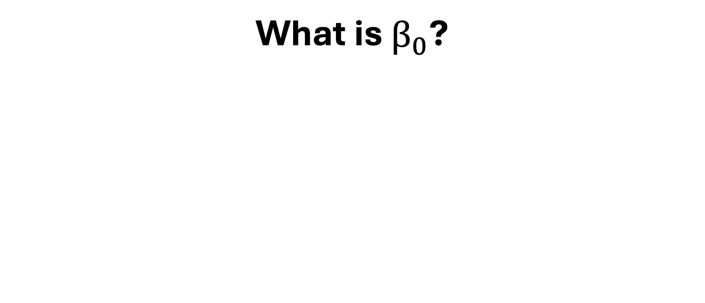
What is $β_{0}$?

Slide 55
Interpretation, Not Interpolation - $800
In a simple linear regression, this is required for the intercept to be interpretable.

Slide 56
What is a predictor that can take on values at or near 0?

Slide 57
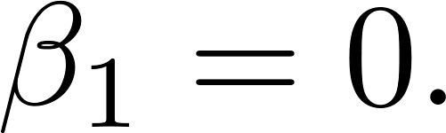
Interpretation, Not Interpolation-$1000
This is the general version (in words) of the interpretation of the alternative hypothesis for the null hypothesis

Slide 58
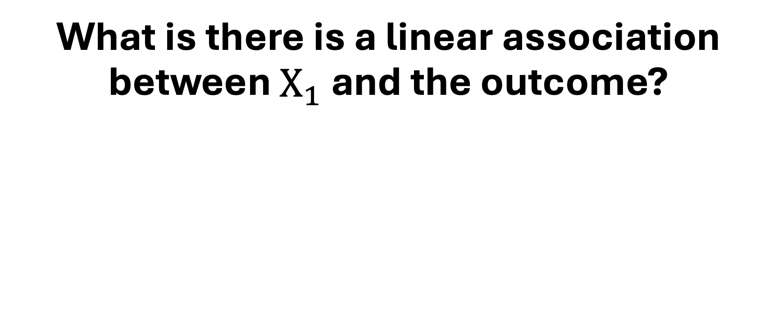
What is there is a linear association between $X_{1}$ and the outcome?

Slide 59
Miscellany-$200
The test statistic for testing a single coefficient in a linear model follows this kind of distribution.

Slide 60
What is a t-distribution?

Slide 61
Miscellany-$400
When you think that the association between the outcome and a predictor changes depending on the value of another predictor, you include this type of term in your model.

Slide 62
What is an interaction term?

Slide 63
Miscellany-$600
This is the range of the log-odds function.

Slide 64
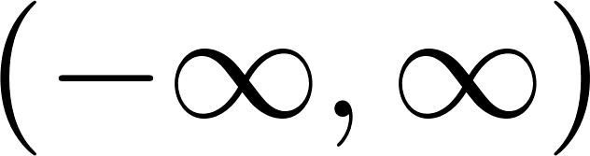
What is ?

Slide 65
Miscellany-$800
This R function produces a grid containing scatterplots, correlation values, and density estimates.

Slide 66
What is ggpairs()?

Slide 67
Miscellany-$1000
This function can be used to change the reference category manually in R.

Slide 68
What is fct_relevel()?

Slide 70
Final Jeopardy – Hypothesis Testing

Slide 71
Final Jeopardy
You decide to run a multivariable linear regression model to evaluate the association between treatment and systolic blood pressure for a clinical trial with 750 participants. You have reason to believe that this association changes depending on disease stage (1, 2, or 3) and a patient’s age (continuous). This is your model:
This is the distribution of the test statistic for the overall F-test on your model.

Slide 72
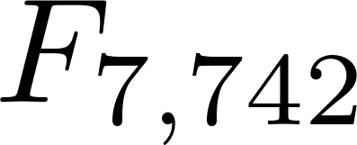
What is ?

