Slide 1
Lec 1: Course overview & What is statistical inference?
BIOS 600 - Summer Session II 2026

Slide 2
Welcome! Meet Molly
5th year PhD student, Department of Biostatistics
Originally from Connecticut, but lived in Boston for 8 years before moving here
Interests: Spending time outdoors, reading, watching movies
Office Hours: Mondays and Wednesdays 1-3pm.

Slide 3
Check out Ed Discussion
This semester, you can ask questions about the class in our discussion forum, Ed Discussion
The link to join is also posted on our home page in Canvas.
Take a moment to introduce yourself in the forum! Name, Year + Program, and a fun fact about yourself.

Slide 4
Course overview: Canvas
All course materials by day: syllabus, discussion forum link, class slides, lab materials, assignments
Let’s take a tour!

Slide 5
Course toolkit
RStudio
Assignment submission and feedback: Gradescope
Discussion forum: Ed Discussion

Slide 6
What have I gotten myself into?
BIOS 600 is an introduction to “principles of statistical inference” in biostatistics that:
provides a tour of basic statistical methods commonly encountered in public health and biomedical research,
emphasizes understanding of methods, using them to arrive at data-driven decisions, and effective communication of such results.
Utilizes modern software such as RStudio to reproducibly examine and manipulate data to make sound scientific conclusions

Slide 7
My goals in the course
Introduce you to basic biostatistics toolkit so that you can apply it to your own projects in the future, if you choose!
Build community!

Slide 8
Activities: Participate, Practice, Perform
Participate: Attend and actively participate in lectures and labs, office hours
Practice: Practice applying statistical concepts and computing with lab exercises
Review course topics with occasional participation exercises, typically a few questions administered via Canvas. Annotated notes will be uploaded after class.
Perform: Put together what you’ve learned to analyze real-world data
Homework assignments
Three in-class exams

Slide 9
Cadence
Lecture: Monday-Thursday 9:30-11:00am. Approx. 1 hour 10 min of lecture, 20 minutes of homework time/open office hours.
Labs: Fridays 9:30-11:00am. Tutorial video and assignment will be posted Wednesday around 5:00 PM. Lab time will be used to answer clarification questions and work on assignment; assignments due following Monday by 11:59pm.
HWs: Posted daily, typically due by 11:59pm the next day.
Exams: 3 in-class exams, more info as semester progresses.

Slide 10
What to expect in lab
Lab session will be Fridays from 9:30-11:00, same room as lecture
Instructions and tutorial video will be posted on Canvas on Wednesday by 5 PM.

Slide 11
Tips
You do not have to finish the lab during the lab session, they will always be due the following Monday at 11:59 pm.
One work strategy is to get through portions that you think will be most challenging (which initially might be the coding component) during lab when I can help you on the spot and leave the narrative writing until later.
Use the time wisely to really learn the material and produce a quality report.

Slide 12
Grading
Category | Percentage
Homework | 40%
Labs | 15%
Exams | 40%
Participation | 5%

Slide 13
See the course syllabus (available on Canvas) for how the final letter grade will be determined.

Slide 14
Textbooks
Recommended: (free online)
OpenIntro Statistics, Diez, Barr, Çetinkaya-Rundel, CreateSpace, 4th Ed. (2019)
R for Data Science, Wickham and Grolemund, O’Reilly Media, 1st Ed. (2017)
Optional:
Principles of Biostatistics, Pagano and Gavreau, CRC Press, 2nd Ed. (2018)

Slide 15
Support
Attend office hours
Ask and answer questions on the discussion forum, Ed Discussion
Reserve email for questions on personal matters and/or grades
Additional support resources in the syllabus

Slide 16
Announcements
Posted on Canvas (Announcements tool) and sent via email, be sure to check both regularly
I’ll assume that you’ve read an announcement by the next “business” day

Slide 17
Diversity + inclusion
It is my intent that students from all diverse backgrounds and perspectives be well-served by this course, that students’ learning needs be addressed both in and out of class, and that the diversity that the students bring to this class be viewed as a resource, strength and benefit.
If you have a name that differs from those that appear in your official UNC records, please let me know!
Please let me know your preferred pronouns. You’ll also be able to note this in the Getting to know you survey.
If you feel like your performance in the class is being impacted by your experiences outside of class, please don’t hesitate to come and talk with me. I want to be a resource for you.
If you prefer to speak with someone outside of the course, your advisers and deans are excellent resources.

Slide 18
Diversity + Inclusion
I (like many people) am still in the process of learning about diverse perspectives and identities. If something was said in class (by anyone) that made you feel uncomfortable, please talk to me about it.

Slide 19
Course policies: Late work
HW & Labs: Deadlines are there to help you stay on track. However, I know that life happens! You have a 12-hour grace period to turn in homework and labs with a 5% penalty. No HW/Labs will be accepted after the 24-hour grace period, except in extenuating circumstances.
Lowest HW will be dropped.
No late work will be accepted for exams.

Slide 20
Collaboration policy
Only work that is clearly assigned as team work should be completed collaboratively.
Homeworks must be completed individually. You may not directly share answers / code with others, however you are welcome to discuss the problems in general and ask for advice.

Slide 21
AI policy
Use of artificial intelligence (AI): You should treat AI tools, such as ChatGPT, the same as other online resources.
There are two guiding principles that govern how you can use AI in this course:
Cognitive dimension: Working with AI should not reduce your ability to think clearly. We will practice using AI to facilitate—rather than hinder—learning.
Ethical dimension: Students using AI should be transparent about their use and make sure it aligns with academic integrity.

Slide 22
AI for code
AI tools for code: You may make use of the technology for coding examples on assignments; if you do so, you must explicitly cite where you obtained the code, and share the AI prompt(s) you used.
Any recycled code that is discovered and is not explicitly cited will be treated as plagiarism.

Slide 23
No AI for narrative
No AI tools for narrative: Unless instructed otherwise, AI is not permitted for writing narrative on assignments. In general, you may use AI as a resource as you complete assignments but not to answer the exercises for you. You are ultimately responsible for the work you turn in; it should reflect your understanding of the course content.

Slide 24
Sharing / reusing code policy
Unless explicitly stated otherwise, this course’s policy is that you may make use of any online resources (e.g. RStudio Community, StackOverflow, ChatGPT, etc.) but you must explicitly cite where you obtained any code you directly use or use as inspiration in your solution(s).
I know that you will have access to the internet and AI in the real world. However, you are required to understand (& be able to explain) every line of code you’re turning in.
Exams will be held in person and completed without laptops or AI tools. It is therefore to your benefit that you are able to understand and solve problems independently.
Any recycled code that is discovered and is not explicitly cited will be treated as plagiarism, regardless of source.
Most importantly…
Ask if you’re not sure if something violates a policy!

Slide 25
Three tips for success
I am here to help you succeed! :-)
Ask questions.
Do the homework and labs.
Be proactive, even with the small questions!

Slide 26
Cultivating a supportive learning environment
I want to make sure that you learn everything you were hoping to learn from this class. If this requires flexibility, please don’t hesitate to ask.
You never owe me personal information about your health (mental or physical) but you’re always welcome to talk to me. If I can’t help, I likely know someone who can.
I want you to learn lots of things from this class, but I primarily want you to stay healthy, balanced, and grounded.

Slide 27
Questions
What questions do you have?

Slide 28
What is statistical inference (in a biostatistics context)?
A process that converts data into useful information, whereby practitioners
form a question of interest
collect and summarize data
interpret the results

Slide 29
Identifying the population and question of interest
The population is the group we’d like to learn something about:
What is the prevalence of diabetes among U.S. adults, and has it changed over time?
Is there a relationship between tumor type and five-year mortality in breast cancer patients?
Does the average amount of caffeine vary by vendor in 12 oz cups of coffee at UNC coffee shops?
If we had data from every unit in the population, we could just calculate what we wanted and be done!

Slide 30
Sampling from the population
Unfortunately, we (usually) have to settle with a sample from the population.
Ideally, the sample is representative, allowing us to use probability and statistical inference to make conclusions that are generalizable to the broader population of interest.

Slide 31
Sampling methods
Probability sampling (e.g., simple random sampling, stratified, cluster, or multi-stage sampling)
All units have a known chance of being selected
More likely to be generalizable
Can be more expensive and time-consuming
Non-probability sampling (e.g. quota, convenience, or snowball sampling)
Some units unable to be selected, with no way of knowing size or effect of sampling errors
Less generalizable to population of interest
More convenient and less costly

Slide 32
Study design
Experimental studies (e.g. randomized control trials (RCTs))
Researchers directly control exposures or treatment groups.
Ability to make causal statements
Less real-world applicability and generalizability
Observational studies (e.g. surveys)
Researchers do not assign exposures or treatments
Real-world setting with lower burden on participants
Inability to prove causality

Slide 33
Example
Study: The effect of a new diet on weight loss in adults
Objective: To determine whether a new low-carbohydrate diet leads to significant weight loss compared to a standard diet in adults.
Study Design:
Participants: 100 adults aged 25-45 with a BMI between 25 and 30
Randomization: Participants are randomly assigned to one of two groups:
Group A: 50 participants following the new low-carb diet
Group B: 50 participants following a standard diet.
Intervention: Group A follows the new diet for 12 weeks, while Group B follows their usual diet (standard diet)
Outcome measurement: Weight of participants is measured before the study begins and after 12 weeks.

Slide 34
Example
In small groups, discuss the following:
Is this study an observational or experimental study? Why?

Slide 35

What can go wrong?
Depending on the study design and sampling methods, different types of bias occur (again, we don’t have the full population, only a sample).
Examples include:
Selection bias: sample does not accurately reflect target population
Reporting bias: tendency to under-report all information available
Many more: non-response bias, attrition bias, confounding, detection bias, lack of blinding, straight-up falsified data (this happens)…and more!

Slide 36
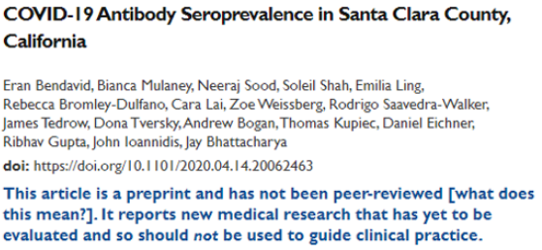
A few years ago…

Slide 37
link to article
seroprevalence = level of pathogen in a population
From Conclusion: “The estimated prevalence of SARS-CoV-2 antibodies in Santa Clara County implies that COVID-19 was likely more widespread than indicated by the number of cases in late March, 2020”.

Slide 38
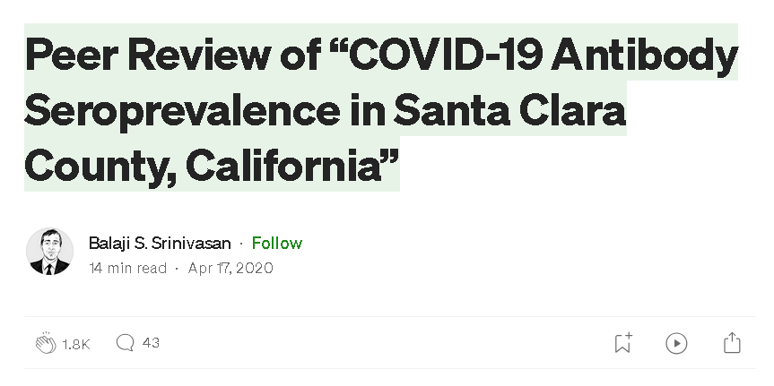
However…

Slide 39
What do some other people have to say about this study…?

Slide 40
Three main issues brought up in blog
Sampling bias
Study recruited participants through Facebook ads, may have attracted people more concerned about COVID-19 or those who thought they were already exposed $→$ overestimation of seroprevalence (level of pathogen in a population)
Symptomatic/exposed individuals may have signed up to get tested, especially when testing was limited.
Participants may have recruited others in their network
Without a truly random sample, findings are less generalizable and reproducible

Slide 41
The issues, continued
Statistical adjustments: High false positive rate could drive results
Study had high false positive rate (2 FP out of 401 known negative samples, about 0.5%), but with a wide confidence interval! (FP Rate could be above 1.2%)
Study reported only 50 positives out of ~3300 participants, so such a high FP rate could account for a significant portion - if not all - of the positive results. ($\frac{2}{401}⋅3300=17$) Yikes!
It could even be more! (re-calibrate the assay on a different set of 401 known negative samples, you may get 0/401 FP or even 6/401).

Slide 42
The issues, continued
Transparency
Study does not make its raw data, code, and full methodology publicly available
Without access to these, other researchers cannot replicate the study or verify its findings, undermining the reproducibility of the research
Transparency essential for the scientific process (particularly in high-stakes studies!)

Slide 43
Reproducibility and replicability
Reproducibility: being able to take original data and code to reproduce all numerical findings.
Replicability: being able to independently repeat an entire study without use of the original data (generally with the same methods)
Best practices from the American Statistical Association:
End-to-end scripting of research
From the moment you “read in” your raw data, document the code you used for data cleaning, visualization, and analysis
Use of version control and documentation (we will not use this in our class)
Publication of code along with data

Slide 44
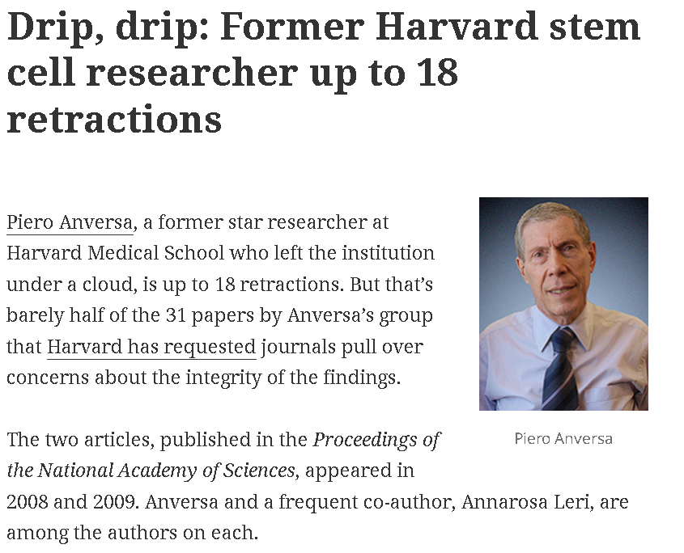
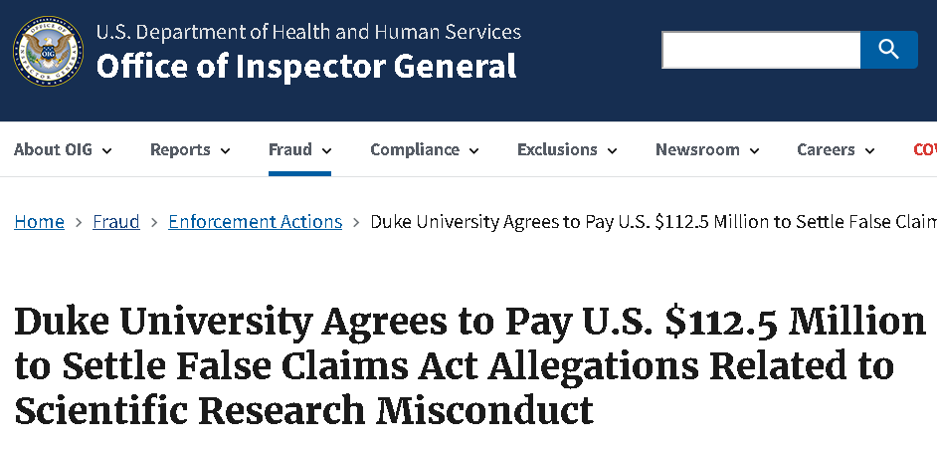
The current replication crisis

Slide 45
Fraudulent data can lead to unreliable research findings, waste resources, and erode trust in scientific integrity!

Slide 46
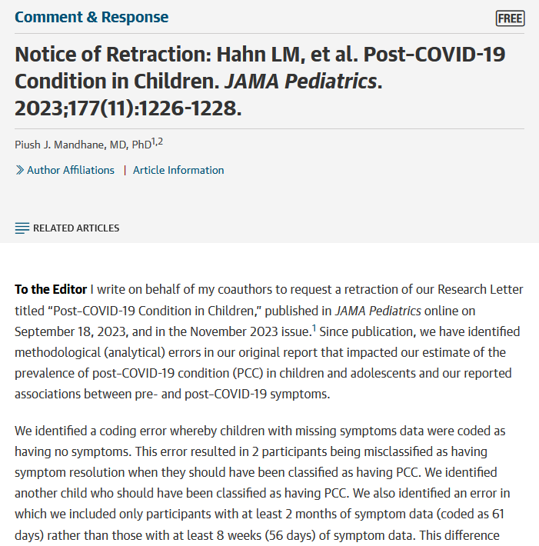
Replication and Transparency as a Path to Self-Correction
Sharing code and data can help identify even accidental mistakes

Slide 47
What is biostatistics good for?
📊 Turning Data Into Insight Biostatistics helps us move beyond raw numbers to identify meaningful patterns in health and disease.
🧪 Evaluating Interventions From vaccines to health policies, biostatistics allows us to rigorously test what really works.
🌍 Promoting Health Equity Careful analysis helps uncover disparities in health outcomes and guide solutions for underserved communities.
🔮 Forecasting & Prevention Models help us anticipate outbreaks, chronic disease trends, and the impact of prevention strategies.
🏥 Improving Patient Care Biostatistics drives evidence-based medicine by connecting research to better clinical decisions.

Slide 48
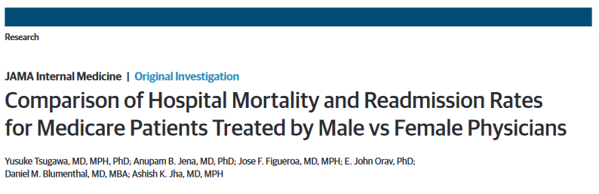
What is biostatistics good for?
When we appropriately apply statistical inference methods, they can do a lot of good!

Slide 49
Link to Study

Slide 50
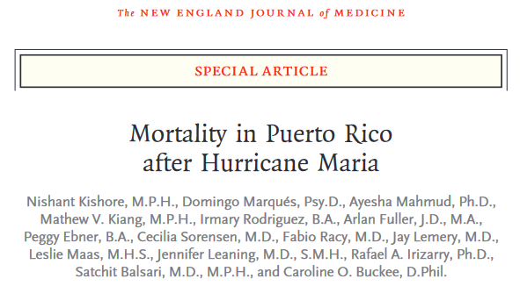
What is biostatistics good for?

Slide 51
Link to Study

Slide 52
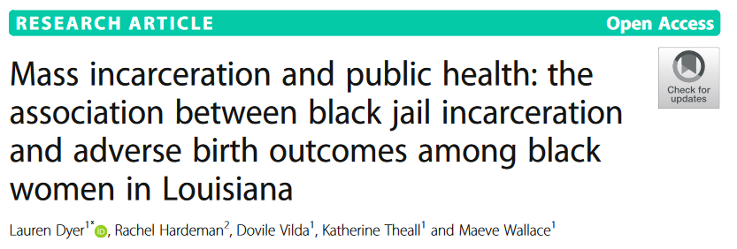
What is biostatistics good for?

Slide 53
Link to Study

Slide 54
In this course, we will…
Apply descriptive techniques commonly used to summarize public health data.
Learn methods to analyze real-world data to answer research questions in a biomedical setting.
Use Quarto within RStudio (now Posit) to write reproducible reports.
Reading in data, cleaning data, visualization, analysis, interpretation
Communicate results from statistical analyses to a general audience.

Slide 55
Getting to know R and RStudio

Slide 56
Recap
What is (bio)statistical inference?
Identifying the population of interest
Sampling types and biases
Reproducibility crisis: falsifying data
Biostatistics for public good!

Slide 57
Next class
Probability Basics

