Slide 1
Exam 1 Review
BIOS 600 Summer Session II

Slide 2
Exam Info
Reminder that the exam is closed-note – all you need to bring is a pencil (or pen)!
There are three categories of question – code-based, applications, and theory
Questions will be a mix of multiple-choice, true/false, and open response
Questions follow formats like the review questions on Canvas

Slide 3
Jeopardy game

Slide 4
Set-up/Rules
Split into three groups
Each group will work as a team to earn points, which are determined by the “worth” of the questions.
There are six categories, and each category has 5 questions with value ranging from $200 to $1000, with difficulty roughly aligned with the worth of the question.
If your group gets an answer correct, the worth of that question is added to your score; if you do not get the answer correct, it is subtracted from your score and the other teams will have the chance to answer it

Slide 5
Set-up/Rules
I’ll pick a group at random to start; they will pick a question off of the board (for example, “BIOS 600 fun facts for $400”)
Once the question is revealed, whichever group has someone raise their hand the fastest will then have 10 seconds to answer the question
Can answer in the form of a question or not, up to you
After we clear the first round, there will be a final jeopardy question, at which point your team can wager as many of your points as you want – if you get the question correct, that wager is added to your final score; if not, it is subtracted.

Slide 6
Tidyverse | Data Types | Diagnostics | Distributions | Probability | Miscellany
$200 | $200 | $200 | $200 | $200 | $200
$400 | $400 | $400 | $400 | $400 | $400
$600 | $600 | $600 | $600 | $600 | $600
$800 | $800 | $800 | $800 | $800 | $800
$1000 | $1000 | $1000 | $1000 | $1000 | $1000

Slide 7
Tidyverse -$200
This dplyr function allows you to choose specific columns in a data frame.

Slide 8
What is select()?

Slide 9
Tidyverse -$400
This ggplot geometry will produce a scatterplot.

Slide 10
What is geom_point()?

Slide 11
Tidyverse -$600
This symbol is used to designate the output of one line of code as the input to the next line in dplyr.

Slide 12
What is a pipe (or |> or %>%)?

Slide 13
Tidyverse -$800
This logical operator is used to assess if two variables are exactly equal.

Slide 14
What is ==?

Slide 15
Tidyverse -$1000
This parameter of the ggplot() function can be used to tell R what variable(s) corresponds to the x axis or the color of the plot, among other things.

Slide 16
What is aes()?

Slide 17
Data Types -$200
One example of this data type is binary data.

Slide 18
What is categorical nominal?

Slide 19
Data Types -$400
This visualization is used to show the frequency distribution for numerical data.

Slide 20
What is a histogram?

Slide 21
Data Types -$600
Examples of this data type include age, calories consumed, and height.

Slide 22
What is numerical continuous?

Slide 23
Data Types -$800
This is a summary statistic for numerical data which describes the most frequent value in the dataset.

Slide 24
What is a mode?

Slide 25
Data Types -$1000
An example of this data type is the “often, sometimes, rarely, never” scale.

Slide 26
What is categorical ordinal?

Slide 27

Diagnostics-$200
 | Flu + | Flu - | Total
Test + | 22 | 10 | 32
Test - | 3 | 65 | 68
Total | 25 | 75 | 100
$$25\%$$

Slide 28
What is prevalence?

Slide 29
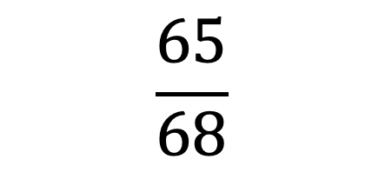
Diagnostics-$400
 | Flu + | Flu - | Total
Test + | 22 | 10 | 32
Test - | 3 | 65 | 68
Total | 25 | 75 | 100
$$\frac{65}{68}$$

Slide 30
What is negative predictive value?

Slide 31
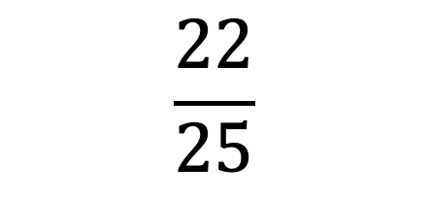
Diagnostics-$600
 | Flu + | Flu - | Total
Test + | 22 | 10 | 32
Test - | 3 | 65 | 68
Total | 25 | 75 | 100
$$\frac{22}{25}$$

Slide 32
What is sensitivity?

Slide 33
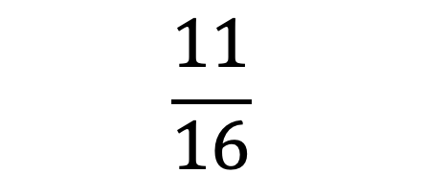
Diagnostics-$800
 | Flu + | Flu - | Total
Test + | 22 | 10 | 32
Test - | 3 | 65 | 68
Total | 25 | 75 | 100
$$\frac{11}{16}$$

Slide 34
What is positive predictive value?

Slide 35
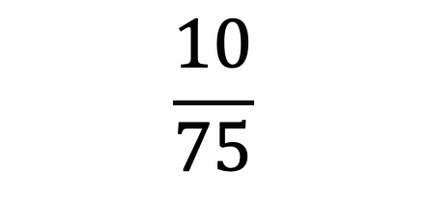
Diagnostics-$1000
 | Flu + | Flu - | Total
Test + | 22 | 10 | 32
Test - | 3 | 65 | 68
Total | 25 | 75 | 100
$$\frac{10}{75}$$

Slide 36
What is the false positive rate?

Slide 37
Distributions-$200
This distribution is used to model the number of successes in a finite series of Bernoulli trials.

Slide 38
What is the binomial distribution?

Slide 39
Distributions-$400
This distribution has equal expectation and variance.

Slide 40
What is Poisson?

Slide 41
Distributions-$600
Increasing the value of this parameter for the normal distribution will make is probability density function shorter and wider.

Slide 42
What is variance?

Slide 43
Distributions-$800
This quantity can be used to compare values from different normal distributions.

Slide 44
What is a z-score?

Slide 45
Distributions-$1000
For X ~ Binom(15, 0.25), this line of R code would calculate P(X = 4).

Slide 46
What is dbinom(4, 15, 0.25)?

Slide 47
Probability-$200
This symbol is used to mean “and” in probability.

Slide 48
What is ⋂ (intersection)?

Slide 49

Probability-$400
This rule allows us to calculate $P(A^{C})$ when we know P(A).

Slide 50
What is the complement rule?

Slide 51
Probability-$600
This is the adjective used to describe two events where A ⋂ B = Ø.

Slide 52
What is disjoint?

Slide 53
Probability-$800
This rule lets us swap the order of conditioning.

Slide 54
What is Bayes’ Rule?

Slide 55

Probability-$1000
${P(A ∩ B)}^{C }= {P(A)}^{C}∪{P(B)}^{C}$ is part of this set of laws.

Slide 56
DeMorgan’s Laws

Slide 57
Miscellany-$200
This type of study allows you to make causal statements about the results.

Slide 58
What is an experimental study?

Slide 59
Miscellany-$400
This R chunk option will hide the code itself, but print anything produced by the code (like a graph or table).

Slide 60
What is #| echo: FALSE?

Slide 61
Miscellany-$600
This is the total area under any probability density function.

Slide 62
What is 1?

Slide 63
Miscellany-$800
This term refers to independently repeating an entire study without use of the original data.

Slide 64
What is replicability?

Slide 65
Miscellany-$1000
This type of visualization is often used with time data on the x-axis.

Slide 66
What is a line plot?

Slide 68
Final Jeopardy – Diagnostic Testing

Slide 69
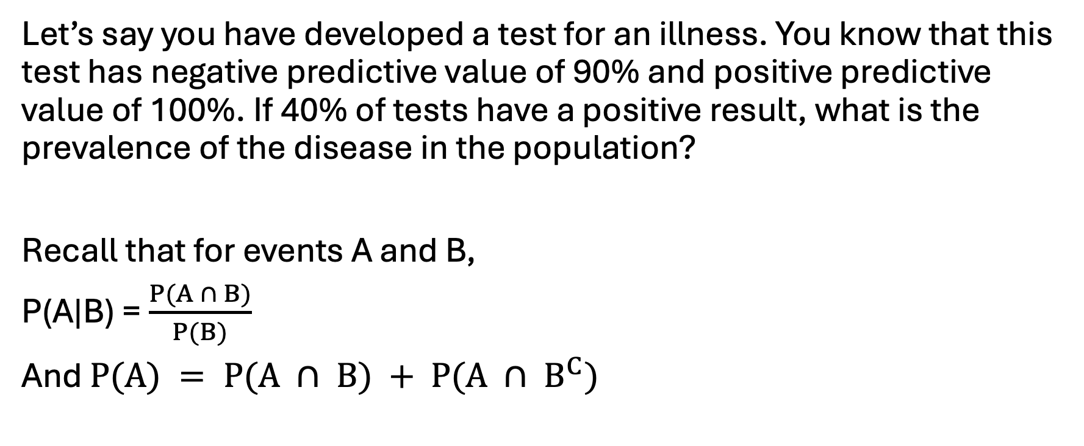
Final Jeopardy
Let’s say you have developed a test for an illness. You know that this test has negative predictive value of 90% and positive predictive value of 100%. If 40% of tests have a positive result, what is the prevalence of the disease in the population?
Recall that for events A and B,
P(A|B) = $\frac{P(A ∩ B)}{P(B)}$
And $P(A) = P(A ∩ B) + P(A ∩ B^{C})$

Slide 70
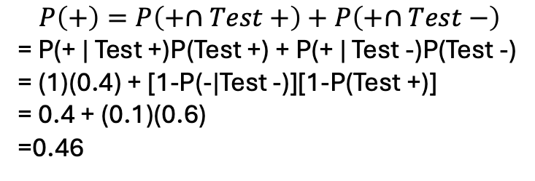
$$P\left(+\right)=P\left(+∩Test+\right)+P\left(+∩Test−\right)$$
= P(+ | Test +)P(Test +) + P(+ | Test -)P(Test -)
= (1)(0.4) + [1-P(-|Test -)][1-P(Test +)]
= 0.4 + (0.1)(0.6)
=0.46
I won’t be asking you to perform any calculations this involved on the exam!
Alternative approach:
 | Test + | Test - | Total
+ | 40 | 6 | 46
- | 0 | 54 | 54
Total | 40 | 60 | 100

