Slide 1
Amazon
Test Suite
CEN 3078
Software Testing
& Automation
8 test classes
41 test cases
Full search and cart flow
Automated UI Testing with
Selenium WebDriver & TestNG
Lujens Pierre · Micah Hodges

Slide 2
01 — PROJECT GOAL
What we set
out to build.
01
Verify UI Elements
Confirm core components load correctly across all major page types.
02
Test Real User Flows
Build a comprehensive automated test suite that validates key Amazon.com user flows, from homepage navigation and search all the way through to the cart and checkout process.
Simulate actual user actions: search, add to cart, proceed to checkout.
03
Automate Regression
Provide a repeatable suite that catches UI regressions immediately.

Slide 3
02 — WORKFLOW
How the suite runs.
1
2
3
4
5
6
Launch
Init
Navigate
Execute
Assert
Report
testng.xml fires the suite
@BeforeClass starts Chrome
openHomePage() loads Amazon
@Test methods run
Verify expected outcomes
@AfterClass closes browser
Test Classes
— AmazonHomePageTest
— AmazonSearchTest
— AmazonProductPageTest
— AmazonCartTest
— AmazonCategoryTest
— AmazonNavigationMenuTest
— AmazonFooterLinksTest
— AmazonLanguageRegionTest

Slide 4
03 — CONTRIBUTIONS
Who built what.
Lujens Pierre
Micah Hodges
– Full test suite review & debugging
– AmazonSearchTest & AmazonProductPageTest
– AmazonCartTest — add-to-cart flow
– AmazonHomePageTest & AmazonCartTest
– Chrome profile automation setup
– AmazonCategoryTest & AmazonNavigationMenuTest
– PowerPoint & demo walkthrough
– AmazonFooterLinksTest & AmazonLanguageRegionTest

Slide 5
04 — TOOLS
The stack.
Java
TestNG
Primary language for all test classes.
@Test, @BeforeClass, dependsOnMethods.
Selenium 4.x
WebDriverManager
WebDriver API — browser automation & JS execution.
Auto ChromeDriver version handling.
Maven
IntelliJ IDEA
Build tool and dependency management.
Development, debugging, test runner.
Chrome Profile
Chrome DevTools
Dedicated session with Amazon login — bypasses bot detection.
DOM inspection to identify correct element selectors.

Slide 6
— CHALLENGES
What got in the way.
01
Dynamic Web Elements
02
Add to Cart Button
Amazon has a dynamic UI which led to IDs/classes changing, different layouts, or different search results.
The Add to Cart button on Amazon has opacity: 0.01 ,it exists in the DOM but Selenium's isDisplayed() returns false, causing every selector check to fail even when the button was right there on the page.
How we handled it
How we handled it
Used flexible locators such as CSS selectors instead of rigid XPaths. Also added helper methods like elementExists() and pageContainsAny() for particularly difficult locators.
Switched from isDisplayed() checks to pure DOM presence, findElements().isEmpty(). Then used a JavaScript executor click (jsClick()) to fire the button directly, bypassing Selenium's native click which the opacity overlay was intercepting. Also built a helper that scans all /dp/ product links on the search page and tries each one until it finds a page with the button in the DOM.

Slide 7
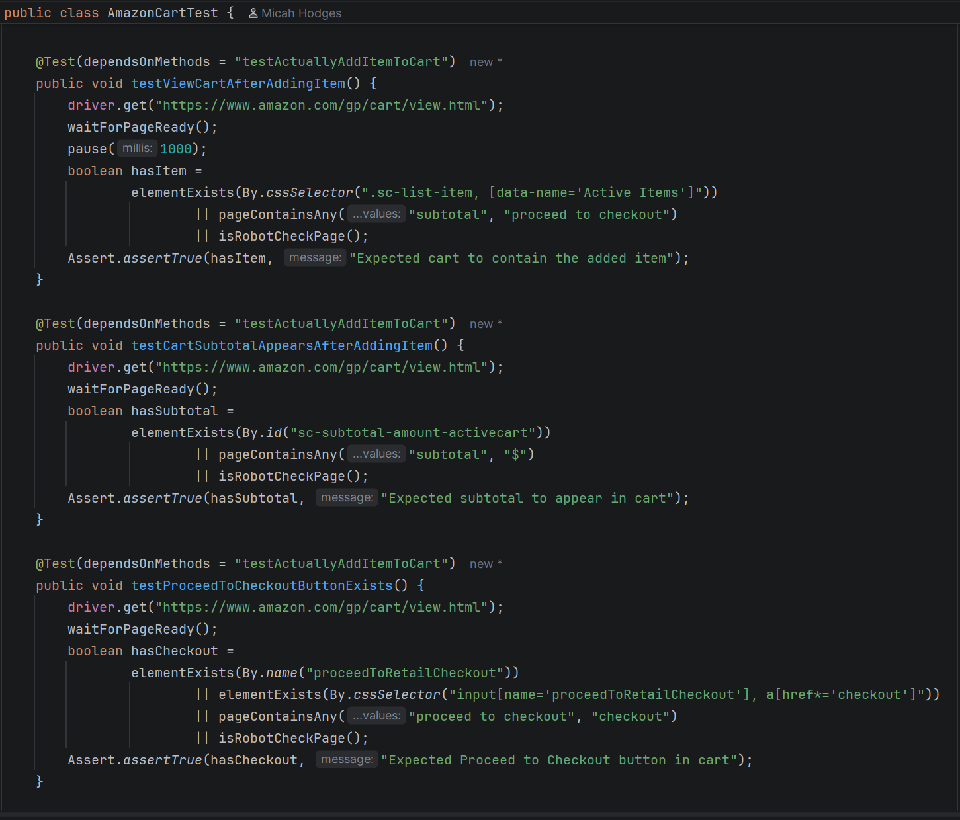
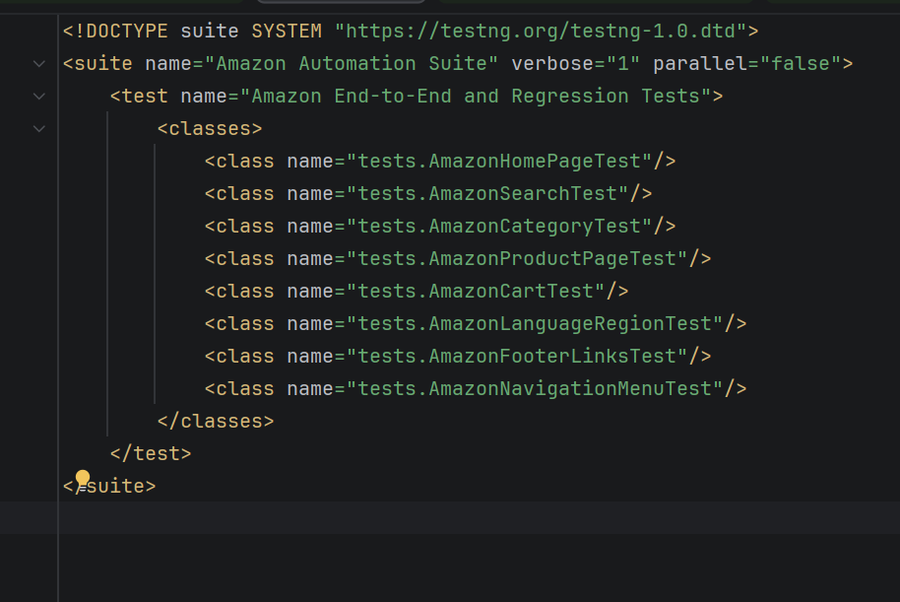
05 — CODE SNIPPET
A closer look.

Slide 8
06 — DEMO
See it in action.

