Slide 1

AMAZON WEB SERVICES
Network Storage
EBS / EFS
[Marcin Hoffman] / [Professor:Victor Govidaswamy] / [09/20/2026]

Slide 2

Amazon EFS
Elastic File System
Characteristics
Multiple EC2 instances across AZ’s
Highly Available
Relativity Expensive
Pay-per-use
Only compatible with Linux not Windows
Notes:
Now we are going to take a look at Amazons EFS or Elastic File System
EFS is a Managed Network File System that you are able to attach to almost any EC2 instance. In contrast to EBS you are able to attach these files through multiple different availability zones.
When using your EFS system, it will be surrounded by a Security Group which essentially acts as a virtual firewall, it will allow for you to better manage the resources that allowed or not allowed to connect to your EFS, it handles incoming and outgoing traffic through ip addresses, protocols etc
In addition the EFS uses the NFSv4.1 protocol, which is what allows your EFS files to be accessed over a network as if they were stored locally, essentially what allows for the use of multiple EC2 instances without problems.
The biggest problems you will see with EFS is that it is three times as expensive as the EBS gp2 storage we mentioned before.
Also Efs is not compatible with windows and is only for Linux based workloads, it uses the POSIX file system where Linux applications are able to use familiar operations and permissions.

Slide 3
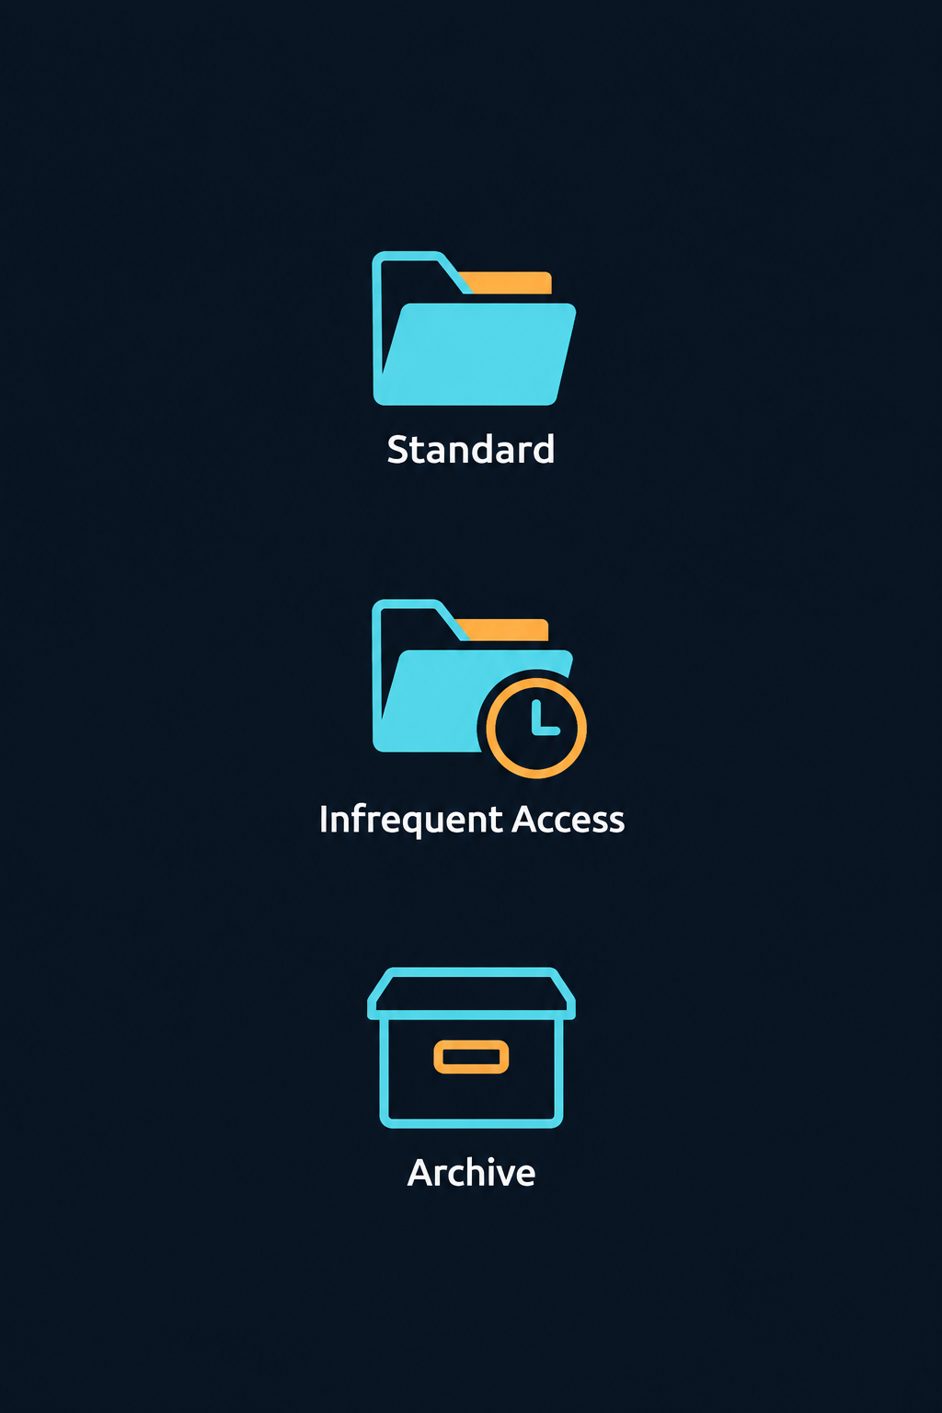
Amazon EFS
Storage Tiers & Management
Classes
Standard
(EFS-IA) Infrequent Access
Archive
Lifecycle Policy
Allow for the movement of files
Notes:
“Amazon EFS offers three storage classes to balance performance and cost.
Standard is for frequently accessed files that need fast access.
Infrequent Access, or EFS-IA, reduces storage costs for files used only occasionally.
Archive offers even lower storage costs for files that are rarely accessed. Both IA and Archive have additional data-access charges, so they suit less active data.
Lifecycle policies automatically move files between these classes based on how long they have gone without being accessed. For example, you could move inactive files to IA after 30 days and Archive after 90 days. You can also enable a policy that moves them back to Standard when accessed again.”

