Slide 1


ASP.NET Core a použití
s kontejnery (Docker)
Miroslav Holec
Software Architect | MVP: Microsoft Azure | MCSD, MCSA, MTA
mirek@miroslavholec.cz
miroslavholec.cz
miroslavholec.cz
vývoj aplikací – proof of concepts – konzultace – mentoring – firemní školení

Slide 2
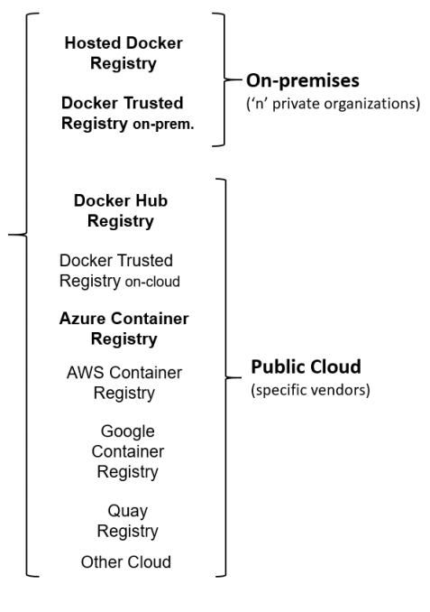
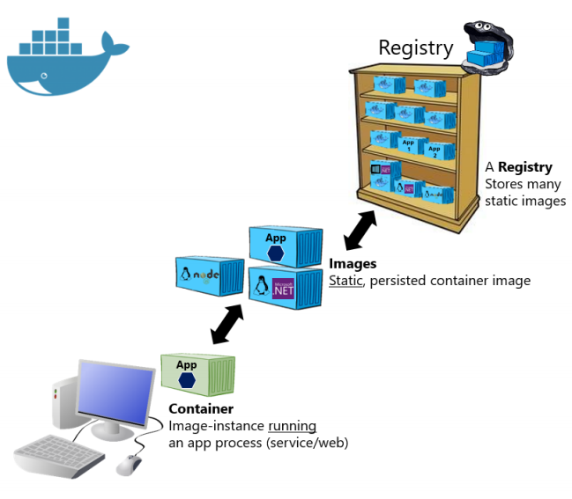
TAXONOMY

Slide 3
IMAGES
https://hub.docker.com/r/microsoft/dotnet
microsoft/dotnet:2.1-runtime
aspnetcore-runtime
aspnetcore-runtime-alpine
aspnetcore-runtime-nanoserver-1803
EBOOK: https://odkaz.me/microservices

Slide 4
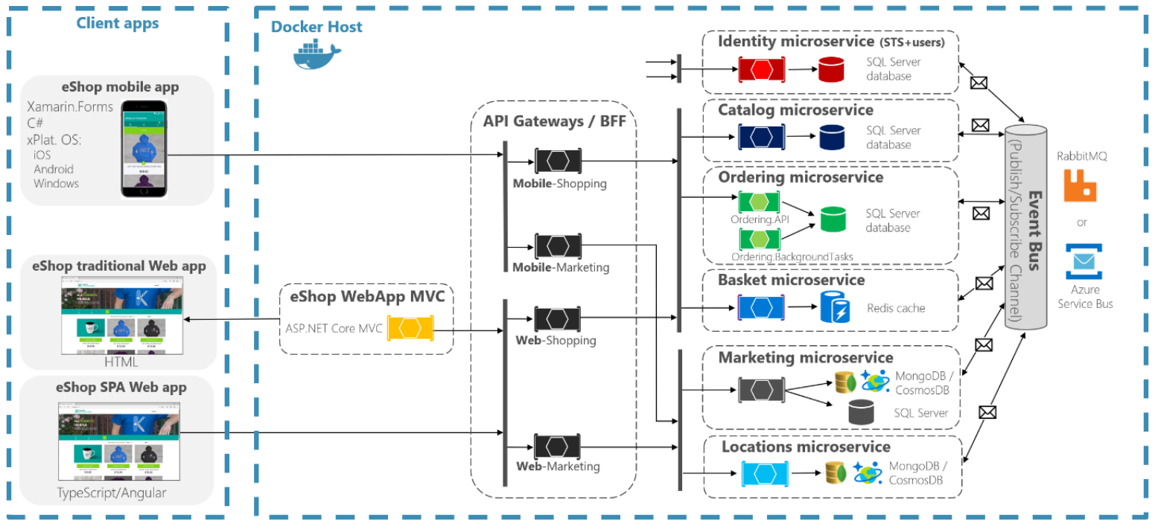
ESHOP ON CONTAINERS

Slide 5
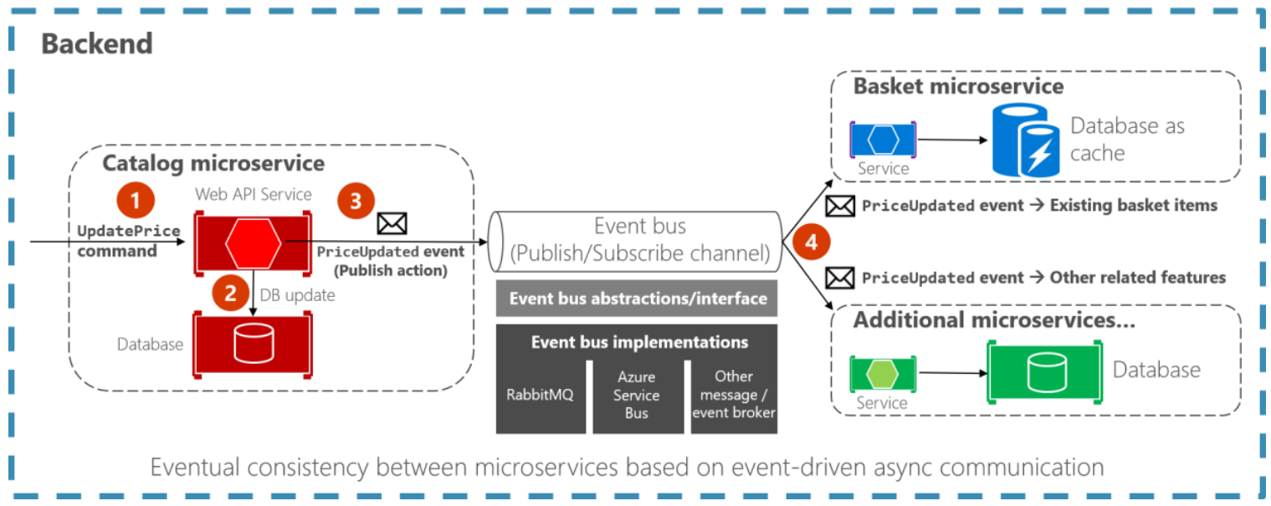
EVENT-DRIVEN COMMUNICATION

