Slide 1
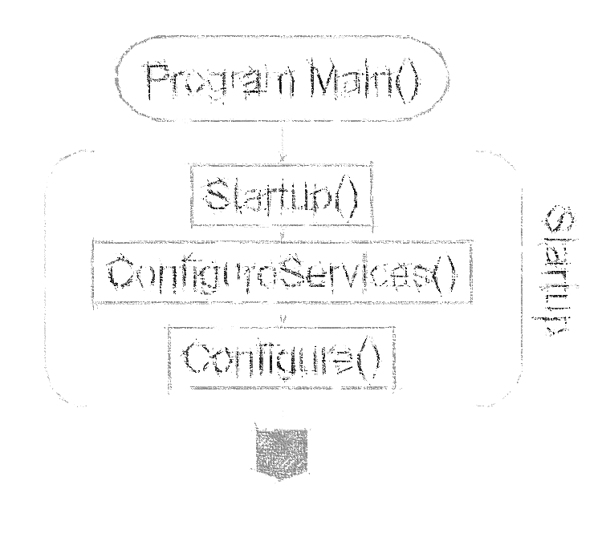

.NET Core architecture
& ASP.NET Core
Miroslav Holec
Software Architect | MVP: Microsoft Azure | MCSD, MCSA, MTA
mirek@miroslavholec.cz
miroslavholec.cz
miroslavholec.cz
vývoj aplikací – proof of concepts – konzultace – mentoring – firemní školení

Slide 2

.NET ECOSYSTEM / .NET STANDARD
Web
Forms
MVC
Web
Api
ASP.NET Core
(MVC = Web API = Razor Pages)
Mobile Apps
ASP.NET (System.Web)
.NET Framework
FRAMEWORK + RUNTIME
.NET Core
FRAMEWORK + RUNTIME
Xamarin
MONO FRAMEWORK + RUNTIME
Base Class Library
CoreFX
Mono BCL
Win API
.NET Standard
Common Infastructure
Compilers Languages Runtime Components

Slide 3
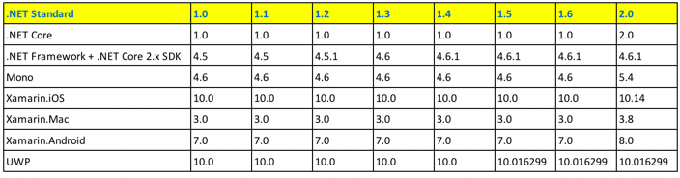
.NET STANDARD
13k APIs
32k APIs

Slide 4
.NET STANDARD
13k APIs

Slide 5
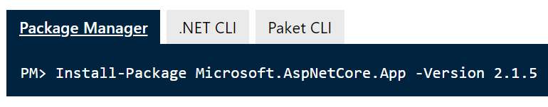
.NET CORE / ASP.NET CORE
Application
CUSTOM APPLICATION
CODE
3rd party libraries
ASP.NET CORE MVC
WEB FRAMEWORK
ASP.NET CORE
Modules (Extensions)
.NET CORE
.NET COREX Fx
https://www.microsoft.com/net/download

Slide 6
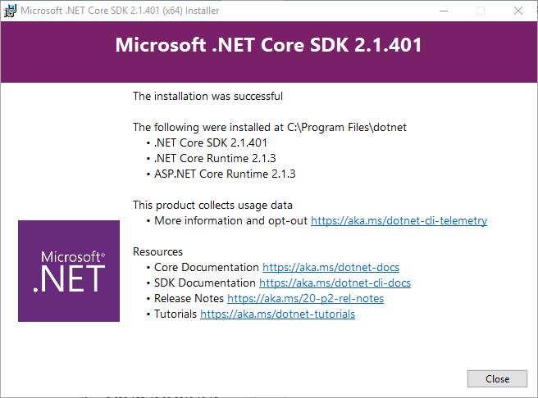
INSTALLATION

