Slide 1
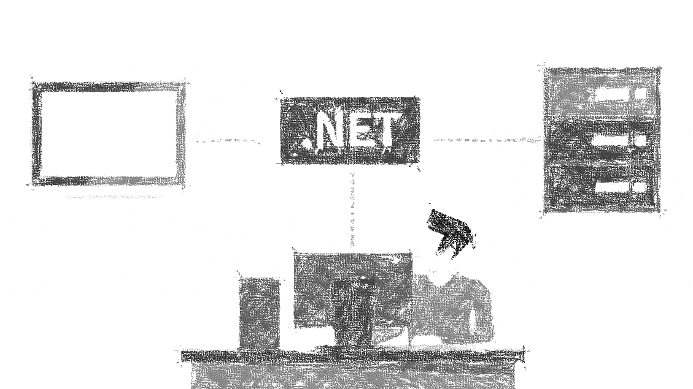

Hostování ASP.NET Core aplikací
od verze 2.1
Miroslav Holec
Software Architect | MVP: Microsoft Azure | MCSD, MCSA, MTA
mirek@miroslavholec.cz
miroslavholec.cz
miroslavholec.cz
školení asp.net - developer evangelism - workshopy - hackatony a semináře

Slide 2







.NET CORE APPLICATION
ASP.NET CORE APPLICATION up to 2.0
custom code
custom code
3rd party libs
3rd party libs
ASP.NET Core
.NET Core
.NET Core
DEPLOYMENT
DEPLOYMENT
self-contained
[with runtime]
framework-dependent
[no runtime]
self-contained
[with runtime]
framework-dependent
[no runtime]
dotnet
runtime
dotnet
runtime

Slide 3
ASP.NET Core – Framework-Dependent Deployment
ASP.NET CORE 1.x
ASP.NET CORE 2.0
ASP.NET CORE 2.1
Microsoft.AspNetCore.All
Microsoft.AspNetCore.All
Microsoft.AspNetCore.App
framework
DEVELOPMENT
3rd party libs
DEPLOY PACKAGE
FRAMEWORK DEPENDENT
DEPLOY (FDD)
ASP.NET Core Runtime
HOSTING
NET Core Runtime
NET Core Runtime
NET Core Runtime

Slide 4

Internal / External server – request processing
IIS / NGINX / APACHE
ASP.NET CORE APPLICATION
HTTP
HTTP
KESTREL
HttpContext
APPLICATION CODE
ASP.NET CORE
HOSTING BUNDLE
CORE MVC
Request
MIDDLEWARE
MIDDLEWARE
MIDDLEWARE
MIDDLEWARE
Response
http://odkaz.me/hosting-bundle
runtime + hosting bundle verze 2.1.5

Slide 5
Co je dobré vědět
S verzí .NET Core 2.1 existují ASP.NET Core runtimes – App / All
menší deploy package v FDD režimu (už neobsahuje ASP.NET Core)
nezávislý auto roll-forward na úrovni patch + minor
Upřednostnit ASP.NET Core App před All (od v3.0 již nebude vydán)
Chování roll-forwardu lze změnit v appname.runtimeconfig.json
Pro použití IIS potřebujeme ASP NET Core Hosting Bundle (module)
Školení aspnetcore.cz efcore.cz

