Slide 1
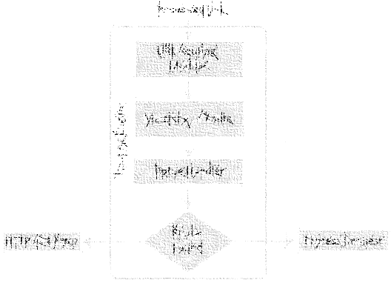
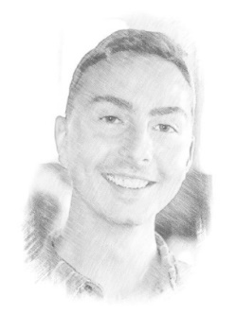
ASP.NET MVC
Application & Request Pipeline
Miroslav Holec
Software Architect | MVP: Microsoft Azure | MCSD, MCSA, MTA
mirek@miroslavholec.cz
miroslavholec.cz
miroslavholec.cz
vývoj aplikací – proof of concepts – konzultace – mentoring – firemní školení

Slide 2
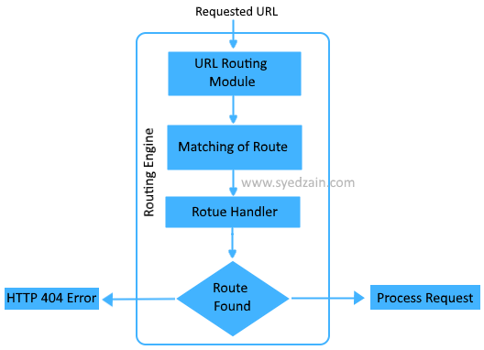
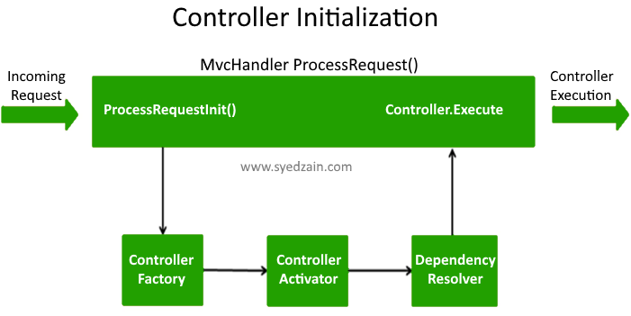
ROUTING + CONTROLLER INITIALIZATION

Slide 3
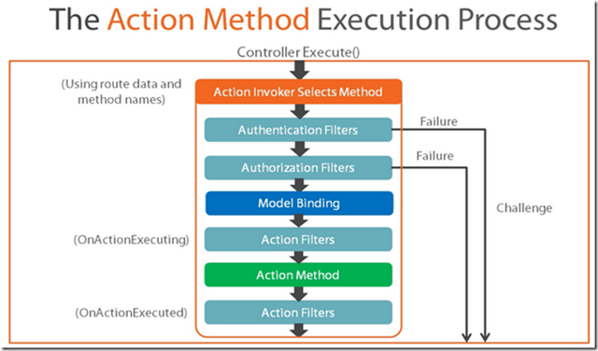
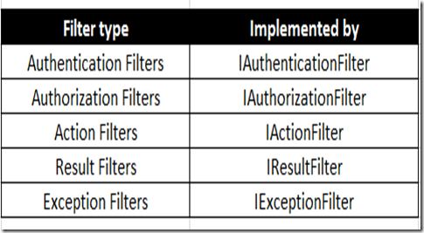
ACTION EXECUTION

Slide 4
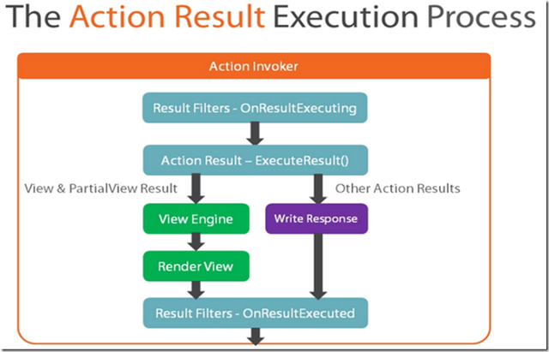
ACTION EXECUTION

