Slide 1
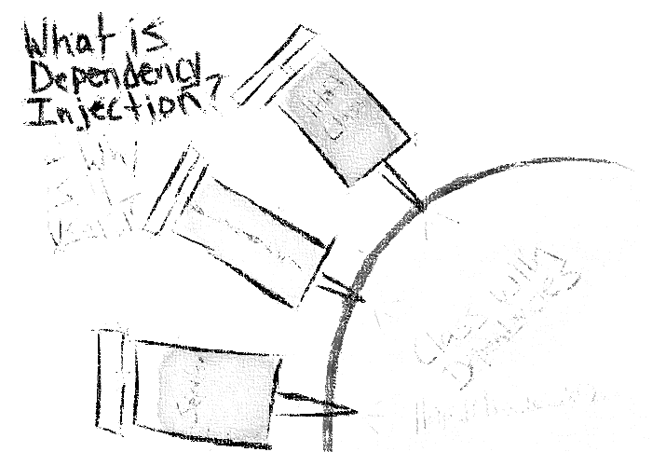

Dependency Injection v
ASP.NET Core
Miroslav Holec
Software Architect | MVP: Microsoft Azure | MCSD, MCSA, MTA
mirek@miroslavholec.cz
miroslavholec.cz
miroslavholec.cz
vývoj aplikací – proof of concepts – konzultace – mentoring – firemní školení

Slide 2
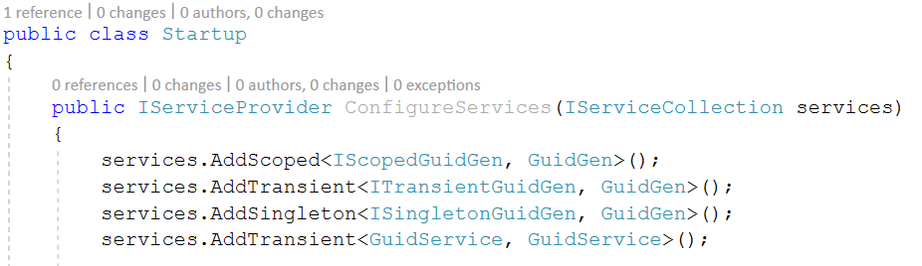

ASP.NET CORE CONTAINER SETUP
SERVICE
IMPLEMENTATION
LIFESTYLE
.NET CORE
TRANSIENT
SCOPED
SINGLETON
OTHER CONTAINERS
PER THREAD
HYBRID

Slide 3
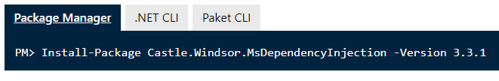
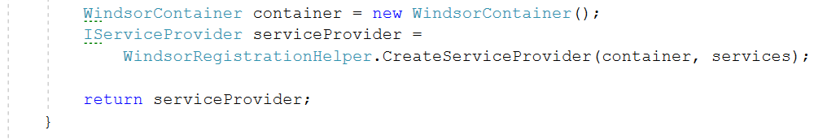
ASP.NET CORE CUSTOM CONTAINER
IMPLEMENTATION – WINDSOR CASTLE

