Slide 1
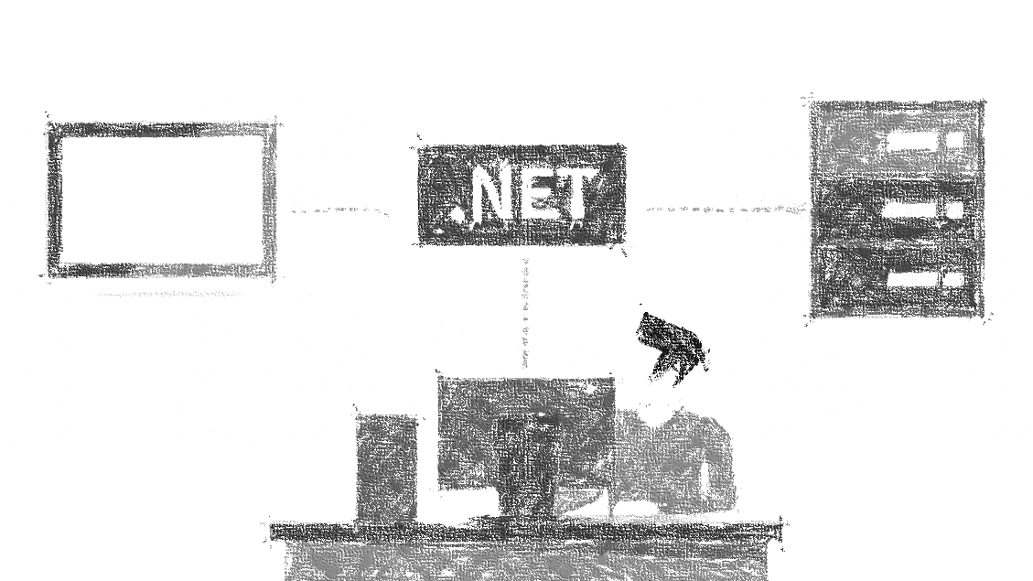

Hostování ASP.NET Core aplikací
od verze 2.1
Miroslav Holec
Software Architect | MVP: Microsoft Azure | MCSD, MCSA, MTA
mirek@miroslavholec.cz
miroslavholec.cz
miroslavholec.cz
vývoj aplikací – proof of concepts – konzultace – mentoring – firemní školení

Slide 2






.NET CORE APPLICATION
ASP.NET CORE APPLICATION up to 2.0
custom app code
custom appcode
nuget packages
nuget packages
ASP.NET Core
.NET Core
.NET Core
DEPLOYMENT
DEPLOYMENT
self-contained
[with runtime]
framework-dependent
[no runtime]
self-contained
[with runtime]
framework-dependent
[no runtime]
dotnet
runtime
dotnet
runtime

Slide 3
ASP.NET Core – Framework-Dependent Deployment
ASP.NET CORE
FRAMEWORK 1.x
ASP.NET CORE 2.0
ASP.NET CORE 2.1 / 2.2
Microsoft.AspNetCore.All
Microsoft.AspNetCore.All
Microsoft.AspNetCore.App
ASP.NET Core
framework
ASP.NET CORE FW
3rd party libs
newtonsoft.json, appinsights…
SHARED FRAMEWORKS
DEPLOY PACKAGE
FRAMEWORK DEPENDENT
DEPLOY (FDD)
ASP.NET Core Runtime
HOSTING
Runtime Store
NET Core Runtime
NET Core Runtime
NET Core Runtime

Slide 4
Semantic Versioning
MAJOR
possible breaking changes
MINOR
new features in API set
rollForwardOnNoCandidateFx = 1
PATCHES
only patches and bug fixes
ASP.NET Core 2.1.4
-preview2-35157
PREVIEW BRANCH
ROLL-FORWARD USE PREV SEMANTIC VERSIONING

Slide 5

ASP.NET Core Hosting
typical solution for ASP.NET Core
IIS / NGINX / APACHE
ASP.NET CORE APPLICATION
HTTP
HTTP
KESTREL
HttpContext
APPLICATION CODE
ASP.NET CORE
HOSTING BUNDLE V1
CORE MVC
MIDDLEWARE
MIDDLEWARE
MIDDLEWARE
MIDDLEWARE
http://odkaz.me/hosting-bundle
runtime verze 2.1.5 + hosting bundle V1

Slide 6
ASP.NET Core Hosting
inprocess (from ASP.NET Core 2.2)
IIS / NGINX / APACHE
ASP.NET CORE APPLICATION
HTTP
KESTREL
HttpContext
APPLICATION CODE
ASP.NET CORE
HOSTING BUNDLE V2
CORE MVC
MIDDLEWARE
MIDDLEWARE
MIDDLEWARE
MIDDLEWARE
<PropertyGroup>
<TargetFramework>netcoreapp2.2</TargetFramework>
<AspNetCoreHostingModel>inprocess</AspNetCoreHostingModel>
</PropertyGroup>

Slide 7
DEMO

Slide 8
Co si odnést
Upřednostnit Microsoft.AspNetCore.App (migrovat z .All)
Od verze ASP.NET Core 2.1 – shared runtimes
Od verze .NET Core 2.2 bude inprocess IIS hosting
Hosting bundle pro IIS: odkaz.me/hosting-bundle
školení aspnetcore.cz efcore.cz

