Slide 1
Steps needed for running hydrated clay mineral systems with Gromacs using the atom Matlab scripts

Slide 2
Steps needed for running hydrated clay mineral systems with Gromacs using the atom Matlab scripts
Creating the input structure – use the .gro structure format (preferably)
(If you do not have some layer laying around…)
Replicate some unit cell – of for instance pyrophillite – into a clay mineral layer
Perform isomorphic substitution on the .gro file from step 1 with substitute_atom() (or the script isosubstitute.m)
Repeat step 2 to create as many layers you need.
Assign the forcefield atom types to the layers you created using clayff_atom() or interface_atom(). These function call the clayff_param/interface_param functions
Generate a gromacs .itp file for each clay layer you created.
Run a buildsystem.m script to build your full system, check if the system has the correct charge with charge_atom(), which only works without organics in the system

Slide 3
Steps needed for running hydrated clay mineral systems with Gromacs using the atom Matlab scripts
Setup all the gromacs input files
Put the preem.gro from buildsystem.m and the .itp files from write_atom_itp(), into the same folder as topol.top
Edit the topol.top file so that it finds the forcefields files and all the .itp files needed, and make sure the [ molecules ] section is correct/matches preem.gro in terms of the order of the molecules
Generate an index file using for instance run_make_ndx.sh (using gmx make_ndx)
You could also look at gmx select
Or the matlab version atom2make_ndx()
Go through the run_x_{em/nvt/npt/md}.sh files – and all mdp options
How many steps do you want to run?
How often should you save data?
Which settings are you using for the pressure control? {iso/semi/aniso}isotropic?
Does all groups mentioned in the mdp settings exist in the index file?

Slide 4
Common pitfalls:
If gmx grompp fails, it will give you a error message explaining whats wrong
Here we could list problems we run into…
Add more thingies here…

Slide 5
Creating and manipulating atomic structures in Matlab
Molecular simulations need physically sound starting structure/configurations (especially of multi-component systems), as well as a correct molecular and forcefield specific molecular topology (information of the atomic, bonding and angle order, atom type info and forcefield parameters etc..)
Gromacs own tools can help in many situations, especially with protein or lipid based systems, see…
gmx {editconf, solvate, insert-molecules, genion, pdb2gmx, x2top and so on}
VMD with various plugins – the psfgen, solvate, topotools or inorganic builder plugins are some useful alternatives. GUI and tk-console versions often avail.
However… since no code will always work for every type of system/simulation setup, being able to write one’s own ’tools’ is sometimes neccessary
When and why?
To perform isomorphic subsitutions
To find bonds with variable cutoff’s
Automatically find bonds across the PBC (can VMD’s topotool do this?)
To find and assign the correct atomtypes for Clayff, Interface
etc..

Slide 6
Creating and manipulating atomic structures in Matlab
For the purpose of automizing/enabling efficient construction of complex and anisotropic (geo)chemical systems, and the corresponding topological info, we use Matlab and matlab struct variable.
Why?
Perform isomorphic subsitutions
Find bonds with variable cutoff’s
Find bonds across the PBC
Find and assign the correct atomtypes for Clayff, Interface etc
Easily build multicomponent systems {mineral/ions/water/organics}
Manipulate the system on the atomic, molecule or molecular type level
How?
%% Examples of the atom functions! Using the struct variable ’atom’ in matlab % Make sure to use the correct apostrophs, like ' or ” instead of ’
atom = import_atom(filename) % xyz/pdb/gro
atom = write_atom_pdb(arguments..) % xyz/pdb/gro/mol2/pqr or itp/psf/lmp data
atom = solvate_atom(arguments..)
atom = merge_atom(arguments..)
atom = translate_atom(arguments..)
atom = COM_atom(arguments..)
+ many other functions…

Slide 7
Creating and manipulating atomic structures in Matlab
For the purpose of automizing/enabling efficient construction of complex and anisotropic (geo)chemical systems, and the corresponding topological info, we use Matlab and the matlab struct variable.
Why?
Perform isomorphic subsitutions
Find bonds with variable cutoff’s
Find bonds across the PBC
Find and assign the correct atomtypes for Clayff, Interface etc
Easily build multicomponent systems {mineral/ions/water/organics}
Manipulate the system on the atomic, molecule or molecular type level
Abouth paths…
%% The VMD path on your computer. Useful to call VMD from within Matlab
function PATH2VMD = PATH2VMD()
% Add your own path to VMD (this works on my Mac..) PATH2VMD = '/Applications/VMD\ 1.9.2.app/Contents/MacOS/startup.command';

Slide 8
The atom struct in Matlab
How to import/export structure files and manipulate molecules using Matlab
Example: a .gro file
Generated by gmx solvate.
1500
1SOL OW 1 0.230 0.628 0.113
1SOL HW1 2 0.137 0.626 0.150
1SOL HW2 3 0.231 0.589 0.021
2SOL OW 4 0.225 0.275 0.996
2SOL HW1 5 0.260 0.258 1.088
2SOL HW2 6 0.137 0.230 0.984
.
.
499SOL OW 1495 1.937 2.207 1.895
499SOL HW1 1496 1.845 2.179 1.866
499SOL HW2 1497 1.968 2.284 1.839
500SOL OW 1498 1.934 2.028 2.180
500SOL HW1 1499 1.917 2.111 2.126
500SOL HW2 1500 2.024 1.991 2.158
2.50000 2.50000 2.50000

Slide 9
The atom struct in Matlab
How to import/export structure files and manipulate molecules using Matlab
Example: a .gro file – fixed format for the most part – How to build and manipulate complex systems?
; Line 1 title string (free format)
; Line 2 number of atoms (nearly free format, integer)
; Line 3 and on…
; residue number (5 positions, integer)
; residue name (5 characters)
; atom name (5 characters)
; atom number (5 positions, integer)
; position (in nm, x y z in 3 columns, each 8 positions with 3 decimal places)
; velocity (in nm/ps (or km/s), x y z in 3 columns, each 8 positions with 4 decimal places). No velocites in this example!
; Line 1503 box vectors (free format, space separated reals), values: v1(x) v2(y) v3(z) v1(y) v1(z) v2(x) v2(z) v3(x) v3(y), the last 6 values may be omitted (they will be set to zero). Gromacs only supports boxes with v1(y)=v1(z)=v2(z)=0. No triclinic box in here!
Generated by gmx solvate.
1500
1SOL OW 1 0.230 0.628 0.113
1SOL HW1 2 0.137 0.626 0.150
1SOL HW2 3 0.231 0.589 0.021
2SOL OW 4 0.225 0.275 0.996
2SOL HW1 5 0.260 0.258 1.088
2SOL HW2 6 0.137 0.230 0.984
.
.
499SOL OW 1495 1.937 2.207 1.895
499SOL HW1 1496 1.845 2.179 1.866
499SOL HW2 1497 1.968 2.284 1.839
500SOL OW 1498 1.934 2.028 2.180
500SOL HW1 1499 1.917 2.111 2.126
500SOL HW2 1500 2.024 1.991 2.158
2.50000 2.50000 2.50000
1
2
3
4
5
6
7
8
.
.
1497
1498
1499
1500
1501
1502
1503
1504

Slide 10
The atom struct in Matlab
How to import/export .gro files and manipulate structures using Matlab
Example .gro file – fixed format for the most part – How to build and manipulate complex systems? Use Matlab and the atom struct functions! In Matlab, change the directory to the folder called: Clayff/gmx_WyNa_3W_spce/MMT_clayff/scripts
Then in the Matlab command window…
atom=import_atom('1xMMT.gro')
Undefined function or variable 'import_atom' Ooops, forgot to set the path to all the atom functions… do it, and re-run
atom=import_atom('1xMMT.gro')

Slide 11
The atom struct in Matlab
The import_atom matlab function imports an .gro (or.pdb, what about .xyz?) file into a matlab struct variable (which basically is a varaible good at holding other variables…)
atom=import_atom('1xMMT.gro') % Run this line
Found .gro file
.gro file imported
Elapsed time is 0.012853 seconds.
composition =
resnames: {'MMT'}
nresidues: 1
natoms: 40
Atom_labels =
'Al' 'H' 'O' 'Si'
Atom_numbers =
4 4 24 8
Box_dim =
5.1980 9.0150 10.0000
atom =
1x40 struct array with fields:
molid
resname
type
fftype
index
neigh
bond
angle
x
y
z
vx
vy
vz
% Box_dim is a vector/array [1x3 or 1x9 if triclinic]
% atom is a struct created with the following fields:
% molid == residue number
% resname == residue name
% type == atom name
% fftype == same as above
% index == atom number
% neigh == the atoms neighbours, empty
% bond == the atoms bonds to other atoms, empty
% angle == the atoms angles to other atoms, if bonded
% x,y,z == the atoms coordinates
% vx,vy,vz == the atoms velocities if they exist.

Slide 12
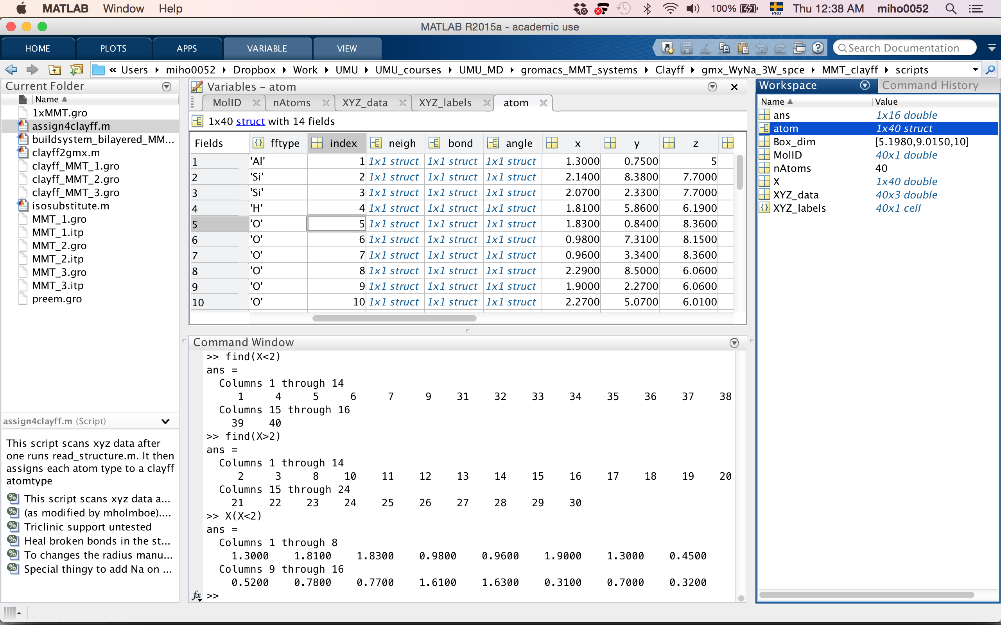
The atom struct in Matlab
The import_atom matlab function imports an .gro (or.pdb, what about .xyz?) file into a matlab struct variable (which basically is a varaible good at holding other variables…)
atom=import_atom('1xMMT.gro') % Run this line
Found .gro file
.gro file imported
Elapsed time is 0.012853 seconds.
composition =
resnames: {'MMT'}
nresidues: 1
natoms: 40
Atom_labels =
'Al' 'H' 'O' 'Si'
Atom_numbers =
4 4 24 8
Box_dim =
5.1980 9.0150 10.0000
atom =
1x40 struct array with fields:
molid
resname
type
fftype
index
neigh
bond
angle
x
y
z
vx
vy
vz
% Box_dim is a vector/array [1x3 or 1x9 if triclinic]
% atom is a struct created with the following fields:
% molid == residue number
% resname == residue name
% type == atom name
% fftype == same as above
% index == atom number
% neigh == the atoms neighbours, empty
% bond == the atoms bonds to other atoms, empty
% angle == the atoms angles to other atoms if bonded
% x,y,z == the atoms coordinates
% vx,vy,vz == the atoms velocities if they exist.

Slide 13
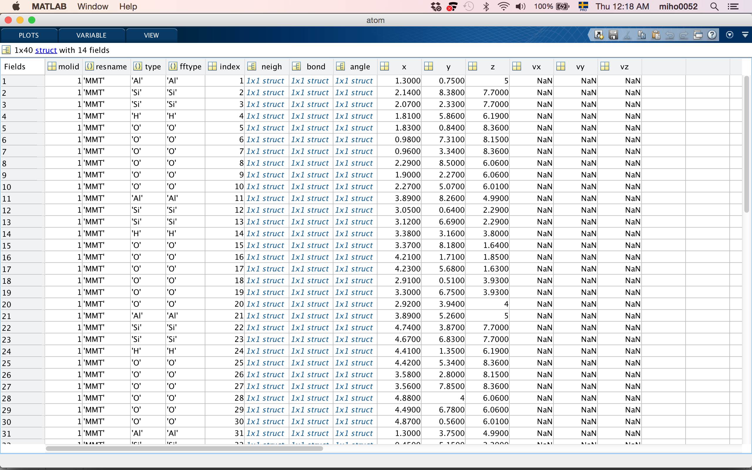
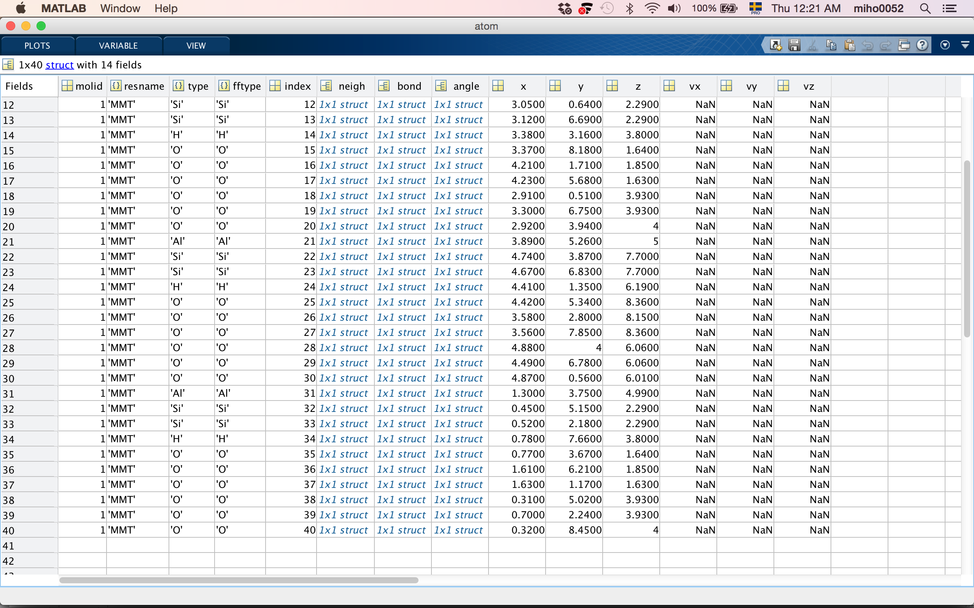
The atom struct in Matlab
The import_atom matlab function imports an .gro (or.pdb, what about .xyz?) file into a matlab struct variable (which basically is a varaible good at holding other variables…)
>> atom=import_atom('1xMMT.gro')
Found .gro file
.gro file imported
Elapsed time is 0.012853 seconds.
composition =
resnames: {'MMT'}
nresidues: 1
natoms: 40
Atom_labels =
'Al' 'H' 'O' 'Si'
Atom_numbers =
4 4 24 8
Box_dim =
5.1980 9.0150 10.0000
atom =
1x40 struct array with fields:
molid
resname
type
fftype
index
neigh
bond
angle
x
y
z
vx
vy
vz
% atom is the struct variable containing the .gro file
% we can inspect the atom struct using the the matlab variable explorer… and start manipulating it using various existing atom functions or matlab commands

Slide 14
Example of atom functions in Matlab
How-to import a .gro/.pdb/.xyz structure file into matlabs variable space/variable explorer using >>import_atom()
%% Import a structure
% atom=import_atom(filename) – Imports the structure file into matlabs variable space
atom=import_atom('1xMMT.gro');
%% Import a structure and move/translate it by some x,y,z vector
% atom=import_atom(filename,[translation vector 1x3]) – Imports a structure and translates it
atom=import_atom('1xMMT.gro',[0 0 10]);
%% Import a structure and center it in a new box and move it by some x,y,z vector
% atom=import_atom(filename,[translation vector 1x3],[New_Box_dim 1x3]) – Imports a structure and % centers it in the x/y plane at z=0, then translates it with the translation vector
atom=import_atom('1xMMT.gro',[0 0 10],[10 20 20]);

Slide 15
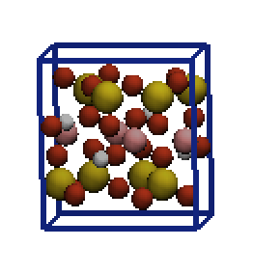
Example of atom functions in Matlab
How-to import a .gro/.pdb/.xyz structure file into matlabs variable space/variable explorer using >>import_atom()
%% Import a structure
% atom=import_atom(filename) – Imports the structure file into matlabs variable space
atom=import_atom('1xMMT.gro');
vmd(atom,Box_dim) % or try plot3([atom.x],[atom.y],[atom.z],'o’);
% or alternatively use the native but slow sho_atom function instead of vmd
show_atom(atom,Box_dim, 'halfvdw’,1) % try also ballnstick, poly etc.

Slide 16
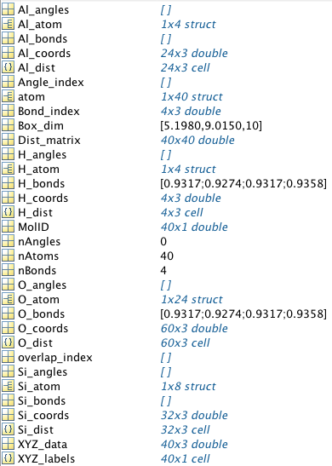
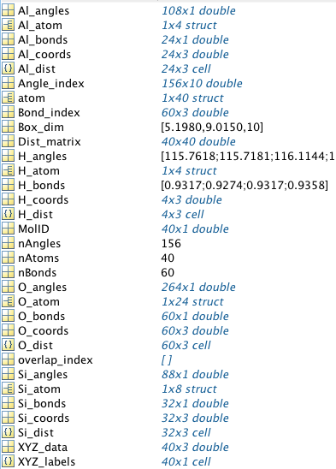
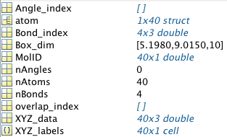
Example of atom functions in Matlab
How-to scan a .gro/.pdb/.xyz structure file or atom struct for bonds and angles
>>bond_angle_atom() % or try bond_angle_type()
>>bond_atom() % newer and faster function
%% Import a structure
%% atom=import_atom(filename) – Imports the structure file into matlabs variable space
atom=import_atom('1xMMT.gro');
%% atom=bond_angle_atom(atom,Box_dim,r_small,r_large), ie we use a dual cutoff [Å] approach to find bonds
atom=bond_angle_atom(atom,Box_dim,1.25,1.25) % Gives you a Bond_index and a (empty) Angle_index
atom=bond_angle_atom(atom,Box_dim,1.25,1.25,'more') % Gives you atom.{neigh/bonds/angles} for the Oh-H’s
%% Note that there are normally no angles in Clayff
%% To scan more/(all?) bonds/angles (needed for the Interface ff) run this command
atom=bond_angle_atom(atom,Box_dim,1.25,2.25,'more’) % Gives you all atom.{neigh/bonds/angles}
%% Not that atom.neigh gives you all neighbours (within r_large?) and atom.bond all actual bonds
1
2
3
2
3
1

Slide 17
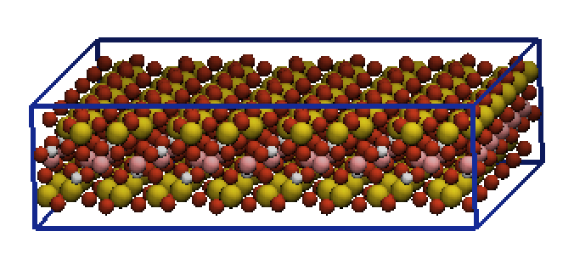
Example of atom functions in Matlab
How-to replicate a .gro/.pdb/.xyz structure file into matlabs variable space/variable explorer using >>replicate_atom(atom,Box_dim,[nx ny nz],{optional 'xyz'})
%% Import a structure
%% atom=import_atom(filename) – Imports the structure file into matlabs variable space
atom=import_atom('1xMMT.gro');
atom=replicate_atom(atom,Box_dim,[6 4 1])
vmd(atom,Box_dim)
1x UC
6x4x1 UC

Slide 18
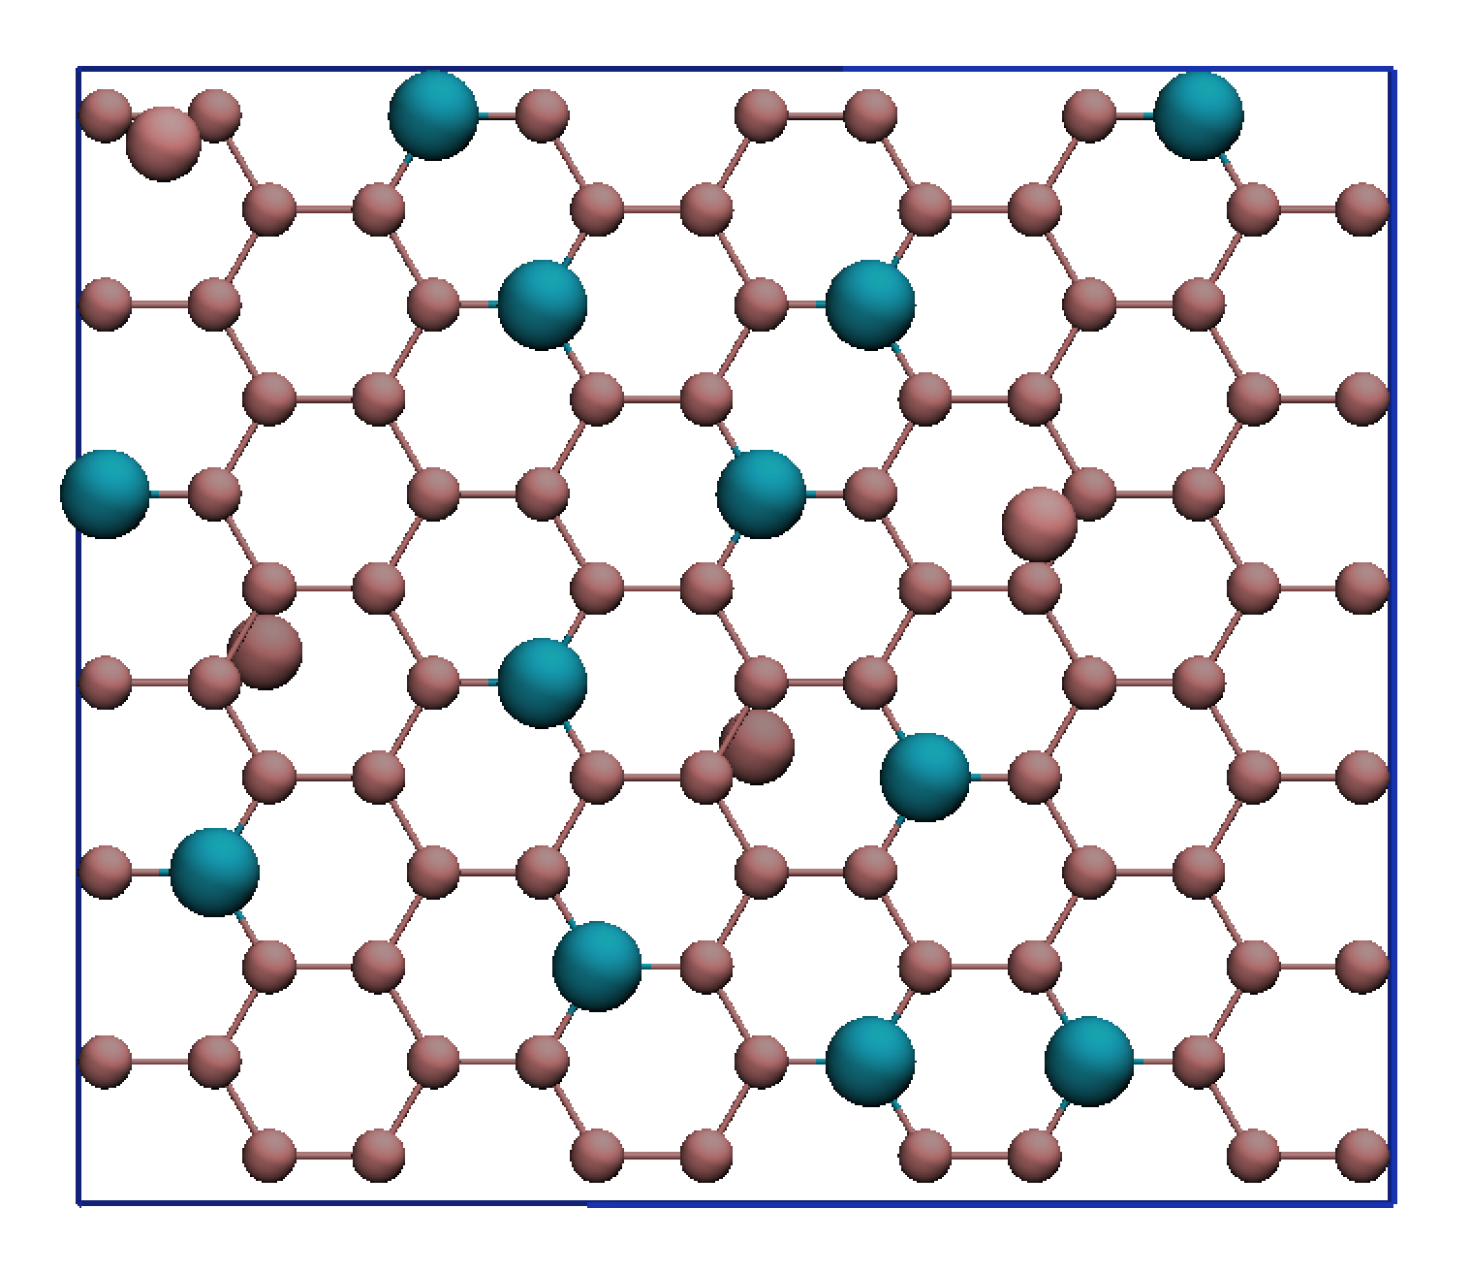
Example of atom functions in Matlab
How-to import a .gro/.pdb/.xyz structure file into matlabs variable space/variable explorer using >>import_atom(filename)
%% Import a structure
%% atom=import_atom(filename) – Imports the structure file into matlabs variable space
atom=import_atom('1xMMT.gro');
atom=replicate_atom(atom,Box_dim,[6 4 1])
atom=substitute_atom(atom,Box_dim,16,'Al','Mgo',5.5) % Only octahedral substitutions, 5.5 is the min dist.
atom=substitute_atom(atom,Box_dim,12,'Al','Mgo',5.5,4,'Si','Alt',10.0) % Play around with the 5.5/10.0
vmd(atom(ismember([atom.type],[{'Al' 'Alt' 'Mgo'}])),Box_dim) % * Only showing the Al, Alt, Mgo atoms
Alt (tetrahedral)
Mgo (octahedral)
XY-view of the 6x4x1 montmorillonite layer, only showing the central Al sheet and the 12+4 octa/tetrahedral Mgo/Alt isomorphic substitution sites
Al (the normal kind, octahedral)
%% Whats this? ismember([atom.type],[{'Al' 'Alt' 'Mgo'}]) % ???

Slide 19
Example of atom functions in Matlab
Small digression… how-to ’filter’ the atom struct with respect to molid, resname, atomtype, index, coordinates and so on…
%% Whats this filtering stuff? index=ismember([atom.type],[{'Al' 'Alt' 'Mgo'}]) % gives a binary (1/0) logical array
index=strcmp([atom.type],'Al') % try also strncmp or strncmpi…
index=find(strncmpi([atom.type],'al',2) % Will find the indexes of 'Al' 'Alt’
index=find(~strncmpi([atom.type],'al',2) % ~ Will find all but the indexes of 'Al' 'Alt’
new_atom=atom(index) % This creates a new_atom struct with the filtered/selected atomtypes
Note that the same principle works on the molid, resname fields! Allows us to manipulate an atom struct on the atomic, molecule and molecular type level!
%% other ways to filter the atom.{molid/resname/type/index/}? Logical indexing…
positive_z_atom=atom([atom.z]>0) % finds all atoms with a positve z-coordinate
first100_atom=atom([atom.index]<101) % Finds the first 100 atoms in the atom struct
first100_v2_atom=atom(1:100) % Also finds the first 100 atoms in the atom struct

Slide 20
Example of the deal command
Small digression again… how-to ’deal’ new values to the atom struct with respect to molid, resname, atomtype, index, coordinates and so on…
%% Whats this deal stuff? [atom(1).x]=0 % Works! Sets the x coordinate of atom 1 to 0
[atom.x]=0 % Does not work!
Too many output arguments.
[atom.x]=deal(0) % Works! Sets the x coordinate of all atoms to 0
%% To deal a string (use {} as in cells)
[atom.type]=deal({'Al'}) % Works! Sets all the atomtypes to 'Al'
Also, the opposite…
atom=rmfield(atom,{'x’ 'y' 'z'}) % here rmfield removes the atom structs fields x, y, z

Slide 21
Example of atom functions in Matlab
How-to assign the Clayff (or Interface) atom types to a .gro/.pdb/.xyz structure file or atom struct
>>clayff_atom(atom,Box_dim,ffname,watermodel) % or interface_atom(arguments)
%% Import a structure
%% atom=import_atom(filename) – Imports the structure file into matlabs variable space
atom=import_atom('1xMMT.gro');
atom=replicate_atom(atom,Box_dim,[6 4 1])
atom=substitute_atom(atom,Box_dim,16,'Al','Mgo',5.5) % Only octahedral substitutions, 5.5 is the min dist.
atom=substitute_atom(atom,Box_dim,12,'Al','Mgo',5.5,4,'Si','Alt',10.0) % Play around with the 5.5/10.0
%% Assign MINFF atomtype names
atom=minff_atom(atom,Box_dim) % Assign the minff atom types to the atomstruct
atom=minff_atom(atom,Box_dim,’minff’,heal) % Try to heal the dangling bonds, see function documentation
%% Assign CLAYFF atomtype names
atom=clayff_atom(atom,Box_dim,'clayff','spc') % Assign the clayff atom types to the atomstruct
atom=clayff_atom(atom,Box_dim,'clayff','spc','heal') % Try to use heal if you have to heal the edges
%% Is the charge correct?

Slide 22
Example of atom functions in Matlab
How-to generate the Gromacs .itp molecular topology file for Clayff (or Interface)
This we should do for each mineral slab/molecule/layer
>>clayff_atom(atom,Box_dim,ffname,watermodel) % or interface_atom(arguments)
%% Import a structure
%% atom=import_atom(filename) – Imports the structure file into matlabs variable space
atom=import_atom('1xMMT.gro');
atom=replicate_atom(atom,Box_dim,[6 4 1])
atom=substitute_atom(atom,Box_dim,16,'Al','Mgo',5.5) % Only octahedral substitutions, 5.5 is the min dist.
atom=substitute_atom(atom,Box_dim,12,'Al','Mgo',5.5,4,'Si','Alt',10.0) % Play around with the 5.5/10.0
atom=minff_atom(atom,Box_dim) % Assign the minff atom types to the atomstruct
atom=minff_atom(atom,Box_dim,’minff’,heal) % Try to heal the dangling bonds, see function documentation
%% Total_charge correct? If the healed O-H point in the wrong direction, change the +/- line 456,471,492
write_atom_itp(atom,Box_dim,filename,1.25,1.25,'clayff','spc/e') % Repeat for each clay layer
write_atom_itp(atom,Box_dim,filename,1.25,2.25,'interface','tip3p') % Same for the INTERFACE ff
%% Total_charge correct? Does the molecule name match the topol.top file? Any [ position_restraints ]?

Slide 23
Example of atom functions in Matlab
Let’s look a bit closer on how we write a Clayff (Cygan, 2004) or Interface (Heinz, 2005) Gromacs .itp file. There is also another way of getting Interface 1.5 .itp files, by using import_atom_car()…
We use the write_minff_itp() or the more general write_atom_itp() function like below, where rmax1 is the maximum allowed bond distance for H-atoms and rmax2 the maximum allowed for all other bond distances, ie for every metal-oxygen bonds. For clayff, we could set them to equal to suppress metal-oxygen bonds.
>>write_atom_itp(atom,Box_dim,filename,rmax1,rmax2,forcefield,watermodel)
%% Import a structure that has the correct forcefield minff, clayff or interface atomnames, as demonstrated on the previous slide. Then invoke:
write_minff_itp(atom,Box_dim,filename) % Write a gromacs/minff .itp file
% see also the write_minff_psf() and write_minff_lmp topology functions
% else for CLAYFF or INTERFACE
write_atom_itp(atom,Box_dim,filename,1.25,1.25,'clayff','spc/e') % Write a gromacs/clayff .itp file
write_atom_itp(atom,Box_dim,filename,1.25,2.25,’interface','spc') % Write a gromacs/interface .itp file
% the last watermodel argument has no effect, and I should change this… %% Now… most importantly, is the charge correct?

Slide 24
Are we ready to buildsystem.m? cd to INTERFACE_CTAB/gmx_CTABMMT/MMT_interface/scripts
By combining different atom functions, we can easily build our final simulation cell, containing for instance a mineral phase, organics, ions and water and INTERFACE ff with CTAB/CHARMM
%% This script creates a structure file for clay+ions+water. Normally one uses one or two structure files
%% with some clay layers, then one can add layers of ions and then 1-2 segments
%% of water, either on a grid or using a preequilibrated water body.
clear all;
format compact;
%%%%%%%%%%%%%%%%%%%%%%%%%%%%%%%%%%%%%%%%%%%%%%%%%%%%%%%%%%%%% clayfiles={'interface_MMT_1.gro' 'interface_MMT_2.gro'}; % the .gro file creating after AssignClayff
molfiles={'1xCTAB_16_16Ang.pdb'}; % the .gro file creating after AssignClayff
filename_out='preem.gro'; % Total system
d001=60*1.1; % 12.4 15.6 18.9 21.8 24.8 for 1W 2W 3W 4W 5W
nlayers=length(clayfiles);
Full_Box_dim=[31.1880 36.0600 nlayers*d001];
nSOL=2000; %UCinX*UCinY*5*3; % 5 water molecules per unit cell and monolayer per MMT layer is reasonable
Cation='Na';nCation=8;
System=[]; % The final stom struct for the whole system, called ’System’
%% Define regions with an 1x6 array, like [xlo ylo zlo xhi yhi zhi];
v1=[0 0 0/4*Full_Box_dim(3) Full_Box_dim(1) Full_Box_dim(2) 1/4*Full_Box_dim(3)];
v2=[0 0 1/4*Full_Box_dim(3) Full_Box_dim(1) Full_Box_dim(2) 2/4*Full_Box_dim(3)];
v3=[0 0 2/4*Full_Box_dim(3) Full_Box_dim(1) Full_Box_dim(2) 3/4*Full_Box_dim(3)];
v4=[0 0 3/4*Full_Box_dim(3) Full_Box_dim(1) Full_Box_dim(2) 4/4*Full_Box_dim(3)];
v_lower=[0 0 0*Full_Box_dim(3) Full_Box_dim(1) Full_Box_dim(2) 1/2*Full_Box_dim(3)];
v_upper=[0 0 1/2*Full_Box_dim(3) Full_Box_dim(1) Full_Box_dim(2) 2/2*Full_Box_dim(3)];
%%%%%%%%%%%%%%%%%%%%%%%%%%%%%%%%%%%%%%%%%%%%%%%%%%%%%%%%%%%%%%
cont. on next slide…

Slide 25
Are we ready to buildsystem.m? cd to INTERFACE_CTAB/gmx_CTABMMT/MMT_interface/scripts
By combining different atom functions, we can easily build our final simulation cell, containing for instance a mineral phase, organics, ions and water and INTERFACE ff with CTAB/CHARMM
%% Add mineral lattices
%% atom = import_atom(filename,optional translation_vector, optional Full_Box_dim)
MMT1 = import_atom(clayfiles{1},[0 0 0],Full_Box_dim); System = update_atom({System MMT1});
MMT2 = import_atom(clayfiles{2},[5.2/3 9/3 d001],Full_Box_dim); System = update_atom({System MMT2});
%vmd(System,Full_Box_dim)
cont. on next slide…

Slide 26
Are we ready to buildsystem.m? cd to INTERFACE_CTAB/gmx_CTABMMT/MMT_interface/scripts
By combining different atom functions, we can easily build our final simulation cell, containing for instance a mineral phase, organics, ions and water and INTERFACE ff with CTAB/CHARMM
%% Add CTAB on a grid
CTAB = import_atom(molfiles,[0 0 18]); %System = update_atom({System CTAB});
CTAB1 = replicate_atom(CTAB,Box_dim,[2 2 1]);System = update_atom({System CTAB1});
CTAB2 = rotate_atom(CTAB1,Full_Box_dim,[180 0 0]);
CTAB2 = translate_atom(CTAB2,[0 0 30],'all');System = update_atom({System CTAB2});
CTAB3 = translate_atom(CTAB1,[0 0 d001],'all');System = update_atom({System CTAB3});
CTAB4 = translate_atom(CTAB2,[0 0 d001],'all');System = update_atom({System CTAB4});
% vmd(System,Full_Box_dim);
%% Or add any number of molecules to a region specified by the v1-v4 limits
% atom = insert_atom(atom,limits,rotate_vector or 'random',rmin,num,atom_solute,{type1 type2}(optional cell),difference in mean z between typ1 type2 (optional number))
% CTAB1 = insert_atom(import_atom(molfiles),v1,'random',2,8,System,{'N' 'C'},2);System = update_atom({System CTAB1});
% CTAB2 = insert_atom(import_atom(molfiles),v2,'random',2,8,System,{'C' 'N'},2);System = update_atom({System CTAB2});
% CTAB3 = insert_atom(import_atom(molfiles),v3,'random',2,8,System,{'C' 'N'},2);System = update_atom({System CTAB3});
% CTAB4 = insert_atom(import_atom(molfiles),v4,'random',2,8,System,{'N' 'C'},2);System = update_atom({System CTAB4});
% vmd(System,Full_Box_dim);
cont. on next slide…

Slide 27
Are we ready to buildsystem.m? cd to INTERFACE_CTAB/gmx_CTABMMT/MMT_interface/scripts
By combining different atom functions, we can easily build our final simulation cell, containing for instance a mineral phase, organics, ions and water and INTERFACE ff with CTAB/CHARMM
%% Add ions randomly wherever there is space (this function is similar to solvate_atom())
%% atom = create_atom(type,resname,limits,scale,maxion,in_atom)
Ion1 = create_atom(Cation,Cation,v1,4,nCation/2,System); System = update_atom({System Ion1});
Ion2 = create_atom(Cation,Cation,v2,4,nCation/2,System); System = update_atom({System Ion2});
Ion3 = create_atom(Cation,Cation,v3,4,nCation/2,System); System = update_atom({System Ion3});
Ion4 = create_atom(Cation,Cation,v4,4,nCation/2,System); System = update_atom({System Ion4});
%vmd(System,Full_Box_dim);
cont. on next slide…

Slide 28
Are we ready to buildsystem.m? cd to INTERFACE_CTAB/gmx_CTABMMT/MMT_interface/scripts
By combining different atom functions, we can easily build our final simulation cell, containing for instance a mineral phase, organics, ions and water and INTERFACE ff with CTAB/CHARMM
%% Solvate the system (first we need to wrap all other atoms)
System = wrap_atom(System,Full_Box_dim); % Wrap all solute atoms into the box before adding water
%% atom = solvate_atom([1x3 or 1x6 Box vector],waterdensity,rmin,number of water or just 'max’,solute_atom);
SOL1 = solvate_atom(v_lower,1.1,2,nSOL,System); System = update_atom({System SOL1});
SOL2 = solvate_atom(v_upper,1.1,2,nSOL,System); System = update_atom({System SOL2});
% vmd(System,Full_Box_dim);
%% A final touch
System = translate_atom(System,[0 0 d001/2],'all'); % Do we want to translate the system
System = wrap_atom(System,Full_Box_dim); % Do we want to wrap atoms into cell
System = center_atom(System,Full_Box_dim,{'MMT'},'z'); % Do we want to center the system
Total_charge = charge_atom(System,Box_dim,'interface','tip3p') % Check the total clayff charge
%% Write the system to a .gro structure file
write_atom_gro(System,Full_Box_dim,filename_out);
%% Plot the final structure in vmd
vmd(System,Full_Box_dim) % Use VMD to plot the simulation box

Slide 29
Let’s try another buildsystem.m cd to 3W_NaMMT_spce_workflow_2/MMT_clayff/scripts
Let’s build a simple bilayered 3W system with Clayffand SPC/E. Note the alternative function to add ions!
%% This script creates a structure file for clay+ions+water. Normally one uses one or two structure files
%% with some clay layers, then one can add layers of ions and then 1-2 segments
%% of water, either on a grid or using a preequilibrated water body.
clear all;
Format compact;
%%%%%%%%%%%%%%%%%%%%%%%%%%%%%%%%%%%%%%%%%%%%%%%%%%%%%%% filename_out='preem.gro'; % Total system
d001=18.9*1.1; % 12.4 15.6 18.9 21.8 24.8 for 1W 2W 3W 4W 5W
nlayers=2;
Full_Box_dim=[31.6800 36.5600 nlayers*d001];
nSOL=360;%UCinX*UCinY*5*3; % 5 water molecules per unit cell and monolayer per MMT layer is reasonable
Cation='Na';nCation=16;
System=[];
%%%%%%%%%%%%%%%%%%%%%%%%%%%%%%%%%%%%%%%%%%%%%%%%%%%%%%%
%% Add mineral lattices
%% atom = import_atom(filename,translation_vector,Full_Box_dim)
MMT1 = import_atom('clayff_MMT_1.gro',[0 0 0],Full_Box_dim); System = update_atom({System MMT1});
MMT2 = import_atom('clayff_MMT_2.gro',[5.2/3 9/3 d001],Full_Box_dim); System = update_atom({System MMT2});
% vmd(System,Full_Box_dim)
cont. on next slide…

Slide 30
Let’s try another buildsystem.m cd to 3W_NaMMT_spce_workflow_2/MMT_clayff/scripts
Let’s build a simple bilayered 3W system with Clayffand SPC/E. Note the alternative function to add ions!
%% Add ions using the copy_atom function
%% atom = copy_atom(atom,origtype,newtype,newresname,trans_vec,num);
Ion1 = copy_type(MMT1,'Mgo',Cation,Cation,[0 0 d001/2],sum(ismember([MMT1.type],'Mgo'))); System = update_atom({System Ion1});
Ion2 = copy_type(MMT2,'Mgo',Cation,Cation,[0 0 d001/2],sum(ismember([MMT2.type],'Mgo'))); System = update_atom({System Ion2});
% vmd([MMT1 MMT2 Ion1 Ion2],Full_Box_dim);
%% Solvate the system
System = wrap_atom(System,Full_Box_dim); % Wrap all solute atoms into the box before adding water
%% atom = solvate_atom([1x3 or 1x6 Box vector],waterdensity,rmin,number of water or just 'max',solute_atom);
SOL1 = solvate_atom([0 0 0 Full_Box_dim(1) Full_Box_dim(2) d001],1.1,2,nSOL,System); System = System=update_atom({System SOL1});
SOL2 = solvate_atom([0 0 d001 Full_Box_dim(1) Full_Box_dim(2) Full_Box_dim(3)],1.1,2,nSOL,System); System = System=update_atom({System SOL2});
% vmd(System,Full_Box_dim);
cont. on next slide…

Slide 31
Let’s try another buildsystem.m cd to 3W_NaMMT_spce_workflow_2/MMT_clayff/scripts
Let’s build a simple bilayered 3W system with Clayffand SPC/E. Note the alternative function to add ions!
%% Put all atom structs together (we can translate/center/wrap if we want but we do not have to…)
% System = translate_atom(System,[0 0 d001/2],'all'); % Do we want to translate the system
% System = center_atom(System,Full_Box_dim,{'MMT'},'z'); % Do we want to center the system
% System = wrap_atom(System,Full_Box_dim); % Do we want to wrap atoms into cell
% System = charge_atom(System,Box_dim,'clayff','spc/e');
%% Write the system to a .gro structure file
write_atom_gro(System,Full_Box_dim,filename_out);
%% Plot the final structure in vmd
vmd(System,Full_Box_dim) % Use VMD to plot the simulation box

Slide 32
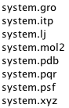
Let’s try to write_atom()
Write_atom tries to write as many different outputfiles as possible, for instance {xyz/pqr/pdb/gro}
structure files, as well as a single Lammps and Gromacs topology file (ie a .lj and a .itp file).
import_atom('preem.gro')
%% write_atom(atom,Box_dim,filename,r_small,r_large,ffname,watermodel)
%% Where ffname is clayff or interface, watermodels can be spc, spc/e or tip3p
write_atom(atom,Box_dim,'system',1.25,1.25,'clayff','spc/e')

Slide 33
Let’s try to write_atom()
Write_atom tries to write as many different outputfiles as possible, for instance {xyz/pqr/pdb/gro}
structure files, as well as a single Lammps and Gromacs topology file (ie a .lj and a .itp file).
import_atom('preem.gro')
%% write_atom(atom,Box_dim,filename,r_small,r_large,ffname,watermodel)
%% Where ffname is clayff or interface, watermodels can be spc, spc/e or tip3p
write_atom_all(atom,Box_dim,'system',1.25,1.25,'clayff','spc/e')
Note that a single .itp file for gromacs acutally do work, but then without the [ settle ] (better than SHAKE, LINCS) for water. Note no dihedrals!
Note that Lammps .lj files (now with support for dihedrals) are only compatible with Clayff(_2004), but that the settings (in write_atom_lmp()):
prev_atom_types=?; prev_bond_types=?; prev_atom_index=?;prev_mol_index=?;
can be used if one manually wants to append this Lammps topology to a previous one, for instance the lammps topology from some organic molecule…
The .mol2 does not contain the correct Sybyl atom names…
The .pdb can optianlly contain the ’CONECT’ section
.xyz with # Box_dim on 2nd line!
.pqr is similar to .pdb and contains chares and ionic radius
.psf topology file (no dihedrals!)

Slide 34
Other atom functions in Matlab
There is more…
add2atom.m
atom2make_ndx.m
ave_atom.m
bond_angle_atom.m
bond_angle_type.m
center_atom.m
charge_atom.m
charge_clayff_atom.m
charge_interface_atom.m
check_clayff_charge.m
check_clayff_H2Odens.m
check_H2Odens.m
check_interface_charge.m
clayff_atom.m
clayff_param.m
COM_atom.m
COM_molid.m
COM_SOL.m
composition_atom.m
concatenate_atom.m
condense_atom.m
CONECT_atom.m
copy_atom.m
copy_type.m
create_atom.m
dipoles_atom.m
dist_matrix_atom.m
dist_matrixes_atom.m
duplicate_atom.m
element_atom.m
find_bonded_atom.m
frame2atom.m
hist_atom.m
import_atom_gro.m
import_atom_multiple_gro.m
import_atom_pdb.m
import_atom_xtc.m
import_atom_xyz.m
import_atom.m
import_traj.m
import_xtc.m
insert_atom.m
interface_atom.m
interface_param.m
ion_radius.m
keep_atom.m
keep_resname.m
median_atom.m
merge_atom.m
molid_translate.m
orto_atom.m
overwrite_atom.m
position_molid.m
put_atom.m
radius_atom.m
radius.m
remove_molid.m
remove_residues.m
remove_resname.m
remove_SOL.m
remove_type.m
rename_type.m
reorder_atom_gro.m
replicate_atom.m
resname_atom.m
rotate_atom.m
scale_atom.m
slice_atom.m
slice_molid.m
solvate_atom.m
sort_atom.m
sort_molid.m
spc2tip4p.m
spce2tip4p.m
substitute_atom.m
tip3p2tip4p.m
tpr2pdb_func.m
translate_atom.m
translate_molid.m
triclinic_atom.m
tweak_charge_atom.m
unwrap_atom.m
update_atom.m
vmd.m
wrap_atom.m
write_atom_gro_traj.m
write_atom_gro.m
write_atom_itp.m
write_atom_lmp.m
write_atom_mol2.m
write_atom_multiple_gro.m
write_atom_pdb.m
write_atom_pqr.m
write_atom_psf.m
write_atom_xyz.m
write_atom.m
…

Slide 35
This slide is intentionally blank

