Slide 1
Lecture 1
Gromacs – input/output files and general operation
Michael Holmboe
Umeå University, Sweden

Slide 2
Overview of this lecture
What is Gromacs? Where do we find it, and how can we find some documentation? Any other programs we should know about?
How do we typically run Gromacs?
What are the input/output files of Gromacs?
Example: Simulation of a small water box - How to setup a general simulation using different ‘workflows’ - Let’s look at some output

Slide 3
1/4 Gromacs?

Slide 4

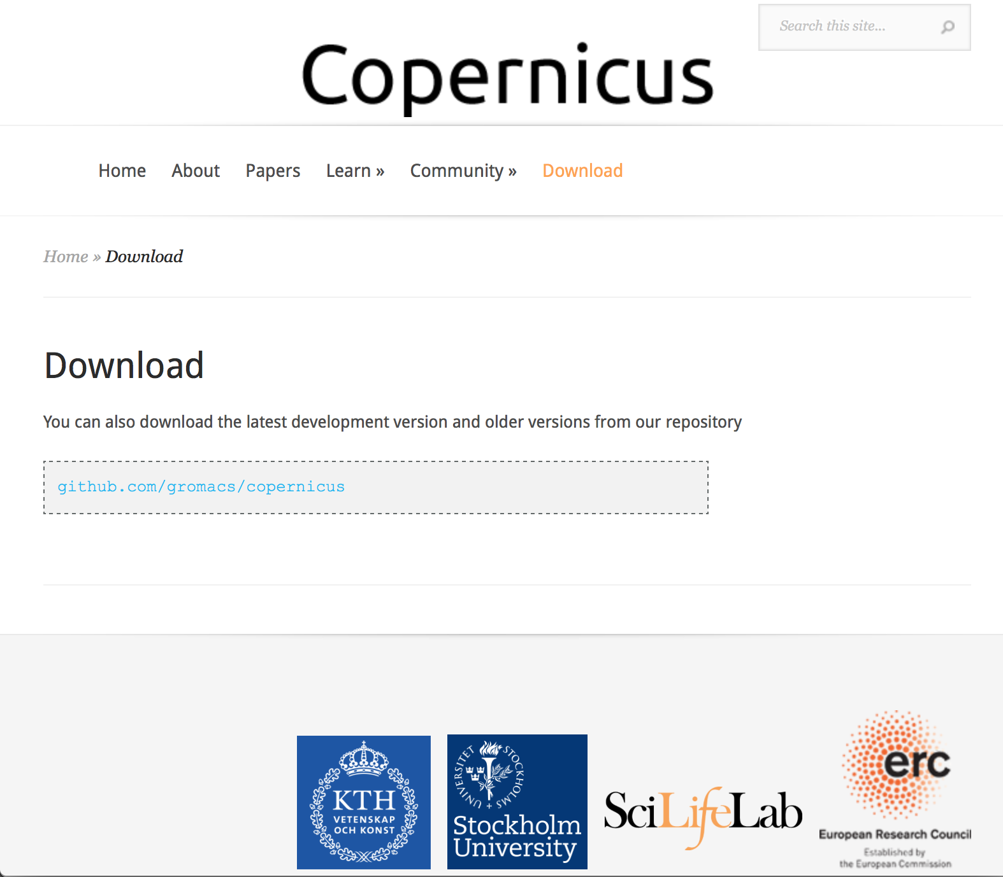
Gromacs (GROningen MAchine for Chemical Simulations)
A molecular dynamics package mainly designed for simulations of proteins, lipids and nucleic acids. It was originally developed in the Biophysical Chemistry department of University of Groningen, and is now maintained by contributors in universities and research centers worldwide, mainly at the SciLife lab in Stockholm, Sweden.
Current development in the Gromacs and MD community
Using GPU ‘s
Copernicus - distributed computing and automatization…

Slide 5
Software to install…
Gromacs – use recent versions! Prior Gromacs-2019.x, there was version 5.1.x, 4.6.x, 3.x… See http://manual.gromacs.org/documentation/ for docs and download
For data analysis (suggestions…)
Xmgrace - recommended program for data handling/plotting .xvg data files. Download from http://plasma-gate.weizmann.ac.il/Grace/
VMD 1.9.3 - Trajectory viewer, movie maker, analysis and more with different plugins. Register/download at http://www.ks.uiuc.edu/Research/vmd/
Python - (2.7.x mostly used). Many third-party tools to Gromacs exist for Python
Matlab - good for data handling/plotting (any recent version will do). Commercial but available at many Universities
Free alternatives to Matlab: Octave/Scilab/Freemat
Other software
You need a good text editor. I use Textwrangler for MacOS, Vim in the bash shell.
Avogadro 1.2 - molecular editor which I like. Do not use the most recent version, use 1.2. http://avogadro.cc/wiki/Main_Page
Openbabel - can be pretty handy for file conversion
Marvinsketch - is nice for drawing organic molecules
ChemDoodle - is also nice for drawing organic molecules

Slide 6
The documentation…
See http://manual.gromacs.org/documentation/ for recent manuals, or http://manual.gromacs.org/documentation/2019/user-guide/index.html for first time users.
Also, http://manual.gromacs.org/online.html is a good starting point, or the http://manual.gromacs.org/programs/bytopic.html for all the utility and analysis programs and for the MD simulations settings: http://manual.gromacs.org/online/mdp_opt.html
See also the old website http://www.gromacs.org It contains a lot of tips & tricks, although some stuff is outdated nowadays since the release of Gromacs 5.x
Check out Justin Lemkul’s nice tutorials
http://www.bevanlab.biochem.vt.edu/Pages/Personal/justin/gmx-tutorials/
Also ,check out the mailing list for specific problems, just google [gmx-users] yoursearchterm (otherwise… just google)

Slide 7
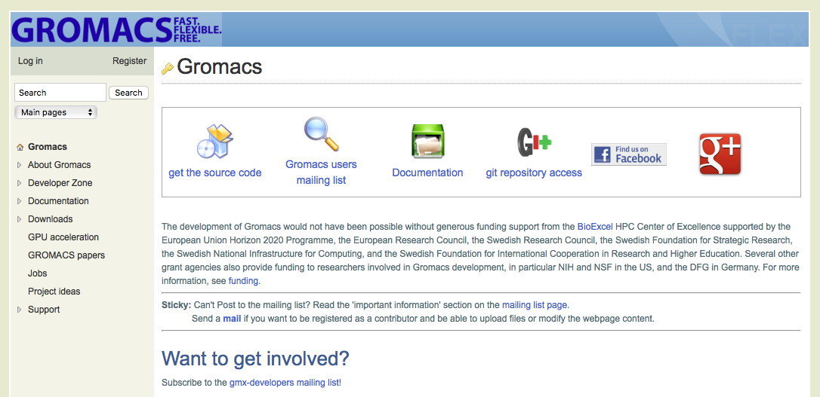
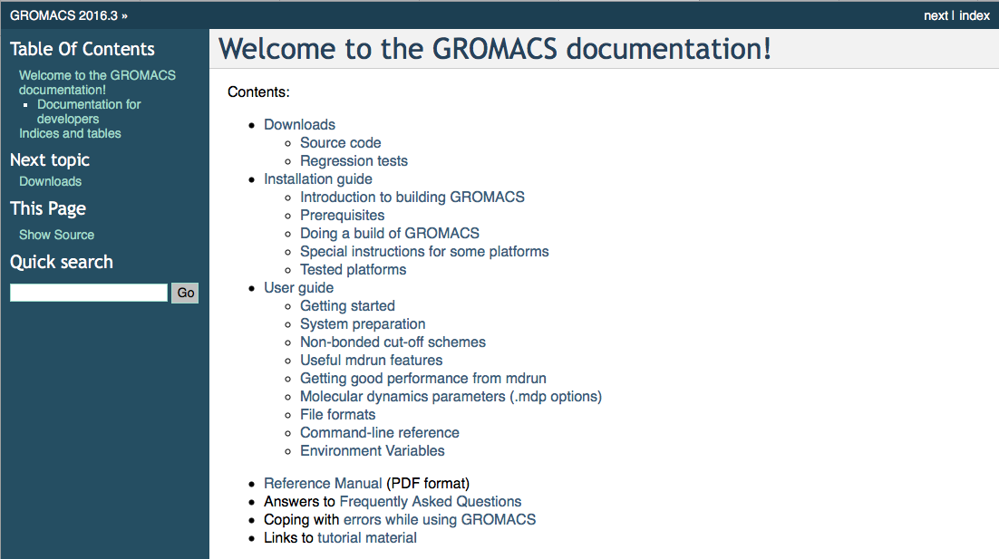
About the Gromacs documentation… Look for the most recent documentation…
www.gromacs.org
http://manual.gromacs.org/documentation/2016.3/index.html

Slide 8
2/4 How do we typically run Gromacs?

Slide 9
4 typical stages of running Gromacs
Constructing an input structure → .gro or .pdb file
Many ways to do this… manually or using VMD, Avogadro, Python, Matlab
Setting up the input files
→ System topology, molecular topology, simulation settings…
Manually (for small molecules) or using some sort topology utility…
Running the simulation (in parallell)
gmx grompp and gmx mdrun(_mpi)
On local computer or HPC cluster in parallell
Analyzing the trajectory/ thermodynamic data
Analyzing the data with any of the many Gromacs utilities or Python, Matlab, Xmgrace or other tools

Slide 10
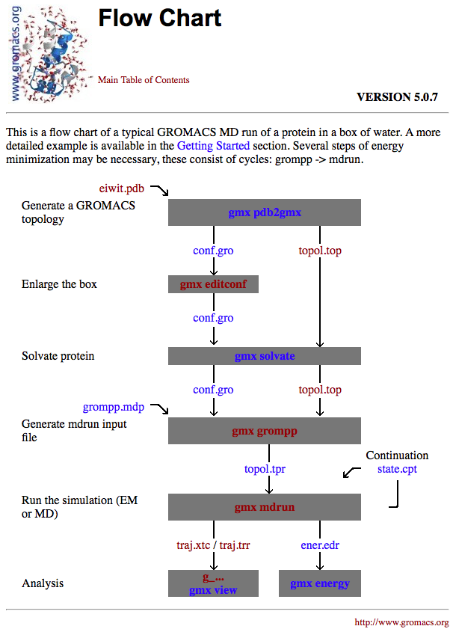
Generic flow chart of Gromacs simulations Does it always work?
http://manual.gromacs.org/online/flow.html
‘Gromacs is a molecular dynamics package mainly designed for simulations of proteins, lipids and nucleic acids.’

Slide 11
The general workflow for a MD simulation
Some initial structure/configuration from a .gro or .pdb file
Relax the structures in the system, minimizing molecular overlap
Energy minimization simulation (EM)
em.gro/prenvt.gro
Quick eq. run to allow for water re-orientation w. solutes
Position restraints simulation (NVT)
nvt.gro/prenpt.gro
Density optimisation of the system, adjusting the volume
Volume optimization simulation (NPT)
npt.gro/premd.gro
Production simulation/s (NVT or NPT or NVE)
Gather statistics and data…
md.gro

Slide 12
How-to run Gromacs?
GROMACS consists of ~90 different large or small programs/codes/utilities and relies on the UNIX command-line option philosophy. Adding “-h” gives you help for any command
Terminal commands to run Gromacs calling gmx mdrun (the actual simulation engine):
gmx mdrun # If using the default file names, we need no flags
gmx mdrun –f topol.tpr # with the –f flag
gmx mdrun –v –deffnm md # md is the common filename for all input/output files
gmx mdrun -deffnm md -cpi md # will do restart from previous md.cpt checkpoint file
gmx mdrun –multidir … # will start many parallell simulations simultaneously
Example on a HPC cluster (supercomputer)… more complicated but consult your local HPC center
srun -n 32 mdrun_mpi_sp –f md.tpr –tunepme
srun -n 32 mdrun_mpi_sp –f md.tpr –ntmpi 32 –ntomp 1 –tunepme # use -tunepme or –npme 8 or 12
srun -n 32 mdrun_mpi_sp –f md.tpr –ntmpi 16 –ntomp 2 –tunepme
srun -n 32 mdrun_mpi_sp –f md.tpr –ntmpi 8 –ntomp 4 –tunepme
Example of tuning mdrun on a HPC cluster with tune_pme and then launching mdrun with the best settings
export MDRUN='mdrun_mpi_sp'
export MPIRUN='srun'
gmx_sp tune_pme -v -mdrun "$MDRUN" -np 64 -npstring n -dlb yes -s md.tpr -check -launch -deffnm md \
-steps 15000 -resetstep 5000 -npme subset -ntpr 4 -rmax 1.4 -rmin 0.9 -r 1 -p -bg -err

Slide 13
3/4 Gromacs – input/output files and general operation

Slide 14
What input files do we need to run Gromacs?
To run Gromacs:
gmx mdrun –f topol.tpr # or something.tpr
topol.tpr is binary (but portable) and the only run input file needed for gmx mdrun
gmx grompp –p topol.top –f grompp.mdp –c conf.gro –n index.ndx –o topol.tpr
topol.top (the system topology file)
#include ”forcefield.itp” ; ff declaration file
#include ”ffnonbonded.itp” ; ff file with non-bonded parameters
#include ”ffbonded.itp” ; ff file with bond parameters
#include ”spc.itp” ; molecule topology file
#include ”posres.itp” ; optional position restraints file
Text input files needed for Gromacs pre-processor gmx grompp
(grompp == gromacs preprocesor)
grompp.mdp (a MD parameter file)
conf.gro (a structure file)
index.ndx (optional index file)

Slide 15
Gromacs input/output files
Topology file/s (.top or .itp, sort of flexible format) Typically the molecular topology file is generated by the program gmx pdb2gmx. gmx pdb2gmx translates a pdb structure file of any peptide or protein to a molecular topology file. Hence we usually need something else than pdb2gmx to simulate an inorganic system.
Molecular structure file (.gro, .pdb, sort of fixed format) First the program gmx editconf should be used to define a box of appropriate size around the molecule. gmx solvate solvates a solute molecule into any solvent (in this case water). The output of gmx solvate is a gromos structure file solvated in water.
Molecular dynamics parameter file (.mdp, sort of flexible format)) The Molecular Dynamics Parameter (.mdp) file contains all information about the Molecular Dynamics simulation itself e.g. time-step, number of steps, temperature, pressure etc. The easiest way of handling such a file is by adapting a sample .mdp file. A sample mdp file can be found online.

Slide 16
Gromacs input/output files
Index file (.ndx, sort of fixed format) Sometimes you may need an index file to specify actions on groups of atoms (e.g. Temperature coupling, accelerations, freezing). Usually the default index groups will be sufficient, so for this demo we will not consider the use of index files.
Run input file (.tpr, binary, use gmx dump or gmx check) The next step is to combine the molecular structure (.gro file), topology (.top file) MD-parameters (.mdp file) and (optionally) the index file (ndx) to generate a run input file (.tpr extension). This file contains all information needed to start a simulation with GROMACS. The gmx grompp program processes all input files and generates the run input .tpr file.
Trajectory file/s (.trr .xtc .tng, binary, use gmx dump or gmx check) Once the run input file is available, we can start the simulation. The program which starts the simulation is called gmx mdrun. The only input file of gmx mdrun you usually need to start a run is the run input file (.tpr file). The output files of gmx mdrun are the trajectory file (.trr or .trj or .tng) and a logfile (.log file).

Slide 17
Gromacs input/output files
Parameter files
.mdp - run parameters, input for gmx grompp and gmx convert-tpr
Generic structure formats:
.gro - the Gromacs format (tpr and cpt files also contain structural data)
.pdb - brookhaven Protein DataBank format
.pqr - pdb-like version, also contains charge (what precision?) and vdw radii
.xyz - simple structure format, deprecated?
Topology files
.top - system topology (ascii)
.itp - #include topology (ascii)
.rtp - residue topology (ascii)
.ndx - index file

Slide 18
Gromacs input/output files
Generic run Input files
.tpr - system topology, parameters, coordinates and velocities (binary, portable)
.tpa - system topology, parameters, coordinates and velocities (ascii)
Structure+mass(db):
.tpr, .tpb, .tpa, .gro or .pdb
Structure and mass input for analysis tools. When gro or pdb is used approximate masses will be guessed..
Generic trajectory formats:
.tng - New format!!! Any kind of data (compressed, portable, any precision)
.trj - x, v and f (binary, full precision)
.trr - x, v and f (binary, full precision, portable)
.xtc - x only (compressed, portable, any precision)
.gro - x and v (ascii, any precision)
.pdb - x only (ascii, reduced precision)

Slide 19
Gromacs input/output files
Generic energy formats:
.ene - energies, temperature, pressure, box size, density and virials (binary)
.edr - energies, temperature, pressure, box size, density and virials (binary, portable)
Other files:
.dat - generic, preferred for input
.edi - essential dynamics constraints input for gmx mdrun
.edo - essential dynamics constraints output for gmx mdrun
.eps - encapsulated Postscript
.log - log file
.map - colormap input for gmx do_dssp
.mtx - binary matrix data
.out - generic, preferred for output
.tex - LaTeX input
.xpm - ascii matrix data, use gmx xpm2ps to convert to eps
.xvg - xvgr input, to be used with xmgrace, can also easily be imported into Python, Matlab

Slide 20
How to setup the molecular topology for Gromacs
i.e. the molecular topology file (.top or .itp, sort of flexible format)
Gromacs comes with its own topology tool (gmx pdb2gmx) designed for proteins and some lipids
gmx pdb2gmx -f someprotein.pdb –o processed.gro -water spce
Select the Force Field:
From '/usr/local/gromacs/share/gromacs/top':
1: AMBER03 protein, nucleic AMBER94 (Duan et al., J. Comp. Chem. 24, 1999-2012, 2003)
2: AMBER94 force field (Cornell et al., JACS 117, 5179-5197, 1995)
3: AMBER96 protein, nucleic AMBER94 (Kollman et al., Acc. Chem. Res. 29, 461-469, 1996)
4: AMBER99 protein, nucleic AMBER94 (Wang et al., J. Comp. Chem. 21, 1049-1074, 2000)
5: AMBER99SB protein, nucleic AMBER94 (Hornak et al., Proteins 65, 712-725, 2006)
6: AMBER99SB-ILDN protein, nucleic AMBER94 (Lindorff-Larsen et al., Proteins 78, 1950-58, 7: AMBERGS force field (Garcia & Sanbonmatsu, PNAS 99, 2782-2787, 2002)
8: CHARMM27 all-atom force field (CHARM22 plus CMAP for proteins)
9: GROMOS96 43a1 force field
10: GROMOS96 43a2 force field (improved alkane dihedrals)
11: GROMOS96 45a3 force field (Schuler JCC 2001 22 1205)
12: GROMOS96 53a5 force field (JCC 2004 vol 25 pag 1656)
13: GROMOS96 53a6 force field (JCC 2004 vol 25 pag 1656)
14: GROMOS96 54a7 force field (Eur. Biophys. J. (2011), 40,, 843-856, DOI: 10.1007/ 15: OPLS-AA/L all-atom force field (2001 aminoacid dihedrals)
Obviously do not work for other forcefields…

Slide 21
How to setup the molecular topology for Gromacs
i.e. the molecular topology file (.top or .itp, sort of flexible format)
Some gromacs topology tools/scripts for organic molecules and forcefields
Use Gromacs gmx pdb2gmx if it works for you, or try gmx x2top –h If else have a look at these tools:
AMBER Antechamber - Assigns the GAFF force field to the molecule
ACPYPE - A Python interface to Antechamber, also OPLS/aa?
CHARMM CharmmCGenFF, generalized force field for CHARMM
SwissParam
CHARMM-GUI, online server that works well in many cases
GROMOS/UA PRODRG 2.5 - An automated server for topology generation
Automated Topology builder – a newer server for topology generation
OPLS-AA Topolbuild - Converts a Tripos .mol2 file into a topology
TopolGen - Converts an all-atom .pdb file to a topology
mktop - Converts a .pdb file into a topology
TPPMKTOP -Have not tested…
Also, have a look at STaGE (dx.doi.org/10.1021/jp505332p uses many different tools) and
TopoGromacs (DOI: 10.1021/acs.jcim.6b00103 conversion tool between CHARMM and Gromacs)
This tutorial is pretty cool and shows how to setup OPLS/aa topologies using some of the above tools/programs http://www.esi.umontreal.ca/~pelletjo/gromacs/derive09.html

Slide 22
How to setup the molecular topology for Gromacs
i.e. the molecular topology file (.top or .itp, sort of flexible format)
Caveat - Most topology utilites do not take into account bonds over the pbc’s ☹
VMD’s inorganic builder + VMD plugin topotools? Can give you an .psf file
Note, the atom matlab script can write a topology file for the inorganic builder!
psf2top.py (github.com/resal81/PyTopol) can convert CHARMM .psf to .top/.itp files?
psf2itp.py (Charmm-gui) can convert CHARMM .psf to .itp files?
Gromacs topology tools/scripts for inorganic molecules/forcefields which can deal with pbc
clayff_atom.m & write_atom_itp.m - generates a Clayff topologies
interface_atom.m & write_atom_itp.m - generates an INTERFACE topologies
I heard Materials studio is also great for this…

Slide 23
3/4 Example: Simulation of a small water box
500 SPC molecules with Gromacs 2016.3

Slide 24
Example: Simulating water example input files… workflow 1
batch01 ; Optional. Needed to run on a HPC cluster in parallell
; hence we do not really need one for local jobs
job1.sh ; bash file executing the overall workflow (running gmx grompp/mdrun)
topol.top ; describes the system, and links the files below together
forcefield.itp ; describes some [ default ] parameters for the forcefield
ffnonbonded.itp ; holds the [ atomtypes ] and their nonbonded LJ parameters
ffbonded.itp ; holds the [ bond/angletypes ] and their bonded parameters
spc.itp ; holds the molecular topology of the spc water model
posres.itp ; special constraint settings
index.ndx ; file used to team up atoms/molecules/residues in groups. It is ; generated by the ’gmx make_ndx’ utility
Multiple simulations… multiple .mdp files
em.mdp ; energy minimization parameter file.
nvt.mdp ; N,V,T molecular dynamics parameter file
npt.mdp ; N,P,T molecular dynamics parameter file
md.mdp ; Production run molecular dynamics parameter file. Could be
; a N,V,T or a N,P,T or a N,V,E simulation…

Slide 25
Example: Simulating water The topol.top file… (see also section 5.8 in the Gromacs manual)
#include "forcefield.itp"
#include "spc.itp"
#include "posres.itp"
; System description
[ system ]
; Title of the system
Water with water with water...
[ molecules ]
;Compound number of molecules
SOL 500

Slide 26
Example: Simulating water The forcefield.itp file…
#define _FF_OPLS ; Means we want to use the ff files from the Gromacs distribution
#define _FF_OPLSAA
; Default forcefield settings
[ defaults ]
; nbfunc comb-rule gen-pairs fudgeLJ fudgeQQ
1 2 no 1.0 1.0
#include "ffnonbonded.itp"
#include "ffbonded.itp”
nbfunc - is the non-bonded function type. Use 1 (Lennard-Jones) or 2 (Buckingham)
comb-rule - is the combination rule, for 1 & 3 see eq. 4.6, for 2 see eq. 4.7
gen-pairs - yes or no. If yes, used to generate pair interactions between 1,4 atoms not already defined in a [ pairtypes ] section. Important for certain forcefields and organic molecules
fudgeLJ - scaling factor to reduce the LJ (Lennard-Jones) interactions between 1,4 atoms
fudgeQQ - scaling factor to reduce the Coulomb interactions between 1,4 atoms

Slide 27
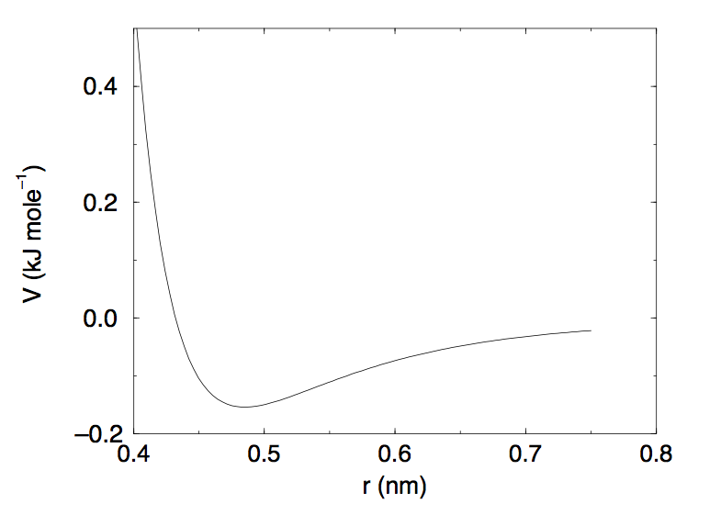

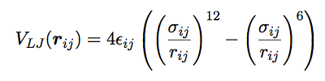
Example: Simulating water The ff parameter files. Starting with the ffnonbonded.itp
[ atomtypes ]
;name at.num mass charge ptype sigma epsilon
HW 1 1.00794 0.4100 A 0.000000 0.000000 ; Water hydrogen
OW 8 15.99940 -0.8200 A 0.316556 0.650170 ; Water oxygen
The [ atomtypes ] section contains the specific ff’s non-bonded parameters for each atom type.
It should contain the atom number, mass, charge, particle type, the LJ parameters sigma and epsilon (or C₆ C₁₂ if comb. rule 1, see previous slide).
Comb. rule 1 (& 3)
Comb. rule 2

Slide 28
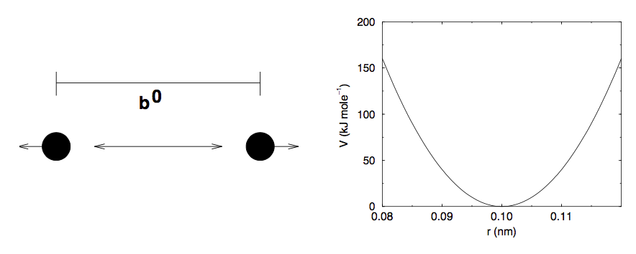

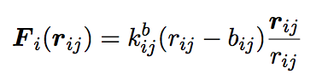
Example: Simulating water The ff parameter files. The ffbonded.itp – hey, whats the units?
[ bondtypes ]
;i j func b0 kb
OW HW 1 0.1 463700
[ angletypes ]
;i j k func th0 cth
HW OW HW 1 109.47 383
The [ bondtypes/angletypes ] sections contains the force-fields bonded parameters between all bonded atomtypes. See also the Gromacs manual, section 4.2 and 5.5.

Slide 29
Example: Simulating water The ff parameter files. The ffbonded.itp – Btw, whats the units?

Slide 30
Example: Simulating water The ff parameter files. The ffbonded.itp – Btw, whats the units?

Slide 31
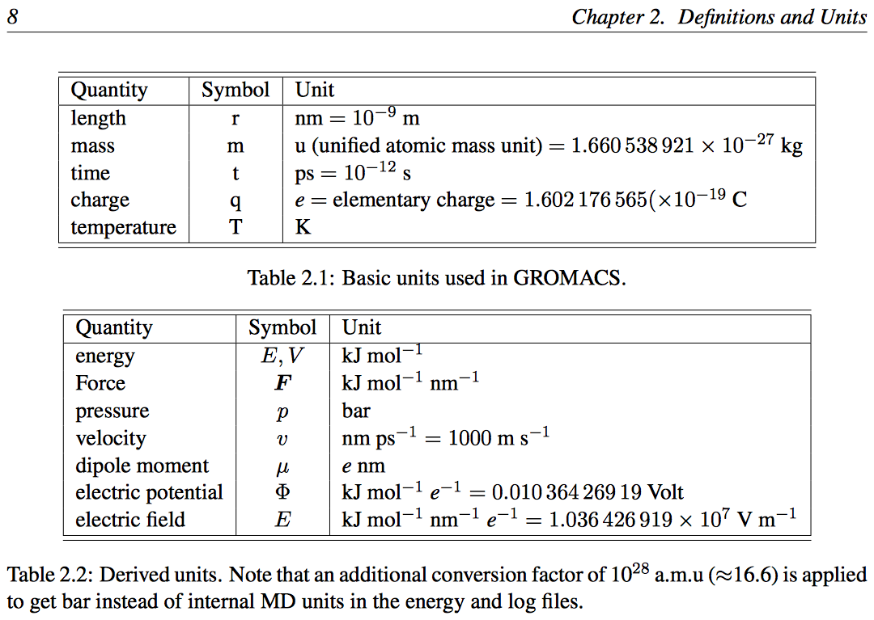
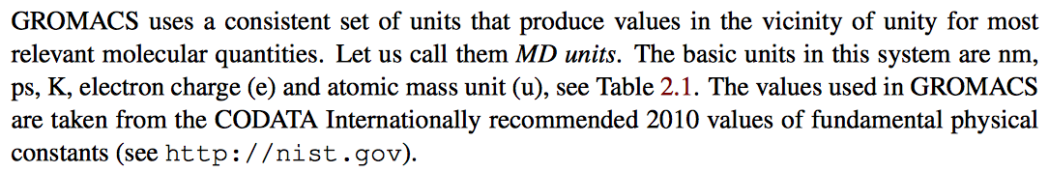
Example: Simulating water Btw… what’s the units used in Gromacs? See Chp 2 in manual…
Gromacs manual 2016.3

Slide 32
Example: Simulating water The molecular topology file for SPC water, i.e. spc.itp
[ moleculetype ]
; molname nrexcl
SOL 2
[ atoms ]
; nr type resnr residue atom cgnr charge mass
#ifndef HEAVY_H
1 OW 1 SOL OW 1 -0.82 15.99940
2 HW 1 SOL HW1 1 0.41 1.00794
3 HW 1 SOL HW2 1 0.41 1.00794
#else
1 OW 1 SOL OW 1 -0.82 9.95140
2 HW 1 SOL HW1 1 0.41 4.03200
3 HW 1 SOL HW2 1 0.41 4.03200
#endif
#ifndef FLEXIBLE
[ settles ]
; OW funct doh dhh
1 1 0.1 0.16330
[ exclusions ]
1 2 3
2 1 3
3 1 2
#else
[ bonds ]
; i j funct length force.c.
1 2 1 0.1 463700 0.1 463700 ; 0.1 345000 ; ‘Bug’ #222 in orig .itp file
1 3 1 0.1 463700 0.1 463700 ; 0.1 345000 ; ‘Bug’ #222 in orig .itp file
[ angles ]
; i j k funct angle force.c.
2 1 3 1 109.47 383 109.47 383
#endif
Each molecule type needs an template topology file (.itp)
The water topologies are a bit special in Gromacs due to the different #if statements and the [ settles ] algorithm.
How to use flexible SPC? Add to the .mdp:
define = -DFLEXIBLE

Slide 33
Example: Simulating water The position restraints file/s… posres.itp
#ifdef POSRES
[ position_restraints ]
;i funct fcx fcy fcz
1 1 1000 1000 1000 ; OW
2 1 1000 1000 1000 ; HW1
3 1 1000 1000 1000 ; HW2
#endif
Position restraints are used to restrain atoms around a fixed point in space, which can be useful for equilibration purposes.
The [ position_restraints ] file (or section) can be created with the gmx genrestr utility or written in matlab or manually…
To use it, use the –DPOSRES.itp flag in the corresponding .mdp file, this:
define = -DPOSRES

Slide 34
Example: Simulating water Last section in the topology file topol.top
; System description
[ system ]
; Title of the system
Water with water with water...
[ molecules ]
;Compound number of molecules
SOL 500
The [ system ] section contains the actual system description for the current simulation. First it needs a title of course. Secondly it also contains the [ molecules ] section, which basically states which molecules, and how many of them, exist in the system. Note that the compound name must be the same as in the molecult topology file (here spc.itp). When more than one moleculetype/compound exist, the order of them must be matched in the initial structure file (a .gro or .pdb file).

Slide 35
Example: Simulating water Some of the Gromacs 93 utilities/programs…
In terminal:
gmx help commands
analyze Analyze data sets
check Check and compare files
convert-tpr Make a modifed run-input file
density Calculate the density of the system
distance Calculate distances between pairs of positions
dump Make binary files human readable
editconf Convert and manipulates structure files
energy Writes energies to xvg files and display averages
genion Generate monoatomic ions on energetically favorable positions
genrestr Generate position restraints or distance restraints for index groups
grompp Make a run input file
h2order Compute the orientation of water molecules
hbond Compute and analyze hydrogen bonds
help Print help information
hydorder Compute tetrahedrality parameters around a given atom
insert-molecules Insert molecules into existing vacancies
make_ndx Make index files
mdrun Perform a simulation, do a normal mode analysis or an energy minimization
msd Calculates mean square displacements
rdf Calculate radial distribution functions
sigeps Convert c6/12 or c6/cn combinations to and from sigma/epsilon
solvate Solvate a system
traj Plot x, v, f, box, temperature and rotational energy from trajectories
trjcat Concatenate trajectory files
trjconv Convert and manipulates trajectory files
trjorder Order molecules according to their distance to a group
tune_pme Time mdrun as a function of PME ranks to optimize settings
velacc Calculate velocity autocorrelation functions
view View a trajectory on an X-Windows terminal
wham Perform weighted histogram analysis after umbrella sampling
x2top Generate a primitive topology from coordinates
xpm2ps Convert XPM (XPixelMap) matrices to postscript or XPM

Slide 36
Example: Simulating water A typical bash job file (job1.sh)
#!/bin/bash
## Create a simple water simulation box using the gmx solvate utility
gmx solvate -cs spc216.gro -o preem.gro -p topol.top -maxsol 500 -box 2.5 2.5 2.5
## Make an index file with:
echo q | gmx make_ndx -f preem.gro -o index.ndx
## Energy minimization
gmx grompp -f em.mdp -c preem.gro -p topol.top -n index.ndx –pp em.top -o em.tpr -maxwarn 1
gmx mdrun -v -deffnm em
## Short NVT simulation with fixed N, volume and T, and position restraints
gmx grompp -f nvt.mdp -c em.gro -p topol.top -n index.ndx –pp nvt.top -o nvt.tpr gmx mdrun -v -deffnm nvt
## NPT simulation with fixed N, pressure and T, with no position restraints
gmx grompp -f npt.mdp -c nvt.gro -p topol.top -n index.ndx –pp npt.top -o npt.tpr gmx mdrun -v -deffnm npt
## The actual production run
gmx grompp -f md.mdp -c npt.gro -p topol.top -n index.ndx –pp md.top -o md.tpr gmx mdrun -v -deffnm md
rm -f \#*

Slide 37
Example: Simulating water A typical bash job file (job1.sh)
#!/bin/bash
## Create a simple water simulation box using the gmx solvate utility
gmx solvate -cs spc216.gro -o preem.gro -p topol.top -maxsol 500 -box 2.5 2.5 2.5
; Here we create our actual system, a simulation box with 500 water molecules in a cubical box width length 2.5 nm. Gromacs does this by stacking a smaller box of 216 SPC water molecules and removing all water molecules that end up outside the box or overlap with other molecules.
; This command then results in a .gro file called preem.gro. Let’s have a look…
; Note! .gro files have a fixed format, and note there is no velocities here, since otherwise you would see three more columns after the x, y, z coordinates.
Looking at preem.gro. Note the fixed format!
Generated by gmx solvate.
1500
1SOL OW 1 0.230 0.628 0.113
1SOL HW1 2 0.137 0.626 0.150
1SOL HW2 3 0.231 0.589 0.021
2SOL OW 4 0.225 0.275 0.996
2SOL HW1 5 0.260 0.258 1.088
2SOL HW2 6 0.137 0.230 0.984
.
.
499SOL OW 1495 1.937 2.207 1.895
499SOL HW1 1496 1.845 2.179 1.866
499SOL HW2 1497 1.968 2.284 1.839
500SOL OW 1498 1.934 2.028 2.180
500SOL HW1 1499 1.917 2.111 2.126
500SOL HW2 1500 2.024 1.991 2.158
2.50000 2.50000 2.50000

Slide 38
Example: Simulating water A typical bash job file (job1.sh)
#!/bin/bash
## Create a simple water simulation box using the gmx solvate utility
gmx solvate -cs spc216.gro -o preem.gro -p topol.top -maxsol 500 -box 2.5 2.5 2.5
## Make an index file with:
echo q | gmx make_ndx -f preem.gro -o index.ndx
; Here we create ’groups’ and prints the index of each atom belonging to certain groups to a text file (index.ndx) for housekeeping. The ’groups’ is a essential concept in Gromacs that allows us to treat or analyze groups of atoms separately. The utility gmx make_ndx allows us to select/create groups based upon atom and residue names or index number. For more comlicated selections, we could also use gmx select
The echo q | is a bash command that lets us run gmx make_ndx automatically in the bash shell,
Since it otherwise runs interactively. Output:
Reading structure file
Going to read 0 old index file(s)
Analysing residue names:
There are: 500 Water residues
0 System : 1500 atoms
1 Water : 1500 atoms
2 SOL : 1500 atoms
nr : group ! 'name' nr name 'splitch' nr Enter: list groups
'a': atom & 'del' nr 'splitres' nr 'l': list residues
't': atom type | 'keep' nr 'splitat' nr 'h': help
'r': residue 'res' nr 'chain' char
"name": group 'case': case sensitive 'q': save and quit
'ri': residue index

Slide 39
Example: Simulating water A typical bash job file (job1.sh)
#!/bin/bash
## Create a simple water simulation box using the gmx solvate utility
gmx solvate -cs spc216.gro -o preem.gro -p topol.top -maxsol 500 -box 2.5 2.5 2.5
## Make an index file with:
echo q | gmx make_ndx -f preem.gro -o index.ndx
; Here we create ’groups’ and prints the index of each atom belonging to certain groups to a text file (index.ndx) for housekeeping. The ’groups’ is a essential concept in Gromacs that allows us to treat or analyze certain atoms/residues separately. The utility gmx make_ndx allows us to select/create groups based upon atom and residue names or index number. For more comlicated selections, we could also use gmx select.
Another way of doing it is through this cat command:
cat << EOF | gmx make_ndx -f preem.gro -o index.ndx
a OW
name 3 OW
a HW*
name 4 HW
q
EOF
; This allows us to create extra groups apart from the default groups
; Hence here we also created a (third) group called OW from all the OW ; atoms and a (fourth) group called HW from all the HW* atoms
0 System : 1500 atoms
1 Water : 1500 atoms
2 SOL : 1500 atoms
3 OW : 500 atoms
4 HW : 1000 atoms

Slide 40
Example: Simulating water A typical bash job file (job1.sh)
#!/bin/bash
## Create a simple water simulation box using the gmx solvate utility
gmx solvate -cs spc216.gro -o preem.gro -p topol.top -maxsol 500 -box 2.5 2.5 2.5
## Make an index file with:
echo q | gmx make_ndx -f preem.gro -o index.ndx
## Energy minimization
gmx grompp -f em.mdp -c preem.gro -p topol.top -n index.ndx –pp em.top -o em.tpr -maxwarn 1
gmx mdrun -v -deffnm em
We could optionally use the –maxwarn flag which allows gmx grompp to ignore potential problems/errors in the input files. With the flag –pp gmx grompp also outputs the final and explicit system topology file em.top. With –po the corresponding output em.mdp file is also printed (else mdout.mdp).
; Secondly, we run the actual simulation using gmx mdrun (on a hpc cluster this command can look a bit different, like gmx_seq_mdrun or gmx_mpi mdrun). The –v flag makes is verbose. The –deffnm defines the name of the input/output files, otherwise Gromacs uses its own default names.
; Then after the energy minimization, we proceed in a similar manner with the NVT,NPT and MD simulations.

Slide 41
Example: Simulating water A typical md parameter file for energy minization, em.mdp
; Parameters describing what to do, when to stop and what to save
define = -DFLEXIBLE; Turn on flexible SPC water bonds
integrator = steep ; Algorithm (steep = steepest descent minimization)
emtol = 1000 ; Stop minimization when the maximum force < 1000.0 kJ/mol/nm
emstep = 0.01 ; Energy step size
nsteps = 1000 ; Maximum number of (minimization) steps to perform
nstxout = 10 ; trajectory output every 10 steps
cutoff-scheme = verlet
; Parameters describing how to find the neighbors of each atom and how to calculate the interactions
nstlist = 10 ; Frequency to update the neighbor list and long range forces
ns_type = grid ; Method to determine neighbor list (simple, grid)
rlist = 1 ; Cut-off for making neighbor list (short range forces)
coulombtype = PME ; Treatment of long range electrostatic interactions
rcoulomb = 1 ; Short-range electrostatic cut-off
rvdw = 1 ; Short-range Van der Waals cut-off
pbc = xyz ; Periodic Boundary Conditions
With this input gmx grompp will produce a commented file with the default name mdout.mdp. That file will contain the above options, as well as all other options not explicitly set, showing their default values.
For all .mdp options, go to:
http://manual.gromacs.org/documentation/2016.3/user-guide/mdp-options.html

Slide 42
Example: Simulating water A typical md parameter file for a NVT simulation, nvt.mdp
define = -DFLEXIBLE -DPOSRES
; Run parameters
Integrator = md ; leap-frog integrator
nsteps = 10000 ;
nstcomm = 1000 ;
dt = 0.0005 ; 0.5 fs
comm-mode = Linear ; Linear COM mass control every 1000 steps
comm-grps = SYSTEM ; Groups to apply COM control to
; Output control
nstxout = 0 ; every 0 ps
nstvout = 0 ; save velocities every 0 ps
nstfout = 0 ; save forces every 0 ps
nstxout-compressed = 100 ; xtc compressed trajectory output every 0.5 ps
nstenergy = 100 ; save energies every 0.5 ps
nstlog = 100 ; update log file every 0.5 ps
; Bond parameters
continuation = no ; first dynamics run
constraint_algorithm = lincs ; holonomic constraints
constraints = none ; all bonds (even heavy atom-H bonds) constrained
lincs_iter = 1 ; accuracy of LINCS
lincs_order = 4 ; also related to accuracy
;see more on next slide…
; A word about bonds or constraints as we call it in Gromacs – To constrain the bonds, we could use shake as the constraint_algorithm but lincs is preferable since its more stable and faster (I think). Note that even if we set constraints = none ; the water (as set in the water .itp file) still will have its bonds and angles constrained by the settle algorithm, unless we have set define = -DFLEXIBLE

Slide 43
Example: Simulating water A typical md parameter file for a NVT simulation, nvt.mdp
;cont’d from previous slide
; Neighborsearching
cutoff-scheme = verlet
ns_type = grid ; search neighboring grid cells
nstlist = 10 ; 10 fs
rlist = 1.0 ; short-range neighborlist cutoff (in nm)
; Electrostatics and vdw
coulombtype = PME ; Particle Mesh Ewald for long-range electrostatics
pme_order = 4 ; cubic interpolation
fourierspacing = 0.16 ; grid spacing for FFT
rcoulomb = 1.0 ; short-range electrostatic cutoff (in nm)
rvdw = 1.0 ; short-range van der Waals cutoff (in nm)
; Temperature coupling is on
tcoupl = V-rescale ; modified Berendsen thermostat
tc-grps = SYSTEM ; on coupling groups - more accurate
tau_t = 0.1 ; time constant, in ps
ref_t = 298.15 ; reference temperature, one for each group, in K
; Pressure coupling is off
pcoupl = no ; no pressure coupling in NVT
; Periodic boundary conditions
pbc = xyz ; 3-D PBC
periodic-molecules = no
; Dispersion correction
DispCorr = EnerPres ; account for cut-off vdW scheme

Slide 44
Example: Simulating water A typical md parameter file for a NVT simulation, nvt.mdp
; Temperature coupling is on
tcoupl = V-rescale ; modified Berendsen thermostat
tc-grps = SYSTEM ; on coupling groups - more accurate
tau_t = 0.1 ; time constant, in ps
ref_t = 298.15 ; reference temperature, one for each group, in K
; A word about thermostats –
tcoupl -Several groups can be coupled separately, these are specified in the tc-grps field separated by spaces.
no - No temperature coupling
berendsen - Temperature coupling with a Berendsen-thermostat to a bath with temperature ref-t [K], with time constant tau-t [ps]
nose-hoover - Temperature coupling using a Nose-Hoover extended ensemble. The reference temperature and coupling groups are selected as above, but in this case tau-t [ps] controls the period of the temperature fluctuations at equilibrium
v-rescale - Temperature coupling using velocity rescaling with a stochastic term (JCP 126, 014101). This thermostat is similar to Berendsen coupling, with the same scaling using tau-t, but the stochastic term ensures that a proper canonical ensemble is generated. The random seed is set with ld-seed. This thermostat works correctly even for tau-t=0. For NVT simulations the conserved energy quantity is written to the energy and log file.

Slide 45
Example: Simulating water A typical md parameter file for a NVT simulation, nvt.mdp
;In nvt.mdp
; Pressure coupling is off
Pcoupl = no ; no pressure coupling in NVT
;In npt.mdp
; Pressure coupling is on
pcoupl = Berendsen ; Parrinello-Rahman ; Pressure coupling on in NPT
pcoupltype = isotropic ; uniform scaling of box vectors
tau-p = 5 ; time constant, in ps
ref-p = 1.0 ; reference pressure, in bar
compressibility = 4.5E-5 ; isothermal compressibility of water, bar^-1
; also, set
continuation = yes ; because the second dynamics run
; A word about barostats – pcoupl
no - No pressure coupling. This means a fixed box size.
Berendsen - Exponential relaxation pressure coupling with time constant tau-p [ps]. The box is scaled every timestep. It has been argued that this does not yield a correct thermodynamic ensemble, but it is the most efficient way to scale a box at the beginning of a run.
Parrinello-Rahman - Extended-ensemble pressure coupling where the box vectors are subject to an equation of motion.
pcoupltype = Isotropic | semiisotropic | anisotropic | surface-tension

Slide 46
Example: Simulating water A typical bash job file (job1.sh)
#!/bin/bash
## Create a simple water simulation box using the gmx solvate utility
gmx solvate -cs spc216.gro -o preem.gro -p topol.top -maxsol 500 -box 2.5 2.5 2.5
## Make an index file with:
echo q | gmx make_ndx -f preem.gro -o index.ndx
## Energy minimization
gmx grompp -f em.mdp -c preem.gro -p topol.top -n index.ndx –pp em.top -o em.tpr -maxwarn 1
gmx mdrun -v -deffnm em
## Short NVT simulation with fixed N, volume and T, and position restraints
gmx grompp -f nvt.mdp -c em.gro -p topol.top -n index.ndx –pp nvt.top -o nvt.tpr gmx mdrun -v -deffnm nvt
## NPT simulation with fixed N, pressure and T, with no position restraints
gmx grompp -f npt.mdp -c nvt.gro -p topol.top -n index.ndx –pp npt.top -o npt.tpr gmx mdrun -v -deffnm npt
## The actual production run
gmx grompp -f md.mdp -c npt.gro -p topol.top -n index.ndx –pp md.top -o md.tpr gmx mdrun -v -deffnm md
rm -f \#*

Slide 47
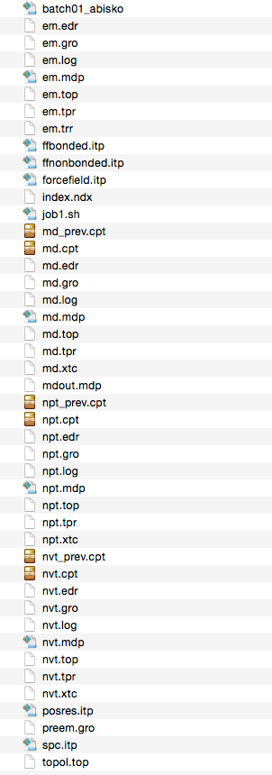
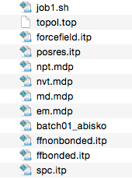
Example: Simulating water The input files before and after the simulations… workflow 1
Before
After
Easily becomes too many files in a single folder!! Especially for more advanced workflows..
Can we simplify this somehow?

Slide 48
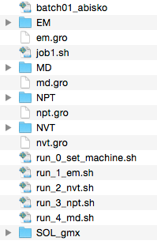
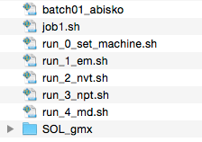
Example: Simulating water The input files before and after the simulations… workflow 2
using some bash scripting
Before
After
We should make use of bash to create rational workflows! Why?
It can make things tidy
Allows us to create advanced workflows
Allows us to run same input files on different computers/HPC clusters

Slide 49
Example: Simulating water The alternative job file job1.sh file, using bash scripting… workflow 2
#!/bin/bash
cluster=$1 # Passed variable 1 (machine) from caller
ncores=$2 # Passed variable 2 (number of proc.) from caller
## SET MAIN DIRECTORY TO CURRENT PATH ############################
gmx_run=$(pwd)
echo "home directory of the gromacs simulations set to $gmx_run"
## SET TWO MOLECULE/FILENAME KEYWORDS ############################
I=SOL
J=gmx
moldir="$I"_"$J"
## Let’s define some variable just for fun that we could in the simulations
Temp=298.15
## CREATE THE SYSTEM AND A INDEX FILE ############################
## Create a simple water simulation box using the gmx solvate utility
gmx solvate -cs spc216.gro -o $moldir/preem.gro -p $moldir/topol.top -maxsol 500 -box 2.5 2.5 2.5
## Make an index file with:
echo q | gmx make_ndx -f $moldir/preem.gro -o $moldir/index.ndx
## RUN THE RUN SCRIPTS ###########################################
source ./run_0_set_machine.sh $cluster $ncores
source ./run_1_em.sh 1000 10
source ./run_2_nvt.sh 10000 1000
source ./run_3_npt.sh 10000 1000
source ./run_4_md.sh 1000000 1000
Note that all the .mdp files are inside the bash run scripts along with the gmx grompp and gmx mdrun commands!

Slide 50
Example: Simulating water Set computer specific settings in a separate file (run_0_set_machine.sh) This file makes the input files compatible with different computers
#!/bin/bash
cluster=$1 # Passed variable 1 (machine) from caller
ncores=$2 # Passed variable 2 (number of proc.) from caller
if [[ $# -eq 0 ]]; then
echo "no passed variables"
else
nPME=$((${ncores}/4)) # Number of dedicated PME cores
fi
if [[ $cluster == "beskow" ]] # This now seems to be for gromacs 5.1.2.
then
echo "Cluster is beskow"
echo "will run on $ncores proc.”
export OMP_NUM_THREADS=1
## APRUN_OPTIONS="-n ${ncores} -d 1 -cc none"
gmx_mdrun="aprun -n ${ncores} -d 1 -cc none gmx_mpi mdrun -npme ${nPME}"
gmx_grompp="gmx_seq grompp"
gmx_wham="gmx_seq wham"
gmx_dist="gmx_seq distance”
elif [ $cluster = "abisko" ] # This now seems to be for gromacs 5.1.1.
then
echo "Cluster is abisko"
echo "will run on $ncores proc."
# For Abisko only!
if [ -n "$SLURM_CPUS_PER_TASK" ]; then
md="mdrun_mpi -ntomp $SLURM_CPUS_PER_TASK -npme ${nPME}"
else
md="mdrun_mpi -ntomp 1"
fi
gmx_mdrun="srun $md”
gmx_grompp="gmx grompp”
gmx_wham="gmx wham”
gmx_dist="gmx distance"
fi
Making use of some bash if-statements!
Note that different HPC centers and local computers might use different gmx run commands!

Slide 51
Example: Simulating water Set computer specific settings in a separate file (run_0_set_machine.sh) This file makes the input files compatible with different computers
# Cont’d from previous slide
else
echo "no cluster, running on local machine"
echo "will run on $ncores proc."
# Do we want to run with a specific Gromacs version
# source /usr/local/gromacs-5.1.1/bin/GMXRC
# source /usr/local/gromacs-5.1.4/bin/GMXRC
# source /usr/local/gromacs-2016.3/bin/GMXRC
gmx_mdrun="gmx mdrun"
gmx_grompp="gmx grompp"
gmx_wham="gmx wham"
gmx_dist=”gmx distance”
fi
echo $run_cmd
echo $run_grompp
No $cluster of $ncores variables needs to be defined when running on our own local computer, hence we finish the if-statement with an else…

Slide 52
Example: Simulating water A first run file - run_1_em.sh
#!/bin/bash
sim=em
type=EM
## Set main directory to current path
gmx_run=$(pwd)
echo "home directory of the gromacs simulations set to $gmx_run"
if [ $# -eq 0 ]
then
echo "No n steps supplied"
nsteps=1000
else
nsteps=$1
fi
if [ $# -lt 2 ]
then
echo "No n steps supplied"
emtol=1000
else
emtol=$1
fi
if [ $# -lt 3 ]
then
echo "No framerate supplied"
framerate=10
else
framerate=$2
fi
echo "Starting energy minimization steep"
cd $gmx_run
mkdir "$type”
cd "$type”
cp $gmx_run/$moldir/preem.gro ./pre"$sim".gro
If no $nsteps or $framerate variables are defined, we should use some default values

Slide 53
Example: Simulating water A first run file - run_1_em.sh
################################################
####### ENERGY MINIMIZATION WITH STEEP #########
################################################
### Create em.mdp file ########################################
cat << EOF >| "$sim".mdp
; Parameters describing what to do, when to stop and what to save
define = -DFLEXIBLE ; position restrain the protein
integrator = steep ; Algorithm (steep = steepest descent minimization)
emtol = $emtol ; Stop minimization when the maximum force < 1000.0 kJ/mol/nm
emstep = 0.01 ; Energy step size
nsteps = $nsteps ; Maximum number of (minimization) steps to perform
Nstxout = $framerate ; xtc compressed trajectory output every .1 ps
cutoff-scheme = verlet
; Parameters describing how to find the neighbors of each atom and how to calculate the interactions
Nstlist = 10 ; Frequency to update the neighbor list and long range forces
ns_type = grid ; Method to determine neighbor list (simple, grid)
rlist = 1 ; Cut-off for making neighbor list (short range forces)
coulombtype = PME ; Treatment of long range electrostatic interactions
rcoulomb = 1 ; Short-range electrostatic cut-off
rvdw = 1 ; Short-range Van der Waals cut-off
pbc = xyz ; Periodic Boundary Conditions
periodic-molecules = yes
EOF
################################################
####### ENERGY MINIMIZATION WITH STEEP #########
################################################
$run_grompp -f ./"$sim".mdp -c pre"$sim".gro -p $gmx_run/$moldir/topol.top -n $gmx_run/$moldir/index.ndx -o "$sim".tpr -maxwarn 1
$run_cmd -v -deffnm "$sim”
echo "Minimization steep complete."
if [ -e "$sim".gro ]
then
echo "Minimization steep may have finished ok!"
cp "$sim".gro ../
fi
cd $gmx_run
We use cat << EOF >| to print the .mdp file and to run gmx grompp and gmx mdrun. After finished, cd to the working folder

Slide 54
Example: Simulating water The subsequent NVT, NPT snd MD simulation files…
################################################
########### VOLUME EQUILIBRATION ##############
################################################
echo "Starting "$type" simulation"
cd $gmx_run
latest_gro=$(ls -t1 *.gro | head -n1)
echo $latest_gro
mkdir "$type"
cp $latest_gro ./"$type"/pre"$sim".gro
cd "$type"
The subsequent NVT, NPT and MD simulations work the same way, except now the most recent .gro file from the working folder is copied to the current simulation folder (instead of the $moldir/preem.gro) and used as the input structure. This has some different advantages but also some disadvantages… can you see why?

Slide 55
Let’s have a look at some output files
Example from the NPT simulations
prenpt.gro # The input structure, hence the ’pre’
npt.gro # The final structure, what if we can’t find it?
npt.xtc # The compressed trajectory, why not .trr?
npt.tpr # The input .tpr file created by gmx grompp
npt.log # The simulation log file. How did we do?
npt.edr # The output energy file. Use with gmx energy npt.mdp # Our md parameter file
mdout.mdp # Gromacs md parameter file, Wait, what? (-po)
npt.top # Gromacs topology file. Wait, what? (-pp)
npt.cpt # The restart checkpoint file.
What’s in a .log text file? Best reference can be found here:
http://www.gromacs.org/Documentation/Tutorials/GROMACS_USA_Workshop_and_Conference_2013
What’s in a .edr file? Use gmx energy to find out, like this
gmx energy –f npt.edr
echo 5 10 11 | gmx energy –f npt.edr

Slide 56
Let’s have a look at some output files
Example from the NPT simulations
gmx energy –f npt.edr
echo 5 10 11 | gmx energy –f npt.edr
…or try →
gmx energy -f ener.edr << EOF
Pot
Kin
Tot
EOF
Opened npt.edr as single precision energy file
Select the terms you want from the following list by
selecting either (part of) the name or the number or a combination.
End your selection with an empty line or a zero.
-------------------------------------------------------------------
1 LJ-(SR) 2 Disper.-corr. 3 Coulomb-(SR) 4 Coul.-recip.
5 Potential 6 Kinetic-En. 7 Total-Energy 8 Temperature
9 Pres.-DC 10 Pressure 11 Box-X 12 Box-Y
13 Box-Z 14 Volume 15 Density 16 pV
17 Enthalpy 18 Vir-XX 19 Vir-XY 20 Vir-XZ
21 Vir-YX 22 Vir-YY 23 Vir-YZ 24 Vir-ZX
25 Vir-ZY 26 Vir-ZZ 27 Pres-XX 28 Pres-XY
29 Pres-XZ 30 Pres-YX 31 Pres-YY 32 Pres-YZ
33 Pres-ZX 34 Pres-ZY 35 Pres-ZZ 36 #Surf*SurfTen
37 T-System 38 Lamb-System
5
10
11
Back Off! I just backed up energy.xvg to ./#energy.xvg.1#
Last energy frame read 1000 time 100.000
Statistics over 100001 steps [ 0.0000 through 100.0000 ps ], 3 data sets
All statistics are over 1001 points (frames)
Energy Average Err.Est. RMSD Tot-Drift
-------------------------------------------------------------------------------
Potential -20866 17 140.671 -56.7338 (kJ/mol)
Pressure -23.6986 21 520.216 114.21 (bar)
Box-X 2.48375 0.0011 0.00363595 -0.00628363 (nm)
gcq#27: "A Man Needs a Maid" (N. Young)
If we did not use the –o flag, gmx energy will output energy.xvg as default. Now we could take a look at it using xmgrace by using this command (or the import_xvg(‘energy.xvg’) matlab function)
xmgrace –nxy energy.xvg

Slide 57
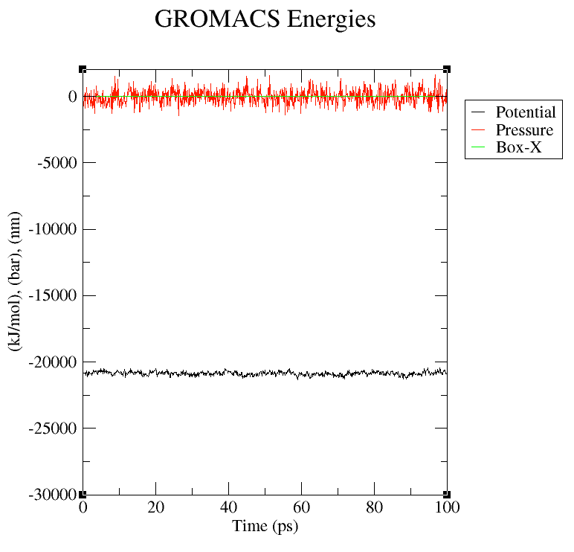
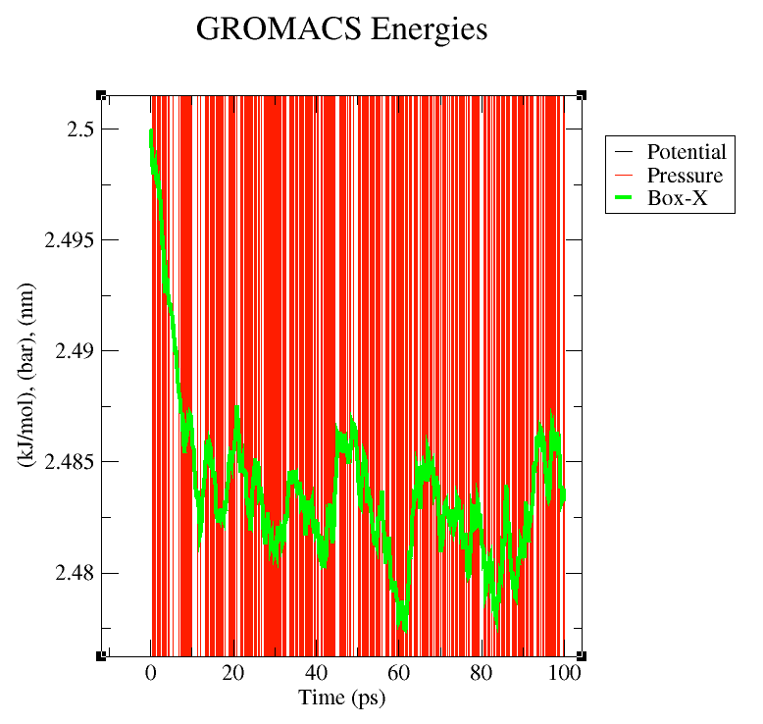
Let’s have a look at some output files
Example from the NPT simulations
xmgrace –nxy energy.xvg
; Has the system equilibrated? Look at Potential energy, pressure, box size…
; Hey, what does the –nxy flag do?

Slide 58
Some simple trajectory analysis
Example with the MD run simulations, assuming files exist in a subfolder called MD
#!/bin/bash
# bash script to analyze the density of the system
type=MD
sim=md
cd $type
echo 0 | gmx density -f $sim.xtc -s $sim.tpr -o density.xvg \
-d z -sl 200
gmx analyze -f density.xvg -errbar stddev -aver_start 100
rm -f \#*
xmgrace -nxy density.xvg &
cd ..

Slide 59
Some simple trajectory analysis
Example with the MD run simulations, assuming files exist in a subfolder called MD
#!/bin/bash
# bash script to analyze the mean-square-displacement and the diffusion # coefficient of the molecules
type=MD
sim=md
cd $type
echo 0 | gmx msd -f md.xtc -s md.tpr -o msd.xvg -trestart 250 -beginfit 20 -endfit 250
xmgrace -nxy msd.xvg &

Slide 60
Some simple trajectory analysis
Example with the MD run simulations, assuming files exist in a subfolder called MD
#!/bin/bash
# bash script to analyze the hydrogen bonds in the system
type=MD
sim=md
cd $type
echo 0 0 | gmx hbond -f $sim.xtc -s $sim.tpr -n ../SOL_gmx/index.ndx -temp 298 -num hbnum.xvg -hbn hbond.ndx -nhbdist nhbdist.xvg -g hbond.log -dist hbdist.xvg -ang hbang.xvg
gmx analyze -f hbnum.xvg
xmgrace -nxy hbnum.xvg &
rm -f \#*

Slide 61
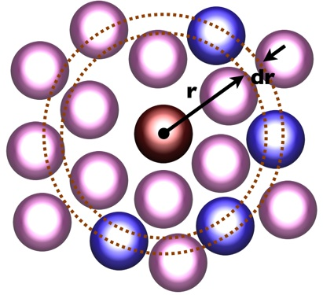
Some simple trajectory analysis
Example with the MD run simulations, assuming files exist in a subfolder called MD using a for-loop to look at time dependency
#!/bin/bash
# bash script to analyze the radial distribution function between OW – HW
# in blocks using a for loop
type=MD
sim=md
cd $type
block=200
for N in 1 2 3 4 5;
do (start=$(($N*$block-$block))
stop=$(($N*$block))
echo $start
echo $stop
echo 2 2 | gmx rdf -f $sim.xtc -s $sim.tpr -n ../SOL_gmx/index.ndx \
-ref OW -sel HW -bin 0.002 -rmax 1.2 -o rdf_OwHw_$N.xvg \
-cn rdf_OwHw_cn_$N.xvg -b $start -e $stop
);
done
rm -f \#*
xmgrace -nxy rdf_*.xvg &
cd ..
Radial distribution

Slide 62
The End

