Slide 1
Passw3rd
Neil Matatall
@nilematotle
oreoshake

Slide 2
What is it?
Cross-platform, cross-language password management for applications
Keeps passwords out of code and configuration files, but keeps them in encrypted files that can be checked into version control
Keys for dev/test can be checked in, but prod keys must be protected

Slide 3
Give me the run down
Generate keys:
passw3rd –g <-k path>
generated keys in /Users/neil
(creates .passw3rd-encryptionIV and .passw3rd-encryptionKey)
Create a password file
$ passw3rd –e file_name <-p path> <-k path>
Enter the password:
Wrote password to /Users/neil/file_name
Verify the password can be retrieved
$ passw3rd –d file_name <-p path> <-k path>
The password is: asdf

Slide 4
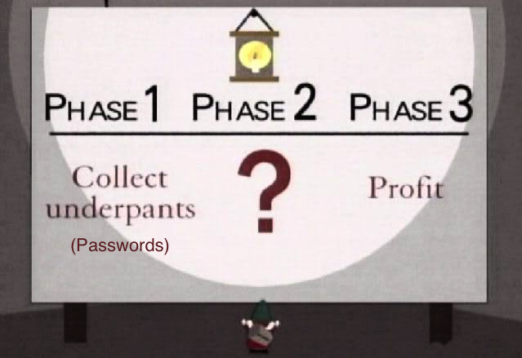
Business model

Slide 5

Phase 3: Profit
Need a password rotation?
Fine, just create a new password file for the affected accounts
Need a new server?
Just make the keys part of your build script
Need to rotate your key?
Trivial, decrypt with the old, encrypt with the new
Wait, hold on a second you can’t change…
oh yeah that sounds like a good idea…

Slide 6
Questions?
https://github.com/oreoshake/passw3rd
https://github.com/oreoshake/passw3rd_java
http://rubygems.org/gems/passw3rd
https://www.owasp.org/index.php/OWASP_Passw3rd_Project#tab=Project_About

