Slide 1
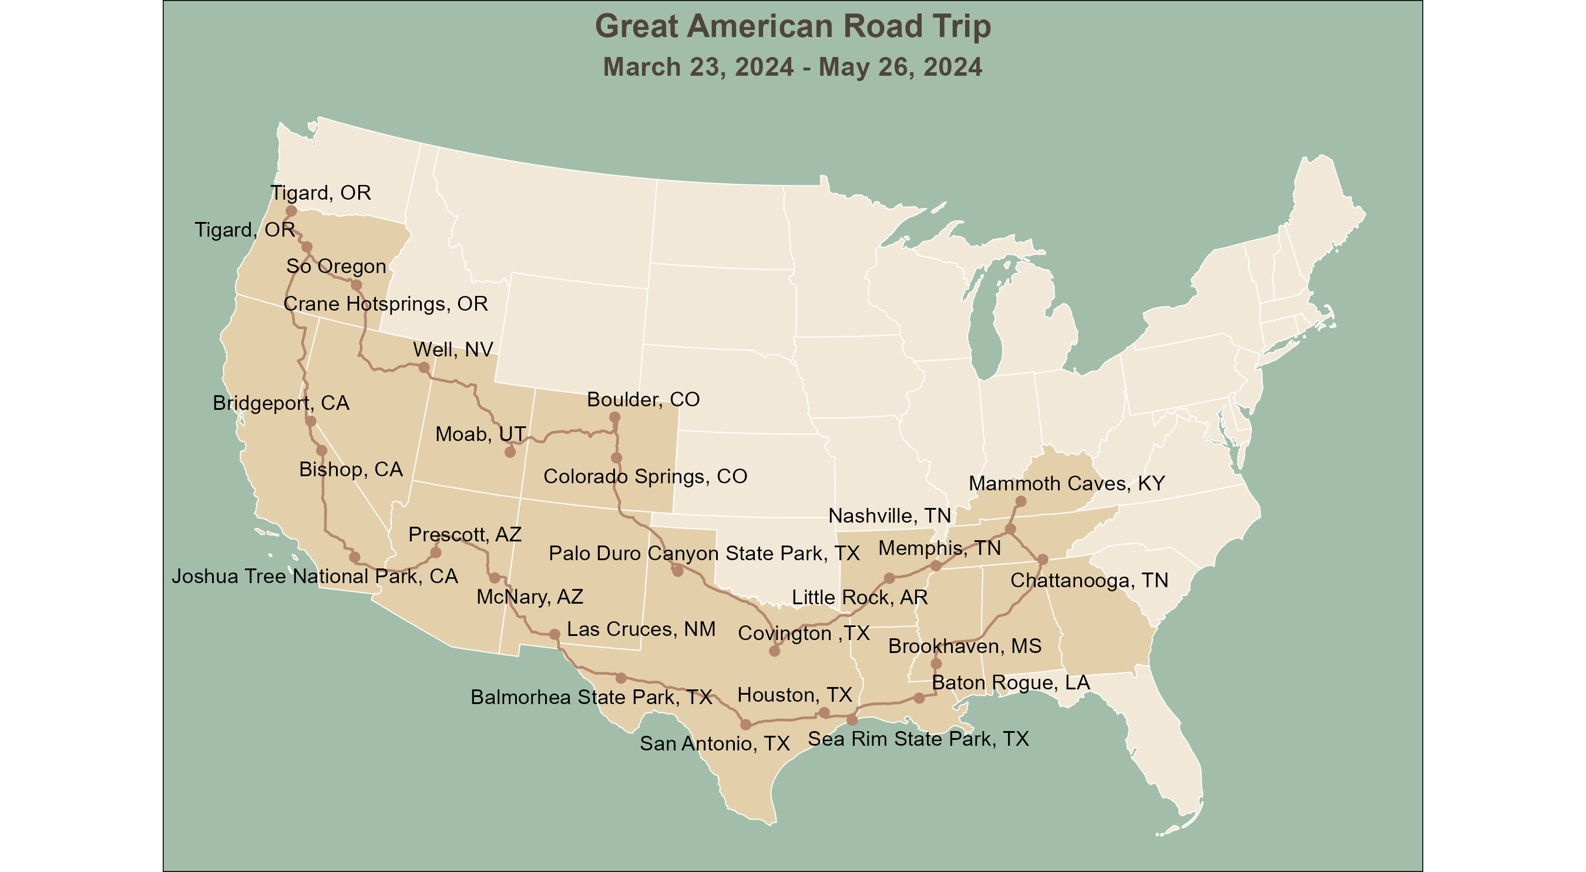

Slide 2
Great American Road Trip
March 23, 2024 - May 26, 2024
Tigard, OR
So Oregon
Crane Hotsprings, OR
Well, NV
Bridgeport, CA
Boulder, CO
Moab, UT
Bishop, CA
Colorado Springs, CO
Mammoth Caves, KY
Prescott, AZ
Nashville, TN
Palo Duro Canyon State Park, TX
Chattanooga, TN
Joshua Tree
National Park, CA
Memphis, TN
McNary, AZ
Little Rock, AR
Las Cruces, NM
Covington ,TX
Brookhaven, MS
Balmorhea State Park, TX
Houston, TX
Baton Rogue, LA
San Antonio, TX
Sea Rim State Park, TX

Slide 3
Great American Road Trip
March 23, 2024 - May 26, 2024
Tigard, OR
Tigard, OR
Crane Hotsprings, OR
So OregonCOllier, OR
Well, NV
Reno, NV
Boulder, CO
Bishop, CA
Moab, UT
Colorado Springs, CO
Mammoth Caves, KY
Prescott, AZ
Nashville, TN
Joshua Tree National Park, CA
Palo Duro Canyon State Park, TX
Memphis, TN
McNary, AZ
Little Rock, AR
Chattanooga, TN
Las Cruces, NM
Covington ,TX
Brookhaven, MS
Balmorhea State Park, TX
Houston, TX
Baton Rogue, LA
San Antonio, TX
Sea Rim State Park, TX

Slide 4
Great American Road Trip
March 23, 2024 - May 26, 2024
Tigard, OR
Tigard, OR
Crane Hotsprings, OR
Collier, OR
Well, NV
Reno, NV
Boulder, CO
Bishop, CA
Moab, UT
Colorado Springs, CO
Mammoth Caves, KY
Prescott, AZ
Nashville, TN
Joshua Tree National Park, CA
Palo Duro Canyon State Park, TX
Memphis, TN
McNary, AZ
Little Rock, AR
Chattanooga, TN
Las Cruces, NM
Covington ,TX
Brookhaven, MS
Balmorhea State Park, TX
Houston, TX
Baton Rogue, LA
San Antonio, TX
Sea Rim State Park, TX

Slide 5
Great American Road Trip
March 23, 2024 - May 26, 2024
Tigard, OR
Crane
Hotsprings,
Collier,
OR
OR
Well, NV
Boulder,
Reno, NV
CO
Bishop, CA
Colorado
Mammoth
Moab, UT
Springs,
Palo Duro
Nashville,
Caves, KY
Prescott,
CO
Canyon
TN
Joshua
AZ
State
Tree
Park, TX
Memphis,
Chattanooga,
National
McNary, AZ
Little
TN
TN
Park, CA
Las
Covington ,TX
Rock, AR
Brookhaven,
Cruces, NM
Balmorhea
Houston,
MS
State
TX
Baton
Park, TX
San
Sea Rim
Rogue, LA
Antonio,
State
TX
Park, TX

Slide 6
Great American Road Trip
March 23, 2024 - May 26, 2024
Tigard, OR
Crane Hot Springs,
OR
Collier, OR
Well, NV
Reno, NV
Boulder, CO
Bishop, CA
Moab, UT
Colorado Springs, CO
Mammoth Caves, KY
Prescott, AZ
Nashville, TN
Memphis, TN
Joshua Tree National
McNary, AZ
Palo Duro Canyon
Little Rock, AR
Chattanooga, TN
Park, CA
State Park, TX
Covington ,TX
Las Cruces, NM
Brookhaven, MS
Balmorhea State
Houston, TX
Baton Rogue, LA
Park, TX
Sea Rim State Park,
San Antonio, TX
TX

Slide 7
Great American Road Trip
March 23, 2024 - May 26, 2024
Tigard, OR
Crane Hot
Springs, OR
Collier, OR
Wells, NV
Reno, NV
Boulder, CO
Bishop, CA
Moab, UT
Mammoth Caves
Colorado
National Park
Springs, CO
Nashville, TN
Prescott, AZ
Palo Duro
Memphis, TN
Joshua Tree
Canyon State
Chattanooga, TN
National Park
McNary, AZ
Park
Little Rock, AR
Las Cruces, NM
Covington ,TX
Brookhaven, MS
Balmorhea State
Houston, TX
Baton Rogue, LA
Park
Sea Rim State
San Antonio, TX
Park, TX

Slide 8
Great American Road Trip
March 23, 2024 - May 26, 2024
Tigard, OR
Crane Hot
Springs, OR
Collier, OR
Wells, NV
Reno, NV
Bishop, CA
Boulder, CO
Moab, UT
Mammoth Caves
Colorado
National Park
Prescott, AZ
Springs, CO
Nashville, TN
Palo Duro
Memphis, TN
Joshua Tree
McNary, AZ
Canyon State
Chattanooga, TN
National Park
Park
Little Rock, AR
Las Cruces, NM
Covington ,TX
Balmorhea State
Houston, TX
Brookhaven, MS
Park
Baton Rogue, LA
San Antonio, TX
Sea Rim State
Park, TX

Slide 9
Great American Road Trip
March 23, 2024 - May 26, 2024
Tigard, OR
Crane Hot
Springs, OR
Collier, OR
Wells, NV
Reno, NV
Bishop, CA
Boulder, CO
Moab, UT
Mammoth Caves
Colorado
National Park
Prescott, AZ
Springs, CO
Nashville, TN
Palo Duro
Memphis, TN
Joshua Tree
McNary, AZ
Canyon State
Chattanooga, TN
National Park
Park
Little Rock, AR
Las Cruces, NM
Covington ,TX
Balmorhea State
Houston, TX
Brookhaven, MS
Park
Baton Rogue, LA
San Antonio, TX
Sea Rim State
Park, TX

Slide 10
Great American Road Trip
March 23, 2024 - May 26, 2024
Tigard, OR
Crane Hot
Springs, OR
Collier, OR
Wells, NV
Reno, NV
Bishop, CA
Boulder, CO
Moab, UT
Mammoth Caves
Colorado
National Park
Prescott, AZ
Springs, CO
Nashville, TN
Palo Duro
Memphis, TN
Joshua Tree
McNary, AZ
Canyon State
Chattanooga, TN
National Park
Park
Little Rock, AR
Las Cruces, NM
Covington ,TX
Balmorhea State
Houston, TX
Brookhaven, MS
Park
Baton Rogue, LA
San Antonio, TX
Sea Rim State
Park, TX

