Slide 1

Lecture – 8/29/2018
SE 461 – Managing Software Development

Slide 2
Assignment #1 – Q/A

Slide 3
C++ Inline Files

Slide 4
C++ Inline Files
Motivation:
Organizational tool for C++ development.
They provide a way to outline your code and separate the interface from the implementation.
Reduces code clutter.
Significant benefits when dealing with large projects and specifically when dealing with many different classes.

Slide 5
C++ Inline Files
Header File:
// ComplexAlgorithm.h
struct Data
{
// Struct defined here…
};
void ComplexAlgorithm( Data* memory );
#include "ComplexAlgorithm.inl"

Slide 6
C++ Inline Files
CPP File:
// ComplexAlgorithm.cpp
#include "ComplexAlgorithm.h"
void SmallerAlgorithmUsedInComplexAlgorithm( Data* memory )
{
// ...
}
void ComplexAlgorithmHelper( Data* memory )
{
// ...
}
void ComplexAlgorithm( Data* memory )
{
// ...
}

Slide 7
C++ Inline Files
INL File:
Can be inline or template functions.
// ComplexAlgorithm.inl
inline void AnotherHelper( )
{
}
inline void YetAnotherHelper( )
{
}

Slide 8
C++ Inline Functions
Optimization technique in order to increase the execution time of a program.
How?
Inline function definitions are replaced at compile time rather than at runtime.
Essentially, we are offloading some of the unnecessary work to allow our program to be more efficient.

Slide 9
C++ Inline Functions
Pros:
It speeds up your program by avoiding function calling overhead.
It save overhead of variables push/pop on the stack, when function calling happens.
It save overhead of return call from a function.
You can put a function definition in a header file.
Cons:
It increases the executable size due to code expansion.
Recompilation needed.
It makes your header file larger.
Increases the executable size.
Embedded systems – where memory is vital.

Slide 10
Inline Function Example
…so when/why would we ever really use an inline function in C++???
Example:
Let’s say we need a function that returns the cubed value of an specific number. This function is simple yet very important to the execution of our code – yet trivial.
inline double cube ( const double side ) {
return side * side * side;
}

Slide 11
const Qualifier

Slide 12
const Qualifier
The const qualifier can be applied to the declaration of any variable to specify that its value will not be changed.
Caveat:
We may change value of const variable by using pointer.
What about when it is used after a function – like in the code you provided us?

Slide 13
const Qualifier
The use of a const function ensures that it a compiler error will occur for this function if an attempt to change a member variable of the class is done.
Essentially this ensures that method will not modify (non-mutable) members of the class itself.
What about Mutable?
Right now – lets not concern ourselves with this possibility…
Mutable vs. Immutable
Can Change – Cannot Change

Slide 14
C++ Review

Slide 15
Programming Languages
The first step in programming is selecting a language.
Duh! Dr. Ryan, I think we already knew that. ☺
How do you select the right language for the job?
You need to know the languages strengths and weaknesses.
Important Keys:
Syntax & Semantics
Language extensibility
Supports exception handling
Built-in abstract data types (ADTs)

Slide 16
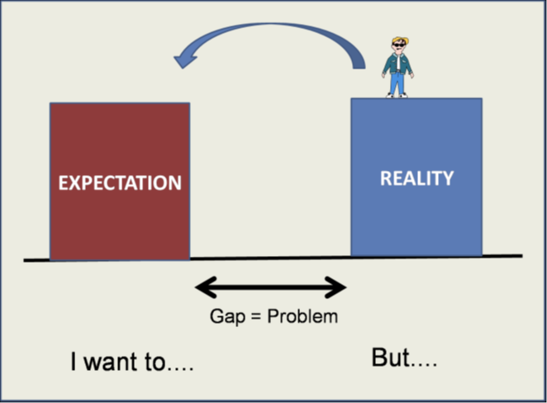
Programming Languages
If we don’t understand the programming language – how do we expect to solve the problem???
“Problem-Implementation” Gap
“We don’t use a sledgehammer to drive a nail.”
Well we can, but it defeats the purpose…

Slide 17

C++ Overview
C++ was developed by Bjarne Stroustrup starting in 1979 at Bell Labs.
C++ is a statically typed and compiled programming language.
Compile time vs. Run time
Supports:
Procedural
Object-Oriented
Generic programming

Slide 18
C++ Review: Pointers
One of the most popular, and powerful, features of the C++ programming language are pointers.
Pointers allow for direct access to the physical memory location.
Example:
int * int_ptr;
Here we are defining the memory location of the “variable” int_ptr.

Slide 19
C++ Review: Pointers
Pointers can point to local variables or a memory location located on the stack.
This gives us complete control over the access of memory within our program.
Example:
char ch = ‘a’;
char * ch_ptr = &ch;
Here we define a char and assign it a value ’a’, then we assign the memory location value of this variable to a new pointer using the & (address of).

Slide 20
C++ Review: Pointers
Pointers can point to dynamically allocated variables (or memory) on the program heap:
Example:
char * data = new char [10];
Lets take a closer look at the operators that are used with pointers:
*
&

Slide 21
C++ Review: Pointers
& = Address of Operator
This returns the memory address where the pointer is pointing to in memory.
* = Dereference Operator
This returns the value pointed to by the pointer.
When initializing a pointer ALWAYS initialize the pointer to NULL (or a known location) – otherwise you can have negative side effects.
int * ch_ptr = 0;

Slide 22
C++ Review: Pointers
A pointer can reference any memory location, but its your job to make sure the pointer is not referencing an invalid memory location.
Dangling Pointer Problem
Arithmetic Operations
+, +=, -, -=
Example:
const char * name = “Rybarczyk”;
const char * ch_ptr = name;
ch_ptr += 5;
char the_ch = *ch_ptr; // equals ‘c’

Slide 23
C++ Review: Pointers
Dangers of Pointer Arithmetic:
What happens if we try to reference a position outside the range of values?
Using the previous example, what happens if I said +=20 instead?
We, as the programmer, must ensure that checks are made to make sure that this does not occur within our code.

Slide 24
C++ Review: Pointers
Memory Management (Heap):
Two Operators:
new()
delete()
In most OO languages we are used to seeing/using the new operator but less acquainted with the delete (automatic garbage collection).

Slide 25
C++ Review: Pointers
Memory Management
// allocate new int and set to 50
int * int_ptr = new int;
*int_ptr = 50;
// delete the pointer
delete int_ptr;
int_ptr = 0; // make sure to set to NULL

Slide 26
C++ Review: Pointers
Lets look at arrays using pointers:
If you know the size of your array you can use the static approach:
char array[5]; // array of size 5
Often, however, we do not know the size of the array at development time. In that case we need a more dynamic approach using the heap:
int * grades = new int [N];

Slide 27
Abstract Data Types

Slide 28
C++ Review: Abstract Data Types
Benefit of Abstract Data Types (ADT):
Allow programmers to extend a programming languages with domain-specific types.
Built-in Types:
char
int
double
…
ADT:
std::string
…

Slide 29
C++ Review: Abstract Data Types
The ADT Lifecycle:
Construction: The ADT is created.
Locally on the stack.
Dynamically on the heap.
Initialization: The variables of the ADT are set to their initial value.
Set the ADT’s initial state.
Usage: The ADT is now ready for use in program.
Invokes its member functions.
Destruction: The ADT and it’s memory is no longer usable.
Removed from the local stack.
Memory released back to heap.

Slide 30
C++ Review: Abstract Data Types
Construction:
The constructor is used to create a ADT either on the stack or heap.
Three types of constructors:
Default
Sets the ADT to its “default” state.
Initializing
Sets the ADT to an “user-defined” state.
Copy
Sets the state to the state of another ADT of the same type.

Slide 31
C++ Review: Abstract Data Types
Default:
// default constructor
Point p1,
*p2 = new Point ();
Initializing:
// initializing constructor
Point p3 (1, 2),
*p4 = new Point (4, 5);
Copy:
// copy constructor
Point p5 (p1),
*p6 = new Point (*p2),
*p7 = new Point (p3);

Slide 32
C++ Review: Abstract Data Types
Key Questions:
Why is it critical to define the initial state of an ADT?
What happens if you do not define the initial state of an ADT?
Do you think it is always necessary to set the initial state of an ADT?

Slide 33
C++ Review: Abstract Data Types
Lets take a closer look at some sample code that will help emphasize good design and practices:
class Stack {
public:
Stack (void) { }
// ...
private:
// variables
int x;
int y;
};
Is this code correct or incorrect?
In terms of good software design? Bad software design?
Why?

Slide 34
C++ Review: Abstract Data Types
Lets take a look at another example:
class Stack {
public:
Stack (void) {
x = 0;
y = 0;
}
// ...
private:
// variables
int x;
int y;
};
Thoughts on this code?

Slide 35
C++ Review: Abstract Data Types
Why is the previous code still incorrect?
Because we used the assignment operator in the constructor.
Why is that incorrect?
Are we assigning something or initializing it?
While perfectly legal it is inefficient to handle your ADT’s in this fashion.
…but in this case int is a built-in type; that is correct – yet it is a good practice to get into.

