Slide 1
Test Automation Architectures:
Planning for Test Automation
Florida Tech Testing 2
January 27, 2014
Douglas Hoffman
Software Quality Methods, LLC.
24646 Heather Heights Place
Saratoga, California 95070-9710
Phone 408-741-4830
doug.hoffman@acm.org
www.SoftwareQualityMethods.com
Douglas Hoffman
Copyright © 1999 2013, SQM, LLC.

Slide 2

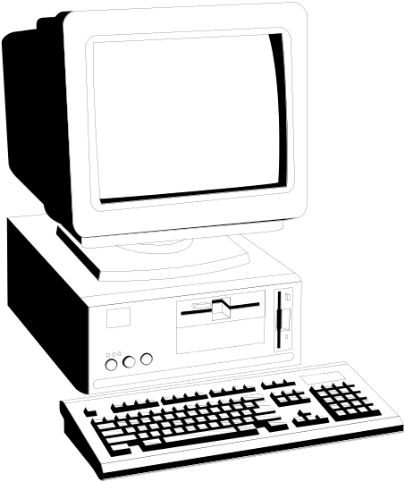
Test Automation
is not just machines running tests!
Douglas Hoffman
Copyright © 1999 2013, SQM, LLC.

Slide 3

Test Automation Architecture
From selecting what to test
through reporting results
Douglas Hoffman
Copyright © 1999 2013, SQM, LLC.
Notes:
When we automate we can generate *LOTS* of data - then we have to check to see it’s right…
For manual testing we have an easy out - the person running the test is also there to verify results.

Slide 4
Manual Software Tests
Person initiates each test case
Person must interact with the test, SUT, or the environment during the test case
Person is required to act in order that analysis of test results takes place
Person summarizes and reports results
Douglas Hoffman
Copyright © 1999 2013, SQM, LLC.
Notes:
This is the easiest and often the fastest – human flexibility, knowledge, and judgement.
Oracle is not explicitly required (people build models sub-consciously)

Slide 5
Automated Software Tests
Able to run two or more specified test cases
Able to run a subset of all the automated test cases
No intervention needed after launching tests
Automatically sets-up and/or records relevant test environment
Runs test cases
Captures relevant results
Compares actual with expected results
Reports analysis of pass/fail
Douglas Hoffman
Copyright © 1999 2013, SQM, LLC.
Notes:
Automation mechanism may also allow running one test case, but important criteria is the capability of running multiple test cases
Intervention may be required for abnormal test behavior such as faults interrupting test flow
Must watch out for error masking and error cascading

Slide 6
Levels of Automation
Somewhere on a continuum:
Fully automated software testing
Semi-automated software testing
Human software testing
Douglas Hoffman
Copyright © 1999 2013, SQM, LLC.
Notes:
Fully automated is push-button, hands-off testing
Semi-automated has some, but not all, characteristics of fully automated software testing
Manual testing is just that – human testing
Watch out for quick “training” to overlook errors
sometimes slower than computers
can’t observe system internals
lose concentration

Slide 7
Key Automation Factors
Components of SUT
Important features and capabilities
SUT environments
Testware elements
Access to inputs and results
Form of inputs and results
Douglas Hoffman
Copyright © 1999 2013, SQM, LLC.
Notes:
Often much more work than setting up or running the tests!

Slide 8
Simple Testing Model
(Black Box)
System Under
Test
Test Inputs
Test Results
Douglas Hoffman
Copyright © 1999 2013, SQM, LLC.

Slide 9
Expanded Testing Model
(Black Box)
Test Inputs
Test Results
Precondition Data
Postcondition Data
System Under
Test
Precondition
Program State
Postcondition
Program State
Environmental
Inputs
Environmental
Results
Douglas Hoffman
Copyright © 1999 2013, SQM, LLC.
Notes:
Precondition data in the program, system, data sets
Program state information is often critical - key sequence on one screen usually does something entirely different on a different screen
System environmental information determines default locations for files, user permissions, resource characteristics and availability, etc.
Post test state is also important - this is something the SUT can muck up, but doesn’t show up until the “test” is done
Oracle needs to take all of these factors into account - and predict proper program behavior

Slide 10



Test Oracles
Douglas Hoffman
Copyright © 1999 2013, SQM, LLC.
Notes:
Test Oracle can be a crystal ball, telling us everything we need to know about program behavior
Or, we can guess about what the program is supposed to do
Often the tester is the oracle, and they aren’t given specific information about behaviors (specifications) - so they test to see that the program does what it does!
This won’t do for automated tests. We need some means of generating expected results.

Slide 11
Testing Model With Oracle
Test Results
Test Inputs
Test Results
Test Oracle
Postcondition Data
Precondition Data
Postcondition Data
Postcondition
Program State
Precondition
Program State
Postcondition
Program State
System Under
Test
Environmental
Results
Environmental
Inputs
Environmental
Results
Douglas Hoffman
Copyright © 1999 2013, SQM, LLC.
Notes:
The perfect oracle would be capable of accepting the same set of inputs (*all* of them) and predicting correct behaviors and outputs

Slide 12
Architecting Automation
Models for the SUT and environment
Break down the software testing problem
Decide on location(s) of automation
Decide on level(s) of automation
Describe the automation architecture (components and relationships)
Douglas Hoffman
Copyright © 1999 2013, SQM, LLC.
Notes:
Model for SUT often overlooked regardless of automation
Splitting makes the problem more manageable

Slide 13
A Model For SUT
User
GUI
Remote GUI
User
Functional Engine
API
Data
Set
System Under Test
Douglas Hoffman
Copyright © 1999 2013, SQM, LLC.
Notes:
Example similar to real world architecture

Slide 14
Break Down The Testing Problem
User
GUI
Remote GUI
User
Functional Engine
API
Data
Set
System Under Test
Douglas Hoffman
Copyright © 1999 2013, SQM, LLC.

Slide 15
Location and Level for Automated Testing
Availability of inputs and results
Ease of automation
Stability of SUT
Practicality of Oracle creation and use
Priorities for testing
Douglas Hoffman
Copyright © 1999 2013, SQM, LLC.
Notes:
Accessibility of inputs and results is key to automated running and results capture
May be easier to model SUT behaviors in several pieces, thus have multiple oracles
Unstable SUT components make automation much less cost effective
Technical difficulties or low ROI may make it impractical
Keep in mind that testing is a black hole for resources. Must prioritize

Slide 16
Automated Test Sequencing
Testware version and configuration management
Select the subset of test cases to run
Set-up and/or record environment
Run test exercises
Monitor test activities
Capture relevant results
Compare actual with expected results
Report analysis of pass/fail
Douglas Hoffman
Copyright © 1999 2013, SQM, LLC.

Slide 17
An Automated Software Testing Process Model

Tester
Test List
Testware

■
❍
Automation Engine
●
SUT
Test
Results

❍
Data
Set

□
□
Douglas Hoffman
Copyright © 1999 2013, SQM, LLC.

Slide 18
Automation Process
List the sequence of automated events
Identify elements of each event
Decide on location(s) of events
Determine flow control mechanisms
Design automation mechanisms
Douglas Hoffman
Copyright © 1999 2013, SQM, LLC.
Notes:
Model for SUT often overlooked regardless of automation
Splitting makes the problem more manageable

Slide 19

Conclusions
Architecture design begins with analysis
Model the SUT
Break down testing problem
Model the testing process
Design the automation architecture
KISS
Douglas Hoffman
Copyright © 1999 2013, SQM, LLC.

