Slide 1
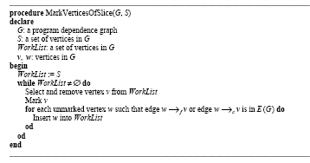
Slicing as Graph Reachability
Slice on v is the subgraph of all nodes and edges that can reach v (see page 8/9)

Slide 2
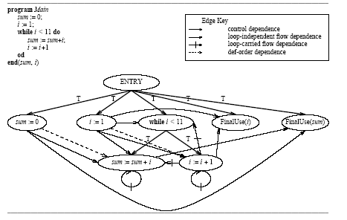
Example

Slide 3
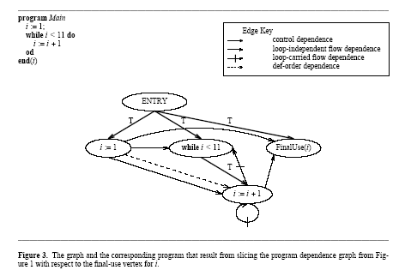
Application of the algorithm

