Slide 1

Program Slicing:
Program Dependence Graphs
source
Interprocedural Slicing
Using Dependence Graphs,
Horwitz, Reps & Binkley
ACM TOPLAS, Jan., 1990.
available on course web site
http://www.dur.ac.uk/k.b.gallagher/local/Slicing/toplas.pdf pp1-9

Slide 2
The Program Dependence Graph 1
Multigraph
Vertices
  Assignment
  Control predicate, no side effects
  Entry,
  InitialState(v)
  FinalUse(v) == End
Control Dependence Edge: v -> w
  v is entry; w is not in loop or conditional
  v is control; w is immediately controlled by v

Slide 3
The Program Dependence Graph - 2
Flow Dependent Edge: v -> w
  v defines variable x
  w uses (references) x
  no intervening defs of x
Loop Carried:
  flow dependent, plus
  edge back to controlling predicate
  v, w in loop

Slide 4
The Program Dependence Graph - 3
Loop Independent:
  flow Dependent, plus
  NO edge back to controlling predicate
Def-Order Dependence: v -> w
  v, w define the same variable
  v, w are in same branch of conditional
  there is z: v -> z and w -> z
  v is “left” of w

Slide 5
Example page 7
main
sum := 0;
i = 1;
while ( i < 11) do
sum := sum + I;
i = I +1;
od;
end( sum, i)

Slide 6
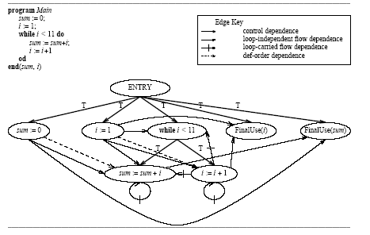
Example page 7

Slide 7
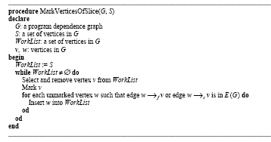
Slicing as Graph Reachability
Slice on v is the subgraph of all nodes and edges that can reach v (see page 8/9)

Slide 8
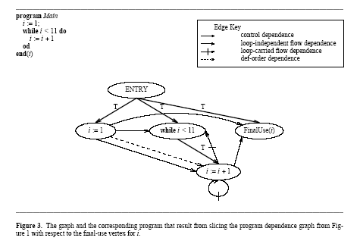
Application of the algorithm

