Slide 1
Program Slicing:
Slicing Procedures II
source
  Interprocedural Slicing Using Dependence Graphs, Horwitz, Reps & Binkley ACM TOPLAS, Jan., 1990. http://www.dur.ac.uk/k.b.gallagher/local/Slicing/toplas.pdf pp1-24

Slide 2
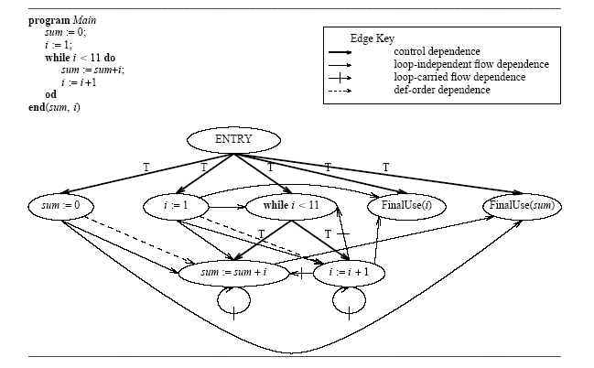

Slide 3
RECALL
main {
sum := 0;
i := 1;
while (i < 11) do
call A( sum, i);
od;
}
Increment ( z ) {
Call Add ( z, 1);
return;
}
Add (a, b) {
a = a + b;
return;
}
A( x, y) {
call Add(x,y);
call Increment(y);
return;
}

Slide 4
Value-result parameter passing
An argument passing convention where the actual argument is a variable V whose value is copied to a local variable L.
If the procedure modifies L, these changes will not affect V, until the procedure returns when the final value of L is copied to V.

Slide 5
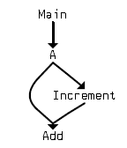
Call Graph of Sample Program

Slide 6
SYSTEM Dependence Graph
New Nodes
  call
  actual_in
  actual_out
  formal_in
  formal_out
New edges
  Call
  parameter_in
  parameter_out
  interprocedural flow

Slide 7
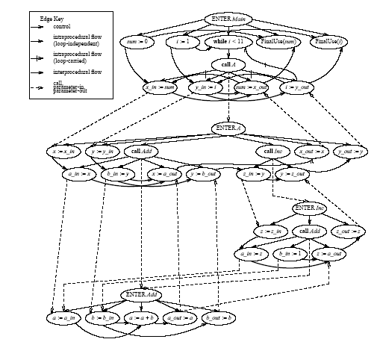

Slide 8
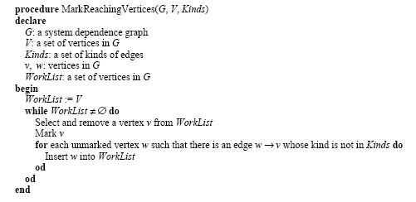

Slide 9
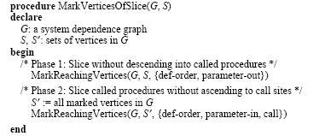

Slide 12
