Slide 1
Dynamic Slicing
source: binkley gallager survey, p21-26

Slide 2
Static Slices
Depend on data flow control flow possiblities….
All possible executions are captured in one object
Sometime this is too much information
  debugging

Slide 3
Dynamic Slices
All statements that actually affect the value of a variable for a particular execution of the program
Use a given input, I
Need a third parameter in the criteria
  <v,n,i>
  n is point in execution history, not merely a program statement.

Slide 4
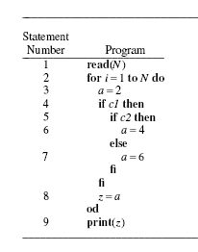
Example

Slide 5
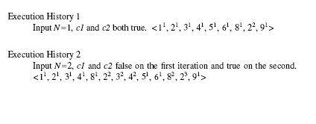

More of the execution history example

Slide 6
Computing Dynamic Slices
front (list, element) = items before element in list
DU: v-i DU u-j
  v-i appears before u-j in exection history
  variable x is defined at v-i
  variable x is used at v-j
  not redefined between v-i and u-j.
TC: v-i TC u-j
  u is (statically) control dependent on v on all occurrences between v-I and u-j
IR: v-i IR u-j : v == u

Slide 7
Using Definitions from Previous Slide wrt (a, 2, 3¹) 3-1 = 3¹
DU = {(1-1,2-1),(3-1,8-1),(6-1,8-2),(8-2,9-1)}
TC = {(2-1,3-1),(2-1,4-1),(2-1,8-1), (2-1,3-2),(2-1,4-2), (2-1,8-2),(2-2,3-2),(2-2,4-2),(2-2,8-2), (4-2,5-1),(5-1,6-1)}
IR = {(2-1,2-2),(2-1,2-3),(2-2,2-3), (3-1,3-2), (4-1,4-2), (8-1,8-2)}

Slide 8
Iterate: V, I, L^{i ==} (a, 2, 3-1)
In front: w such that
  (w,b) in TC
  x in V, defined at w but not redefined between w and L-i
Get 2-1 !!! (only) why?

Slide 9
Continuing…..
Then:
  add in
  Getting (1-1,2-1): iteration ends
  Add in occurrence where slice was taken.
Get : (1-1,2-1,3-1)….
  hmmmm
  headaches??

Slide 10
Defining Dynamic Slices
Idea: reduce execution history
Definitions
  collect(list,predicate) = l in list and predicate(l)
  front(list,l_{i}⁾ ⁼ l_{j} in list and j <= I
  occurrence_of(l_{i},P) = l_{i} is occurrence of P
front(L’,p’) = collect(front(L,p),
lambda l.occurrence_of(l,P’)

