Slide 1
Dynamic Slicing
…As a Graph-reachability problem
source: Binkley Gallagher survey, p26-31
get ooslicing.pdf on web site.

Slide 2
Dynamic Slices
All statements that actually affect the value of a variable for a particular execution of the program
Use a given input, I
Need a third parameter in the criteria
  <v,n,i>
  n is point in execution history, not merely a program statement.

Slide 3
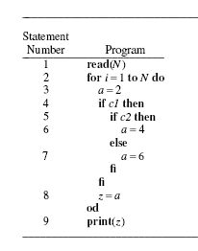
Example

Slide 4
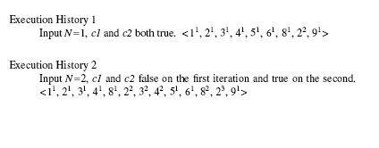
Execution history

Slide 5
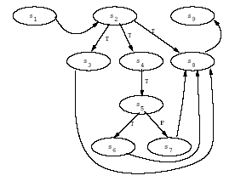
PDG of the Program

Slide 6
Two Dynamic Approaches
Mark edges as executed
  1st Sequence: s1,s2,s4-s6,s8,s9
  2nd Sequence: s1-s6,s8,s9

Slide 7
Two Dynamic Approaches
Mark nodes as executed:
  1st Sequence: s1 – s6, s8, s9
  2nd Sequence: s1 – s6, s8, s9

Slide 8
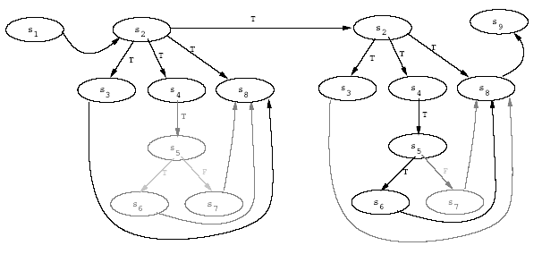
Dynamic Dependence Graphs
Vertex for each occurrence of a statement ( in E.H)
Executed edges

