Slide 1
Frontiers of Software Maintenance:
Program Slicing
Dave Binkley
Loyola College
Keith Gallagher
Durham University

Slide 2
The Little Slicer:
Definition
  x = 42
  d = 23 d
  x = 42 // !!
  d = 23

Slide 3
The Little Slicer:
Data Dependence
      a = 42
      x = 2
      b = 23 + a
      y = 3
      c = b + 2 c
      a = 42
      x = 2
      b = 23 + a
      y = 3
      c = b + 2

Slide 4
The Little Slicer:
Control Dependence
  a = 42
  while (B)
  {
    a = b - 2
    x = 10
    b = 64
  }
  c = a + 2 c
  a = 42
  while (B)
  {
      a = b - 2
      b = 64
  }
  c = a + 2

Slide 5
The Little Slicer:
Meaningful Semantics
  sum = 0
  prod = 1
  i = 1
  while ( i < 11)
  {
    sum = sum + i
    prod = prod * i
    i = i + 1
  }
        prod
sum = 0
  prod = 1
  i = 1
  while ( i < 11)
  {
    prod = prod * i
    i = i + 1
  }

Slide 6
The Little Slicer: hmmm....
  while ( true)
  {
    x = 1
  }
  y = 2 y
  y = 2

Slide 7
The Little Slicer:
OOOWWW!!!
    if (b)
      goto L2
  L1:
    y = 1
    goto L3
    z = 2
  L2:
    x = 3
    goto L1
  L3:
  print x
  print y y
  L1:
    y = 1
    goto L3
  L3:
  print y

Slide 8
The Little Slicer
Other Techniques: Forward
sum =0
prod = 1 prod
i = 0
while( i < 11)
{
  sum = sum + i
  prod = prod * i
  i = i + 1
}
prod = 1
  prod = prod * i

Slide 9
The Little Slicer
Other Techniques: Dynamic
// input 42
read (a)
if ( a < 0)
  a = -a
x = 1 / a x
// input 42
read (a)
x = 1 / a

Slide 10
The Little Slicer
Other Techniques: Conditioned
// a > 0
read (a)
if ( a < 0)
  a = -a
x = 1 / a x
// a > 0
read (a)
x = 1 / a

Slide 11
The Little Slicer
Other Techniques: Amorphous
sum =0
prod = 1
i = 0
while( i < 11)
{
  sum = sum + i
  i = i + 1
} sum
  sum = 55

Slide 12
The Little Slicer
Applications: Dicing
main() {
        int c, nl, nc;
        nl = 0;
        nc = 1;
        c = getchar();
        while ( c != EOF ) {
        nc = nc + 1;
        if ( c == '\n') nl = nl + 1;
        c = getchar();
        }
        printf("%d \n", nl);
        printf("%d \n", nc);
        }

Slide 13
The Little Slicer
Applications: Regression Testing
        main() {
        int c, nl, nc;
        nl = 1;
        nc = 0;
        c = getchar();
        while ( c != EOF ) {
        nc = nc + 1;
        if ( c == '\n') nl = nl + 1;
        c = getchar();
        }
        printf("%d \n", nl);
        printf("%d \n", nc);
        }

Slide 14
The Little Slicer
Applications: Maintenance
        inword = NO;
        nl = 0;
        nw = 0;
        nc = 0;
        c = getchar();
        while ( c != EOF ) {
        nc = nc + 1;
        if ( c == '\n') nl = nl + 1;
        if ( c == ' ' || c == '\n' || c == '\t')
        inword = NO;
        else if ( inword == NO )
        { inword = YES;
        nw = nw + 1; }
        c = getchar();
        }

Slide 15
Program Slicing
What statements effect the value of ___ at line ___? (line numbers for discussion only.)
        1. c = 4;
        2. b = c;
        3. a = b + c;
        4. d = a + c;
        5. f = d + b;
        6. a = d + 8;
        7. b = f + 30;
        8. a = b + c:

Slide 16
How about this one?
1. a = ….;
2. b = …;
3. if (a <= b)
4. x = a + b;
5. else
6. y = a – b ;
7. ….

Slide 17
And this one?
while(…) {
e = d;
d = c;
c = b ;
b = a;
}

Slide 18
And?
1. c = 0;
2. while (true) {
3. c = 1;
4. }
5. c = 2;

Slide 19
Minimal???
input x;
if (x) {
// nothing involving x here..
x = 1;
}
else x = 2;

Slide 20
What about “a”?
a = 5;
while (p(k)) {
if (q(c)) then {
b = a;
x = 1;
} else { c = b;
y = 2; }
k = k + 1;
}
z = x + y;

Slide 21
“The Classic”
        #define YES 1
        #define NO 0
        #include <stdio.h>
        main() {
        int c, nl, nw, nc, inword;
        inword = NO;
        nl = 0;
        nw = 0;
        nc = 0;
        c = getchar();
        while ( c != EOF ) {
        nc = nc + 1;
        if ( c == '\n') nl = nl + 1;
        if ( c == ' ' || c == '\n' || c == '\t')
        inword = NO;
        else if ( inword == NO )
        { inword = YES;
        nw = nw + 1; }
        c = getchar();
        }
        printf("%d \n", nl);
        printf("%d \n", nw);
        printf("%d \n", nc);
        }

Slide 22
Sub-Classic 1
      #include <stdio.h>
      main() {
      int c, nl, nw, nc, inword; /* !! ?? */
      nc = 0;
      c = getchar();
      while ( c != EOF ) {
      nc = nc + 1;
      c = getchar();
      }
      printf("%d \n", nc);
      }

Slide 23
Sub-Classic 2
      #include <stdio.h>
      main() {
      int c, nl, nw, nc, inword;
      nl = 0;
      c = getchar();
      while ( c != EOF ) {
      if ( c == '\n') nl = nl + 1;
      c = getchar();
      }
      printf("%d \n", nl);
      }

Slide 24
Sub-Classic 3
    #include <stdio.h>
    #define YES 1
    #define NO 0
    main() {
    int c, nl, nw, nc, inword;
    inword = NO;
    nw = 0;
    c = getchar();
    while ( c != EOF ) {
    if ( c == ' ' || c == '\n' || c == '\t')
    inword = NO;
    else if ( inword == NO )
    { inword = YES;
    nw = nw + 1; }
    c = getchar();
    }
    printf("%d \n", nw);
    }

Slide 25
Sub-Classic 4
      #include <stdio.h>
      #define YES 1
      #define NO 0
      main() {
      int c, nl, nw, nc, inword;
      inword = NO;
      c = getchar();
      while ( c != EOF ) {
      if ( c == ' ' || c == '\n' || c == '\t')
      inword = NO;
      else if ( inword == NO )
      { inword = YES;
      }
      c = getchar();
      }
      }

Slide 26
Sub-Classic 5
#include <stdio.h>
#define YES 1
#define NO 0
main() {
int c, nl, nw, nc, inword;
c = getchar();
while ( c != EOF ) {
c = getchar();
}
}

Slide 27
Files and Functions
int rufus,toby;
main ( ) {
int polar,watergate;
polar = 1;
rufus = 2;
toby = 3;
watergate = 4;
ride (toby );
}
print (int critter) {
printf ("%d",critter );
}
extern int rufus, toby ;
ride (int horse) {
int mule,donkey;
mule = horse;
print (rufus );
donkey = toby + horse;
print (horse );
horse++;
rufus = donkey;
toby = mule;
}

Slide 28
reference variables…
        int cond(); // something that returns T F
        main ( ) {
        int w, x, y, z;
        int *e, *f, *g, *h, *i, *j ;
        int **b, **c, **d;
        int ***a;
        a = cond ( ) ? (cond ( ) ? &b : &c ) : &d;
        b = cond ( ) ? &e : &f;
        c = cond ( ) ? &g : &h;
        d = cond ( ) ? &i : &j;
        e = cond ( ) ? &i : &j;
        f = &x;
        g = &y;
        h = &z;
        i = &w;
        j = cond ( ) ? &w : &z;
        /* now assign to w, x, y or z */
        }

Slide 29
Challenges Trends Future

Slide 30
Challenge 1
Programs are less static
Harder to statically predict code used
(an issue for all static analysis)
Consider
imperative → OO → agents

Slide 31

Challenge 2
Observation
  slicing has failed to capture the intuition that engineers bring to programming

Slide 32
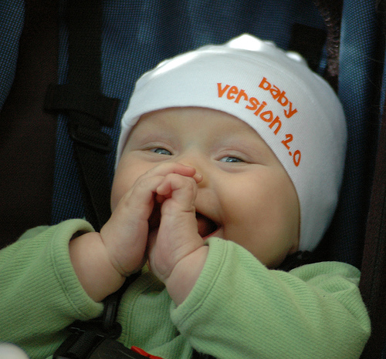
Challenges - Intuition
Observation
  slicing has failed to capture the intuition ….
This means opportunity!!
For you!

Slide 33
Challenges - Intuition
For example one might ask
Why has slicing has failed to capture the intuition ….
At an average 1/3 of the program,
perhaps slices are too large

Slide 34
Challenges - intuition
One recent proposal thin slicing
A thin slice includes only
producer statements
a = new A() // produces object o1
  a.f = new F() // produces o1.f
  d = a // not a producer
  x = d.f // uses o1.f (but not d)

Slide 35
From Challenges to Trends
But first the dream

Slide 36
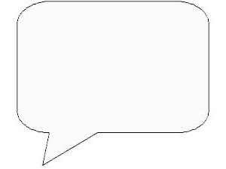

The (original) Dream
Now I’ll just slice on sum
Programmer in Pink

Slide 37
Current Trends (the Reality)
Slicing used to aid other analyses
  in part
    e.g., Paul’s Codesurfer
  in whole
    model checking
    dependence structure
  in theory

Slide 38
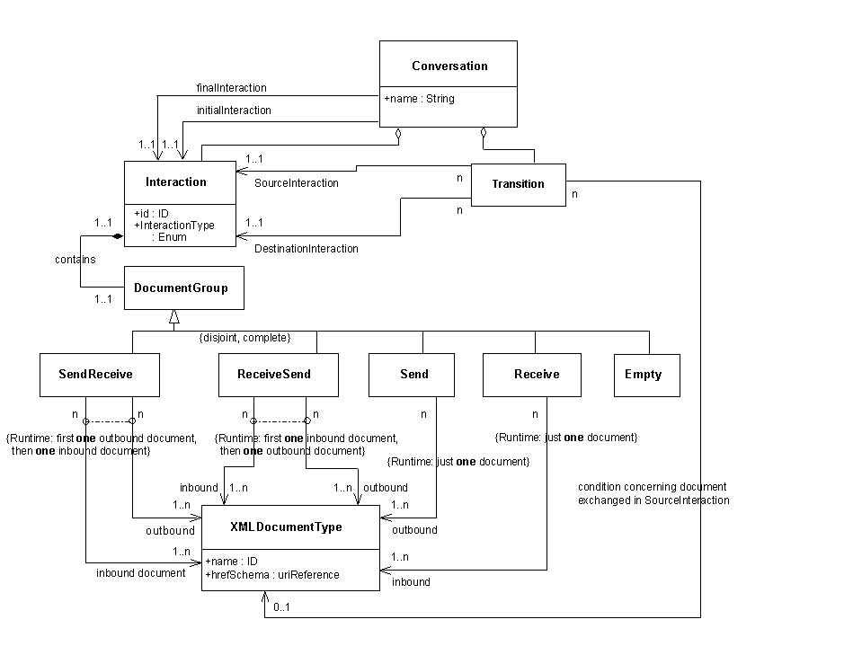
Trend 1
Slicing as an Aid
Consider model checking when verifying a property
Is there a memory leak when sending a message?

Slide 39
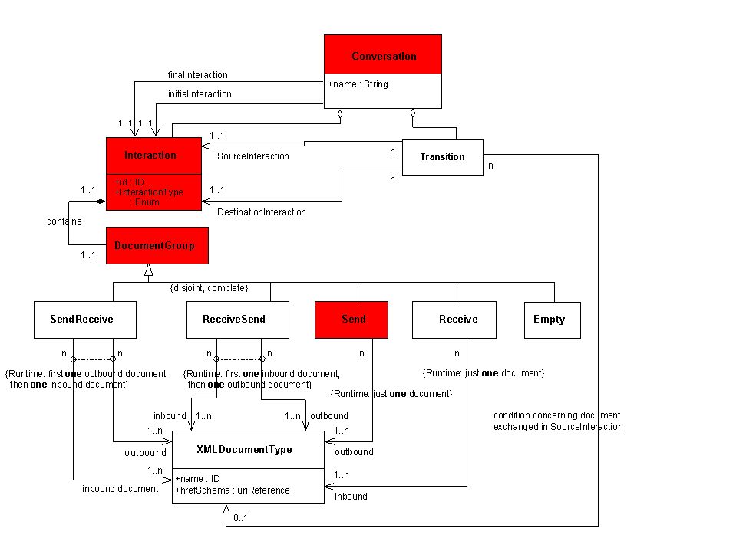
Slicing as an Aid

Slide 40
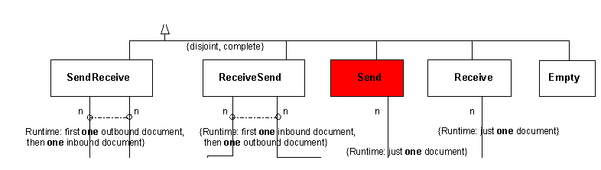
Slicing as an Aid
5 times faster after slicing!

Slide 41
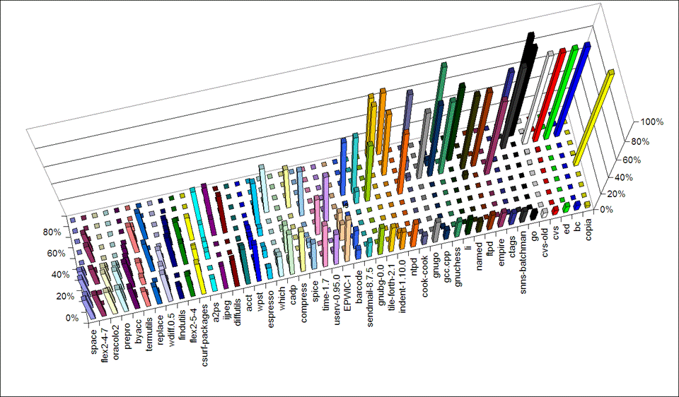
Trend 2
Slicing as an Aid
Understanding dependence structure

Slide 42

(commitment) Dependence
I’ll go if you go

Slide 43
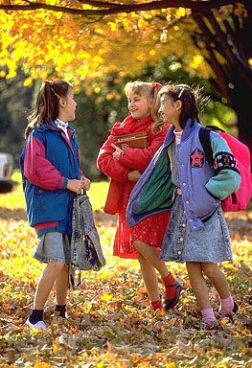
Dependence Cluster
I’ll go if you go
I’ll go if you go
I’ll go if you go
Thus you get
all or nothing!

Slide 44
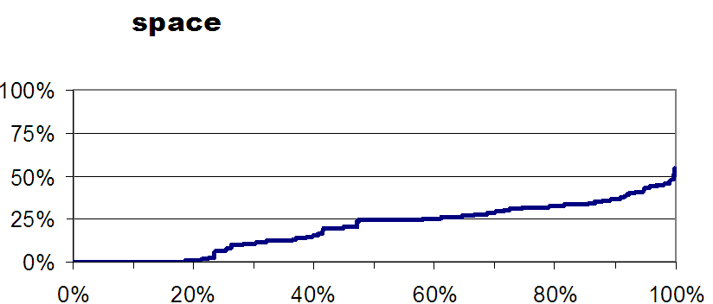
Dependence Structure
Slice size
Slices (sorted by size)

Slide 45
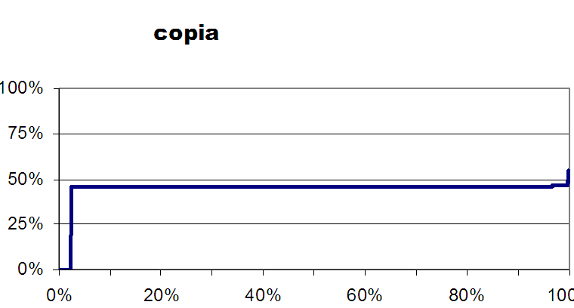

Dependence Structure
A Second Program

Slide 46
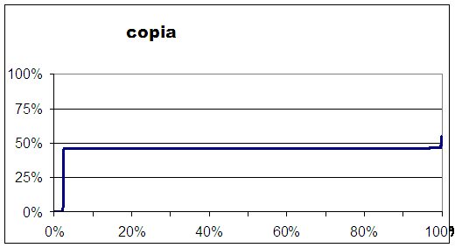
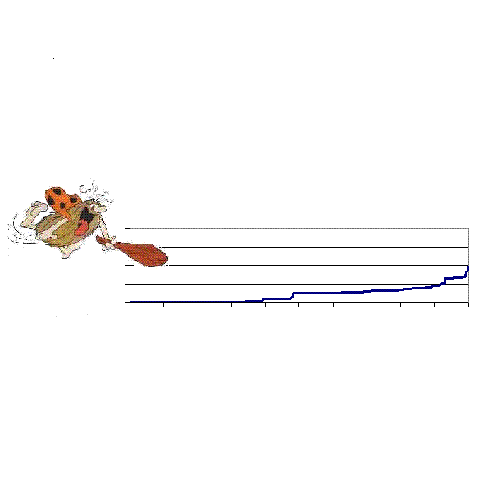
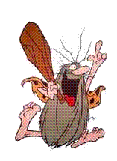
Dependence Structure Breaking Dependence Clusters

Slide 47
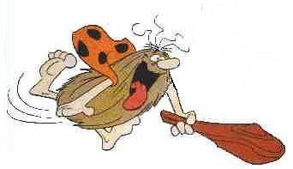
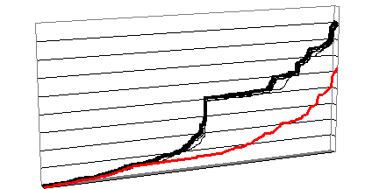
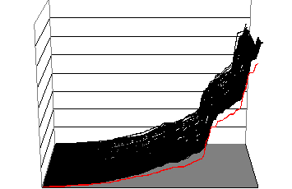
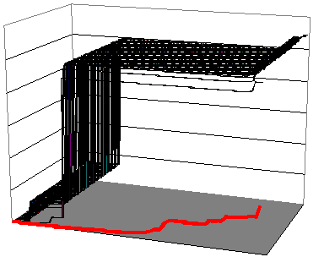
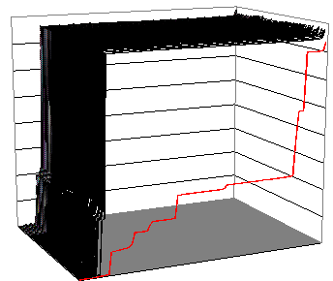
Dependence Structure Automated Breaking
time
wdiff
ctags
barcode

Slide 48
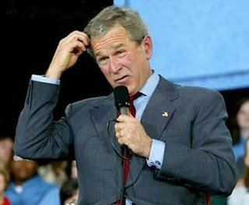
Trend 3
In Theory
Better Formal Understanding

Slide 49
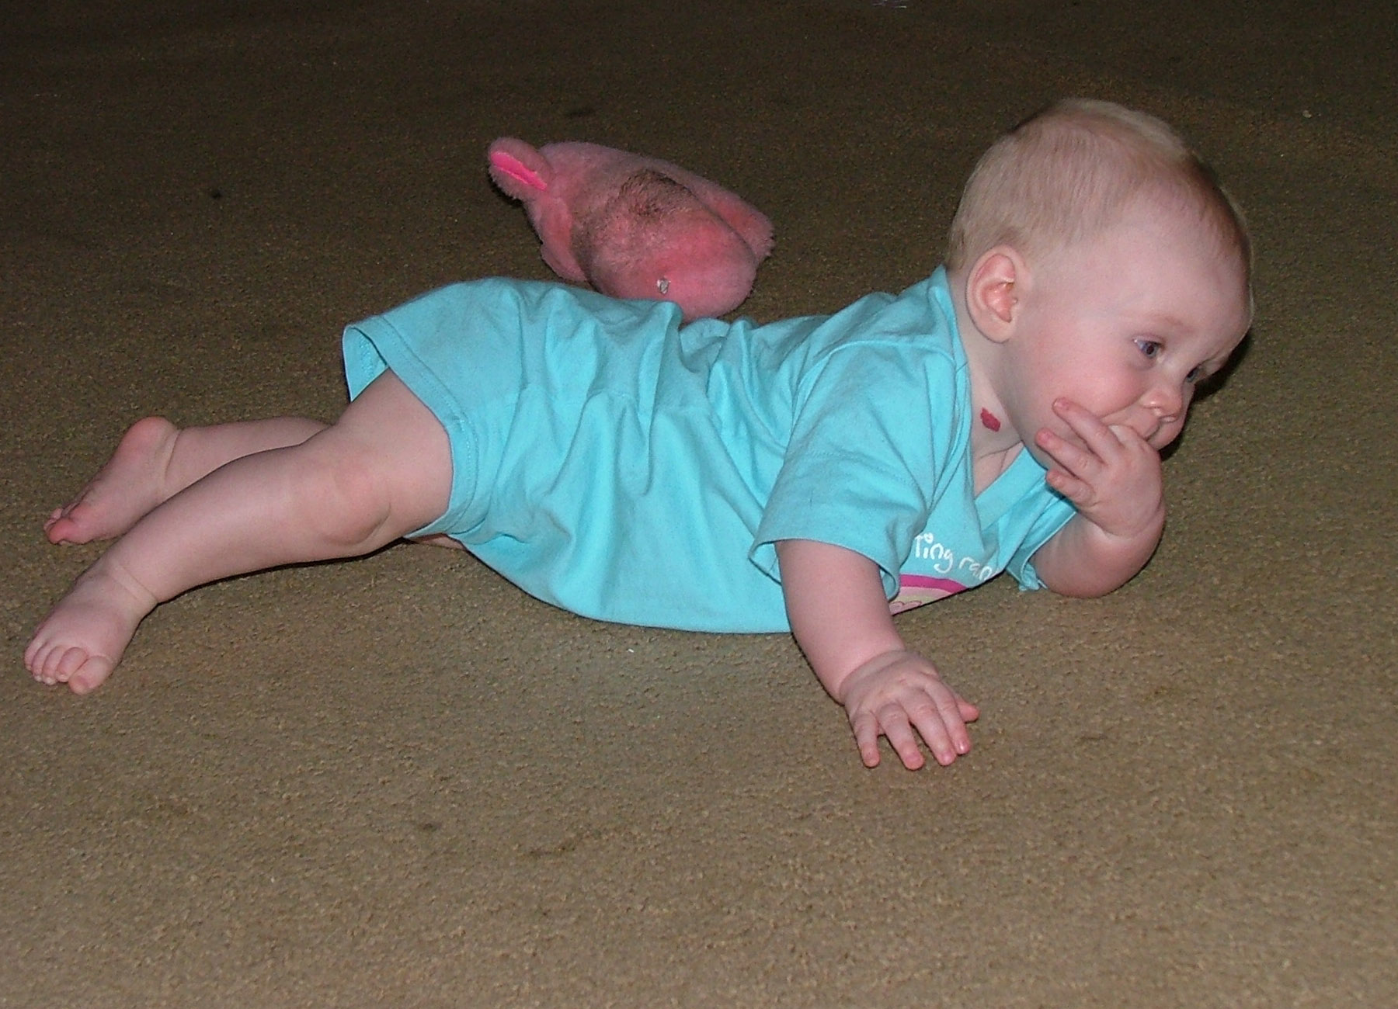
Formalization
Relate traditional operational semantics to more declarative denotational semantics

Slide 50
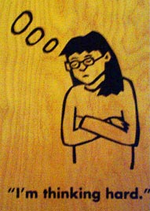
Formalization
Semantics of reactive systems
  Example - rethink of control dependence definition

Slide 51
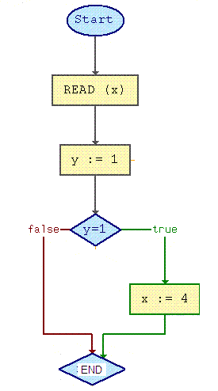
Control Dependence
Traditional definition
paths to END

Slide 52
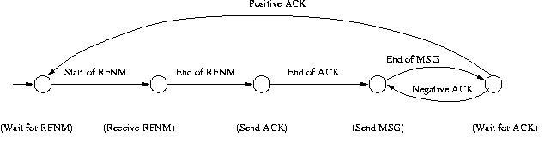
Control Dependence
Reactive definition
oops … there is no END

Slide 53
Finally the Future
iow, what my friends working on

Slide 54
Future Ideas
Slicing design level concepts in code
Slicing architecture descriptions
Slicing UML
Slicing comments and documentation
Slicing from requirements to code and back
Slices as building blocks

Slide 55
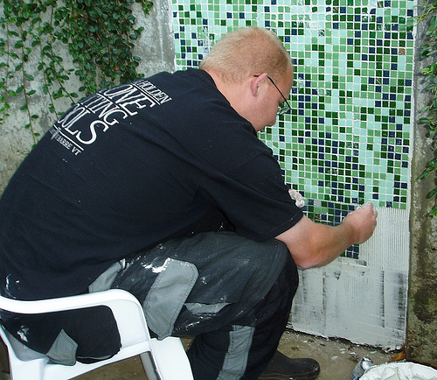
Future Ideas
Program Composition
Think of a program as composed of particular syntactic entities
Program
Code Monkey

Slide 56
Future Ideas
Program Composition
Dominant tiles 1960’s
assembler instructions
ADD CSECT
BALR 12,0
USING *,12
AR 2,3
BR 14

Slide 57
Future Ideas
Program Composition
Dominant tiles 1970’s
statements
if x 10,20,20
10 x = x * -1
20 continue

Slide 58
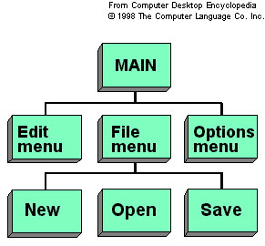
Future Ideas
Program Composition
Dominant tiles 1980’s
functions

Slide 59
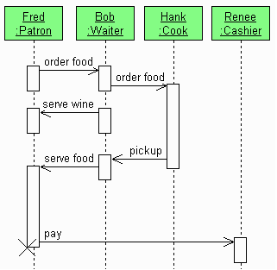
Future Ideas
Program Composition
Dominant
tiles 1990’s
objects

Slide 60
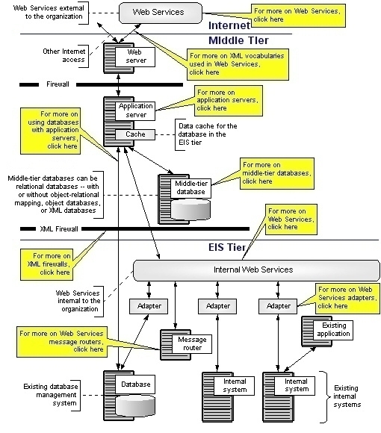
Future Ideas
Program Composition
“Dominant”
tiles 2000’s
services

Slide 61
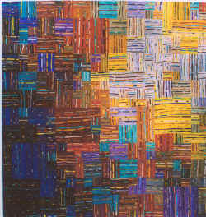
Future Ideas
Program Composition
Dominant tiles of the future
slices!

Slide 62
Questions?
Sample Tool URLs
www.dsic.upv.es/users/elp/german/slicing
kathrin.dagstuhl.de/05451/Materials2
bandera.projects.cis.ksu.edu/papers/slicing.shtml
www.ssw.unilinz.ac.at/Research/Projects/ProgramSlicing
jslice.sourceforge.net
hissa.ncsl.nist.gov/~jimmy/refs.html
www.dagstuhl.de/en/program/calendar/semhp/?semnr=05451
www.gramatech.com
(largely from the first 200 hits of the web search ‘program slicing tools’)

Slide 63
Trends
Formalization
Relationship between existing operational and denotational slice semantics
Semantic slice properties
Semantics of reactive systems

Slide 64
Future Ideas
Programming is composing syntactic entities
In historic order
  assembler instructions
  statements
  functions
  objects
  aspects
  agents
  slices ‘woven’ together

