Slide 1
Instance Types
NEW
Amazon Lightsail
T3
M5
D2
H1
R5
R5m
X1
X1e
I3
I3m
C5
G3
P3
F1
Z1d
Z1 dm
Virtual Private Servers
Burstable
General Purpose
Dense Storage
Big Data Optimized
Memory Optimized
In-memory
Memory Intensive
High I/O
Bare Metal High I/O
Compute Intensive
Graphics Intensive
General Purpose GPU
FPGA
Compute and Memory Intensive
EC2 Elastic GPUs
Graphics acceleration for EC2 instances
EC2 Fleet
Simplified provisioning
Massive scale
Flexible capacity allocation
Notes:
One of the very clear ways that this manifests itself is in our instance delivery, where every year we ensure that you all have the absolute latest and greatest platforms on which to build your applications. I won’t go through each and every new instance that we launched this past year, but I will point out a couple of the highlights.

Slide 2

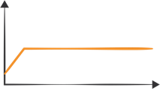
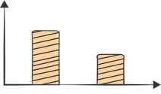
Purchasing options at a glance
On-Demand
Instances
Reserved Instances
Spot Instances
Pay for compute capacity by the hour with no long-term commitments
Make a low, one-time payment and receive a significant discount on the hourly charge
Bid for unused capacity, charged at a spot price which fluctuates based on supply and demand
For Spiky workloads or to define needs
For committed utilization
For time-insensitive or transient workloads
Notes:
Explain how pricing works, integrate our new SPOT model with 1-6 hours. Great slide to just talk and whiteboard out how our offerings could be bought in a hybrid model. Some Spot, some Demand, and some RI.

Slide 3
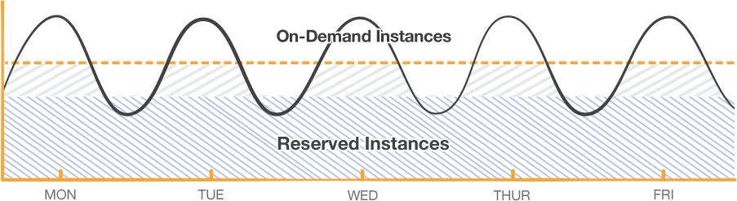
Layer your options
Notes:
Traditional Data Center use and how the old model of purchasing more than needed can still translate in to the Cloud. Buy what you know is your baseline and utilized On-Demand or Spot for Excess.

