Slide 1
Implementing Continuous Integration Practices
Automated Cloud Deployment Using Terraform
Build and Deployment
Model Training
Building the End-to-End Application Architecture for Using the Model
Cloud Integration (Exploring Google Cloud)
Exposing an API Using Swagger
Documentation and Summary

Slide 2








Implementing Continuous Integration Practices
Automated Cloud Deployment Using Terraform
Build and Deployment
Model Training
Building the End-to-End Application Architecture for Using the Model
Exposing an API Using Swagger
Cloud Integration (Exploring Google Cloud)
Documentation and Summary

Slide 3
Model Training
Building the End-to-End Application Architecture for Using the Model
Implementing Continuous Integration Practices
Exposing an API Using Swagger
Build &
Deployment
Cloud Integration (Exploring Google Cloud)
Automated Cloud Deployment Using Terraform
Documentation and Summary

Slide 4
Model Training
Building the End-to-End Application Architecture for Using the Model
Implementing Continuous Integration Practices
Exposing an API Using Swagger
Documentation and Summary
Automated Cloud Deployment Using Terraform
Cloud Integration (Exploring Google Cloud)
Build &
Deployment

Slide 5
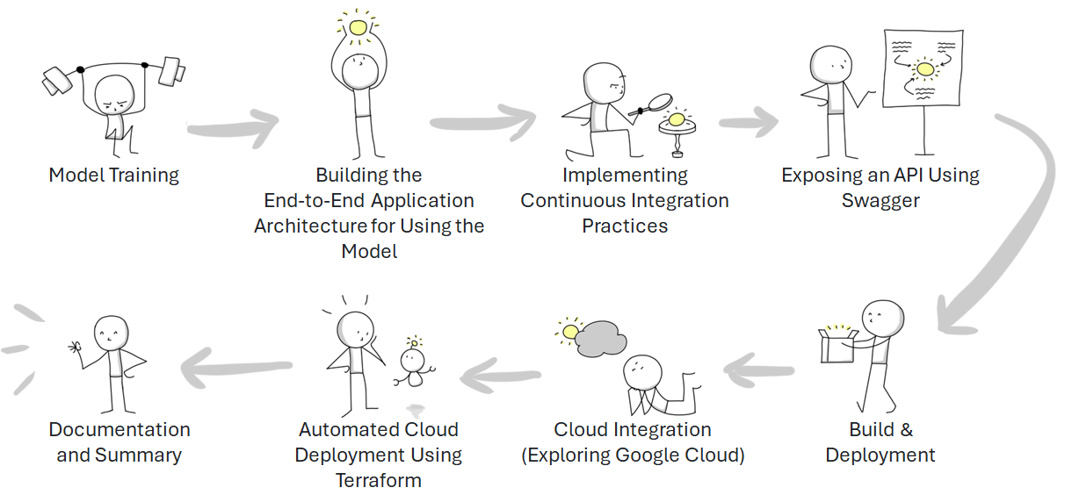

Slide 6
