Slide 1








Model Training
Building the End-to-End Application Architecture for Using the Model
Implementing Continuous Integration Practices
Exposing an API Using Swagger
Documentation and Summary
Automated Cloud Deployment Using Terraform
Cloud Integration (Exploring Google Cloud)
Build &
Deployment

Slide 2
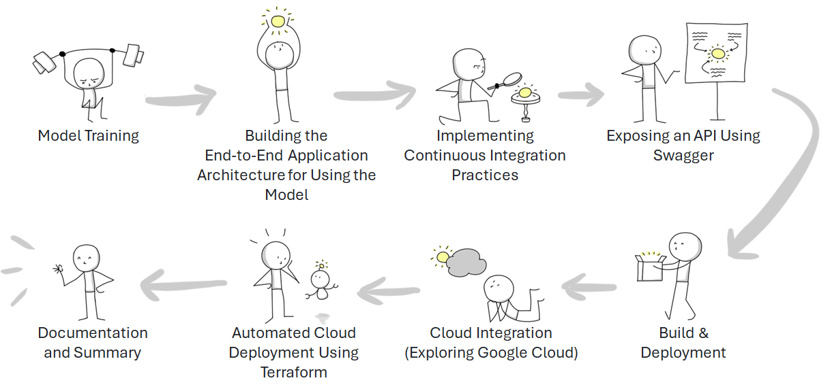

Slide 3
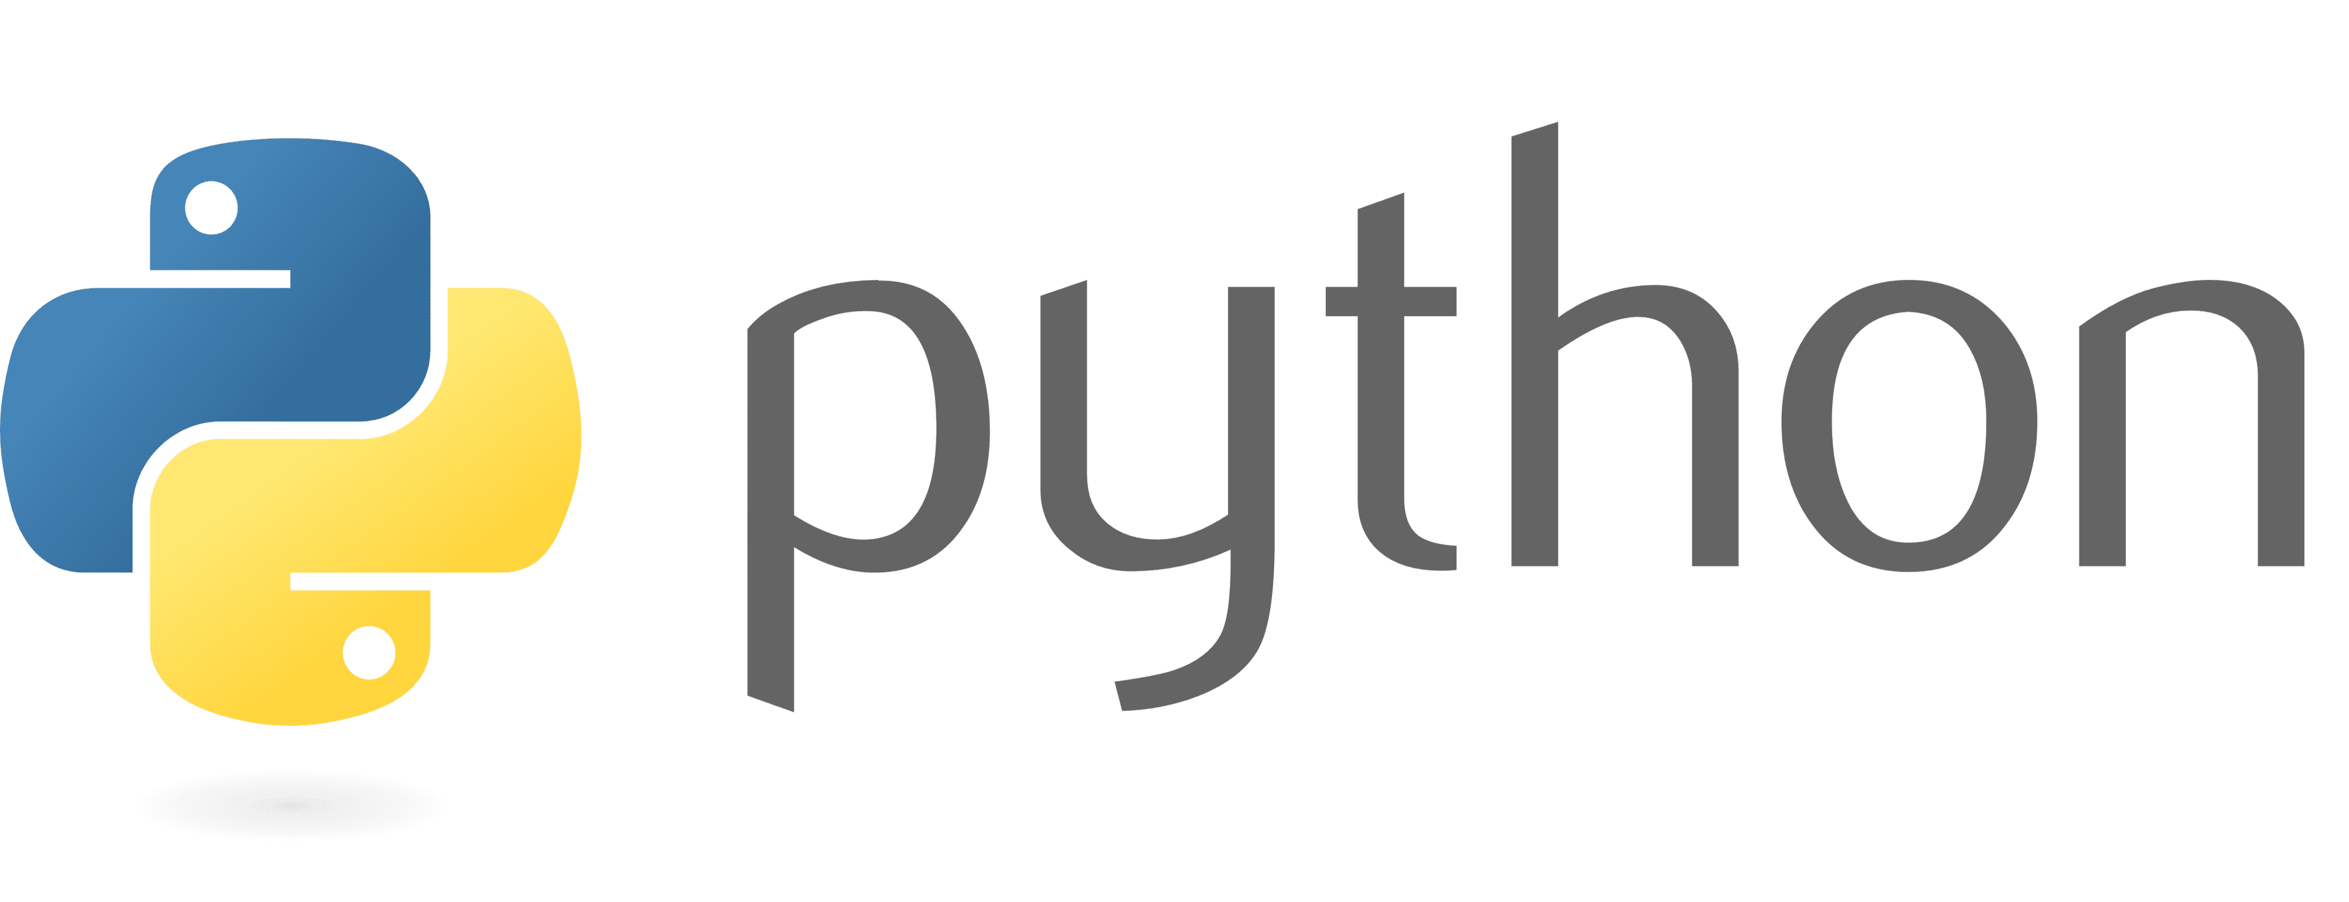


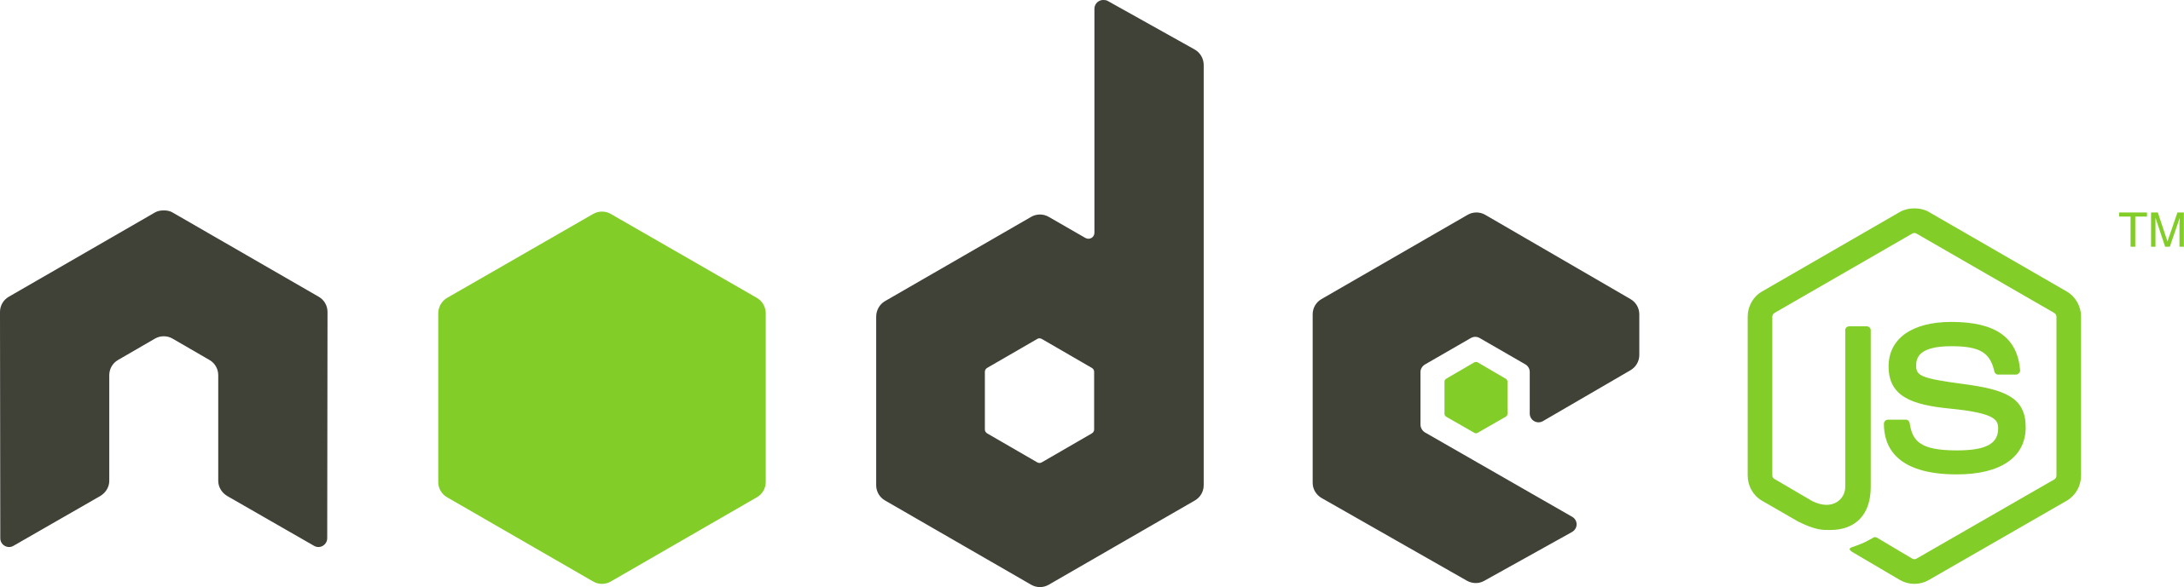



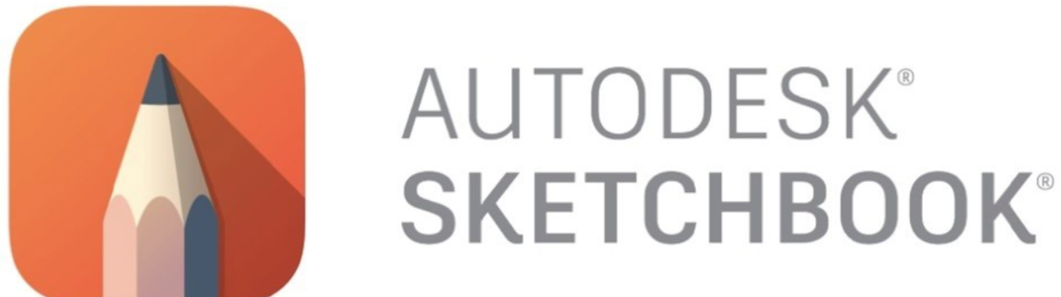


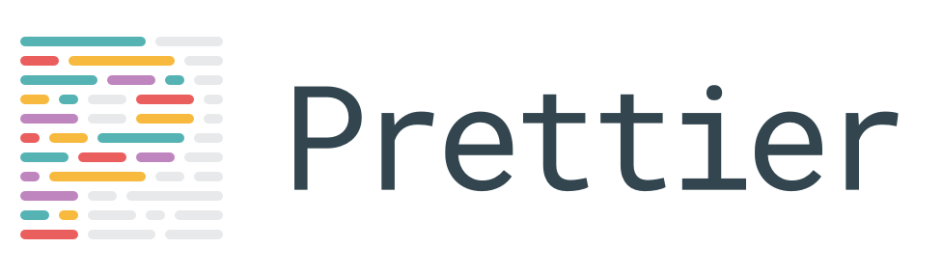



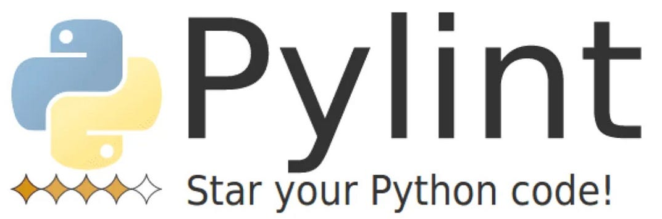




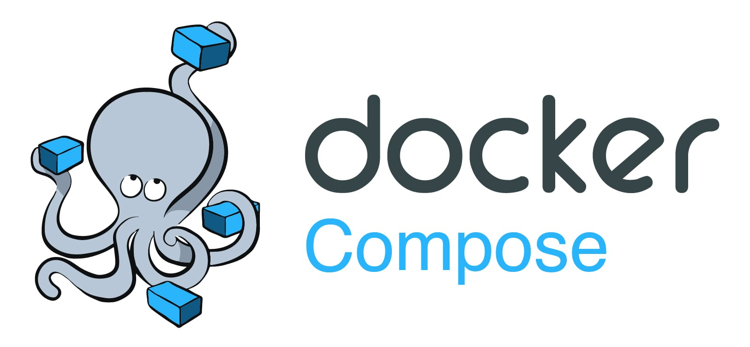

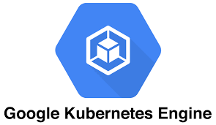




Slide 4
