Slide 1
Neural Network to Break CAPTCHA
By: Michael Horton, Steven Kornajcik, Frank Waters, and diana gandy

Slide 2

Objective
Create a Convolutional Neural Network
Recognize letters presented in a CAPTCHA image
Optimize the number EPOCHs, nodes, and filters
Limitations
All images have six letters no numbers
No alterations beyond blurring, noise, and rotations
19 letters and no Capitals

Slide 3


Pre-Processing Data for Training
Steps Taken to Get the Test Data Ready
Inverted the image
Make the Gradient all Black
Crop edges, re-invert, and use OpenCV to find the letters
16,000 CAPTCHA images were prepared, 95,000 individual letters

Slide 4
Why We chose Convolutional Neural Network
First Attempt used a non-convolutional ANN
Encountered issues breaking apart the captchas as the ANN required completely horizontal images to be able to process.
Also showed issues with learning once it had decided on certain kerning groups as a specific letter combination. It would continuously make the same mistakes.
Our convolutional neural network has…
Two convolutional layers which not only learns based on pixel placement but also by pixel pattern
Can therefore recognize letters with slight tilts

Slide 5
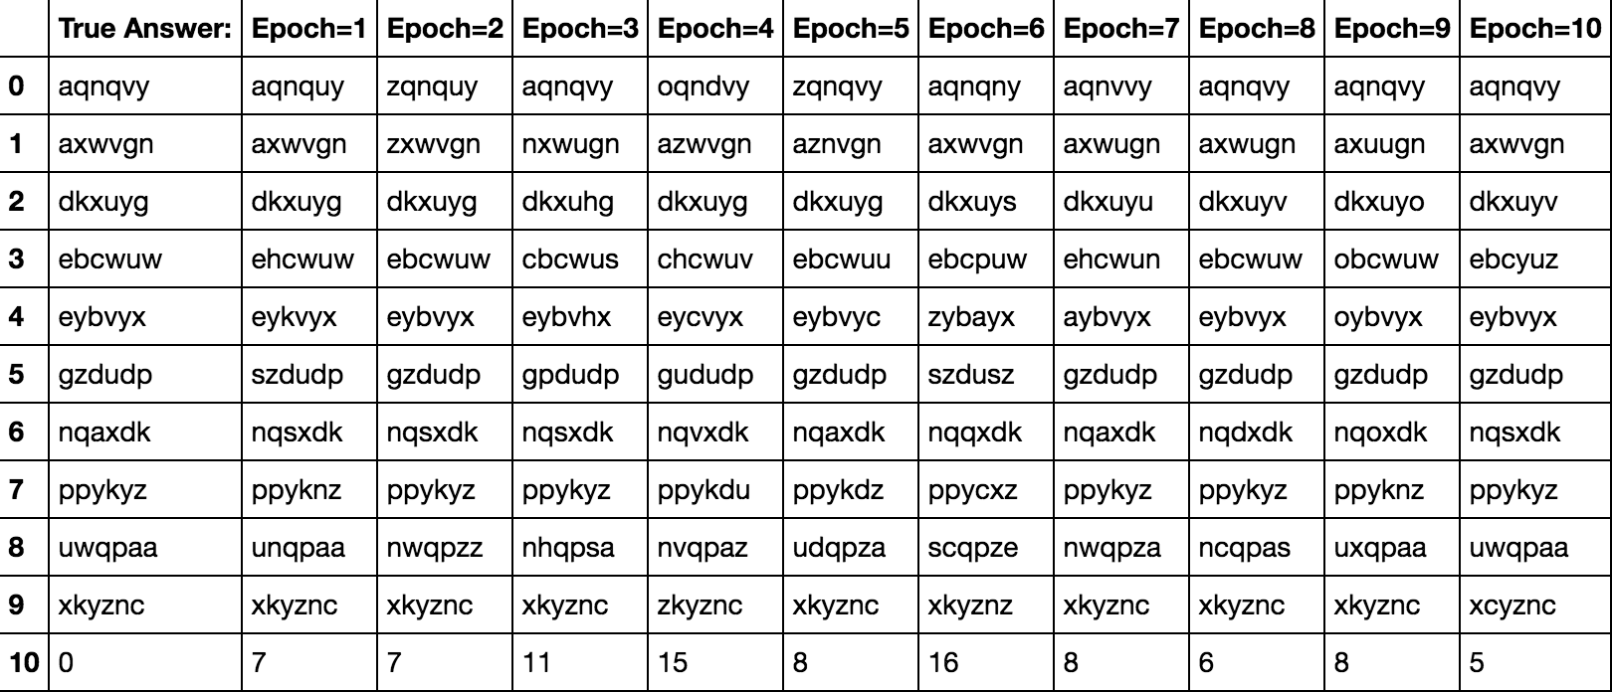
Results

Slide 6
OPTIMIZINGs our neural network
Wanted to optimizes three aspects of our CNN
How many Training cycles (Epochs)
How many output filters per Convolution
How many nodes for hidden dense layer

Slide 7
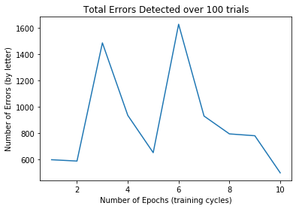
Epoch optimization

Slide 8
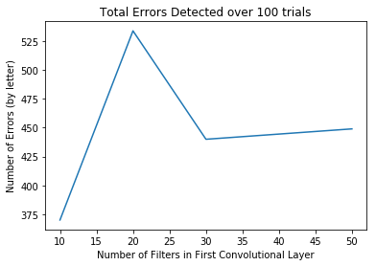
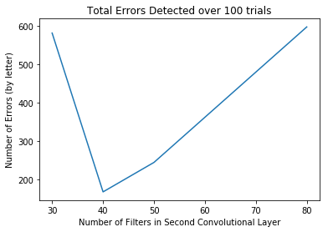
Filter per layer optimization
First Convolutional Layer
Second Convolutional Layer

Slide 9
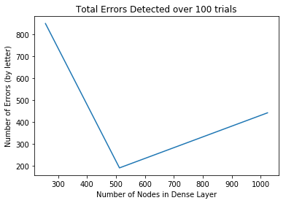
Optimization of hidden dense layer

Slide 10
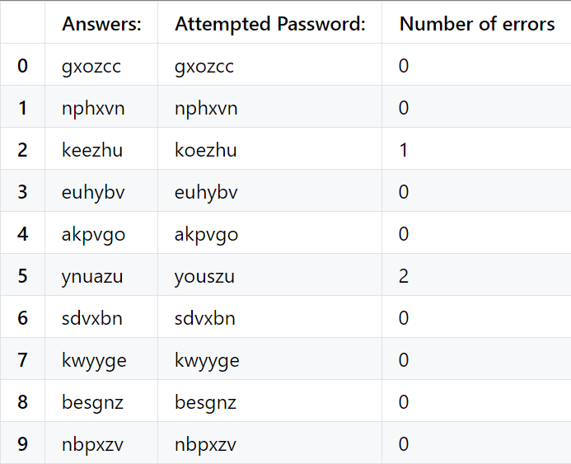
Fully Optimized Model Statistics
Using all of the parameters at the optimal values:
Per letter success rate: ~97%
Per CAPTCHA success rate: ~81%

Slide 11
Pre optimization results (for comparison)

