Slide 1
Lending Club Case Study
Group Members:
Megharaj Hothur
Shivani Kharra.

Slide 2
Lending Club Case Study
Abstract:
This company is the largest online loan marketplace, facilitating personal loans, business loans, and financing of medical procedures. Borrowers can easily access lower interest rate loans through a fast online interface. The aim of this case study is to identify risky loan applicants based on several factors.
Business Problem Statement
The lending company is incurring huge cost due to Credit loss
Lending Club wants to understand the driving factors (or driver variables) behind loan default, i.e. the variables which are strong indicators of default. The company can utilize this knowledge for its portfolio and risk assessment.
Analyze dataset containing past loan applicants and their loan information using EDA to understand how customer-centric and loan-centric attributes can impact and influence a loan default
Context & Outcome of EDA

Slide 3
Exploratory Data Analysis Approach
Data Sourcing & Understanding
Loading data
Data Cleaning
Remove missing values
Remove unwanted columns
Remove outliers
Remove rows having null values
Data Analysis
Data Type Standardization
Derive new columns for analysis
Univariate Analysis
Segmented Univariate Analysis
Bivariate Analysis
Inference through Data Visualization & Recommendations
Derive visualization through plots
Determine factors affecting loan default
Derive relationship between different variables

Slide 4
Analysis & Assumptions
We are provided with past loan dataset of customers -Loans and Meta data to understand the loans data itself.
After detailed analysis , we identified the following variables that will have influence to loan defaulting for this analysis.
The data set contained loans applied from the year 2007 to 2011
only individual type loans were considered for the analysis.
We have excluded loans that are currently in process as they do not provide any significance to the analysis.
Only the loans with statuses of ‘Paid Off’ and ‘Charged Off’ are considered for analysis.
A cleaned dataset of 27 columns and 36502 rows are considered for analysis
~14% of Charged off loans were present in the data set
~86% of Paid off loans were present in the data set
We created few derived columns during the analysis-
Status –> 1 – Paid off; 0 – Charged off
For Issue_d column; years and months were separated into different derived columns
Binning of annual income of borrower , loan amount. Instalment, interest rate are performed
The ratio of the charged off/default loans has been increasing over the years from 2007 to 2011
Interest Rate | Loan Grade or Credit Rating | Loan Purpose
Employee Length | DTI (Debt/Income Ratio) | Loan Amount
Annual Income (of borrower) | Verification status of the loan | Term of the loan
Home Ownership (of borrower) | Publicly Recorded Bankruptcies

Slide 5
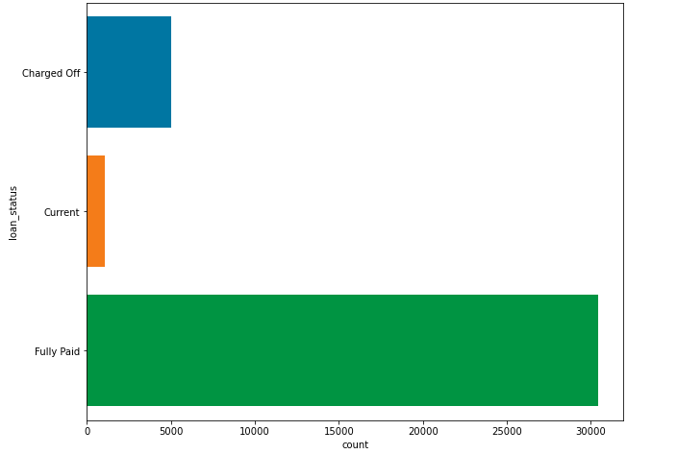
Loan Status Analysis
Most of the loans from the dataset are Fully Paid
The dataset has ~14% default rate with borrower's status changing to Charged-Off.

Slide 6
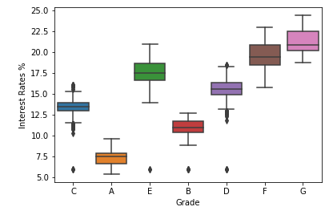
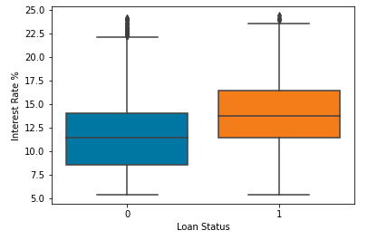
Interest Rate Analysis
Observations:
Interest rate increased for all grades, interest rates dropped to an extent for grades of A and B. The lower grades such as E,F & G have very high interest rates.
Higher the interest rates, higher are the tendencies for the loan to be charged off.
Recommendation(s):
Lending club should look at less risker loans (grade A and B) as riskier the loan, higher the interest rate and higher the interest rate higher are the chances of defaulting.

Slide 7
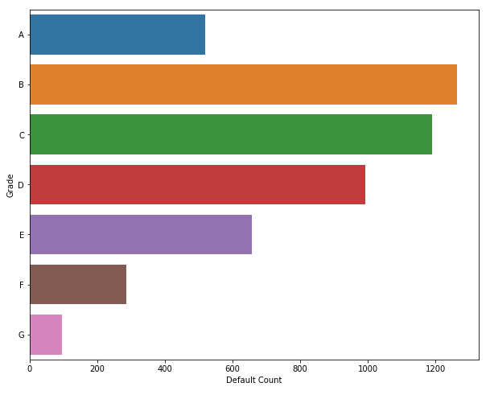
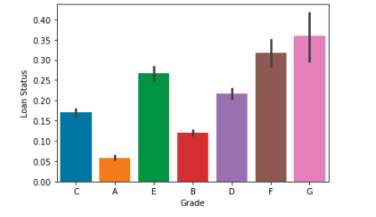
Loan Grade Analysis
Observations:
The lower the grades like E, F and G, higher charged off/default rates.
Loans belonging to risk category of B and C have the highest number of charged off loans.
Recommendation(s): Lending club should avoid providing to loans which belong to grade of E, F and G as default rates are high in those categories.

Slide 8
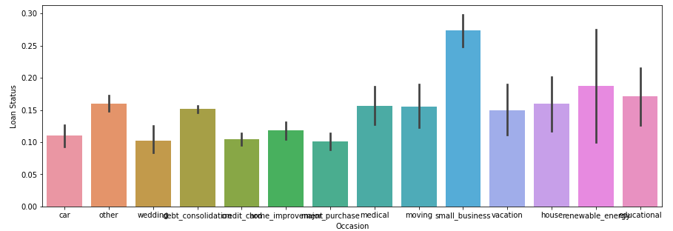
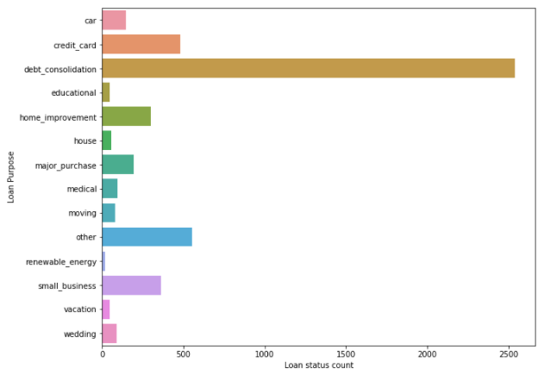
Loan Purpose Analysis
Observations: With respect to count, loans with purpose of ‘debt consolidation’ have the highest number of charged off loans.
However, from default rate stand point, loans with purpose of ‘small business’, ‘renewable energy’ and ‘educational’ have the highest default rate in the chronological order.
Recommendation(s)
Lending club should be very cautious while approving loans for “Small business” by employing stringent measures and reduce their loans for purposes of ‘Small Business’ as 27% of the loans on that purpose are getting defaulted.

Slide 9
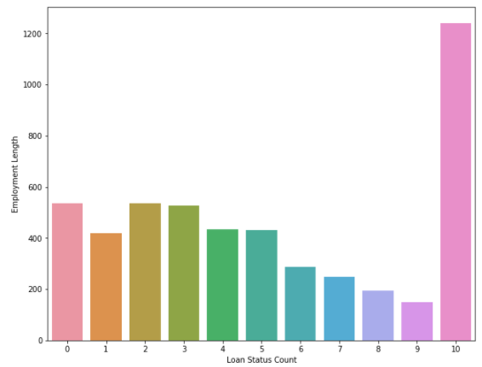
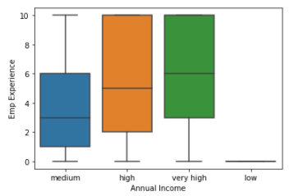
Employee Length Analysis
Observation(s):
Majority of the customers are employees having 10 years of work experience.
Higher the employee length, higher is the annual income.
Recommendation(s):
Lending club should be careful while providing loans to people who have higher experience; as higher experience individuals tend to take higher amounts exposing to higher risks of defaulting.
Lending club should also be careful of providing loans to individuals who have <= 3 years of experience as their salaries will be less and their capacity to pay back will be less comparatively.

Slide 10
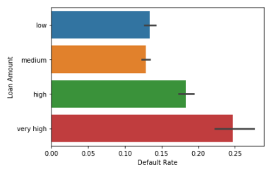
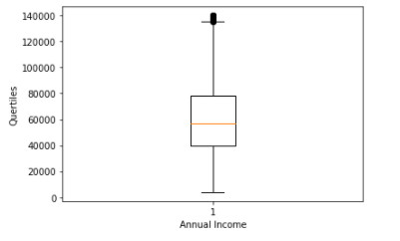
Annual Income Analysis
Observation(s):
Majority of the loans taken by customers have annual income between 40,000 – 80,000 USD.
Customers with lower annual income (<20,000) are highly susceptible to defaulting.
Recommendation(s):
Lending club should do rigorous due diligence with Lower Annual Income bracket and Medium income bracket individuals as their dti is higher compared with other income brackets. Higher dti means higher risks of defaults as seen in the next slide.

Slide 11
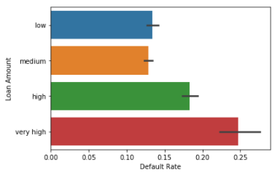
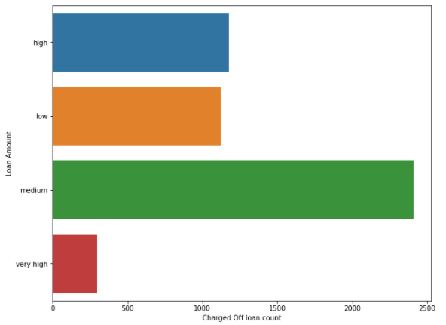
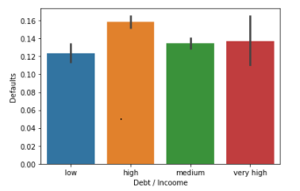
Debt-to-Income Ratio & Loan Amount Analysis
Observation(s):
Higher the debt-to-income ratio, higher are the tendency for loans to get default.
Higher the loan amount, higher are the default rate. But, from the count perspective, loan amounts that are 15000 and higher are tending towards default.
Recommendation(s):
Lending club should avoid providing loans to individuals with higher DTI as higher the Debt-to-Income ratio; higher are the chances of loans getting charged off.
LC should consider loans which are less than 10000 and should be careful of approving loans which are more than 20000 since the charged off ratio's are higher.

Slide 12
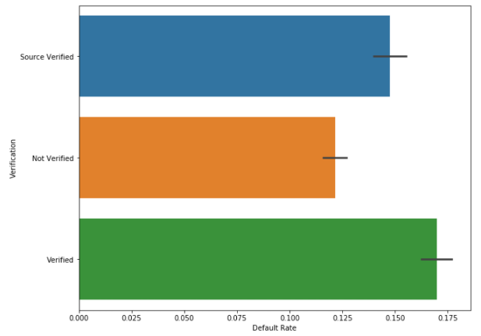
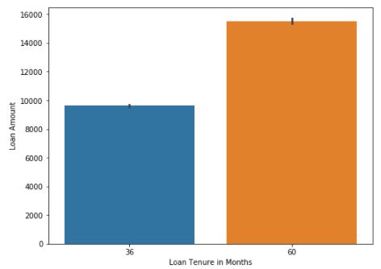
Verification Status and Term of the loan Analysis
Observation(s):
Loans with verified status have higher default rate of 16.8%.
Loans with term of 60 months have higher default rate of 25%
Recommendation(s):
Lending club should look at their process of verification to be more stringent. Although verified, their loans are defaulting at higher rate
Lending club should look at lending more loans with term of 36 months and less.

Slide 13
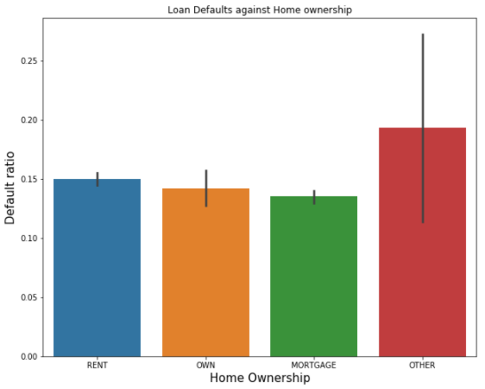
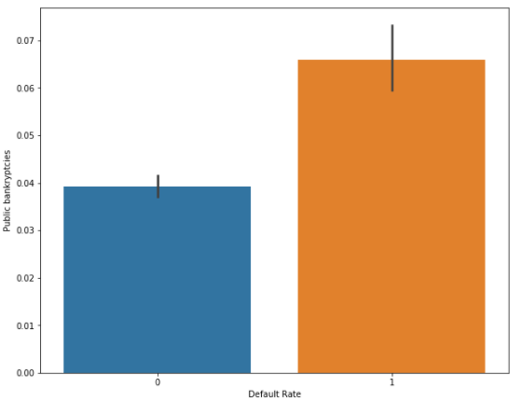
Home Ownership & Publicly Recorded Bankruptcies Analysis
Observation(s):
Borrowers who are renting are defaulting more.
Borrowers with higher public record of bankruptcies have tendency to default
more.
Recommendation(s)
Lending Club should perform more due diligence while providing loans to borrowers who are renting and doesn’t own or mortgage.
Lending Club should avoid lending to individuals who have more publicly recorded bankruptcies.

Slide 14
Conclusions
Based on the Exploratory data analysis of Lending Case Study, we can conclude that –
Loans having higher interest rate have higher tendency to default. Interest rate is also correlated highly with term, loan amount. Hence, Lending club should check all these factors before approving any loan.
Lending Club should be very cautious while approving loans for small businesses & debt consolidation and borrowers living in Rent and who do not own house.
Lending club should be very cautious while approving loans with low grade and should also improve their verification process as majority of loans that defaulted in the past were verified internally by Lending Club.

