Slide 1
AI Stocks
Multi-Model Stock Price Prediction System
Using MLP, Transformer, and Sentiment Analysis
COMP7015 Project
Mak Ho Wai Winson
Student No.: 24465828

Slide 2
ACT 1: THE MYSTERY
What questions drive our investigation?

Slide 3
The Questions That Drive Us
Can we solve the mystery of stock price prediction?
❓ Key Research Questions:
  • Can AI predict stock movements accurately?
  • Which model architecture works best?
  • How do we combine multiple data sources?
  • What patterns hide in the noise?
🔍 Challenges We Face:
  • Market volatility: Non-stationary patterns that change over time
  • Multiple data sources: Price, news, fundamentals - how to integrate?
  • Real-time requirements: Fast predictions for trading decisions
  • Multi-modal analysis: Numbers, text, and ratios - all matter

Slide 4
ACT 2: THE INVESTIGATION
Our systematic approach to solving the mystery

Slide 5
Our Investigation Strategy
We hypothesized that a multi-model approach would reveal hidden patterns:
💡 Combine multiple ML models
  • Baseline: Our control experiment
  • MLP: The feature detective
  • Transformer: The pattern recognition expert
💡 Integrate heterogeneous data
  • Price: Market dynamics
  • News: Public sentiment
  • Fundamentals: Company health
💡 Build an interactive system
  • Real-time predictions
  • Actionable recommendations

Slide 6
Following the Data Trail
Our investigation began by gathering evidence:
📊 Price Data (Yahoo Finance):
  • Daily OHLCV for 365 days
  • 10 AI-related stocks: AAPL, MSFT, NVDA, GOOGL, AMZN, META, TSLA, AVGO, TSM, SMCI
  • Intraday: 30-minute intervals, 60 days
  • Caching: JSON format for reproducibility
📰 News Data (NewsAPI):
  • Real-time headlines
  • Sentiment labels: 5 classes
  • Integration with prediction models
📈 Fundamental Data:
  • P/E ratio, P/S ratio, market cap
  • Revenue growth

Slide 7
Transforming Data into Clues: MLP
MLP: Tabular Features (Single Snapshot)
📊 Format & Structure:
  • Format: 1D vector of 8 features per sample
  • Features: [last_close, MA_10, MA_30, std_10, std_30, sentiment, PE_ratio, PS_ratio]
  • Input shape: (batch_size, 8)
  • Philosophy: Captures current state + aggregated statistics
  • No temporal order: Each sample is independent
📋 Example: AAPL on 2024-01-15
  • last_close: 185.50
  • MA_10: 183.20, MA_30: 180.45
  • std_10: 2.15, std_30: 3.42 (volatility)
  • sentiment: 0.65 (positive)
  • PE_ratio: 28.5, PS_ratio: 7.2
  • Full vector: [185.50, 183.20, 180.45, 2.15, 3.42, 0.65, 28.5, 7.2]
🏷️ Label Format:
  • Calculate 5-day future return from 2024-01-15
  • Class 0 (DOWN): Return ≤ -1%
  • Class 1 (FLAT): -1% < Return < +1%
  • Class 2 (UP): Return ≥ +1%
  • Example: If future return = +2.5% → Label = 2 (UP)

Slide 8
Transforming Data into Clues: Transformer
Transformer: Sequential Features (Time Series)
📈 Format & Structure:
  • Format: 2D matrix of 30 days × 8 features per sample
  • Features: Same 8 features, repeated for each day in sequence
  • Input shape: (batch_size, 30, 8)
  • Philosophy: Captures temporal evolution and patterns over time
  • Temporal order matters: Sequence position encodes time
  • Enables attention: Model learns which days are most important
📋 Example: AAPL 30-day sequence ending 2024-01-15
  • Shape: (30, 8) - 30 days × 8 features
  • Day 1 (2023-12-17): [180.20, 178.50, 175.30, 1.85, 2.90, 0.55, 28.2, 7.0]
  • Day 15 (2023-12-31): [182.80, 181.20, 178.90, 2.05, 3.15, 0.60, 28.4, 7.1]
  • Day 30 (2024-01-15): [185.50, 183.20, 180.45, 2.15, 3.42, 0.65, 28.5, 7.2]
  • Each row represents one trading day's features
  • Model sees the entire 30-day evolution, not just the final day
🏷️ Label Format:
  • Calculate 5-day future return from sequence end date (2024-01-15)
  • Class 0 (DOWN): Return ≤ -1%
  • Class 1 (FLAT): -1% < Return < +1%
  • Class 2 (UP): Return ≥ +1%
  • Example: If future return = +2.5% → Label = 2 (UP)
  • Same label format as MLP, but features capture 30-day history
💡 Key Advantage:
  • Sees patterns: Upward trend over 30 days
  • Attention mechanism identifies important days
  • Captures momentum and temporal dependencies

Slide 9
Our Investigative Tools: Baseline Model
The Control Experiment - Moving Average Crossover:
📐 Simple yet interpretable
  • Calculate 10-day MA (MA_short)
  • Calculate 30-day MA (MA_long)
  • Compare relative positions
🔍 Signal Generation:
  • UP: MA_short > MA_long by >2%
  • DOWN: MA_short < MA_long by >2%
  • FLAT: Otherwise
💡 Why it matters:
  • Fast: No training required
  • Interpretable: Clear rules
  • Baseline: Comparison point for ML models

Slide 10
Our Investigative Tools: MLP Model
The Feature Detective - Feedforward Neural Network:
🏗️ Architecture:
  • Input: 8-dimensional feature vector
  • Hidden: 2-3 layers, 64-128 units
  • Activation: ReLU
  • Output: 3-class logits
  • Parameters: ~5K-10K weights
💡 Design Rationale:
  • 8 Features: Technical + fundamental + sentiment
  • 2-3 Layers: Sufficient for tabular data, avoids overfitting
  • 64-128 Units: Balance capacity vs training data size
  • Small model: Appropriate for limited data

Slide 11
Our Investigative Tools: Transformer Model
The Pattern Recognition Expert - Sequence-Based Encoder:
🏗️ Architecture:
  • Input: 30-day sequence (30×8)
  • Input projection: Linear(8 → d_model)
  • Positional encoding: Sinusoidal
  • Encoder: 2-3 layers
  • Attention: 4-8 heads
  • Parameters: ~100K weights
💡 Design Rationale:
  • 30-Day Sequence: Standard for stock prediction
  • d_model=32-64: Start small, scale up if needed
  • 4-8 Attention Heads: Multiple perspectives on temporal patterns
  • 2-3 Layers: Balance depth vs overfitting

Slide 12
Our Investigative Tools: Sentiment Analysis
The Language Interpreters - Deep Learning Models:
🤖 LSTM Model:
  • Embedding → LSTM (2 layers, 128 units)
  • Supports GloVe embeddings
  • Dropout 0.5: High regularization for text
🤖 BERT Model:
  • Pre-trained bert-base-uncased (110M params)
  • Fine-tuning: LR 2e-5, dropout 0.1, 3-5 epochs
  • Transfer learning benefits
💡 Why BERT > LSTM:
  • Pre-trained transformer knowledge
  • Better language understanding
  • Captures nuanced financial language

Slide 13
The Training Journey
How we trained our models:
📊 Dataset: 10 stocks, rolling windows
  • 2,150 samples from 365 days
  • Future returns: 5-day horizon
  • Split: 80% train, 20% validation
🎯 Training Strategy:
  • Hyperparameter search
  • Early stopping: Patience=5
  • Optimizer: Adam (lr=1e-3)
📈 Metrics:
  • Cross-entropy loss
  • Classification accuracy

Slide 14
Putting It All Together
End-to-End Prediction Pipeline:
🔄 Steps:
  1. Fetch data (price, news, fundamentals)
  2. Extract features
  3. Run inference (all models)
  4. Generate recommendations
💰 Buy/Sell Logic:
  • UP: Buy@98%, Sell@105%
  • DOWN: Sell signal, Buy@95%
  • FLAT: Hold
🖥️ Frontend: Streamlit interface
  • Real-time analysis
  • Interactive visualizations

Slide 15
ACT 3: THE DISCOVERY
What did our investigation reveal?

Slide 16
Setting the Stage for Discovery
Our evaluation methodology:
📊 Dataset:
  • 2,150 samples from 10 AI-related stocks
  • Period: 365 days
  • Split: 80/20 train/test
📊 Evaluation Focus:
  • Stock Direction Prediction Models
  • Sentiment Analysis Models
🎯 Task: 3-class classification
  • Class 0 (DOWN): Return ≤ -1%
  • Class 1 (FLAT): -1% < Return < 1%
  • Class 2 (UP): Return ≥ 1%

Slide 17
The Moment of Truth: Which Model Won?
Our investigation revealed:
🏆 Transformer Model: 50.0% accuracy (Best)
  • Precision (Macro): 0.348
  • Recall (Macro): 0.353
  • F1-Score (Macro): 0.294
  • Best Config: d_model=64, nhead=8, num_layers=3
🥈 MLP Model: 40.9% accuracy
  • Precision (Macro): 0.248
  • Recall (Macro): 0.325
  • F1-Score (Macro): 0.204
  • Best Config: hidden_dim=64, num_layers=3
📊 Baseline Model: ~36% accuracy
  • Moving average crossover strategy (MA_10 vs MA_30)

Slide 18
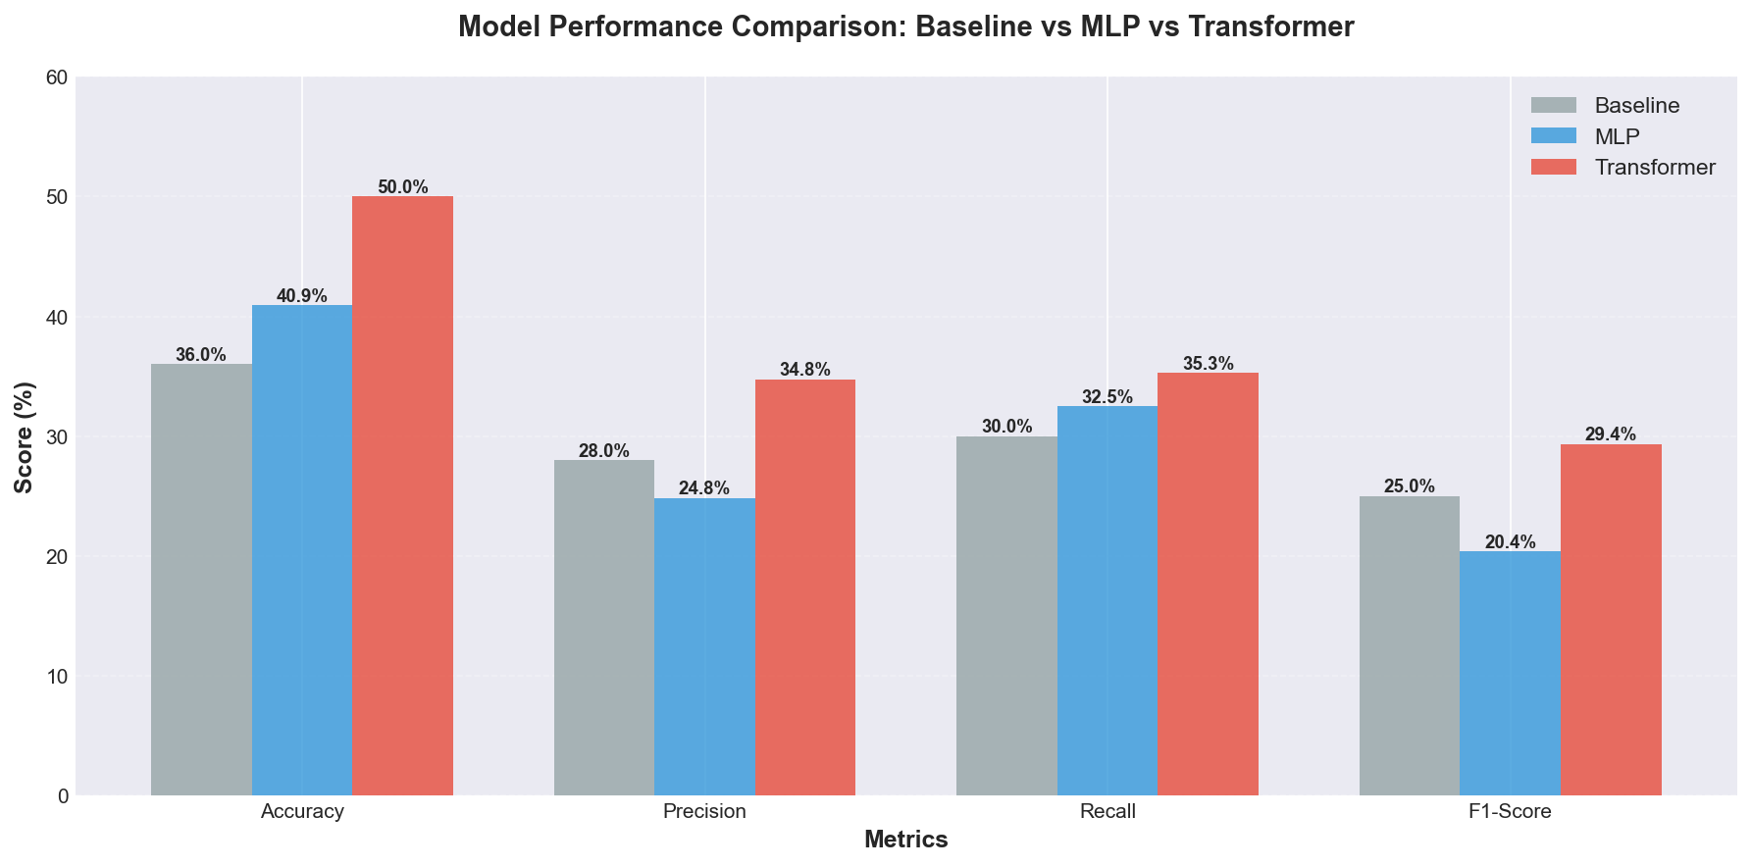
Visual Evidence: Model Performance Comparison (Baseline vs MLP vs Transformer)

Slide 19
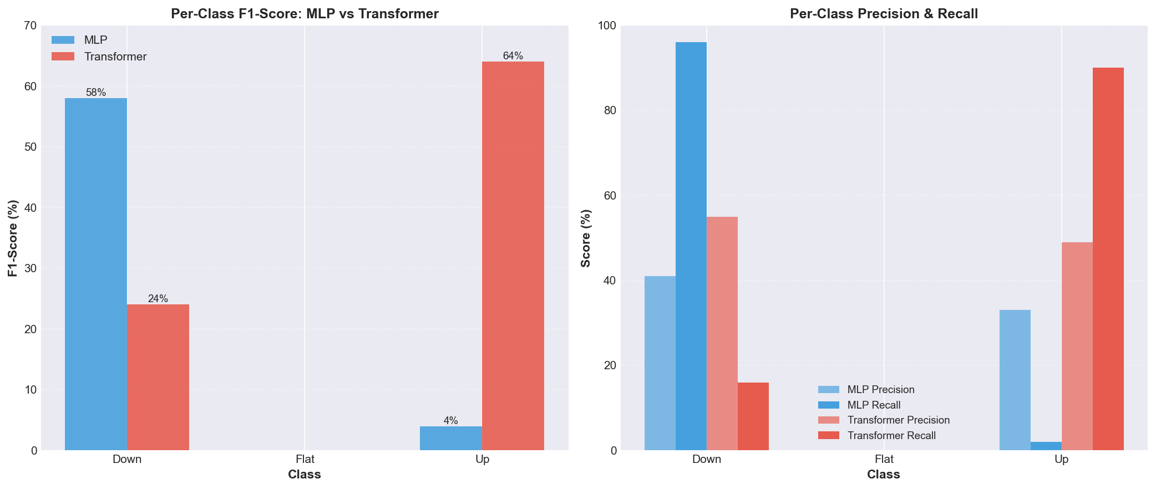
Deeper Investigation: Per-Class Performance

Slide 20
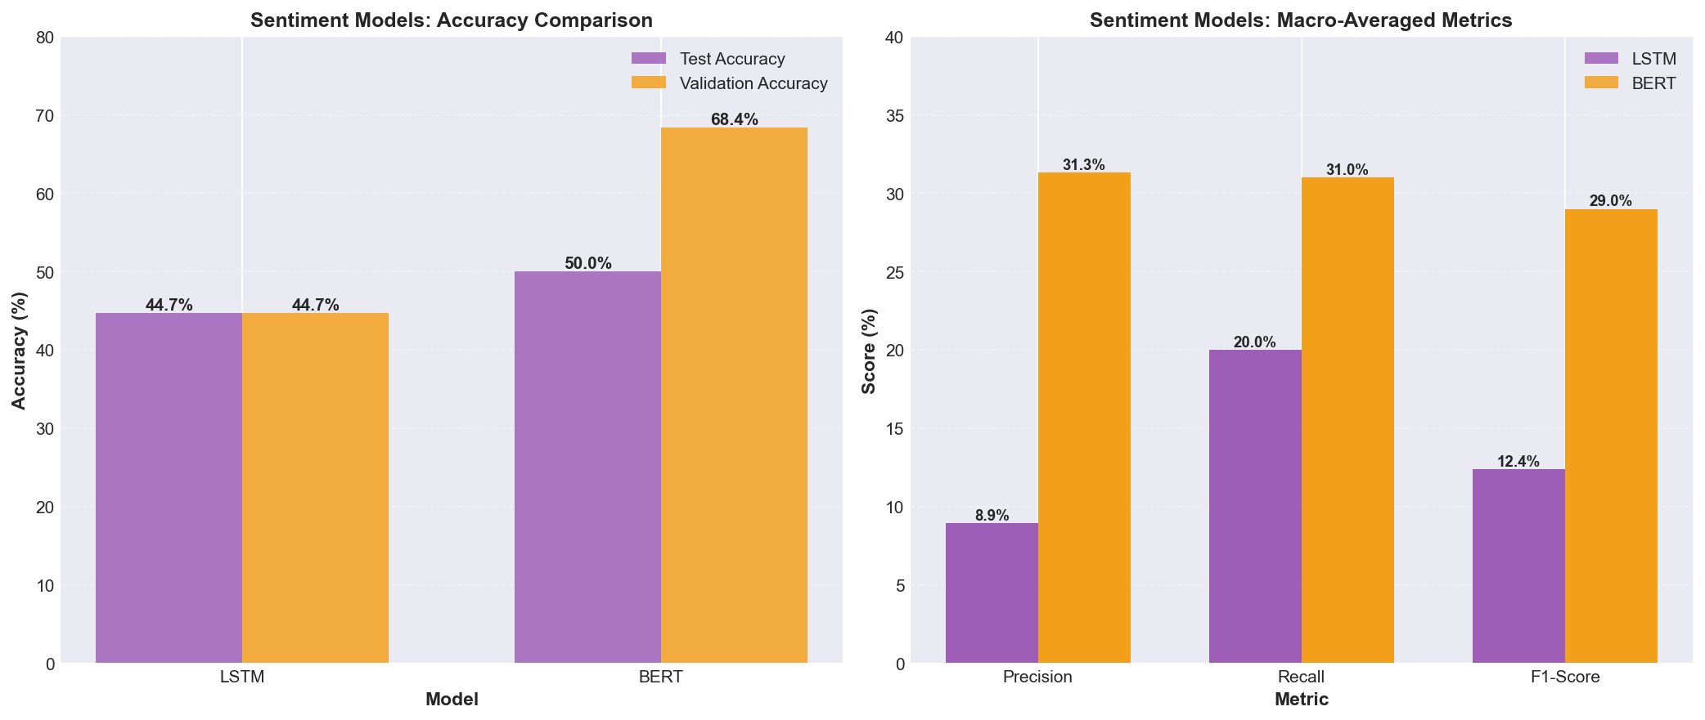
Sentiment Models: Visual Comparison

Slide 21
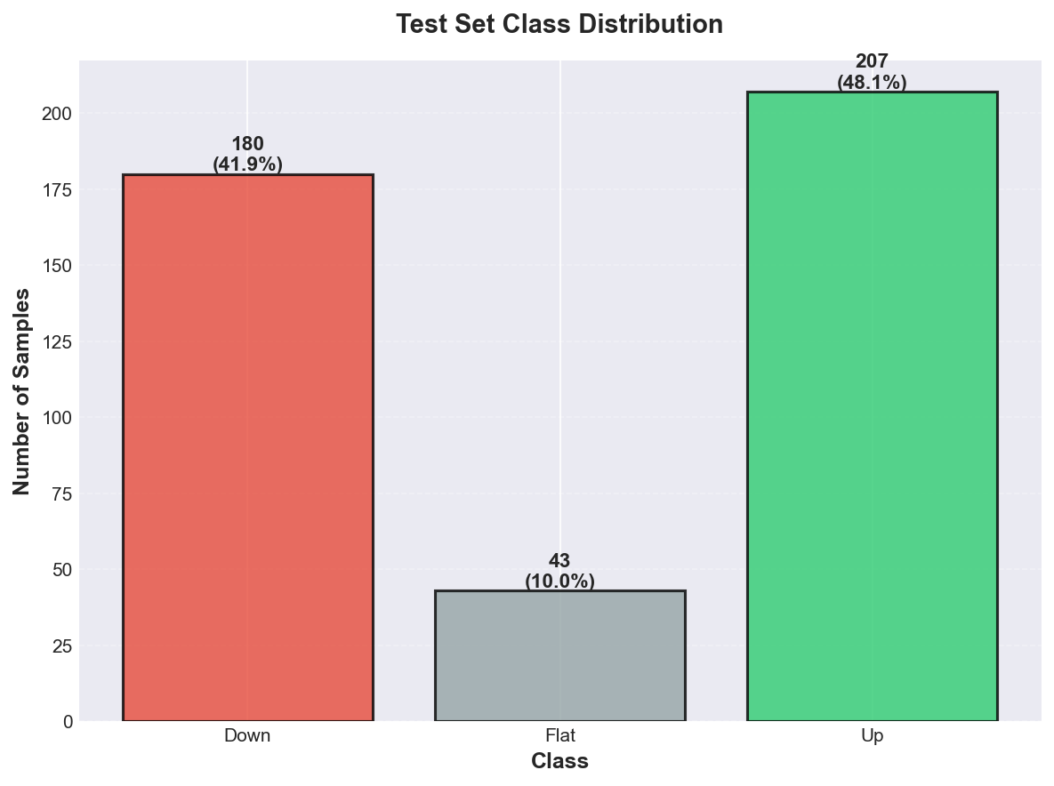
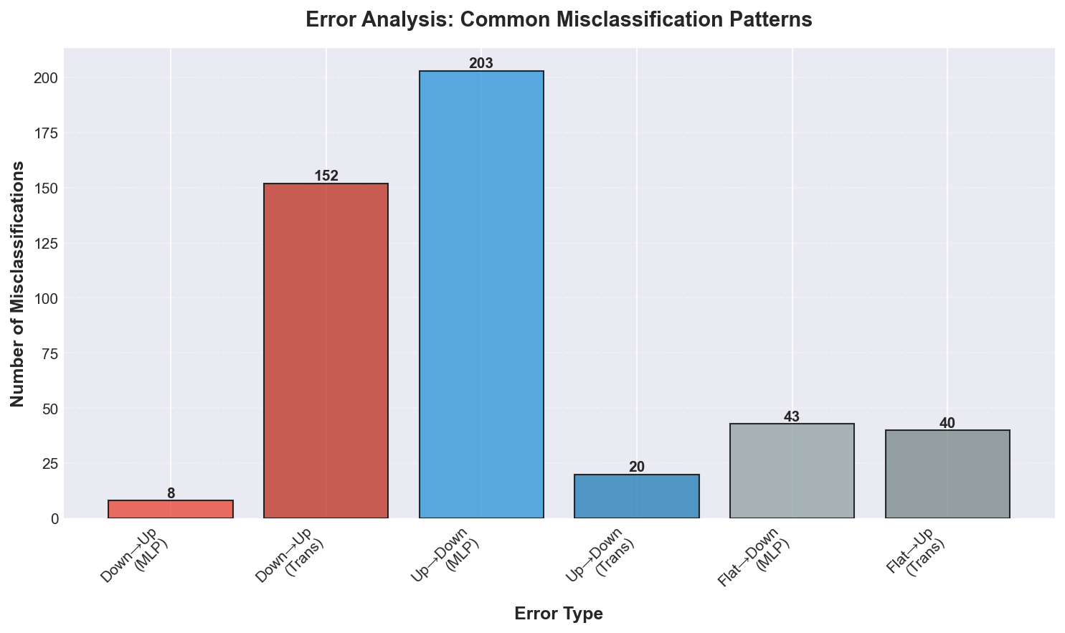
Dataset Analysis

Slide 22
Pattern Recognition: What Models Learned
Key insights from our analysis:
🔍 Class Imbalance Revelation:
  • Both models struggle with 'Flat' class
  • Test set: Down (42%), Flat (10%), Up (48%)
  • Models bias toward majority classes
🔍 Model Strengths:
  • Transformer: Excellent at 'Up' predictions (F1=0.64)
  • MLP: Better at 'Down' predictions (F1=0.58)

Slide 23
ACT 4: THE INSIGHTS
What does it all mean?

Slide 24
The Trade-offs: Honest Reflection
Every discovery comes with limitations:
⚠️ Model Limitations:
  • 50% accuracy is above random (33%) but not perfect
  • Class imbalance affects predictions
  • 'Flat' class remains challenging
⚠️ Data Constraints:
  • Only 10 stocks, limited history
  • Small sentiment dataset (176 samples)
  • Market efficiency limits predictability
⚠️ Computational Considerations:
  • Transformer requires more compute than MLP
  • BERT fine-tuning needs GPU resources

Slide 25
ACT 5: THE FUTURE
Where does this lead us?

Slide 26
Beyond the Horizon: Future Improvements
Potential enhancements for future investigations:
📈 Advanced Models: LSTM/GRU, Temporal CNNs
📊 Enhanced Features: More indicators (RSI, MACD), alternative data
🔍 Explainability: SHAP values, attention visualization
📉 Risk Management: Position sizing, stop-loss, portfolio metrics
📊 Backtesting: Historical evaluation with transaction costs
🔄 Real-Time: Live data feeds, incremental updates, continuous learning
⚖️ Class Imbalance: Class weighting, oversampling

Slide 27
Questions & Answers
Thank you for joining our investigation!

