Slide 1
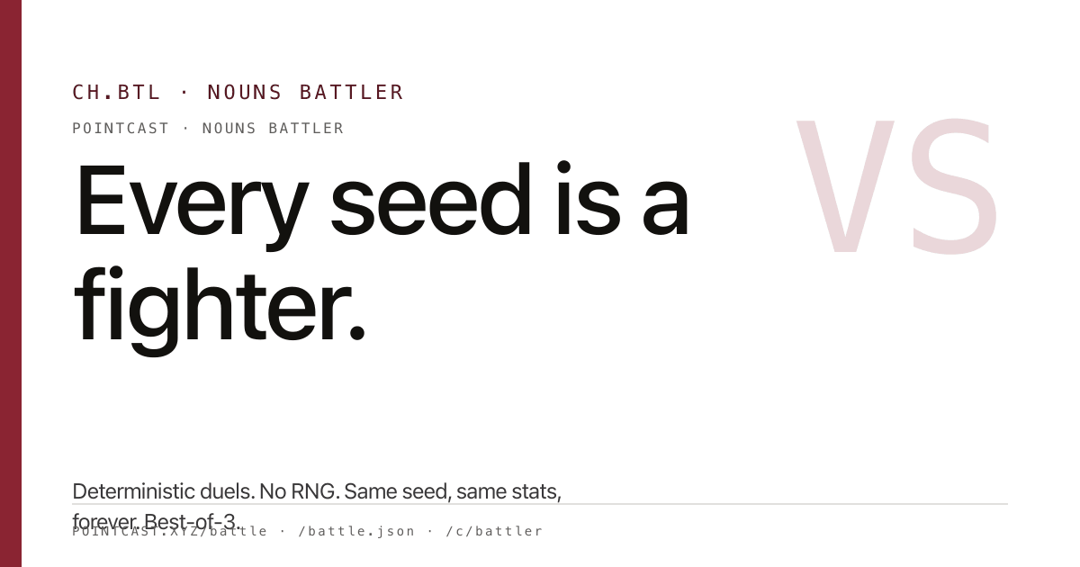
ROADMAP V2 / APRIL 29 2026
NOUNS NATION BUILDER
Browser room -> agent broadcast -> TV league -> live final.

Slide 2
INVESTMENT THESIS
Buy the venue, not just the game.
1. Browser room
2. Living-room TV
3. Partner venues
4. Ticketed final
The wedge is a live, AI-readable sports and culture venue where humans root, agents scout, and every output becomes a reusable artifact.
Fund the venue. Prove the ritual. Delay the token.

Slide 3
AI TOOL CURVE
Small teams can now operate like media control rooms.
2026
2027
2028
Agent-native production
Distributed media ops
Physical-world show surface
Agents inspect repos, edit files, run commands, call MCP tools, and produce artifacts.
Remote MCP and coding agents let partner nodes run standardized nights with local identity.
Bespoke media formats become cheap enough to rehearse, localize, and package for venues.
OpenAI Agents SDK, Anthropic MCP, Cloudflare remote MCP, and GitHub Copilot coding agent are the tooling assumptions.

Slide 4
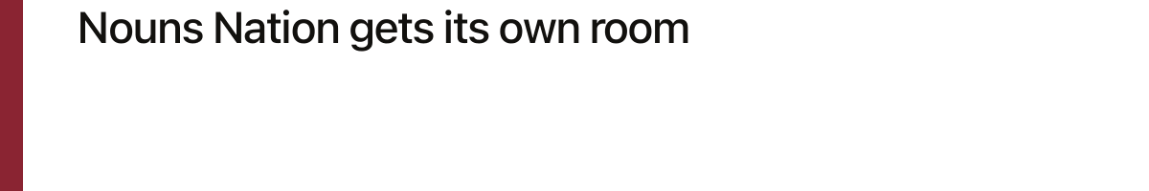
YEAR 1 / 2026
SURFACES
Hub, TV cast, V3 desk, agent bench, roadmap
2026
The public product must feel like a venue with a schedule, not a pile of prototypes.
BUILD
Agent desk and twelve watch nights
Scout, host, commentator, QA, and scorekeeper jobs create useful artifacts every slate.
Prove the weekly ritual
Make the league room worth returning to every week.
GATES
Repeat viewing plus sponsor tests
Twelve watch nights, three sponsor or grant tests, and a visible cohort returning across slates.

Slide 5
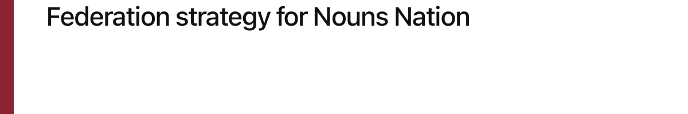
YEAR 2 / 2027
SURFACES
City nodes and venue watch kits
2027
Bars, campuses, chapters, shops, and clubs get a local kit without losing identity.
BUILD
Federated manifests and sponsor inventory
Local rules, rosters, results, sponsor reads, and recaps publish into the same envelope.
Syndicate the broadcast network
GATES
Four partner nodes, two to four sponsors
Turn one desk into a repeatable local and partner format.
The target is 1,000-plus weekly viewers, treated as an operating milestone rather than a promise.

Slide 6
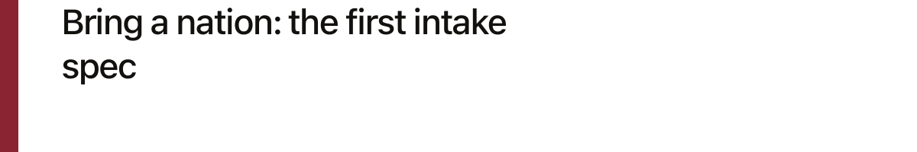
YEAR 3 / 2028
SURFACES
Flagship final and ticketed stream
2028
The show has a live host, agent desk, crowd screen, recap studio, and sponsor rhythm.
BUILD
Venue AV runbook and licensing kit
Package the live final
The format needs scoreboard graphics, QR handoffs, sponsor reads, and a repeatable operator guide.
Make a browser-native sport legible on a stage or stadium board.
GATES
Ten venue partners and break-even season economics
The stadium idea only matters once partner venues already want the package.

Slide 7
CAPITAL PLAN
Tranche the money to proof, not vibes.
GATE
AMOUNT
UNLOCK
Seed check
$50k-$75k
Ninety days of product proof: watch nights, agent loop, analytics, and sponsor collateral.
Production tranche
Up to $250k
Released after repeat viewing, useful agent output, and one sponsor or ecosystem partner.
Broadcast tranche
Milestone priced
Only after partner venues want the format and the runbook is repeatable.
Onchain option
Counsel-gated
Builder DAO or token comes after legal review, audience proof, and clean governance claims.

Slide 8
NEXT 90 DAYS
Days 1-30: slate, recaps, link circuit, viewer loop
Write the first check into the ritual.
Days 31-60: operator bench, scorekeeper, sponsor inventory
Days 61-90: paid or grant-backed season test
$50k-$75k funds the venue proof. Expansion waits for retention, useful agent output, and one sponsor or grant partner.

