Slide 1
5 Year Higher Education Enrollment Data Analysis
By Miranda hoyt

Slide 2
Enrollment in higher education is always evolving and has many external factors that influence that. I have reviewed the spring term enrollment for the last 5 years to see what trends can be seen in total enrollment, enrollment by sector, enrollment by year, and enrollment by state/region. Github repo (includes data sources & tableau project): https://github.com/mhoyt22/Hoyt_A7 Tableau Project: https://public.tableau.com/views/Hoyt_A7/Goal1?:language=en-US&publish=yes&:sid=&:redirect=auth&:display_count=n&:origin=viz_share_link
1. Write a brief introduction of your project. Include clickable link to your published project if available.
Section 1. Introduction

Slide 3
Higher education enrollment data for the last 5 spring terms. Total enrollment is broken down by sector, year, and state. String: Terms State & Region: Geographical Numerical: Total Enrollment, Total Enrollment, % Change from Previous Year, Public 4-year, Private nonprofit 4-year, Private for-profit 4-year, Public PAB, Public 2-year, Term Year (calculated), p.Sectors (calculated) Provided in an Excel Workbook (xlsx) format, the data is comprised of one simplified sheet of the enrollment data.
2. Data Description
3. Describe the domain of the data set
4. Describe the data file (be specific!)
Section 2. Data Description

Slide 4
Rows: Terms, State, Region, Term Year (Calculated), p.Sectors (calculated) Columns: Total Enrollment, Total Enrollment, % Change from Previous Year, Public 4-year, Private nonprofit 4-year, Private for-profit 4-year, Public PAB, Public 2-year The original data sheet was compiled & published by the National Student Clearinghouse. You can find it in my GitHub here as well as on their website here. I narrowed the data down to what I needed for my analysis and that can be found here.
5. Clearly state the number of rows and columns you are using in this project.
6. Describe the data source (be specific!)
Section 2. Data Description Cont.

Slide 5
My data source had a lot of extra data that I did not utilize for this project. To make it easier to work with, I condensed it down.
7. what did you do to clean your data? If no cleaning was needed, state this.
Section 3. Data Cleaning Strategies

Slide 6
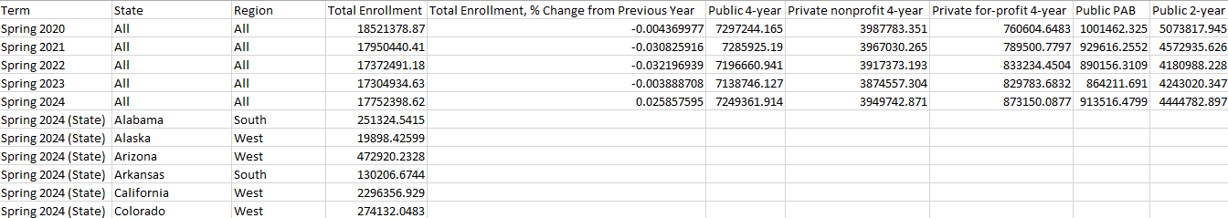
The higher education enrollment data I am using for visualization is broken down by term, sector, year, and state/region. The state/region data is only provided for the Spring 2024 term and is not broken down by sectors. You can view enrollment by sector(s) or as a total for the term.
8. Describe the clean dataset that you will visualize. Show an excerpt of the data (you don't have to show all the rows if your data set is huge).
Section 4. Clean Dataset

Slide 7
I used Tableau to create the charts needed for the project and to create storyboards as I reviewed each chart. Tableau Project: https://public.tableau.com/views/Hoyt_A7/Goal1?:language=en-US&publish=yes&:sid=&:redirect=auth&:display_count=n&:origin=viz_share_link I used GitHub to store my files in a publicly accessible place. GitHub Repo: https://github.com/mhoyt22/Hoyt_A7
9. Tell us which tools you selected for this project. Tell us why you chose them. Include clickable links to your working files (hosting your project in GitHub is great for your portfolio). From the document - and from your repo if you make one - provide clickable links to your work in Tableau Public.
Section 5. Visualization Tools

Slide 8
Each slides in this section will include.. 12. List the goal 13. Display the chart(s) for that goal 14. Display the story for that goal. 15. Take clear screenshots to include in your report. Make sure your chart title, legend, labels, and stories are clear and easy to read.
11. Use Dashboards & storyboards to represent your charts and findings. You should have at least 6 subsections, one for each goal. In each section (which may correspond to an associated sheet):
Section 6. Visualizations and Stories

Slide 9
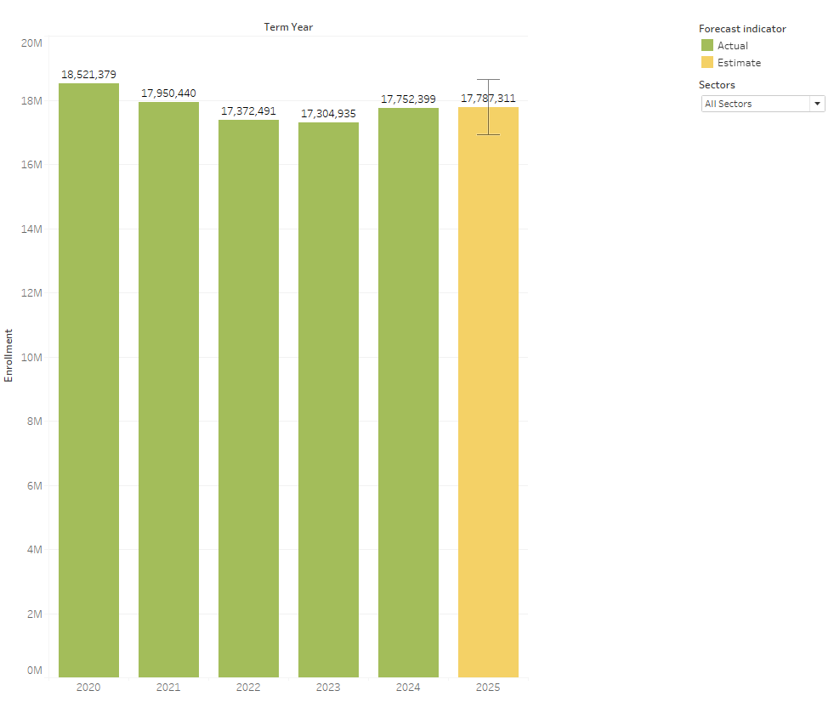
GOAL 1 Forecast Spring 2025 National Total Enrollment
As you can tell from the forecasted Spring 2025 enrollment number, total enrollment is expected to increase in the next year. When breaking down the enrollment by sector, that overall 4-year institutional enrollment is expected to decline or stay constant while 2-year institutional enrollment is expected to increase.

Slide 10
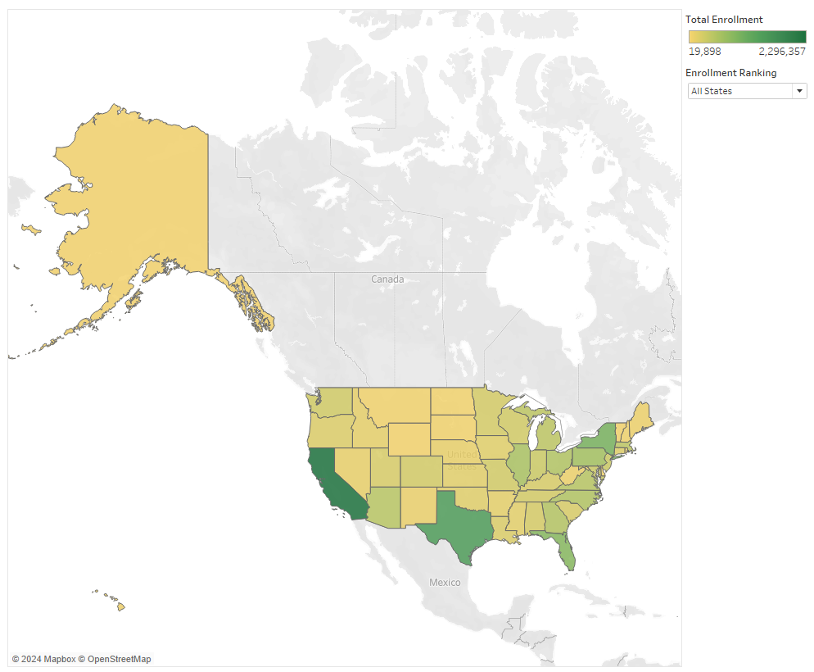
GOAL 2 What is the distribution of national enrollment by state for Spring 2024?
There are some clear outliers on state enrollment. The top states being Texas, California, Pennsylvania, and New York.

Slide 11
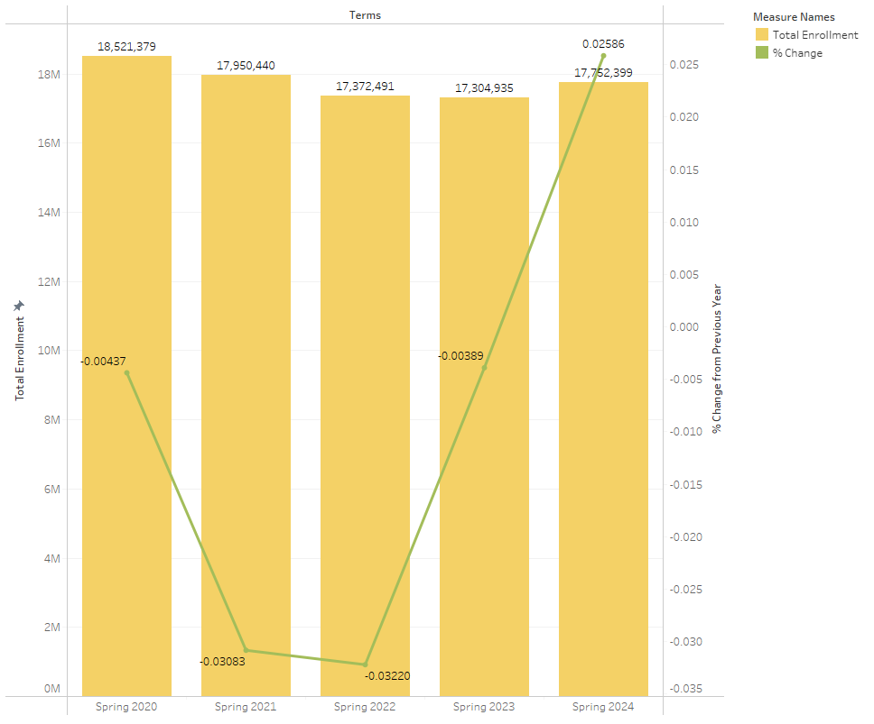
GOAL 3 Compare total enrollment figures with year-over-year percentage changes.
Overall enrollment has been continuing to decrease over the last 5 years until Spring 2024. From the percent change we can see that Spring 2023 is the first term that had been more consistent with post-covid numbers and Spring 2024 being a positive change. This leads us to anticipate a stable (or even increased) Spring 2025 enrollment.

Slide 12
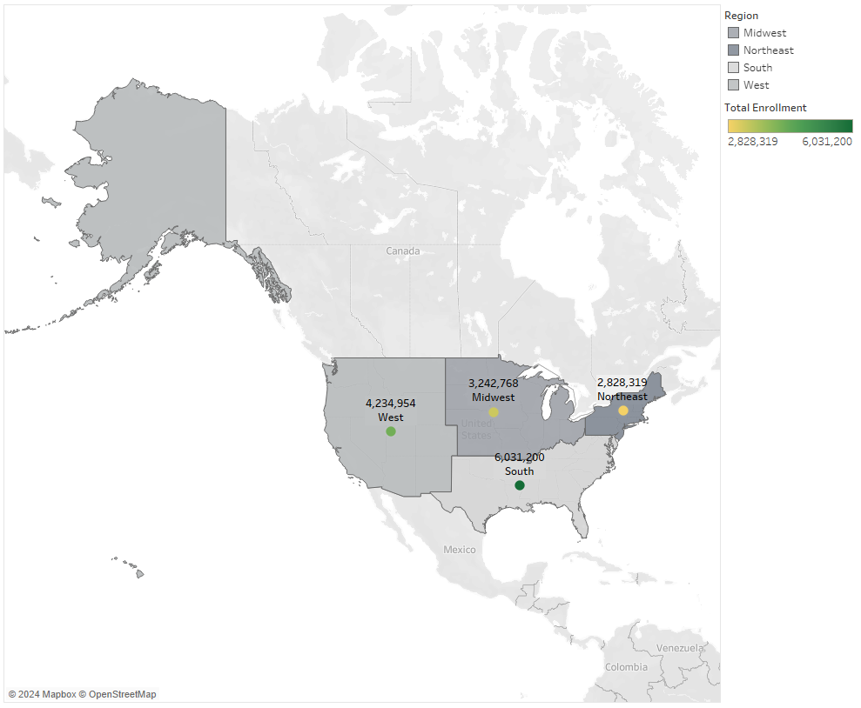
GOAL 4 How is each region performing?
With Texas being such a strong enrollment state, I am not surprised to see that the South is leading in regional enrollment. They are followed by the West, Midwest, and Northeast, in that order.

Slide 13
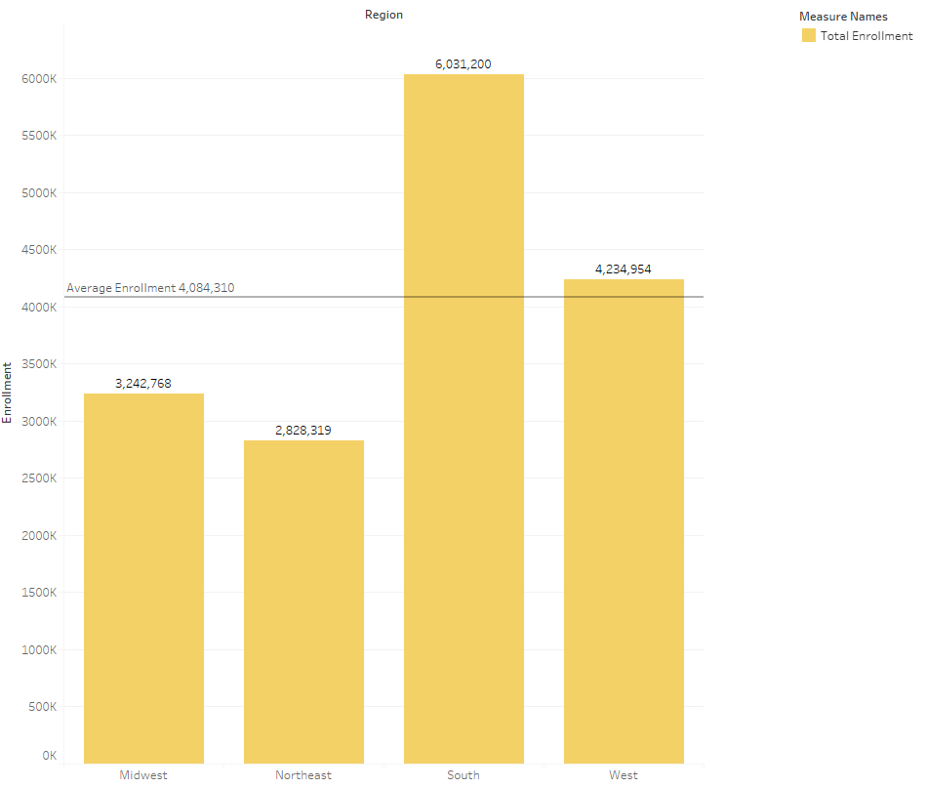
GOAL 5 How does each region's Spring 2024 enrollment compare to the average?
This visualization gives us a stronger idea of how much more enrollment is in the South compared to the other regions. You can see that the Midwest and the Northeast are stuggling to meet the average enrollment met by the other two regions.

Slide 14
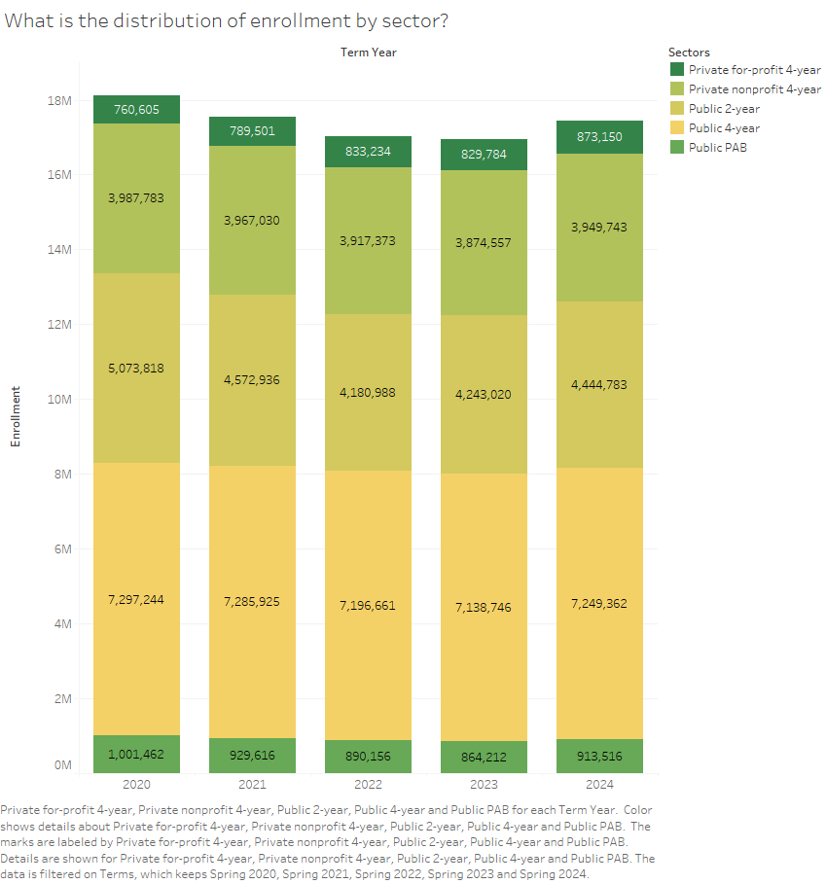
GOAL 6 What is the distribution of enrollment by sector?
Most of the sectors are tending consistent with overall enrollment trends from year to year (decrease in 2021, stability in 2023, increase in 2024). Most of the sectors, even when trending down, vary only slightly. This is not the case for the Public 2-year sector whose enrollment is wavering from almost 500,000 from 2020 to 2021.

Slide 15
Overall, all sectors are seeing the same enrollment trends with a dip in 2021, stability gained in 2023, and growth in 2024. Likely this pattern was caused by Covid19’s impact on high education’s ability to serve students & student’s desire to obtain education beyond high school. Spring 2025 is expected to be another year of growth. 4-year institution enrollment tends to be more stable overtime while 2-year institutions can be more volatile. This can be seen with the large enrollment changes and the ability to “bounce back” quicker. Public 4-year institutions carry most of the enrollments in good and bad times. Regionally, the south and the west a clear leaders in enrollment. This is likely because largely populated, top performing states are in those areas.
16. share the overall key conclusions and insights from your analysis. Our work is never done.
Section 7. Conclusions

