Slide 1
Scenario-Based Validation for ADAS
Finding the failures a test fleet rarely sees, using synthetic scenarios and an automated safety judge.
Proof of concept on NVIDIA Cosmos and AWS.

Slide 2
From a few clips to audited safety coverage
EXECUTIVE SUMMARY
SITUATION
OEMs must show ADAS behaves safely in rare conditions, and those conditions are the hardest to capture on the road.
BOTTOM LINE
You build a defensible safety case for the conditions a fleet rarely sees, without launching a new data campaign.
Evidence is reproducible and standards-aligned for SOTIF (ISO 21448) and ISO 26262.
COMPLICATION
Road data campaigns are slow and costly, yet they still miss most of the hazardous edge cases that SOTIF asks you to address.
APPROACH
We expand a small set of seed clips into many edge cases with NVIDIA Cosmos, then score every clip with a judge that explains its reasoning.
RESULT
The first run flagged a missed stalled vehicle at night and a late reaction to an occluded pedestrian, each with a risk score and a written rationale.

Slide 3
Safety risk concentrates where road data is thinnest
THE CHALLENGE
Disengagements and near misses cluster in uncommon mixes of weather, light, and road-user behavior.
SCENARIO SPACE
A fleet can drive for years before it meets fog at dusk with a pedestrian stepping out from behind a vehicle.
SOTIF (ISO 21448) expects evidence about the unsafe and unknown space, not only the miles already driven.
The gap is not volume. It is the rare combinations that decide safety.
Recorded by the fleet
Still needs evidence

Slide 4
One pipeline generates scenarios and verdicts
THE APPROACH
1
2
3
4
Seed
Start from a small set of real driving clips.
›
Generate
Cosmos Transfer and Cosmos Predict create weather, lighting, actor and behaviour variants.
›
Validate
The perception model runs on each clip; Cosmos Reason scores it and explains every failure.
›
Report
Coverage view, failure gallery, and a one-page validation record.
Closed loop. New failures feed back into the scenario matrix, so coverage grows with each run.
BUILT ON THE NVIDIA PLATFORM
Cosmos Predict 2.5
Cosmos Transfer 2.5
Cosmos Reason
NVIDIA AI Enterprise
NGC containers
H100 and A100 on AWS

Slide 5
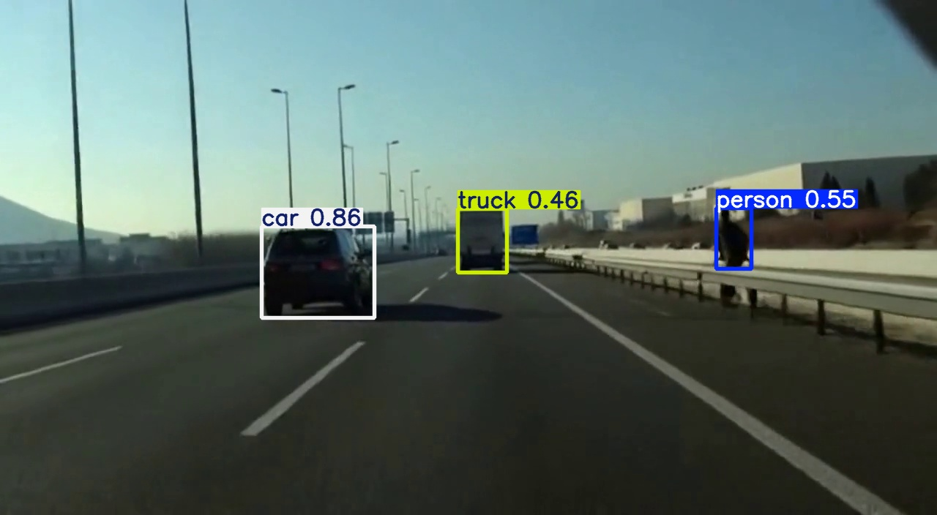
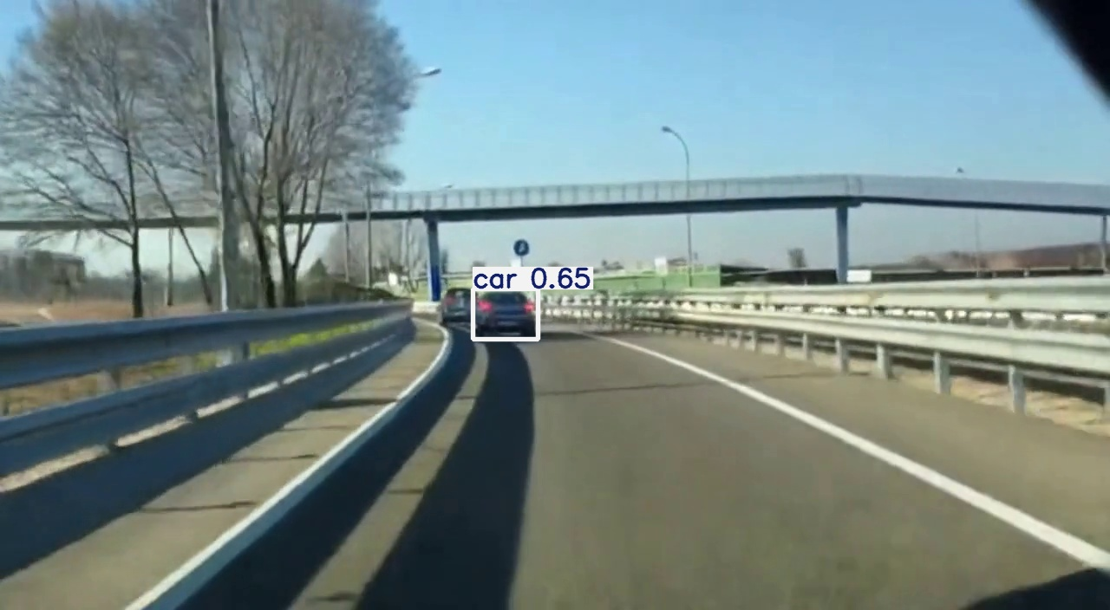
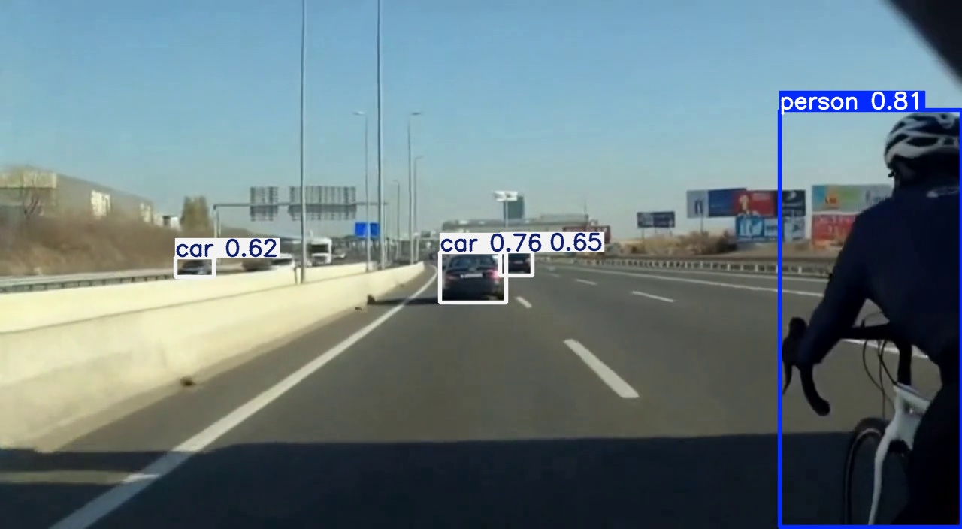
The first run already surfaced two unsafe responses
EVIDENCE FROM THE PROOF OF CONCEPT
Risk 3/5
Risk 5/5
Risk 4/5
Fog at dusk, occluded pedestrian
Rain at night, stalled vehicle
Low sun glare, cyclist cut-in
Detected late at frame 40, present from frame 29. The vehicle braked, but the margin was reduced.
Cosmos Reason: late detection, action safe.
The stopped vehicle was not detected, and the vehicle held its speed into braking traffic.
Cosmos Reason: missed hazard, unsafe action.
The cyclist was flagged late under glare. Braking began, but not early enough to clear the path.
Cosmos Reason: late detection, unsafe action.
System under test: YOLOv8 perception. Judge: Cosmos Reason. Representative results from an initial run.

Slide 6
MHP turns this into repeatable, audited validation
WHY MHP AND WHAT COMES NEXT
Coverage by design
We translate your hazard catalogue into a scenario matrix, so testing targets the conditions that matter to your programme.
NEXT STEPS
1
Agree the priority hazards and the seed clips.
Verdicts you can defend
Every clip carries a written rationale and a risk score, ready to drop into a SOTIF or ISO 26262 file.
2
Run a scoped pilot on your perception stack.
Engineered for cost control
Short GPU batches on AWS keep spend predictable while coverage grows with each run.
3
Review the findings and a sample validation record together.
From a handful of clips to a defensible safety story, without a new data campaign.

