Slide 1
Springboard Capstone
Marshall Pagano
July 2018

Slide 2
Overview
The objective of this project was to estimate an NBA player’s first non-rookie contract based on his NBA body of work.
Phases to this project were:
Data wrangling: locating and pulling down relevant NBA data to perform the above analysis
Data exploration: interrogating the data set to look for insights to help guide and shape the eventual analysis
Data analysis: building two models, one generic, one ensemble, to compare and contract their merits and analyze the value of the final model.

Slide 3
Objective
The goal of this capstone project is to be able to predict an NBA player’s first non-rookie salary.
The hope is that the model would provide value to a potential client. A couple scenarios in which a model of this type would be useful:
NBA team could use this when determining how much to pay their players (that are just coming off Rookie contracts). Allows determination of what is a “fair price” for a qualifying player.
NBA agents could use this as a negotiation tool to ensure that they are not being undersold by an NBA team.
This model could serve as a proxy for overall player quality. Quality and salary are different things, but correlate extremely closely.

Slide 4
Data Wrangling
Data used for this capstone project was primarily from BasketballReference.com.
First, a list of players must be generated.
Base list: all players drafted from 1990-2013.
Final list: all players from base list that played long enough in NBA to receive a second NBA contract.
Data from each qualifying player’s individual webpage included:
Traditional Per Game statistics
Advanced statistics
Contract information

Slide 5
Data Wrangling continued
Traditional Per Game Statistics:
Age, Pos, G, GS, MP, FG, FGA, FG%, 3P, 3PA, 3P%, 2P, 2PA, 2P%, eFG%, FT, FTA, FT%, ORB, DRB, TRB, AST, STL, BLK, TOV, PF, PTS
Advanced Statistics:
Age, Pos, G, MP, PER, TS%, 3PAr, FTr, ORB%, DRB%, TRB%, AST%, STL%, BLK%, TOV%, USG%, OWS, DWS, WS, WS/48, OBPM, DBPM, BPM, VORP
See Appendix A for explanation of these statistics
Salary cap information was gathered to normalize salaries based on the league wide salary cap which varies from year to year. Finally all salaries were converted into 2018 dollars.

Slide 6
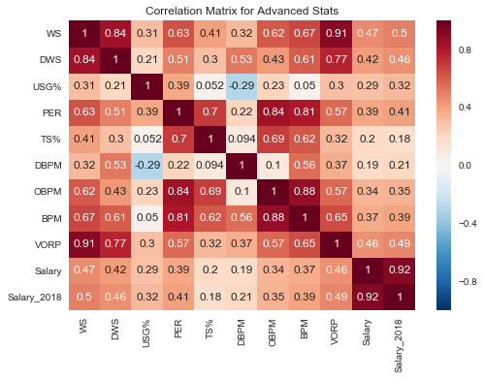
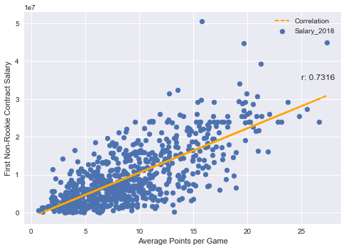
Data Exploration
Correlation matrices were used to find strong correlations with target variable (desired) and amongst each other (not desired)
Variables were individually analyzed to confirm correlation levels and look for trends in relationships to 2018 adjusted salary.

Slide 7
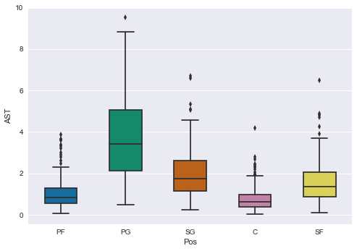
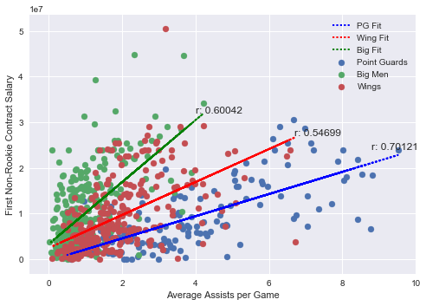
Data Exploration continued
Variables were analyzed and grouped by other variables, like position, to help determine structure of eventual ensemble model
Variables with statistically significant differences in correlation levels across position were used in the position specific portion of the ensemble model (e.g. Assists)
Variables without statistically significant differences correlation levels across position were used in the general portion of the ensemble model

Slide 8
Data Analysis
Two models were created:
General model – using a traditional OLS approach
Ensemble model – using position-specific OLS sub-models
Test-train split analysis was performed to ensure model was not overfitting to the data
Weights of general vs. position-specific sub-models were optimized to minimize overall root mean squared error
Ensemble model performed slightly better than General model based on root mean squared error
General model: RMSE = $4,796,258
Ensemble model: RMSE = $4,562,856

Slide 9
Data Analysis continued
General model output explanation:
Each incremental Point per game increases a player’s predicted salary by $718,000
Each incremental Block per game increases a player’s predicted salary by $1.51M
Overall model explains nearly 67% of the variance of the players’ first non-rookie contract salary
R Squared: 0.6725
Variable | Coefficient
PTS | 718,183
AST | 323,0491
TRB | 345,619
BLK | 1,512,113
DWS | 1,831,869
Age | -389,763
Root Mean Squared Error: 4,796,257

Slide 10
Conclusion
Ensemble model proved to show modest increase in overall quality of model.
Points per game are the main determinant of a player’s future salary
Both models could be improved through inclusion of new data (both more variables, and more data points).
Existing model is has limited use given its relatively high RMSE values.
Models could be used as a guideline for salary determination, but further improvements would need to be made for model to have real use

Slide 11
Appendix A
Age - Age
Pos - Position
G – Games played
GS – Games started
MP – Minutes played
FG – Field goals made
FGA – Field goal attempts
FG% - Field goal percentage
3P – Three pointers made
3PA – Three point attempts
3P% - Three point percentage
2P – Two pointers made
2PA – Two pointers attempted
2P% - Two point percentage
eFG% - Effective field goal percentage
FT – Free throws made
FTA – Free throw attempts
FT% - Free throw percentage
ORB – Offensive rebounds
DRB – Defensive rebounds
TRB – Total rebounds
AST - Assists
STL - Steals
BLK - Blocks
TOV - Turnovers
PF – Personal fouls
PTS - Points

Slide 12
Appendix A continued
PER – Player efficiency rating
TS% - True shooting percentage
3PAr – Three point attempt rate
FTr – Free throws attempt rate
ORB% - Offensive rebound percentage
DRB% - Defensive rebound percentage
TRB% - Total rebound percentage
AST% - Assist percentage
STL% - Steal percentage
BLK% - Block percentage
TOV% - Turnover percentage
USG% - Usage percentage
OWS – Offensive win shares
DWS – Defensive win shares
WS – Win shares
WS/48 – Win shares per 48 minutes
OBPM – Offensive box plus-minus
DBPM – Defensive box plus-minus
BPM – Box plus- minus
VORP – Value over replacement player

