Slide 1
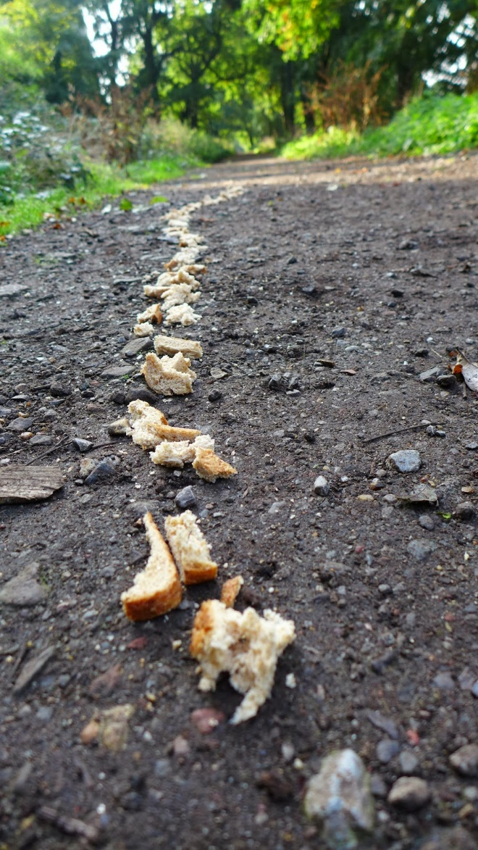
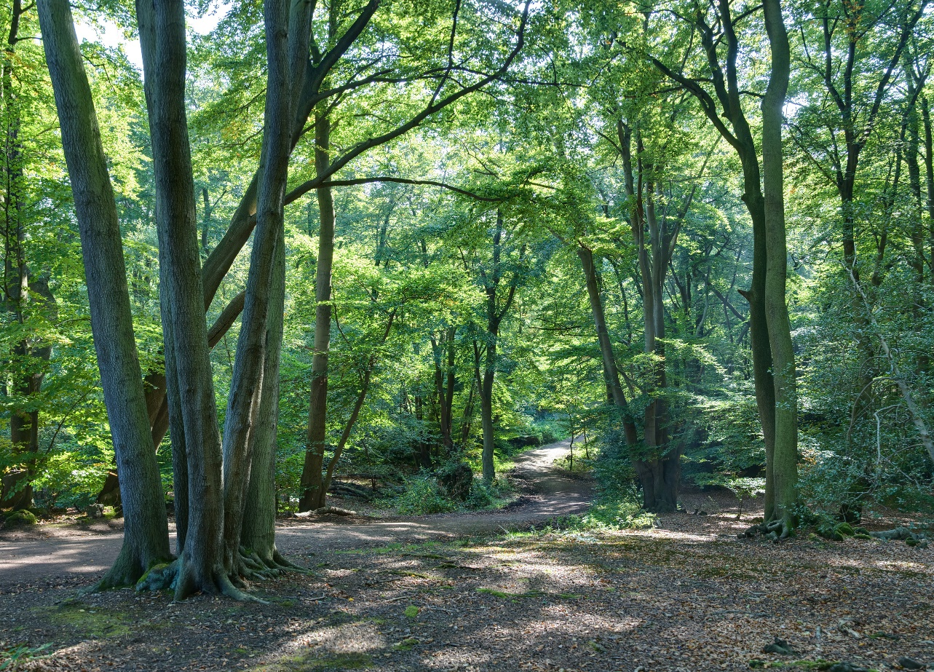
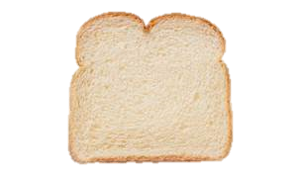
Left onto Charles St
Pass CMM
Merge Left onto 2/4
Turn right onto 2 at 2/4 split
Second exit at roundabout
ANNAPOLIS
First exit at next roundabout
Right on Rt 301
Arrive in Annapolis

Slide 2
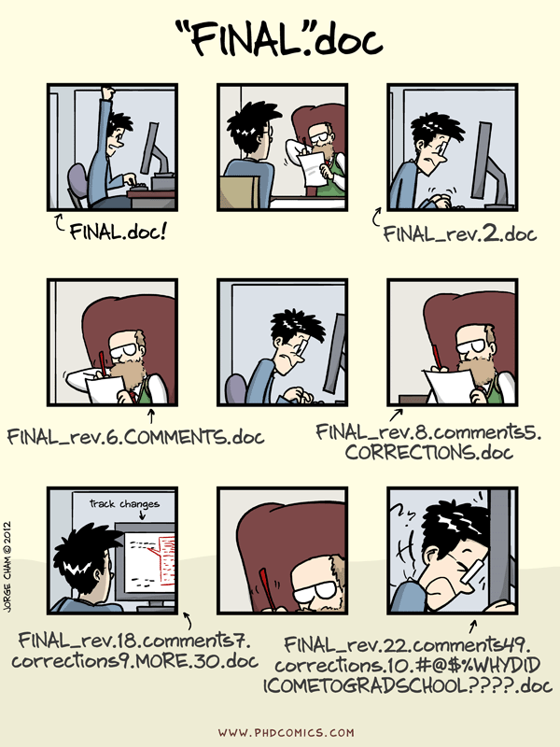

Slide 3




Share content
Interact with content creators
Make content

Slide 4
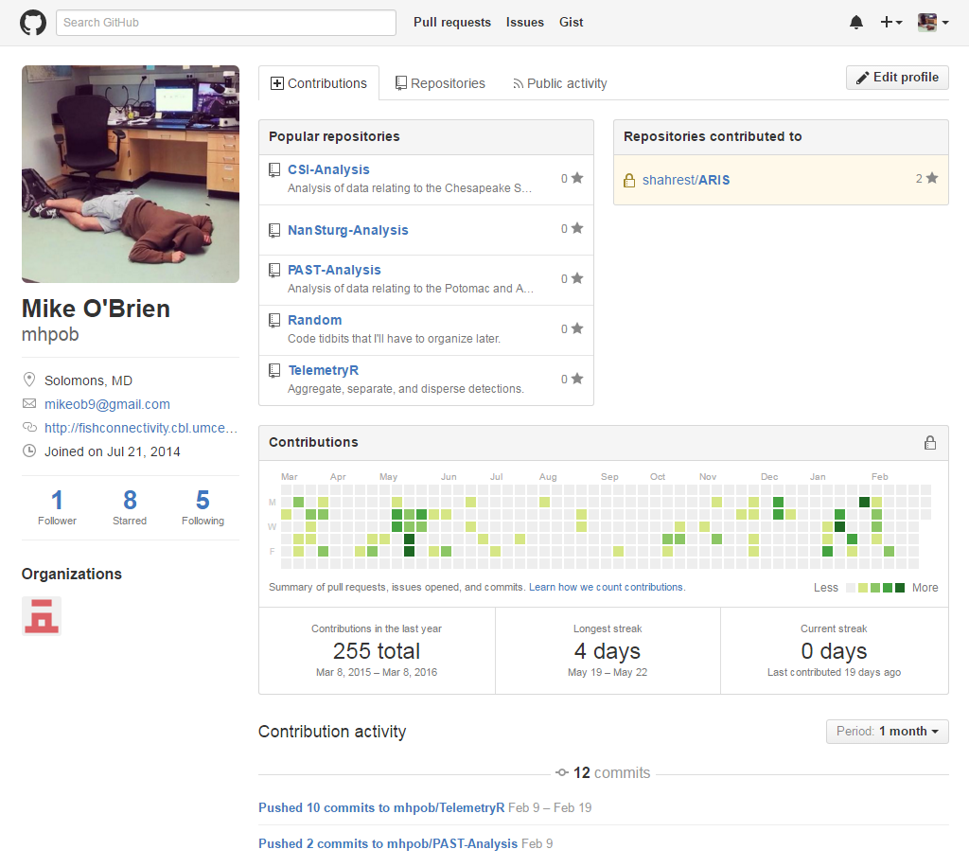
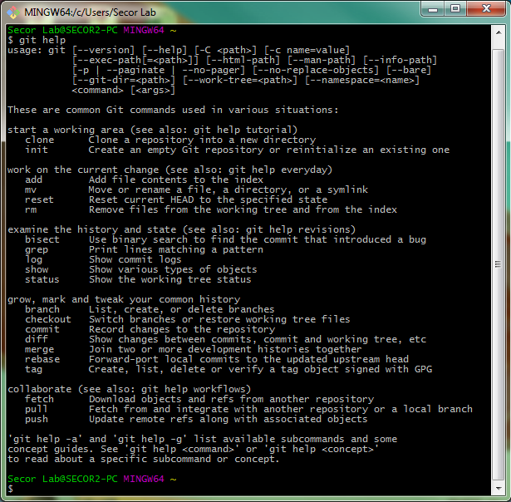

Slide 5
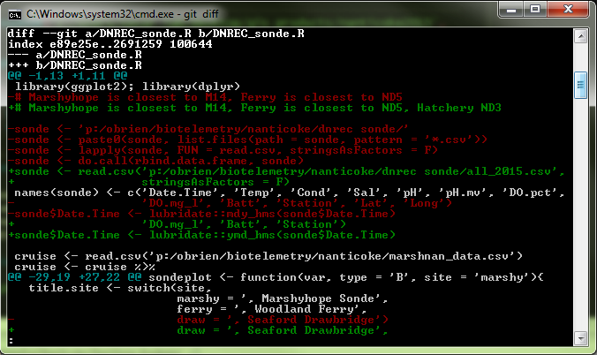
Verbs
diff
commit
push/pull
branch
merge
diff
Shows difference since last commit
Removals are in red, additions in green
Unchanged “hunks” are not listed

Slide 6
Verbs
diff
commit
push/pull
branch
merge
Left onto Charles St
commit
Logs changes since last commit (logs the diff)
Short description of changes
Creates unique SHA
Pass CMM
Merge Left onto 2/4
Turn right onto 2 at 2/4 split
Second exit at roundabout
First exit at next roundabout
Right on Rt 301
Arrive in Annapolis

Slide 7
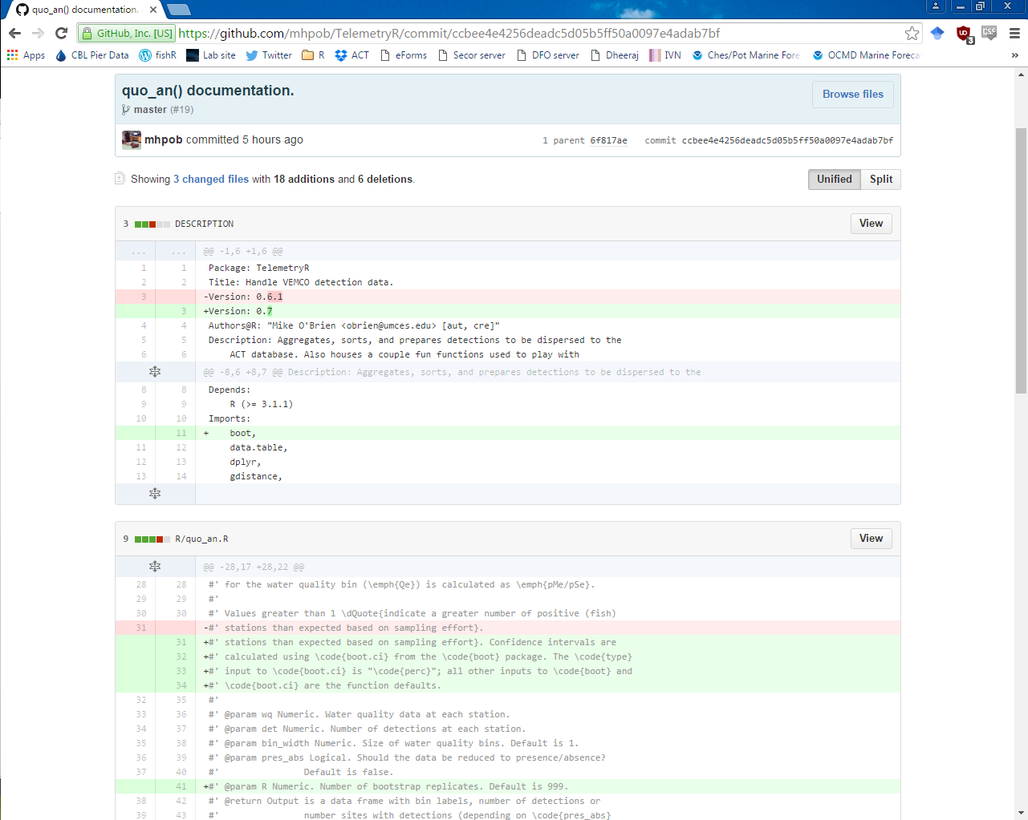
diff
commit
push/pull
branch
merge

Slide 8

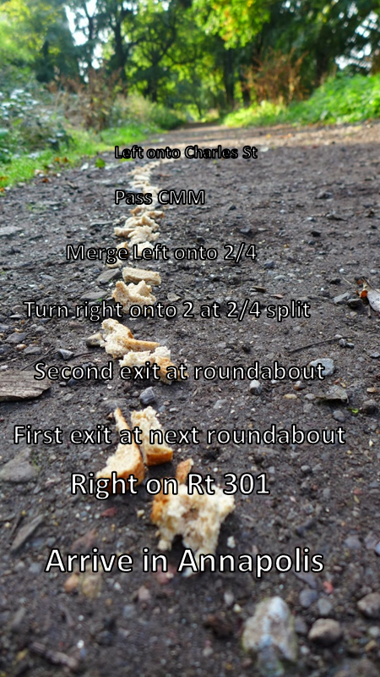
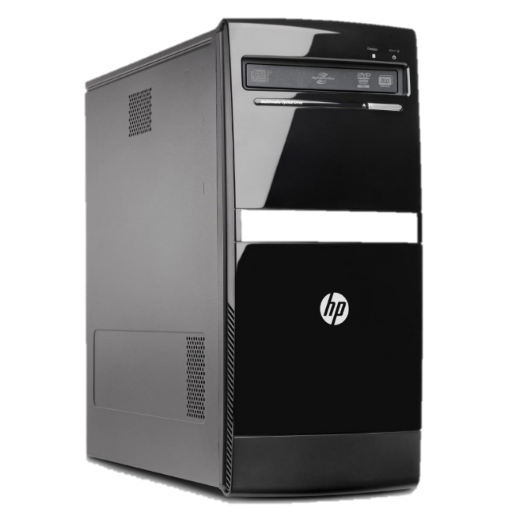
Verbs
diff
commit
push/pull
branch
merge
Push/Pull
Interact with other versions (branches)
Interact with your code in the cloud
Push
Pull

Slide 9

Verbs
diff
commit
push/pull
branch
merge
Branch
Opens another line of development
Experiment without messing everything up
Collaborate without butting heads

Slide 10
Verbs
diff
commit
push/pull
branch
merge
Branch
Opens another line of development
Experiment without messing everything up
Collaborate without butting heads
master
wawa-stop
Right into lot
Ham shorti
Left out of lot

Slide 11
Verbs
diff
commit
push/pull
branch
merge
Merge
Add changes from branch to original code
Git checks to make sure there are no conflicts. If there are, it will ask you to resolve them first.

Slide 12
Verbs
diff
commit
push/pull
branch
merge
Merge
Add changes from branch to original code
Git checks to make sure there are no conflicts. If there are, it will ask you to resolve them first.
master
wawa-stop
Right into lot
Grab ham shorti
Left out of lot

Slide 13
Verbs
diff
commit
push/pull
branch
Pull request (GitHub)
Pull Request
Request that the owner pulls your changes into their code
A GitHub-specific version of merge
Allows for discussion prior to wholesale changes

